Slide 1
Indigenous Studies
Research Data Management Policy
Breaking Barriers in Indigenous Research and Thinking
National Indigenous Studies Conference, Canberra, 2014
Notes:
This workshop is proposed to explore the development of a research data management policy in support of indigenous studies. Careful consideration of cultural protocols, ethics processes, and principles guiding the activities of a research institution need to inform that policy development. At the same time, it may also be important to consider the consequences of practical methodologies from other areas of research that may or not be applicable. Research methodologies such as de-identification and procedures for enabling data linking may enable critical health and wellbeing research in support of national policy development. However, these same methodologies may also be entirely inappropriate for other types of research where the data is culturally sensitive. What questions need to be asked and what information needs to be considered so that a research data management policy can be developed and effectively support indigenous study now and into the future?

Slide 2
http://www.intersect.org.au
Ingrid Mason em: ingrid.mason@intersect.org.au tw: @1n9r1d

Slide 3
http://www.ands.org.au
Ingrid Mason em: ingrid.mason@ands.org.au tw: @andsdata

Slide 4
Covering today
Cultural rights and ATSILIRN protocols
Key issues: data custodianship
Policy and process: research data management
Data custodianship and policy and process development and GERAIS guidelines
Key questions: policy and process development
Research data management: policy example (Monash)
Formalising processes: example (NLNZ) what/how
Approaches to support indigenous studies
Notes:
Session is aimed at representatives wishing to consider the key issues and to glean some fundamental steps to consider in developing a research data management policy and some consideration about approaches that may support indigenous studies specifically.

Slide 5
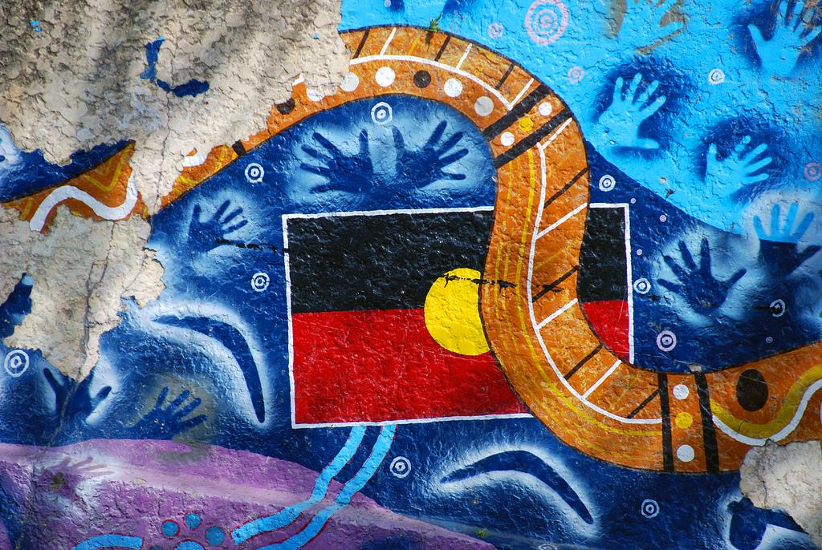
Leonard John Matthews CC-BY-NC-SA. Indigenous Flag Art.
http://www.flickr.com/photos/67953162@N00/4227603729/

Slide 6
ATSILIRN Protocols
“The protocols address:
the recognition of the moral rights of Aboriginal and Torres Strait Islander peoples as the owners of their knowledge;
other important issues arising from Aboriginal and Torres Strait Islander content and perspectives in documentary materials, media and traditional cultural property; …
Notes:
http://aiatsis.gov.au/atsilirn/index.php
http://www.wipo.int/tk/en/databases/creative_heritage/museum/link0049.html
http://www.wipo.int/export/sites/www/tk/en/databases/creative_heritage/docs/atsilirn_protocols.pdf

Slide 7
ATSILIRN Protocols
“They are a guide to good practice which will need to be interpreted and applied in the context of each
organisation's mission, collections and client community.”
Notes:
http://aiatsis.gov.au/atsilirn/index.php
http://www.wipo.int/tk/en/databases/creative_heritage/museum/link0049.html
http://www.wipo.int/export/sites/www/tk/en/databases/creative_heritage/docs/atsilirn_protocols.pdf

Slide 8
Key Issues
Data Custodianship

Slide 9
Key Issue - Policy
“Developments in both the digital context and in the Indigenous information context indicate the need for a coordinated policy and planning approach to deal with the issues.”
(Aboriginal and Torres Strait Islander Library, Information and Resource Network (ATSILIRN) protocols (2002). Digitisation and Internet, p27.)

Slide 10
Key Issue - Metadata
“Become aware of the issues surrounding cultural documentation and the need for cultural awareness training. ...
Share information on initiatives involving cultural documentation.”
(Aboriginal and Torres Strait Islander Library, Information and Resource Network (ATSILIRN) protocols (2002). Intellectual Property, Marcia Langton, p4)
Notes:
http://www.wipo.int/export/sites/www/tk/en/databases/creative_heritage/docs/atsilirn_protocols.pdf

Slide 11
Key Issue - Process
“The development of accessible guidelines and protocols for library and information services and Indigenous communities and organisations involved in documentation and the provision of access to Indigenous materials is also indicated.”
(Aboriginal and Torres Strait Islander Library, Information and Resource Network (ATSILIRN) protocols (2002). Digitisation and Internet, p27.)

Slide 12
Policy and Process
Research Data Management

Slide 13
Research data management is..
Purpose: data created or collected, accessed and used to support research.
Institutional role: manager, overseer and enabler of access.

Slide 14
Research data management policy..
Governance needed over actions of:
data collection
access and use, and,
research conducted.

Slide 15
Policy >> Process
Connections between legal requirements and organisational principles and practice.
Application to the organisation, staff or affiliates, the data, and the research.

Slide 16
Research Data Management Policies
University examples arising out of the ANDS funded Seeding the Commons projects.

Slide 17
Take away
Formalise information about data custodianship and support of indigenous research:
How decisions are made to collect or use data and support of indigenous research.
What expert and relevant advice informs those decisions and how that advice is sought.
What prior decisions have been made and why.
What policies and processes (information and technical access) are in place and why.

Slide 18
Data Custodianship
Policy and Process Development

Slide 19
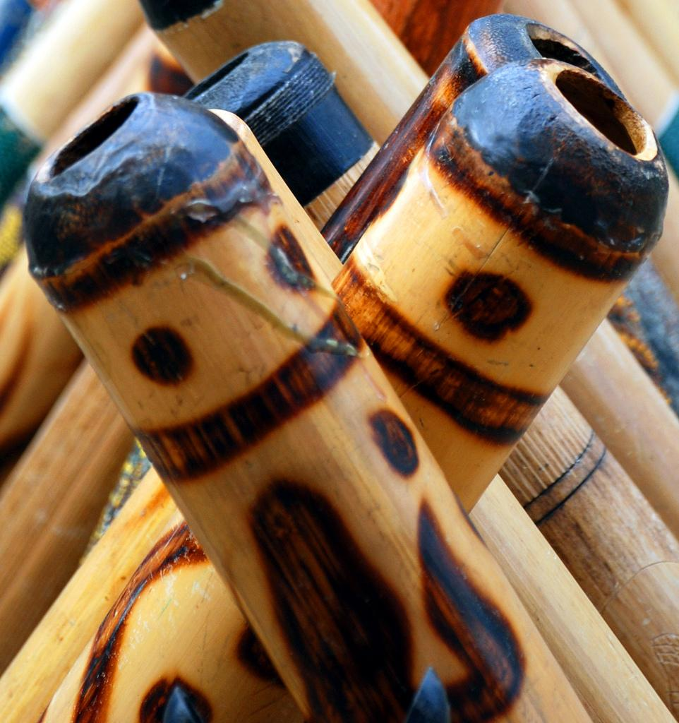
Philippa Willitts CC-BY-NC. Didgeridoos Close-Up
http://www.flickr.com/photos/49503155381@N01/2476673198/

Slide 20
Data custodianship
Roles and agency
Responsibilities
Institutional governance and practice
Policy and process development
Key questions

Slide 21
Roles and agency around data
Data custodian
Community
Research institution
Researcher
Roles may be mixed, e.g. Data custodian is a member of the Community or Research institution is also Data custodian.
Notes:
All four roles may occur within a research institution.
Important to know what roles are being played, and how this impacts upon community, data management, research output, to embed trust, security, and consultation, into data curation and research approval processes.

Slide 22
Responsibilities around data
Data custodian Provide access
Community Advocate/protect
Research institution Support research
Researcher Use data
Responsibilities may also be mixed.

Slide 23
Research institution practices
Practices governed by laws, policy, procedures, standards and protocols.
Practices may relate to: research conducted, data curated, and community advocacy or protection.

Slide 24
Key questions
Policy and Process Development

Slide 25
Pre-existing policy?
Research approval and conduct
Community liaison or consultation
Archives or records management
Collection or information management
Notes:
What pre-existing policy may be relevant?
Maybe possible to revise policy, or if new policy is developed, references to other policy may be needed.

Slide 26
Pre-existing processes?
Access to information (within institution).
Reuse of information (from other parties).
Research project approvals (within institution or by other parties).
Notes:
Procedural information is critical and where the principles (and legal requirements) around access and use of data is tested.

Slide 27
Institutional context
Where will research data management policy sit in the institutional policy framework?
Where will research data management processes flow across the institution?

Slide 28
Ethics or cultural protocols?
Are there social mechanisms, e.g. processes for consultation or community representation, to support decision-making?
Are there practice-based mechanisms, e.g. evaluation criteria, established precedents, curatorial and research guidelines to support decision-making?

Slide 29
Who needs to be involved?
What parties need to be engaged so that high level policy statements can be readily embedded in and inform institutional processes?
Internal representatives, external partners, community members, independent observers or experts.

Slide 30
RDM Policy Example
Monash University

Slide 31
Policy Example - Monash
“The purpose of this policy is to ensure that research data is stored, retained, made accessible for use and reuse, and/or disposed of, according to legal, statutory, ethical and funding bodies’ requirements.”
Research Data Management Policy
Notes:
http://www.policy.monash.edu/policy-bank/academic/research/research-data-management-policy.html

Slide 32
Policy Statement - Monash
“The management of research data should be compatible with the University’s commitment to the highest ethical standards in research, protecting the rights, dignity, health, safety and privacy of the community, including research subjects, and with its commitment to the welfare of animals and the integrity of the environment.”

Slide 33
Procedure Example - Monash
Research Data Management: Staff, Adjuncts and Visitors Procedures
Parent Policy: Research Data Management Policy
“Research data management awareness
Faculties, heads of academic units and supervisors responsible for performance development must take all reasonable steps to ensure on a regular basis that all researchers are aware in advance of their obligations under this policy and procedures and the guidelines provided on the Monash University Research Data Management website;”
Notes:
http://www.policy.monash.edu/policy-bank/academic/research/research-data-management-procedures-staff-adjuncts-and-visitors.html
http://monash.edu/library/researchdata/index.html
http://monash.edu/library/researchdata/guidelines/ethics/
http://www.aiatsis.gov.au/_files/research/ethics.pdf

Slide 34
Planning Example - Monash
Guidelines for Ethical Research in Australian Indigenous Studies, AIATSIS, 2nd ed., 2011.
>> Outlines principles and provides advice around applying those principles.

Slide 35
Applying principles
“Managing research: use, storage and access.
Principle 13: Plans should be agreed for managing use of, and access to, research results.
Identify at the start of a research project all Indigenous people, organisations and communities who will need to be involved in determining strategies for access to research results.
Agree on the rights to research results, their forms and presentation, and individual or community use of them.
This may involve ongoing access to data or representations of the results of research through digital media. …”
(Guidelines for Ethical Research in Australian Indigenous Studies. AIATSIS, 2nd ed., 2011, pages 15-16.)
Notes:
Identify at the start of a research project all Indigenous people, organisations and communities who will need to be involved in determining strategies for access to research results.
Agree on the rights to research results, their forms and presentation, and individual or community use of them.
This may involve ongoing access to data or representations of the results of research through digital media.
Agree at the outset on the ownership of research results, including institutional ownership of data, individual rights of researchers and Indigenous participants, and collective rights of Indigenous community groups.
Agree when and how results of research will be fed back to and discussed with relevant individual community members and/or appropriate community organisations.
Make clear the level of community control over access to, and use of, any research results, including print, pictorial, audio and video, and digital materials. Discuss making these available online and/or depositing in libraries and archives.
Report research results to the community before publication and before discussion with the media.
Negotiate with the community any discussion with the media of the research project and its results.
Agree on the disposition and storage of results of research, including primary data.
Try to anticipate the evolving use of technology and the impact it could have on research results and their storage.
Discuss thoroughly matters of confidentiality and agreed restrictions on use of information.
Explain fully any limits on confidentiality (for example, where field notes or research data might be subpoenaed for legal proceedings).
Be willing to make results known to appropriate local, state or territory, and national authorities if requested.

Slide 36
Formalising processes
Steps further:
maintain support documentation
capture decision-making and curatorial methods
build up institutional practice, information and knowledge
advise the research community “this is how we support indigenous studies and the process by which access to data is enabled”
Outcomes are:
make the link between policy and practice explicit
enable clearer understanding about how access to data can be supported and ethical research is conducted
Notes:
Formalise this, i.e. capture this information, document how this happens, develop methods to sustain these activities, i.e. design a process.
Process links to and actualises the principles in the research data management policy that is developed.

Slide 37
Process
Research Data Management

Slide 38
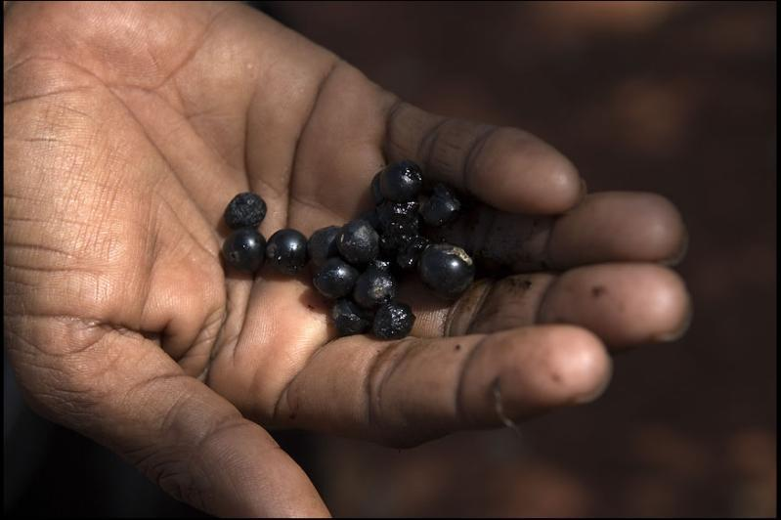
Rusty Stewart CC-BY-NC-ND. Ampilatwatja Walk Off.
http://www.flickr.com/photos/rustystewart/4475514877/

Slide 39
Process is the test
Is data access and use consistent with intent in the policy, any ethics approval, or conditions of the data captured or already deposited?

Slide 40
Example: NLNZ Access Policy
Access Principle #3
"Access to resources from the collections of the Alexander Turnbull Library may be subject to restrictions agreed with the donor, vendor or creator of the resources. Approval to make such restrictions will be delegated from the National Librarian."
(National Library of New Zealand, Access Policy, Explanatory Guidelines Supporting the Access Principles, page 5, no. 3)
Notes:
http://www.wipo.int/export/sites/www/tk/en/databases/creative_heritage/docs/nz_access.pdf
World Intellectual Property Organisation

Slide 41
Getting into the detail: security
Access Principle #6
“Access to resources from the collections may be restricted by the need to preserve and protect the item. The National Library will maintain appropriate levels of security for collections and may require researchers and reference users to register.”
(National Library of New Zealand, Access Policy, Explanatory Guidelines Supporting the Access Principles, page 5, no. 6)
Notes:
http://www.wipo.int/export/sites/www/tk/en/databases/creative_heritage/docs/nz_access.pdf

Slide 42
Getting into the detail: description
Access Principle #19
“To better address information needs of Maori, enhancement of records on National Library databases will be undertaken where the subject of the material is in te reo Maori or provides unique information about iwi.”
(National Library of New Zealand, Access Policy, Explanatory Guidelines Supporting the Access Principles, page 6, no. 19)
Notes:
http://www.wipo.int/export/sites/www/tk/en/databases/creative_heritage/docs/nz_access.pdf

Slide 43
Getting into the detail: community
Access Principle #18
“The commitment made by the National Library to the Treaty of Waitangi has significant implications for the use of recorded knowledge relating to New Zealand's tangata whenua. The needs of research and reference users of Maori resources are recognised as a priority for the National Library. Protocols (See Appendix 1) for the treatment of, and access to Maori resources have been developed with advice from experts including the National Library's Komiti Maori.”
(National Library of New Zealand, Access Policy, Explanatory Guidelines Supporting the Access Principles, page 6, no. 18)
Notes:
http://www.wipo.int/export/sites/www/tk/en/databases/creative_heritage/docs/nz_access.pdf

Slide 44
Principles to consider and formalise
Guardianship
Relationships
Attribution
Cultural development
(National Library of New Zealand, Access Policy, Appendix 1 - Principles for the care and preservation of Maori materials, page 7-8.)
Notes:
http://www.wipo.int/export/sites/www/tk/en/databases/creative_heritage/docs/nz_access.pdf

Slide 45
What

Slide 46
Relationships
“The National Library seeks collaborative relationships with families and descent groups connected to taonga in its collections. These relationships are drawn on to make decisions about all aspects of the management of these items, including conservation, exhibition and attribution regardless of whether the Library is legally the owner or guardian of the item in the collection.”
(National Library of New Zealand, Access Policy, Appendix 1 - Principles for the care and preservation of Maori materials, page 7-8.)

Slide 47
Cultural development
“Staff, particularly those with responsibilities for decision making in the areas of conservation and intellectual property, will have access to kaumatua and or Maori staff with the ability to promote effective relationships with iwi and hapu.”
(National Library of New Zealand, Access Policy, Appendix 1 - Principles for the care and preservation of Maori materials, page 7-8.)
Notes:
Two further commitments
Consultation with Maori staff shall not be an acceptable substitute for the development of collaborative relationships with iwi and hapu.
Professional development opportunities, aimed at deepening the cultural understanding of Library staff, will be developed and maintained.

Slide 48
How

Slide 49
A checklist: to manage your data
Policy
Storage
Metadata
Licencing
Ethics
Identifiers
✔ principles
✔ secure and robust
✔ discovery and access
✔ reuse
✔ consent
✔ stable

Slide 50
A checklist: data custodianship
Content and perspective
Intellectual property
Secret or sacred material
Offensive materials
Governance and management
Staffing
Education and training
Awareness of people and issues
Copying and repatriation
Notes:
Checklist draws heavily from the sections headings of the ATSILIRN guidelines as starting points to consider with procedures.

Slide 51
A checklist: data custodianship
Content and perspective
Intellectual property
Secret or sacred material
Offensive materials
Governance and management
Staffing
Education and training
Awareness of people and issues
Copying and repatriation
Notes:
Checklist draws heavily from the sections headings of the ATSILIRN guidelines as starting points to consider with procedures.

Slide 52
A checklist: for research institutions
Content and perspective
What data to collect?
What data to make available and how to who?
Access policy?
Collection development policy?
Notes:
Checklist draws heavily from the sections headings of the ATSILIRN guidelines as starting points to consider with procedures.

Slide 53
A checklist: for research institutions
Intellectual property
Who owns the data?
Who manages the data?
Who has rights over the data?
Access policy?
Licensing policy?
Intellectual property policy?
Notes:
Checklist draws heavily from the sections headings of the ATSILIRN guidelines as starting points to consider with procedures.

Slide 54
A checklist: for research institutions
Secret or sacred material
What type of data is it?
Who should or shouldn’t get access to this data?
Who can be consulted?
Access policy?
Cultural protocols?
Curatorial guidelines?
Notes:
Checklist draws heavily from the sections headings of the ATSILIRN guidelines as starting points to consider with procedures.

Slide 55
A checklist: for research institutions
Offensive materials
What type of data is it?
What metadata can be added to reflect this?
Who can be consulted?
Access policy?
Cataloging guidelines?
Notes:
Checklist draws heavily from the sections headings of the ATSILIRN guidelines as starting points to consider with procedures.

Slide 56
A checklist: for research institutions
Governance and management
How are institutional policies developed, overseen and reviewed?
How are institutional processes developed, overseen and reviewed?
Board membership?
Community liaison policy?
Notes:
Checklist draws heavily from the sections headings of the ATSILIRN guidelines as starting points to consider with procedures.

Slide 57
Approaches
Information and Technical

Slide 58
Information access
Notices - statements where any data is sensitive or may cause offense, or where gaps or paucity of information are problematic.
Metadata - rich and draws on expert advice and domain vocabularies.
Acknowledgements - statements of community support, knowledge and rights.

Slide 59
Technical access
Highly granular application access levels.
Security controls, e.g. registration, verification and approval, password protection and authentication, or encryption.
Data linking services, e.g. CHeReL.

Slide 60
Take away
Formalise information about data custodianship and support of indigenous research:
How decisions are made to collect or use data and support of indigenous research.
What expert and relevant advice informs those decisions and how that advice is sought.
What prior decisions have been made and why.
What policies and processes (informational and technical access) are in place and why.

Slide 61
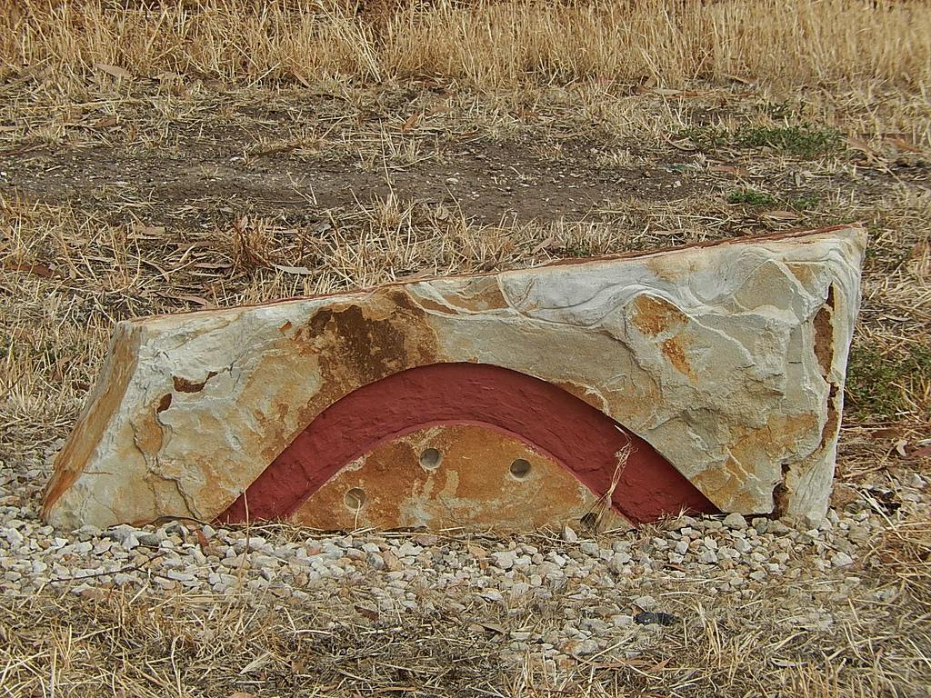
Michael Coghlan CC-BY-SA. Boomerang on rock.
http://www.flickr.com/photos/89165847@N00/11384257783/

