Slide 1
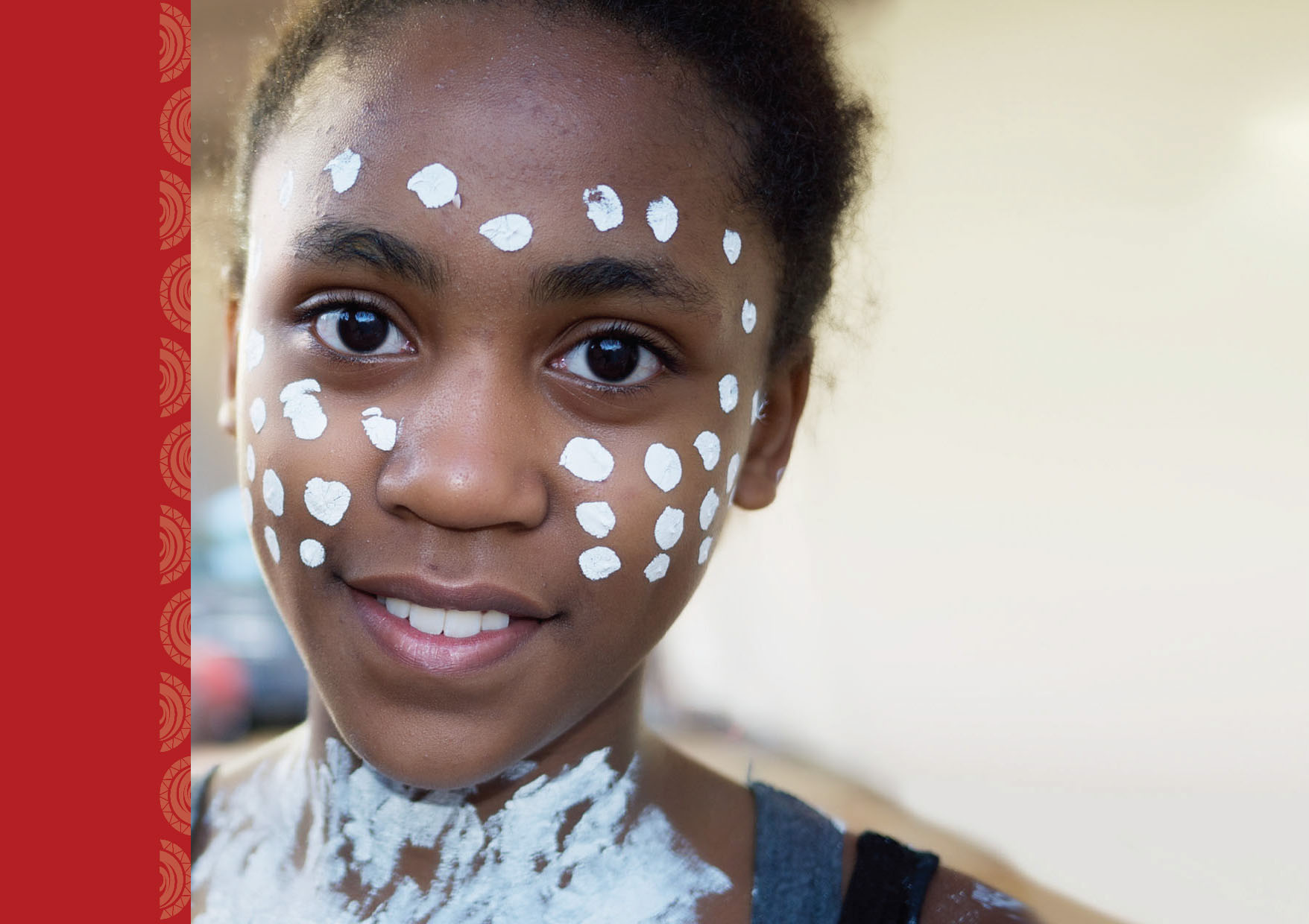
Financial Wellb & Indigenous Australia
AIATSIS Canberra
Vinita Godinho
28 March 2014

Slide 2
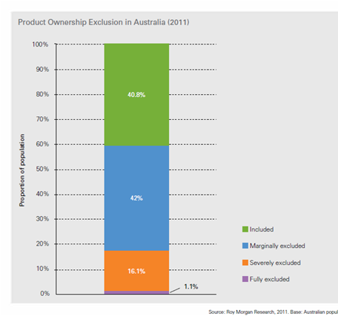
FINANCIAL EXCLUSION IN AUSTRALIA
A growing ‘Under-banked’ population…
Lack access to safe, affordable & appropriate financial services from mainstream
Financial Inclusion & Indigenous Australia
17.7% , growing
43.2% Indigenous
‘Wicked’ problem
Age, Language, Location, Employment, Income,
Financial ‘Capability’ (Literacy)
Key:
Wellbeing
Source: ‘Measuring Financial Exclusion in Australia’ NAB June 2013
1
Notes:
Financial exclusion in Australia is more about the ‘under-banked’
Almost 1 in every 5 Australians is ‘under-banked’. Most excluded are the Indigenous population – 1 in every 2 is likely to be excluded. Also digital exclusion.
Indigenous disadvantage is a ‘wicked’ problem, which needs cross-sectoral, multi-disciplinary attention..
Reasons for exclusion are similar to those in the US / UK – culturally & linguistically diverse populations are over-represented..

Slide 3
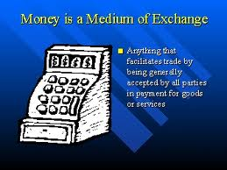
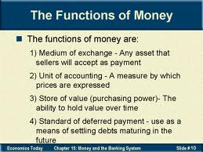
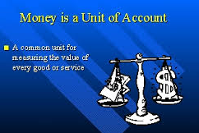
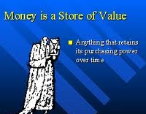
ECONOMICS 101
What is money?
Money in Indigenous Australia
Source: Vinita Godinho PhD, ASIC Conference Alice Springs 23 October 2013
2
Notes:
Financial ‘capability’ is broader than ‘literacy’:
Knowledge & Understanding:
A basic body of knowledge on which to base their management of financial affairs – can be acquired through education & training, advice from family & friends or industry / govt.
Skills: ability to apply knowledge & understanding, to make appropriate decisions
Attitudes: Need to be willing to invest the time & effort required to apply their knowledge, able to gain access to info & advice and confident in exercising their skills

Slide 4
FINANCIAL CAPABILITY
Making informed decisions about money…
Experiences & Circumstances
Personality
influence
influence
3 key elements of financial capability
Knowledge & Understanding
Skills
Confidence & Attitudes
Money in Indigenous Australia
influence
influence
Behaviour
Managing Money
Planning Ahead
Choosing Products
Staying Informed
Source: Adapted from “Measuring Financial Capability – an exploratory study” FSA 2005
3
Notes:
Financial ‘capability’ is broader than ‘literacy’:
Knowledge & Understanding:
A basic body of knowledge on which to base their management of financial affairs – can be acquired through education & training, advice from family & friends or industry / govt.
Skills: ability to apply knowledge & understanding, to make appropriate decisions
Attitudes: Need to be willing to invest the time & effort required to apply their knowledge, able to gain access to info & advice and confident in exercising their skills

Slide 5
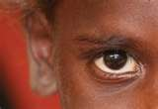
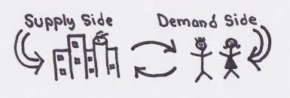
INDIGENOUS LENS
What does Financial Inclusion look like?
Understanding
of money
Culture as enabler, not a
barrier, for inclusion
Money in Indigenous Australia
Policy Implications
Financial Capability
Design of products & services
Consumer education
Source: Vinita Godinho PhD, ASIC Conference Alice Springs 23 October 2013
4

Slide 6
‘INDIGENOUS MONEY’
Culturally Distinctive vs. mainstream Australia…
Medium of relationships, not exchange. One of many resources..
Financial Inclusion & Indigenous Australia
Domestic boundary: large & fluid, financial unit is not nuclear household..
Money is not top priority, caring for family is..
Phase 1:
Remote
Source: Vinita Godinho PhD, ASIC Conference Alice Springs 23 October 2013
5
Notes:
Findings:
(1) Understanding of money is culturally distinctive.

Slide 7
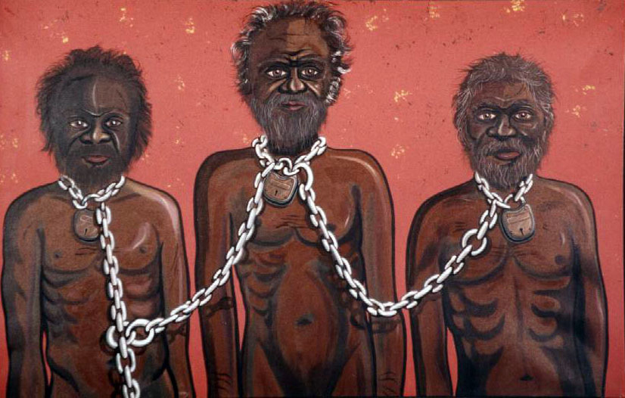
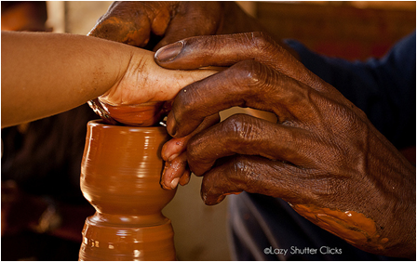
‘INDIGENOUS MONEY’
Culturally Distinctive vs. mainstream Australia…
Imposed from outside culture, history, disconnect from knowledge systems (trade)
Financial Inclusion & Indigenous Australia
Role of elders
Learning by doing
Respect, value
Confidence
Control vs. Share
Growing money
Money seen as problem, lacks ‘social legitimacy’
Source: Vinita Godinho PhD, ASIC Conference Alice Springs 23 October 2013
6
Notes:
Findings:
(1) Understanding of money is culturally distinctive.

Slide 8
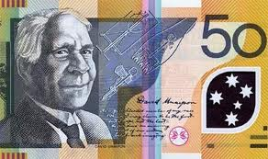
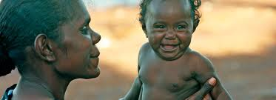
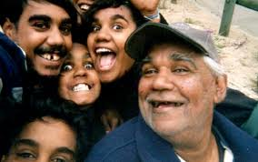
‘INDIGECONOMICS’ 101
What is money?
Phase 1:
Remote
Medium of relationships, not just exchange..
Money in Indigenous Australia
Caring is the unit of account..
Family is store of value..
Source: Vinita Godinho PhD, ASIC Conference Alice Springs 23 October 2013
7
Notes:
Financial ‘capability’ is broader than ‘literacy’:
Knowledge & Understanding:
A basic body of knowledge on which to base their management of financial affairs – can be acquired through education & training, advice from family & friends or industry / govt.
Skills: ability to apply knowledge & understanding, to make appropriate decisions
Attitudes: Need to be willing to invest the time & effort required to apply their knowledge, able to gain access to info & advice and confident in exercising their skills

Slide 9
‘INDIGENOUS BANKING’
Distinctive Pattern vs. mainstream Australia…
Domestic financial unit = Household cluster
Money is for caring, one of many resources
Control vs. share, Respect, value, confidence
Disconnect from knowledge , role of elders
Passwords & user IDs are routinely shared amongst family & kin
Confusion about the ‘money story’, lower respect and value for money
Difficult to control own money whilst maintaining relationships
Financial Inclusion & Indigenous Australia
Repeated Balance Enquiries
Incur higher fees (eg. ATM fees, interest rates)
Pre-allocate money to regular expenses
Privacy & security concerns
Maintain Multiple Bank Accounts to ‘hide’ money
Difficult to ‘know, grow & control’ money
All money is removed from account
‘Chuck-in’ style
Source: Vinita Godinho PhD, ASIC Conference Alice Springs 23 October 2013
8
Notes:
Findings:
(2) Banking Patterns & Financial Capability is culturally distinctive – repeated balance enquiries (HIGH COST), privacy concerns & withdraw money. Need to manage money, allocate for regular expenses, ‘hide’ money.
(3) Remote service provision is not sustainable – high costs, low revenue (due to distinctive banking).

Slide 10
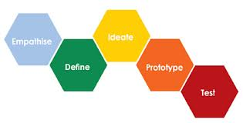
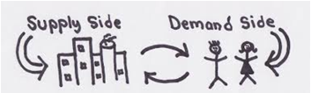
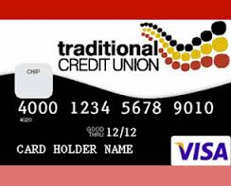
‘INDIGENOUS FINANCIAL INCLUSION’
‘Culturally Appropriate’ Policy Design…
PRODUCT DESIGN
CAPABILITY
Financial Inclusion & Indigenous Australia
REMOTE DELIVERY
‘UNDER-BANKED’ POLICY
Source: Vinita Godinho PhD, ASIC Conference Alice Springs 23 October 2013
9
Notes:
Design implications apply to 4 aspects - product & service design, financial capability design, ‘under-banked’ Policy & remote delivery. ICTs particularly mobile can assist in LOWER COSTS, greater PRODUCTIVITY,
Pdts & Svs:
ACCESS in remote areas.
Reduce COST via m-alerts
Tools to manage money, budget, pre-allocate, hide
Education: M-tools to deliver f-2-f education
Remote delivery: SCALE, less f-2-f,
Under-banked policy: study impact of culture on money, enhance use of mobile.

Slide 11
INDIGENOUS FINANCIAL CAPABILITY
Culturally Distinctive vs. mainstream Australia…
Experiences & Circumstances
Personality
CULTURE
Connect & Build on Traditional knowledge
Respect & Value of money
Positive Social norms
Know, Grow & Control money
Role of Elders
Money is for Caring
Empower Elders
Individual Obligations
Collective Support
Money in Indigenous Australia
Knowledge & Understanding
Skills
Confidence & Attitudes
3 key elements of financial capability
Money is a Valued resource,
Enabler to achieve ‘own’ goals
Behaviour
Managing Money
Planning Ahead
Choosing Products
Staying Informed
Source: Vinita Godinho PhD, ASIC Conference Alice Springs 23 October 2013
10
Notes:
Must build capacity of elders so that they are empowered to role-model the right way to respect and use money…
Individuals have obligations to ensure collective benefit – can achieve own goals if they are able to obtain social legitimacy by articulating the collective benefit from the individual goal…
Road to individual success is via collective support
Culture has so far been seen as a barrier to financial inclusion – sharing reduces saving etc. but there are +ive aspects to these social norms that can assist eg. the social legitimacy that comes from collective benefit & support,
Clear Gap in knowledge on how to Know, Control & Grow money (ie investment, wealth creation)
Behaviour: Money is a valued resource – unlock its potential as an enabler to achieve individual goals – be they collective or individual in nature….

Slide 12
INDIGENOUS FINANCIAL CAPABILITY
‘Culturally Appropriate’ Design…
Build on & connect to traditional knowledge
Role of Elders in Financial Capability
Money is for caring – achieve own goals
Know, Grow & Control Money
Money is a resource, Rights & Obligations
Elders are vital,
Role model & support
Saving is Caring
Money in Indigenous Australia
Individual Obligations, Collective Benefit
Care for Oneself to
Care for Others
Build elders’ capability
Allocate, Manage & Preserve
Manage money
to
Manage Life
Practise skills in family
Collective support to achieve goals
Goal-oriented Savings
Source: Vinita Godinho PhD, ASIC Conference Alice Springs 23 October 2013
11
Notes:
Must build capacity of elders so that they are empowered to role-model the right way to respect and use money…
Individuals have obligations to ensure collective benefit – can achieve own goals if they are able to obtain social legitimacy by articulating the collective benefit from the individual goal…
Road to individual success is via collective support
Culture has so far been seen as a barrier to financial inclusion – sharing reduces saving etc. but there are +ive aspects to these social norms that can assist eg. the social legitimacy that comes from collective benefit & support,
Clear Gap in knowledge on how to Know, Control & Grow money (ie investment, wealth creation)
Behaviour: Money is a valued resource – unlock its potential as an enabler to achieve individual goals – be they collective or individual in nature….

Slide 13
Financial Inclusion & Indigenous Australia
Vinita.Godinho@rmit.edu.au
+61395709393

