Slide 1
Acknowledgement of Traditional Owners
In keeping with the spirit of Reconciliation
We acknowledge the Ngunnawal people as the Traditional Owners of the lands where Canberra now stands – and recognise that these have always been places of teaching and learning.
We pay our respect to their Elders – past, present and emerging – and acknowledge the important role Aboriginal and Torres Strait Islander people continue to play within the Canberra community.
We extend this respect to all Aboriginal and Torres Strait Islander people in attendance today.
Notes:
Acknowledgement of Traditional Owners
^{Short version:}
I acknowledge the Traditional Owners of the lands where QUT now stands, pay respect to their Elders - past, present and emerging –
and acknowledge the important role Aboriginal and Torres Strait Islander people continue to play within the QUT community.
^{Long version:}
In keeping with the spirit of Reconciliation, I acknowledge the Turrbal, Jagera/Yuggera, Kabi Kabi and Jinibara Peoples as the Traditional Owners
of the lands where QUT now stands – and recognise that these have always been places of teaching and learning.
I wish to pay respect to their Elders - past, present and emerging – and acknowledge the important role Aboriginal and Torres Strait Islander people continue to play within the QUT community.

Slide 2
Professor Anita Lee Hong, Ms Larissa Melanie, Dr Deb Duthie and Dr Odette Best Aboriginal and Torres Strait Islander Higher Education Social Marketing Strategy (Strategy) Aboriginal and Torres Strait Islander Higher Education Portal Project (Portal) 28 March 2014, Sutherland Theatrette, National Convention Centre, Canberra 2014 AIATSIS National Indigenous Studies Conference Breaking Barriers in Indigenous Research and Thinking: 50 Years On
‘Means to ends’ integration for stakeholder engagement

Slide 3
Overview
To produce the Aboriginal and Torres Strait Islander Higher Education Social Marketing Strategy (Strategy) and create and maintain the Aboriginal and Torres Strait Islander Higher Education Portal (Portal)
Strategy - $1m over one year
Portal - $1.5m over four years
Behrendt Review:
To contribute to a number of priorities arising from the Behrendt Review:
Build aspiration and address barriers
Increase flow of accurate and current higher education information

Slide 4
Stakeholder Engagement & PM Relevance

Slide 5
Integrating Comparative Principles
‘Means to Ends’ - Comparative Principles: Sustainability, Project Management and *Aboriginal and Torres Strait Islander Pillars
 | Sustainability Pillars | Project Management Pillars | *Aboriginal and Torres Strait Islander Pillars | Integrating Project Management into Sustainability, with Aboriginal and Torres Strait Islander Values
Ultimate Ends | A. Social | 1. Discovery | i. Cultural Safety | Through user-led projects and considering human well-being, equity, inspiration, spirituality, self-actualisation and aspirations, esteem, thoughts, passions, visions, mission, spirit & integrity, and equality through stakeholder engagement to inform the project objectives.
Intermediate Means | B. Economy | 2. Design | ii. Self-determination | Through the filters of realities and restrictions stemming from budgets, technology, politics, ethics, positional stature, esteem, love/belonging, safety, passions, fears, mission, organisational strategy and objectives, respect and reciprocity to plan and design project activities.
Ultimate Means | C. Environment | 3. Delivery | iii. Sovereignty | Through awareness and sensitivity to natural capital, function, safety, physiological needs, population growth, fears, organisational strategy and objectives, and relationships with portfolios, programs and projects, responsibility and survival & protection to deliver and embed sustainable project outcomes.

Slide 6
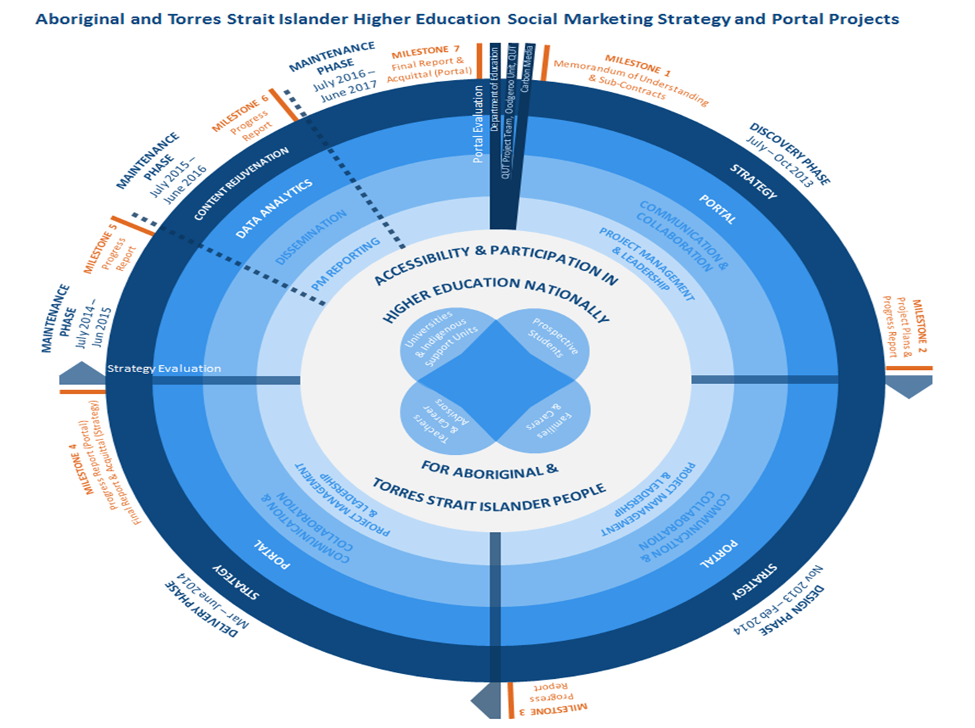
Project Life Cycle

Slide 7
State/Territory Workshop Dates
Queensland – Monday 17th March, Queensland University of Technology
Western Australia – 20th March, Curtin University of Technology
South Australia/Northern Territory – 8th April 2014, National Wine Centre of Australia
Victoria/Tasmania – 9th April, La Trobe University
New South Wales/Australian Capital Territory – 10th April, Novotel Sydney Central.
Colleagues that are unable to the Workshops will still have the opportunity to contribute to the Projects in the form of an online survey.

Slide 8
Contacts
Mr Lone Pearce,
Project Officer, Oodgeroo Unit,
Queensland University of Technology
Ph: 07 3138 4719 Email: lone.pearce@qut.edu.au
Professor Anita Lee Hong,
Director Oodgeroo Unit,
Queensland University of Technology
Ph: 07 3138 3721 Email: anita.leehong@qut.edu.au

