Slide 1
Tauri Simone BA (Hons), current PhD candidate, Institute of Koorie Education, Deakin University, Geelong
Research Topic: Aboriginal stockwomen and their legacy in the northern pastoral industry
Today’s presentation: Looking and talking about research

Slide 2
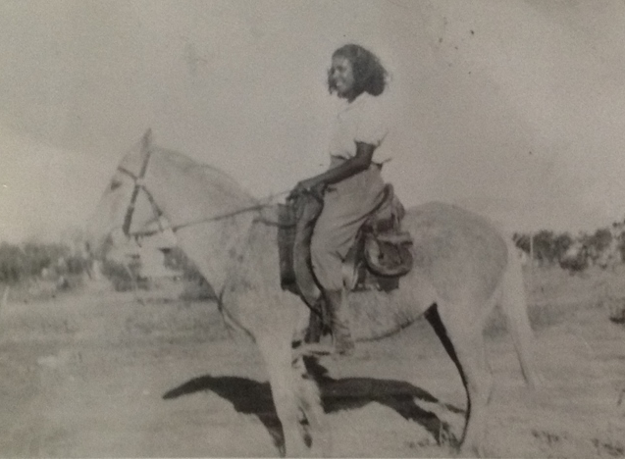
My grandmother when she was a stockwoman

Slide 3
Overview of my approach to the research:
Multiversity (multi-faceted) approach combining Western paradigms and Indigenous knowledge systems
Using ‘researching back’ (applying an Aboriginal lens to the way history has been written)
And the respectful, relationship-based approach of yarning (exchange of knowledge through the use of the spoken word), providing a voice for Aboriginal stockwomen within the pastoral industry

Slide 4
Concepts and theory underpinning my research
Culture is an outward expression of spirituality
Knowledge is the awareness gained from our experiences of the world and our awakening to this knowledge
Research must use culturally appropriate methods that reflect the circularity of Aboriginal knowledge

Slide 5
To quote Tafoya, for Aboriginal people…
‘Stories go in circles. They don’t go in straight lines. It helps if you listen in circles because there are stories inside and between stories, and finding your way through them is as easy and as hard as finding your way home. Part of finding is getting lost, and when you are lost you start to open up and listen’ (Tafoya 1995, cited in Wilson, 2004: 10).

Slide 6
Yarning
Lived experience = Meaning, understanding and our own truths
Yarning –
A means of transmitting knowledge
The interweaving of knowledge experienced through the spoken word
Respect and Relationships

Slide 7
Knowledge and Relationships
Knowledge is a connection formed through experience of relationships.
The researcher and participant are both teacher and student.
Relational accountability is to participants and the research.
The researcher is responsible for the transmission of the story.

Slide 8
Responsibility to community
______________________________________________________________________________
Conducting research in a culturally appropriate manner.
Ensuring that the research is beneficial to the community.
Interpreting the research gathered from contributors in a respectful and
responsible manner.
Fully involving contributors in ensuring that translation of the research
material is true to their lived experiences.

Slide 9
Building relationships
Forming relationships with participants is based on - Respect, Responsibility, Reciprocity and Relational accountability.
First steps in building relationships is connecting me through relationships either with people, places or knowledge.
Relationships are ongoing even once the research is complete.

Slide 10
Researching back
Analysing historical literature through an Aboriginal lens.
Critiquing political policies, laws relating to land tenure systems and the historical foundations of the pastoral industry.
Unpacking and unmasking literature which is awash with patriarchal social structures/dynamics.
Yarning and researching back enables a holistic approach to research.

Slide 11
Secondary sources accessed
Historical literature
Archival documents such as:
Aboriginal protectors correspondence and reports
Permit systems
Land tenure laws
Pastoral diaries

Slide 12
Addressing the lacuna in history
Deductive method of analysis with an Aboriginal lens
Infer information from secondary sources
Collate and analyse current material
Identify themes and patterns
Infer conclusions

Slide 13
Autoethnography
Insider/outsider perspective
Authoritative voice into otherwise unknowable worlds
Formulate knowledge of Aboriginal stockwomen
Experience from an Aboriginal perspective
Insight into the hardships of living in rural remote Australia

Slide 14
Conclusion
Greater understanding of cultural and historical foundations
Understanding of cultural relationships
Culturally appropriate and holistic approach to research
Providing a voice, recognition and acknowledgement
Knowledge base for the children of the future

Slide 15
References
Bessarab, D and Ng’andu, B 2010, ‘Yarning about Yarning as a Legitimate Method in Indigenous Research’, International Journal of Critical Indigenous Studies, Vol 3, no 1, pp 45-50.
Hammersmith, JA 2007, ‘Converging Indigenous and western knowledge systems: implications for tertiary education’, PhD thesis, University of South Africa.
Houston, J 2007, ‘Indigenous autoethnography: formulating our knowledge, our way’, The Australian Journal of Indigenous Education, Vol 36, supplement, pp 37-50.
Martin, K 2003, Ways of knowing, ways of being and ways of doing: a theoretical framework and methods for Indigenous re-search and Indigenist research. Voicing Dissent, New Talents 21C: Next generation Australian studies, Journal of Australian Studies, 76, pp 203-214.
Rigney, LI 2001, ‘A first perspective of Indigenous Australian participation in science: framing Indigenous research towards Indigenous Australian intellectual sovereignty,’ Flinders University.
Wilson, S 2004, ‘Research as Ceremony: articulating an Indigenous research paradigm’, PhD thesis, Monash University.
Wilson, S 2008, Research is Ceremony: Indigenous research methods, Fernwood Publishing, Canada.

Slide 16
Thank you
Any Questions, Critiques, Comments

