Slide 1
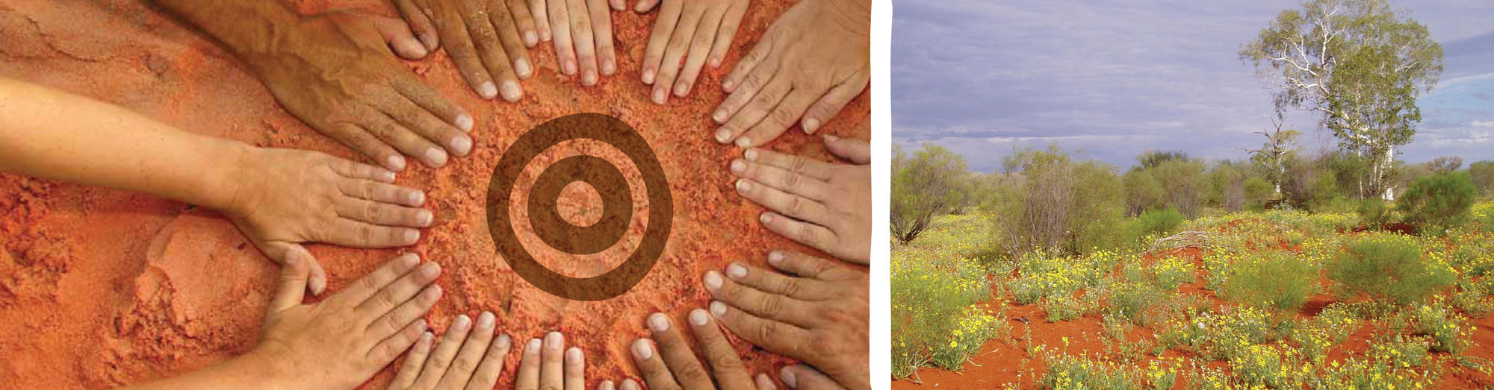
Developing Holistic Indigenous Learning Scapes across Platforms
Henk Huijser – henk.huijser@batchelor.edu.au

Slide 2
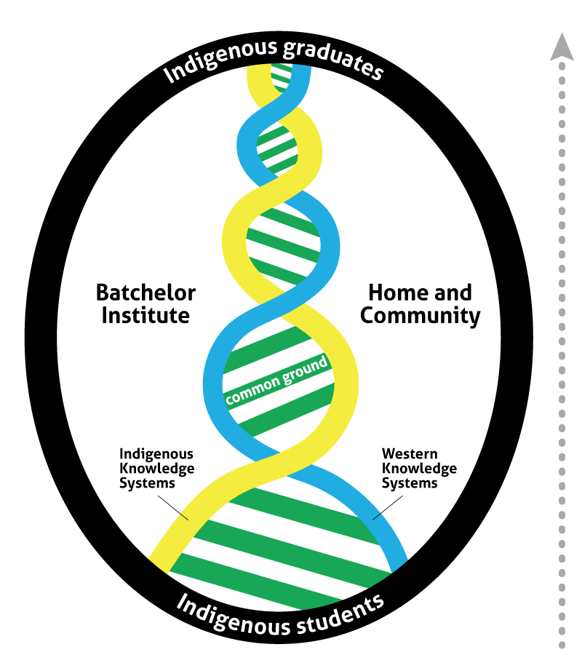
‘Both-ways’ philosophy
‘Both-ways’ is a philosophy of education that brings together Indigenous Australian traditions of knowledge and Western academic processes and cultural contexts, and embraces the values of respect, tolerance and diversity.
Both-ways diagram
Ober, R & Bat, M 2008, ‘Paper 2, Both-ways: Philosophy to practice’, Noongjook [online], no. 32, pp.56-69, viewed 19 February 2013, via informit.

Slide 3
Both Ways Principles of Practice
Principle 1: Both-ways is a shared learning journey
Principle 2: Both-ways is student-centred
Principle 3: Both-ways strengthens Indigenous identity

Slide 4
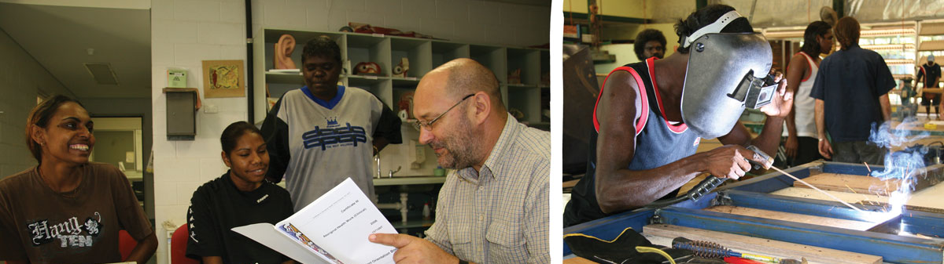
Key Element: Relationships
Do you need face-to-face contact first…?
Or can you develop relationships online…?
Or can you only develop pre-existing relationships online...?

Slide 5
Social Media for Learning
Social Media for Learning | Traditional Teaching Approaches
Social | Individual performance & achievement
Group work/ Group discussion | Individual performance & opinion
Oral communication/ ‘bite-sized’ writing | Written communication (e.g. essays and reports)
Multi-modal/ multi-media | Focus on the written word/ traditional literacy
Just-in-time, applied social knowledge creation (‘social constructivist’) | Read/write – individual knowledge acquisition

Slide 6
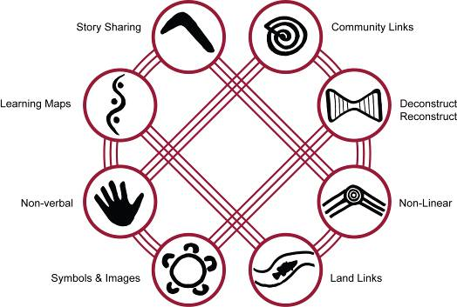
Example - “8ways Aboriginal Pedagogy Framework” (Yunkaporta, 2009, p. 10)

Slide 7
Yunkaporta’s (2009) “8 Ways Aboriginal Pedagogy framework” – alignment
“8 Ways” | Social Media, Mobile & E-Learning Tools
Story sharing | Collaborate/ Saba Online Classroom, MS Lync, Skype, YouTube, Vimeo, Blogs, Wikis, iPads/Tablets
Community Links | Collaborate/ Saba Online Classroom, Skype, YouTube, Facebook, Twitter
Deconstruct/ Reconstruct | Discussion forums, Chatrooms
Non-linear | A-synchronous discussion forums, Facebook, Twitter, YouTube, Flicker, iPads/Tablets
Land Links | Facebook, YouTube, Flicker, Vimeo, PPTs, Word Docs, iPads/Tablets
Symbols & Images | Facebook, YouTube, Flicker, Vimeo
Non-Verbal | YouTube, Flicker, Vimeo, iPads/Tablets
Learning Maps | Collaborate, a-synchronous discussion forums

Slide 8
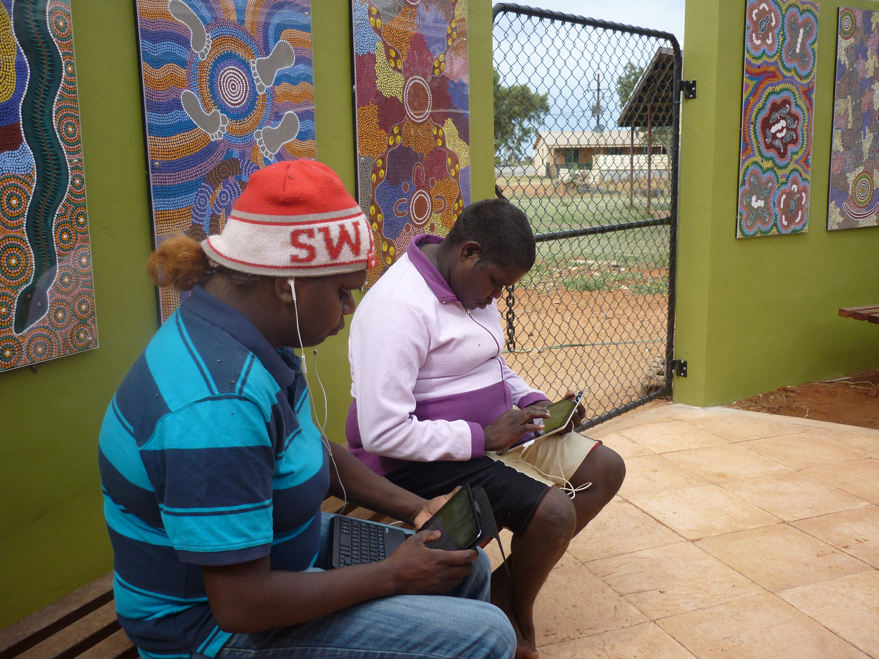
Case Studies at Batchelor Institute
“E-Learning for Participation and Skills” project called Expanding DigiLink through Mobile Social Media
http://participationandskills.wikispaces.com/NT228
Use of iPads to engage students at Batchelor Institute – iMovie, Creative Book Builder (iBooks), iAnimate, Garageband

Slide 9
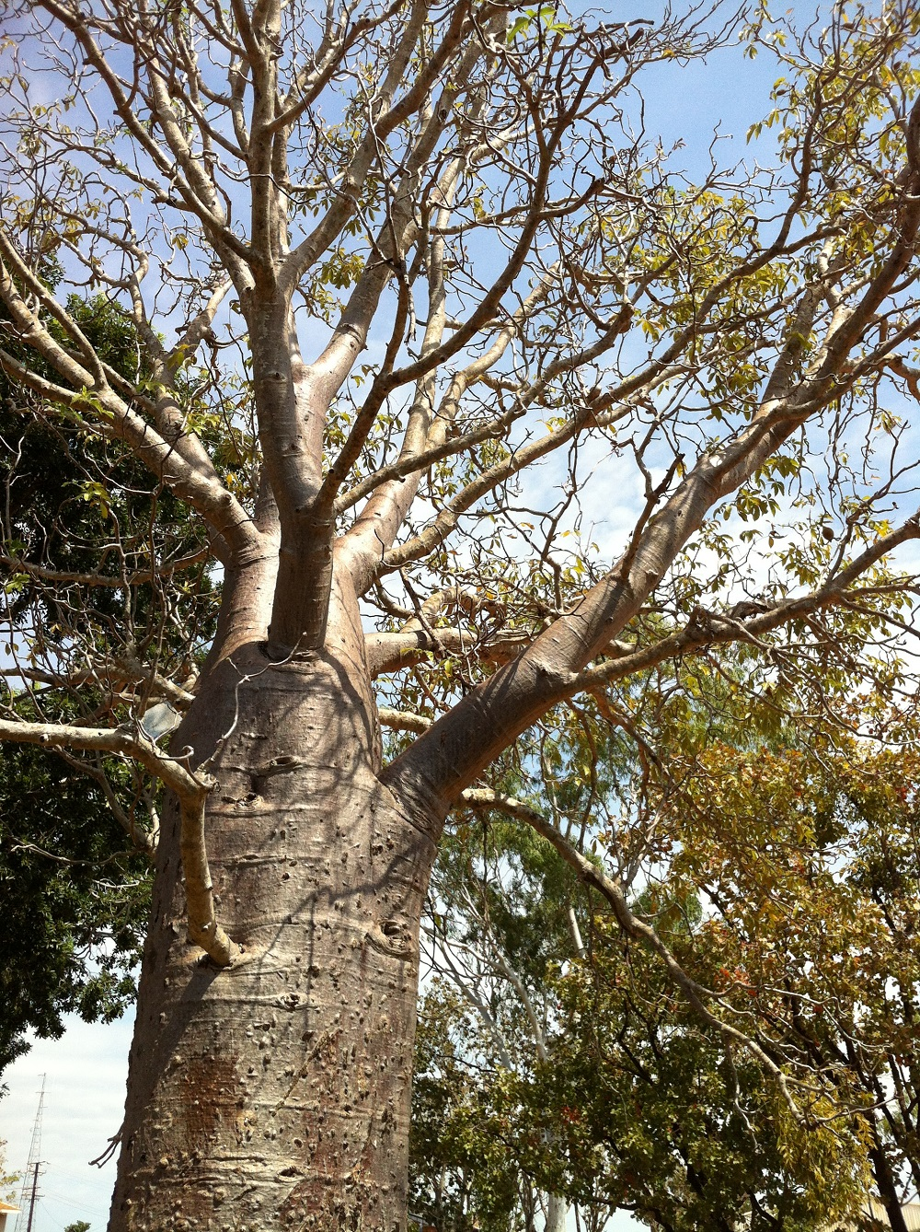
Early Lessons from Case Studies
Mobile and social media have great potential to engage Indigenous learners
Social media are already widely used by many Indigenous learners, so they feel comfortable in those spaces
Mobile media (in particular iPads) are very intuitive and thereby
engage learners easily
Mobile media are well-suited to create
Indigenous learning-scapes because they blur
the lines (e.g. between formal and informal
learning environments, between private and
public spaces including online spaces)
→ allows for more holistic approaches

Slide 10
Potential barriers
  Physical access (e.g. access to computers, reliable internet access, access to mobile devices)
  Educational access (e.g. educational background, digital literacy)
  Generational diversity in remote communities & diverse learning backgrounds – e.g. ‘Gen Y’ vs digitally ‘illiterate’ generation…potential issue in a small group of learners
  Cultural barriers
  Teachers’ attitudes and skills

Slide 11
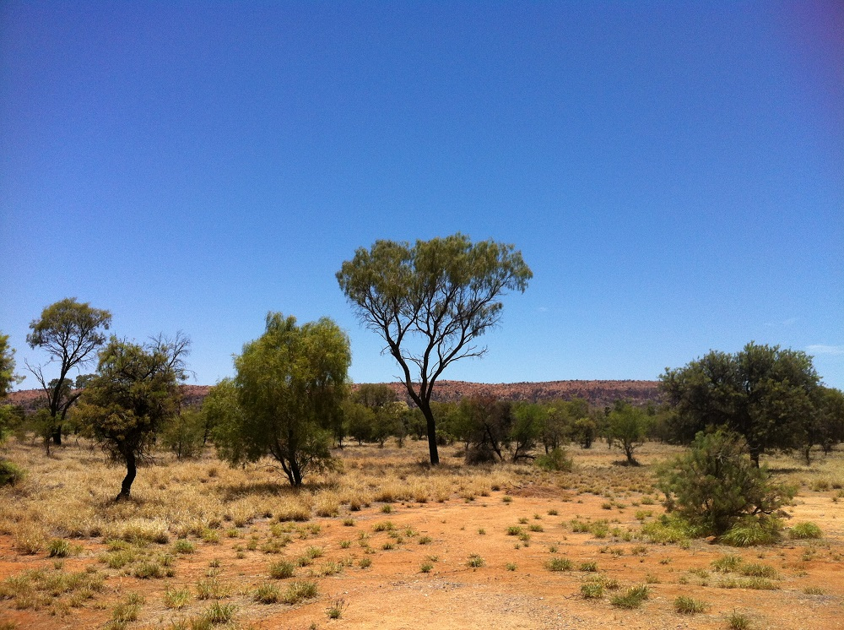
Into the future…? Some questions
Where do digital literacies fit into the overall curriculum…?
How important is face-to-face teaching…? Can all our teaching potentially be ‘mediated’…?
How does ‘both-ways’ work in a context where global MOOCs (Massively Open Online Courses) and Open Courseware are beginning to become a part of higher education…?
“Ubiquitous Learning”
(Cope & Kalantzis)

Slide 12
Thank you!

