Slide 1
Impact of culturally mediated clinical interviews
Dr Ray Lovett
Research Fellow
Australian Institute of Aboriginal and Torres Strait Islander Studies
Canberra, Australia

Slide 2
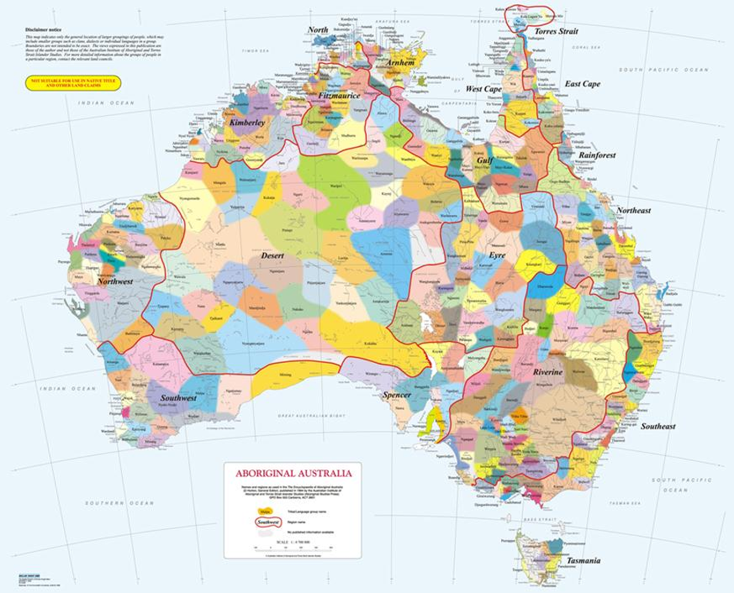

Slide 3



Outline
Context of the study
Aims
Methods
Results
Discussion
Implications
Acknowledgements

Slide 4
Context
Consumption
Consequences
Heavy
Severe
Alcoholism and Alcohol dependence
Harmful alcohol use, abuse
Problem drinker
Risky use
Low risk use
abstinence
Alcohol-use disorders
Unhealthy use
none
Source: Saitz, 2005
none
Notes:
For those not familiar there is a hierarchy of harms associated with alcohol use. 100 percent of the morbidity and mortality associated with alcohol is avoidable. But world-wide there are more than 2.25 million deaths from diseases associated with it. It has been estimated in the general population that alcohol is associated with 30 per cent of road accidents, 44 per cent of fire injuries, 34 per cent of falls and drowning, 16 per cent of child abuse, 12 per cent of suicides and 10 per cent of industrial accidents (Alcohol and Drug Information Service, 2011, Ridolfo and Stevenson, 2001a). Alcohol intoxication also has a large impact on criminality, with over 60 per cent of prisoners being intoxicated at the time of their offence. It is also estimated that 40 per cent of domestic violence occurs when offenders are intoxicated (Indig, 2010).
Among the Aboriginal population, alcohol problems are associated with 7% of all Indigenous deaths and is the third leading cause of Indigenous deaths in Australia behind Tobacco and obesity. It is also responsible for 5% of all illness among Aboriginal people in Australia. These are likely to be underestimates as well. One study in 2010 that looked into recording of reasons for hospitalisation showed that alcohol related hospital admissions were under reported by about 62 per cent!
In addition, the average age of death for alcohol related deaths in the Aboriginal population is 35yrs. We know that 20% are consuming at levels considered harmful over the long term and in my work showed that 60 percent of people were consuming alcohol at risky levels over the short term (about twice the rate of the non-Indigenous population). Despite the vast differences between the NT (30% of the population are Aboriginal compared to 1.5% in the ACT), there is one similarity with the ACT having the second highest per capita alcohol consumption in Australia (just behind the NT).
But what is risky use? In Australia the National Health and Medical Research council (NHMRC) develops guidelines on safe drinking limits from national and international Burden of Disease studies. In May 2009 new guidelines were released that recommended not more than 2 standard drinks (20g) of alcohol be consumed on any day to keep the risk of lifetime harm from alcohol below the risk threshold (a 1 in 100 chance of death or disease from alcohol related causes) and no more than 4 standard drinks on a single occasion for single occasion risk. This study is aimed at identifying those in yellow and blue areas. Much research has occurred at the pointy (red).
We know that early intervention through a combination of screening (with valid instruments) and BI can reduce risky consumption from between 5-20 per cent over the following 12 months after screening and BI has taken place. It is cheap, costs little and is effective.

Slide 5
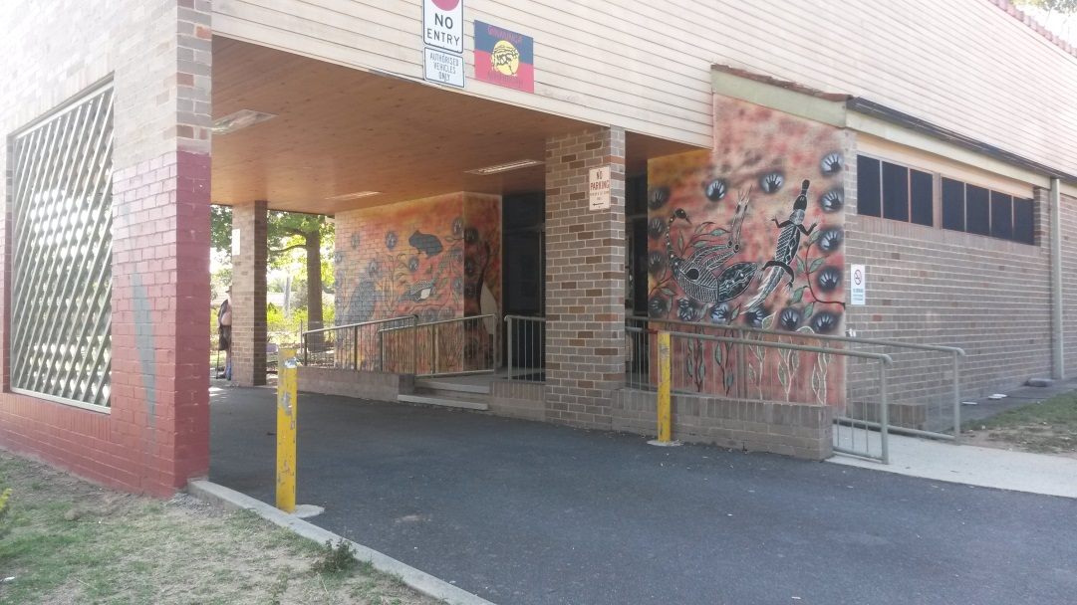
More context
Poor current practice
Valid instruments
How to incorporate screening and BI in hard to reach populations including Aboriginal peoples?
Notes:
The problem is – we don’t do it very well. Less than 10 per cent of physicians conduct screening according to clinical guidelines. There are varied reasons for this and of the limited information we have with the Aboriginal population we know that fewer people are screened according to these guidelines. A study from 2009 showed that screening rates in three Aboriginal Health services showed between 3-7 per cent had been screened in the previous 12 months.
One of the common reasons for not screening Aboriginal people is that they are uncomfortable in asking about issues considered sensitive and that may want to build rapport with the clients and asking about alcohol will lessen rapport. This is a major impediment.
In my previous work, we were able to show some improved reporting of risky use with a drop in levels of discomfort during the screening interaction when participants were asked about their mob a country. Using a cultural construct such as this appeared to increase rapport and trust. The fundamental question then became: Does this translate to non -Indigenous clinicians working in Aboriginal primary health care?

Slide 6
Aim of the study
To determine if a culturally mediated approach to alcohol screening effects reporting of risky alcohol use.
    Assess psychometric properties of screening instruments
    Assess levels of distress in the clinical interaction
Notes:
The concepts of mob and country are fundamental to Indigenous identity
Improves capacity of Indigenous Australians to interact with others (Taylor, 2003).
Mob generally refers to the cultural or linguistic groups from which an Indigenous Australian’s lineage can be traced.
Country refers to the geographic location from where that language group originated.
Being able to identify one’s mob and country is increasingly seen as a way of verifying and taking pride in one’s Indigenous heritage (Taylor, 2003).
Recognising the important role mob and country can play in a holistic approach to Indigenous health and wellbeing is important, especially in relation to building rapport and trust.
This study aimed to combine the these concepts into the clinical assessment process to see if it would impact on assessment scores and how distressed participants were on the process.

Slide 7
Ethics
Respect
Reciprocity
Equality
Responsibility
Survival and protection
Spirit and Integrity
https://www.nhmrc.gov.au/guidelines/publications/e52
Notes:
For all research in Australia when dealing with Aboriginal people there are 6 principals researchers are required to demonstrate adherence to. These are in addition to the National Statement on conducting ethical research.
In this study we addressed these values through:
Respect – uses appropriate engagement processes in the community. In this study a community based steering body was responsible for decision making.
Responsibility – feedback to the community, transparency in the study development, methods and analysis
Reciprocity – being able to demonstrate a return to the community.
Equality – receiving benefits from the research process are spread equally among the researcher, Institution and community. Within this study the Aboriginal health service was contracted to employ a site coordinator (the practice manager). A substantial portion of the grant monies were allocated to the health service. All service staff involved in the study are coauthors in any publications. We will be returning the dataset to the health services after our analysis is finalised. Some IP was retained by the health service.
Survival and protection – Does not bring notions of assimilation or subjugation of values. We are using Aboriginal notions of identity in the process, therefore affirming the value of identity in the research process.
Spirit and integrity – to communities not just to individuals (the collective).

Slide 8
Methods: Design
Arm 1
Arm 2
Pre study screening audit
(n=314) client files
Enrolment (n=315)
Useable (n=266)
Horton's map + (mob and country q’s)
AUDIT (n=160)
K10 (n=108)
Mean AUDIT score
Mean K10 score
AUDIT (n=106)
K10 (n=94)
Mean AUDIT score
Mean K10 score
Eligibility
Aboriginal and/or Torres Strait Islander
≥ 16 years
Not intoxicated
Pre- survey clinicians capacity for preventative screening (n=10)
Case/Control
Survey clinicians capacity for preventative screening (n=10)
Analysis
T-Tests /ANOVA
Factor analysis
Post-Screening audit
(n=314) client files
Notes:
The main focus of my presentation today will be presenting the results from the second arm of this study, but I will briefly highlight some of the results from arm 1 as the post screening audit of client files is currently being undertaken.
In determining the adequate sample size factor analysis became the determining consideration with 300 participants recommended for 10 item scales.
Fewer participants were required to adequately power the study for testing differences in means and for chi2 analysis. Our initial sample size achieved was 315. After cleaning and dealing with missing values we were left with 266 participants for the validation of the instruments

Slide 9
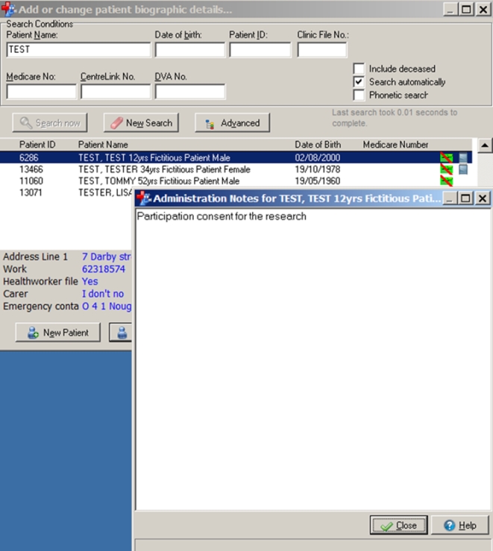
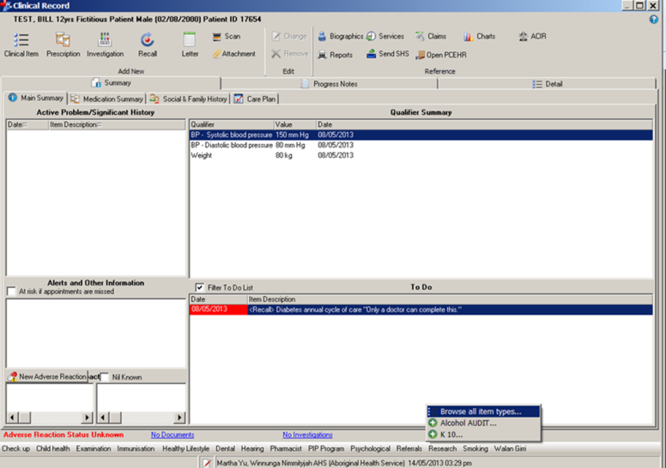
Methods: data collection
Recruitment
Study governance structures
Study site Coordinator
Information and consent at clinic reception
All eligible clients presenting to clinic asked to participate
Consent process included in PIRS when clinician opened client file
‘Research’ tab for data collection
Research tab listing clinical items AUDIT & K10
Notes:
Much of the day-to-day running of the study fell to the local site coordinator. This approach facilitated ease of recruitment and left the clinic with a sense of ownership over the project. Strategically the site coordinator was the manager of the clinic and is a long term staff member.
Much of the consultation with the clinicians focused on ensuring that the research did not add burden to workload. In the initial stages much of this concern focuses on what they would do with clients once identified as ‘risky consumers’. One of Australia's foremost experts of screening and brief intervention in Aboriginal primary health care provided training for all clinicians, prior to recruitment commencing.
The clinic reception staff provided information sheets and consented participants-lessening the burden on clinicians.
Within the electronic health records management system used by the clinic we were able to develop a system that would inform the clinician that a patient had consented for the study and created an electronic data collection form within the clients electronic file so the data could be exported once the participant recruitment was completed and so that there was a permanent record of the screening data on the client file for comparisons in the future. The electronic collection form also contained a function for the clinician to provide feedback to the patient on their risk status.
At the completion of recruitment we were able to extract all the data from the system using SQL, transfer this into EXCEL and then SPSS for data cleaning.

Slide 10
Methods: Data analysis
Descriptive
Inferential
Socio-demographic
Alcohol and distress frequency tables
Internal reliability α
Exploratory factor analysis
T-test and ANOVA (mean alcohol and distress scores) in case/control groups
χ² for binary variables
Notes:
We used descriptive stats to describe our population of study and to look at the representation across continuous and dictomous variables.
We first look at the appropriateness of the screening instruments for use with this population and after determining this move into conducting t-tests to observe any effect of using the map of Aboriginal Australia on mean alcohol and distress scores. An additional test was preformed to determine of the gender of the clinician. Chi2 test were also used to observe significant association between binary variables.

Slide 11
Results
Arm 1 results
Demographics
Reliability of instruments
Alcohol + distress
Notes:
First I will talk about our pre-data collection study concerning GP knowledge and attitudes, then move into the case control study.

Slide 12
GP survey results (wave 1)
Lack of awareness of guidelines
Poor confidence
Concerns over referral
Poor recording of screening
Notes:
The four major issues identified from the pre data collection survey of GP’s was that:
Less than 20% of GPs were aware of revised alcohol screening guidelines.
Less than half were Confident in identifying and treating alcohol related issues
While not aware or confident of identifying issues, they were also reluctant to refer people on to social health workers internally (concerns about follow up) and didn’t want to overburden other system that were available
A preliminary audit of client files showed that less than 2 percent of client files listed alcohol status being recorded in the previous 12 months (the currently recommended timeframe for screening in the Royal Australian College of General Practitioner Clinical guidelines)

Slide 13
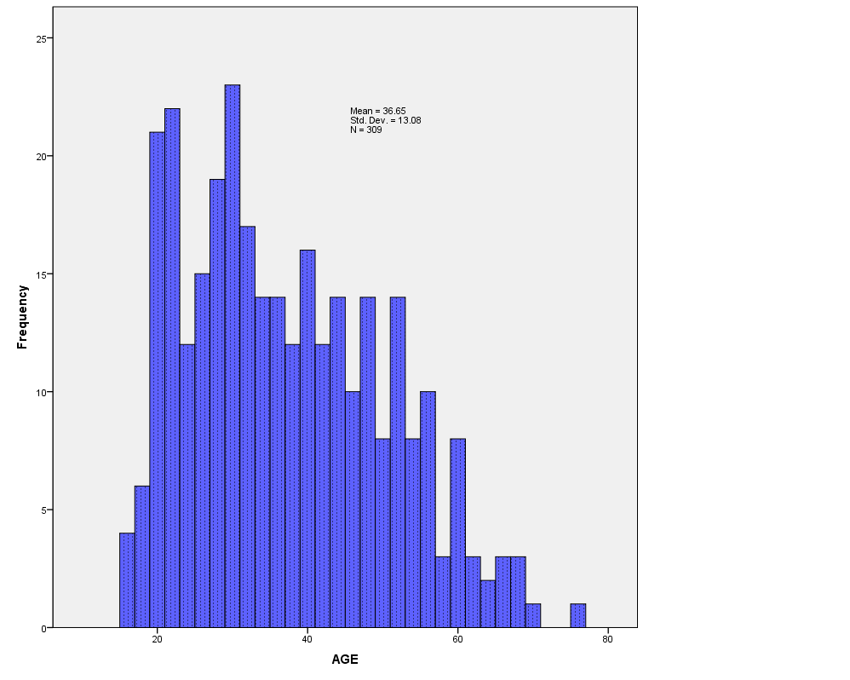
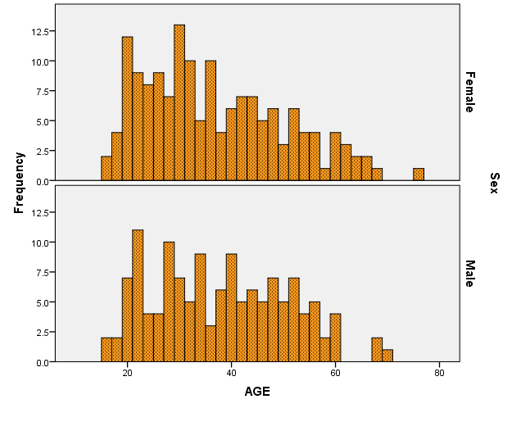
Age and gender
Age structure
Age + gender
Notes:
The mean age of participants was 36, with a poor representation in the younger ages, given the young age profile of the Aboriginal population. Females made up 56 percent of the sample.

Slide 14
Participant demographics
Notes:
This figure shows a range of demographic variables collected. Of note here are:
The high proportion of males with a education of year 10 (softmore) or less (60 per cent)
30 per cent unemployment
A high rate of disability and caring roles 13.5%
Smoking rates at 55 per cent which is higher than the ACT rate of 36% for Aboriginal people and 12 per cent for the general population

Slide 15
Results scale reliability
AUDIT
K10
Chronbach’s α=0.90
Exploratory factor analysis: 2 factors explaining 64% of the variance (Consumption and consequences)
Chronbach’s α=0.97
Exploratory factor analysis (2 factors explaining 68 % of variance)
Notes:
To ensure that the measures being used were appropriate for use we first conducted tests of psychometric properties of both AUDIT and the K10. Both AUDIT and K10 demonstrated good internal reliability with alphas over 0.9.
The AUDIT Exploratory factor analysis identified a two factor solution (consumption, consequences), consistent with other studies.
The K10 also identified a two factor solution consistent with other studies.
The conclusion drawn was that both instruments were appropriate for use.

Slide 16
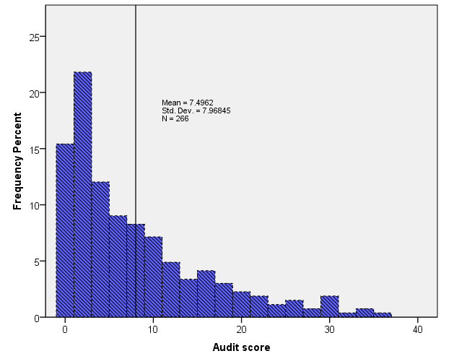
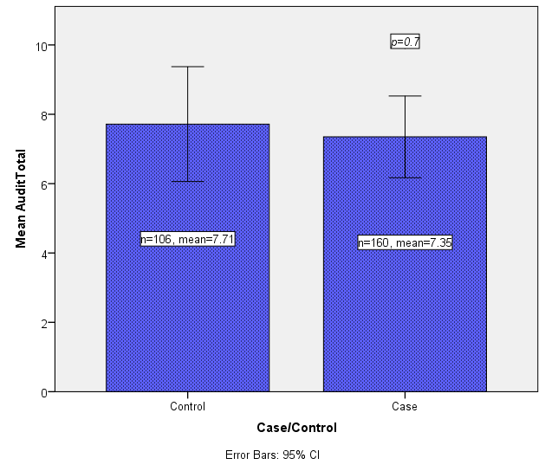
AUDIT by Control and Case
Notes:
The t-test results revealed no significant difference between the case and control groups in difference of mean alcohol scores. Of note though is the overall mean score of over 7, which is above the cut-points for risky drinking among this population. Just over 50 percent were identified as drinking above long term risk limits, this is in comparison to 20 percent of the general population in the ACT.

Slide 17
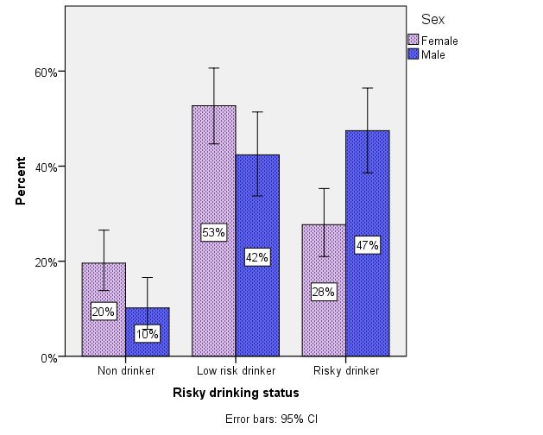
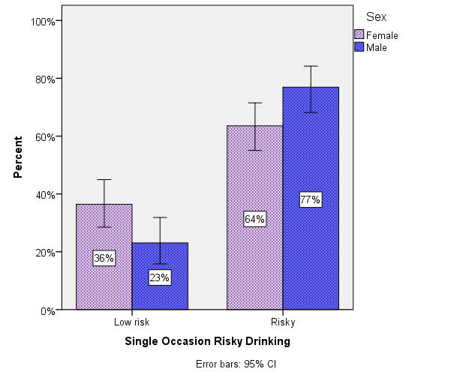
Drinking risk
Single occasion
Lifetime

Slide 18
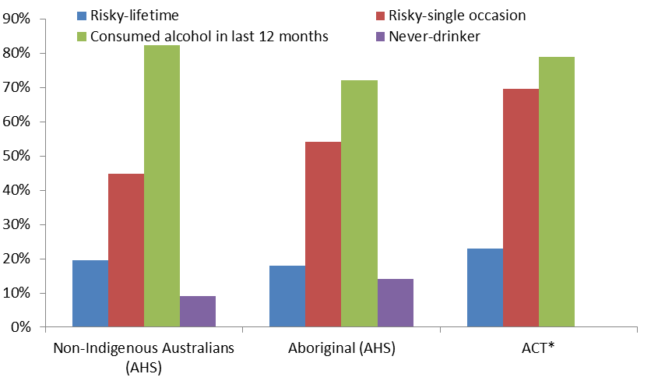
Drinking risk comparators
Notes:
Data presented here is from the Australian Health Survey conducted over 2011-12. Comparisons are drawn against the participants in my sample.
The key points here are that there are more non-Indigenous people overall that drank alcohol in the previous 12 months (82 per cent compare to 72 percent nationally for Aboriginal people and 79 per cent in my sample).
We can see that the rates of lifetime risky drinking are similar across the three groups with a slightly higher rate among participants in my study.
The major observable difference is in single occasion risk. Nationally just over half of Aboriginal people drink above recommended guidelines. Within my sample this moves up to 70 per cent, some 25 per cent above the general population level.

Slide 19
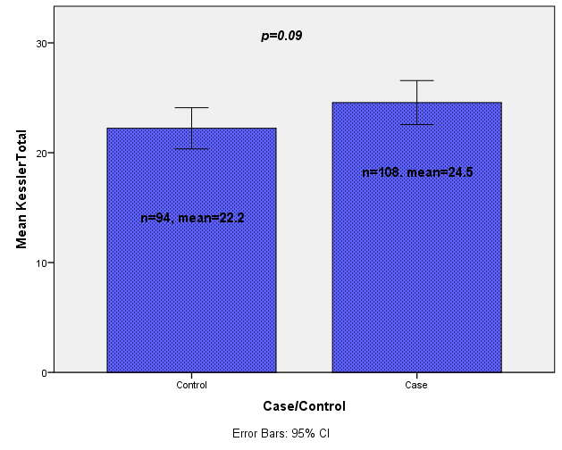
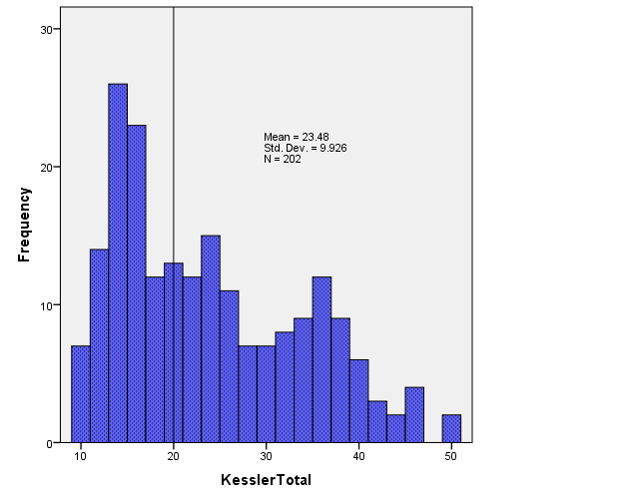
Distress
Kessler 10
Kessler 10 Control/Case
Notes:
The t-test result revealed no significant difference between the case and control groups on mean distress. Of note is the overall mean score of over 23, which is above the cut-points for classifying moderate to severe distress for this population. Just over 50 percent were identified as drinking above long term risk limits, this is in comparison to 20 percent of the general population.

Slide 20
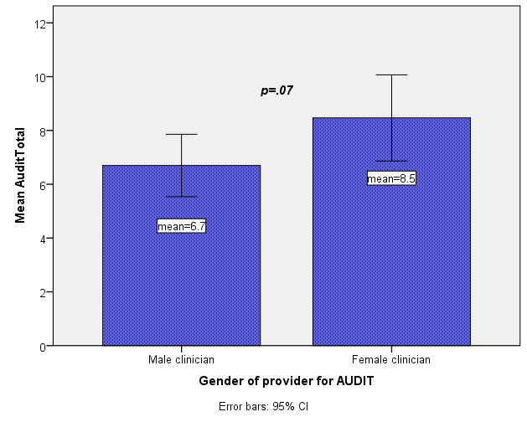
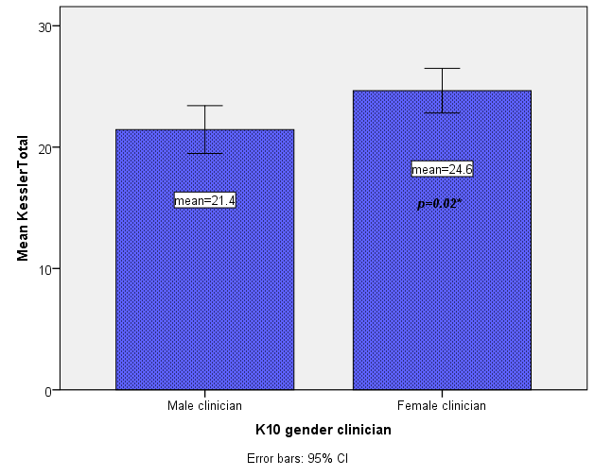
Differences by provider
Audit scores by clinician
Distress scores by clinician
Notes:
One of the other factors we were interested in was the gender of the provider and whether this impacted scores. At the individual clinician level there wasn’t enough power to discern a difference. higher means scores on both AUDIT and distress scales were observed when participants visited female clinicians, a increased mean distress score (significantly) was observed for participants when they saw a female clinician.

Slide 21
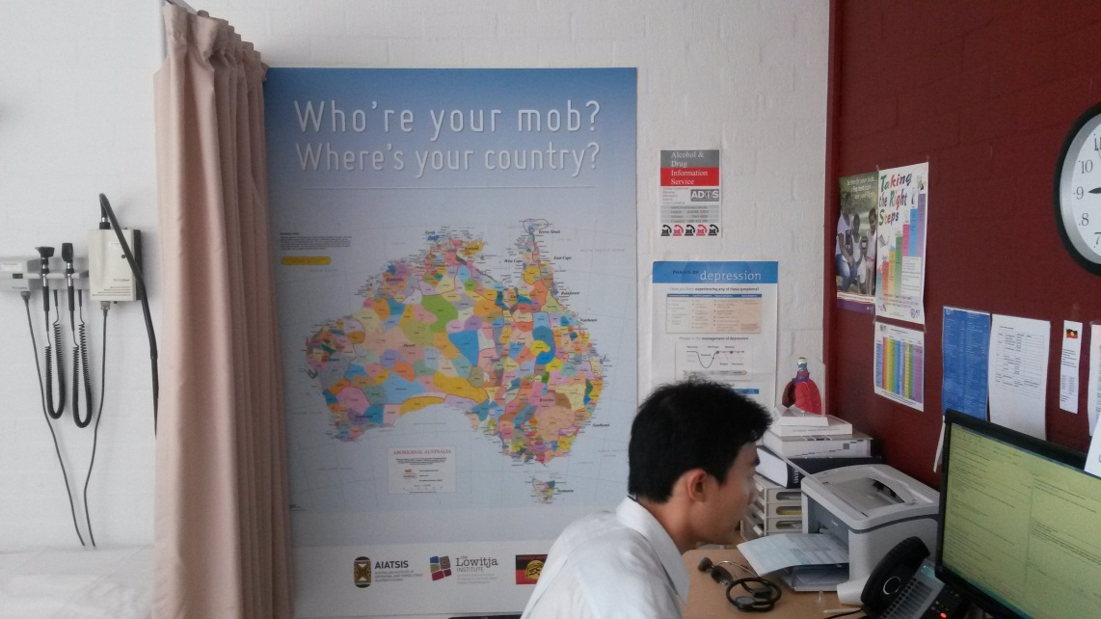
Discussion
Methods of recruitment and study governance
Clinician buy in
Reliability of instruments
‘Culturally appropriate care’
Notes:
The methods of recruitment were paramount in the recruitment being completed in around 3 months, the health clinic was driving the process, not the researchers. The clinic staff had good buy-in as they are required to report on the proportion of clients screened for alcohol use in their funding agreements, highlighting the timeliness of the research.
Working with clinicians required some training to identify training needs to build confidence in addressing a sensitive issue. Alcohol use among Aboriginal people is a sensitive issue in Australia with many stereotypes. As demonstrated in wave 1 of this study: clinicians don’t always know what they need to know and in this sector the importance of knowing about screening and brief intervention are very important.
Many alcohol screening instruments exist, but few have been validated for this population in Australia. My previous work and this study confirms the usefulness of the AUDIT, but cut-points for classification of risky drinking required lowering for this population from 8 to 7.
A simple concept such as knowing about a clients mob and country didn’t seem to impact overall screening scores much or distress clients, but it was also an educational opportunity for clinicians working in Aboriginal health who might not be aware of the importance of the map in affirming Aboriginal identity. It was also an opportunity to educate clinicians (some might also call this cultural awareness training).
If I compare my previous work in the area I saw a higher alcohol screening score (3 points) an a decreased distress score (by some 7 points) when I interview clients. This work was conducted among the same client population, and used a long timeframe for the participant consultation. I was also known within the community as an Aboriginal and this may have been a contributing factor. This does raise in interesting idea though: should the role of screening and brief intervention for sensitive issues such as alcohol rest with local Aboriginal health workers? We would need another study for this.

Slide 22
Implications
Screening in combination with BI effective and more needed ++
Need for regular clinician training
Further study: Who best delivers screening & BI
Study governance & ethics
Gender of clinician may be important
Notes:
Study governance & ethics
Ethical process done right improve study buy-in, recruitment and then success.
Need for clinician training (regular)
Clear need to regular up-dates in preventative screening training. And training on identity concepts fundamental to Aboriginal people.
Further study: Who best delivers screening & BI
Should we investigate who could be best placed to deliver screening and BI in this context?
Screening in combination with BI effective and more needed
Our audit showed poor screening rates amongst a population who are consuming a risky rates
Gender of clinician may be important
Further analysis is required, but men’s and women’s business is a continuing factor in dealing effectively with gendered issues among Aboriginal people in Australia.

Slide 23
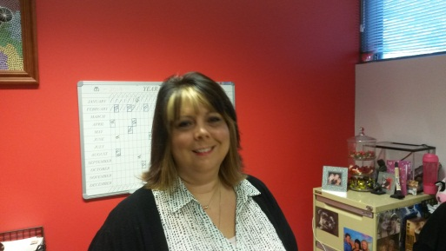
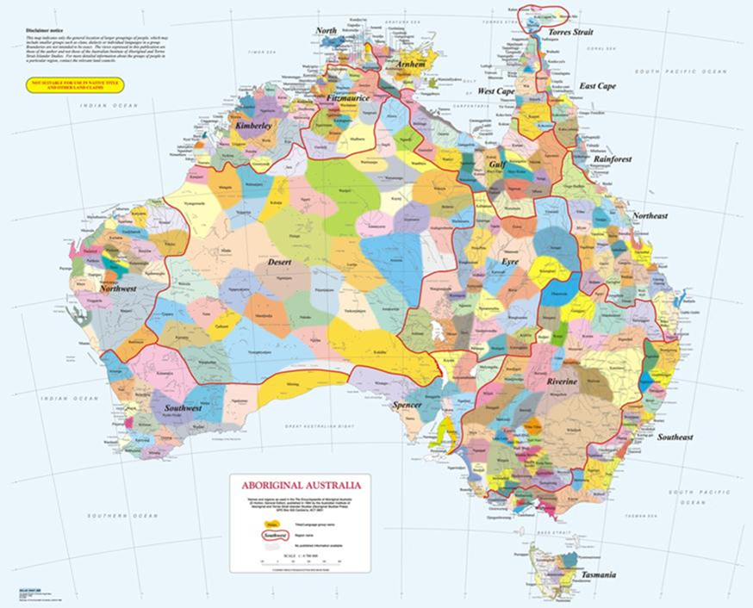
Acknowledgements
Participants
Study team
Jodie Lonford: Study Coordinator
(Wiradjuri)
Jay Moore: Clinic reception (Wiradjuri)
Mieke Snijder: Research assistant
Study Steering group
Julie Tongs (Wiradjuri)
Ray Lovett (Wongaibon)
Jodie Longford (Wiradjuri)
Marianne Bookalil (GP)
Ana Herceg (Public Health)
Lowitja Institute: Funder
Who’re your mob?
Where’s your country?

