Slide 1
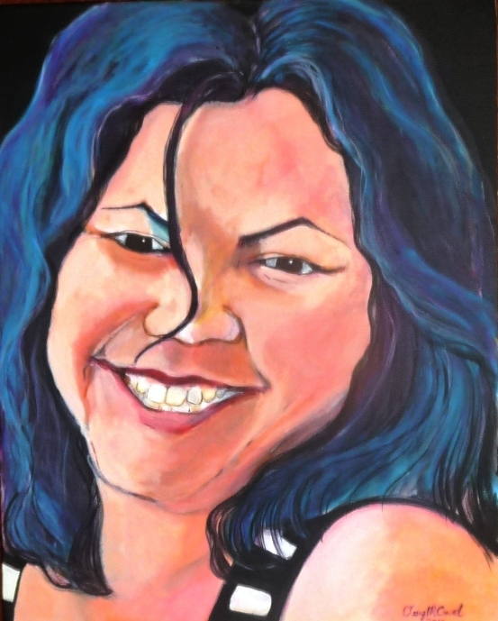
AIATSIS 50th Conference Program (Breaking Barriers In Researching and Thinking) Canberra "26 - 29 Marc 2014.
Cheryl Creed Aboriginal Portrait Artist
Seeing The Beauty Of Indigenous Australians Through The Eye’s Of An Aboriginal Portrait Artists

Slide 2
Artist Biography
Born in Cherbourg Aboriginal Settlement in SE Queensland in 1965, traditional Country of the Wakka Wakka People.
I am the eldest child of Thomas and Cassandra Creed seven children, the same hospital where her parents were born
At this was the time, Aboriginal People were not recognised citizens, we were a non- People in our own Country, fiercely controlled under the white policy Acts.
At the age of 10, my parents move our family to Brisbane, this was a huge decision, as it meant giving up the security of your family and friends in our Aboriginal world.
I cried for the only world I knew, I remember feeling scared, and I didn’t want to leave my home.
Settling into life in the city was a huge adjustment, a cultural shock, we were now living in a white world, life was to change forever, but my parents had foreseen the opportunities for their children.
Through my years at state school and high school, I was always happy when doing art, and this helped me through some of the tougher times, I loved creating colourful designs and patterns
In 1984 , I had my first son, as a young mum, I continued to paint, art had always been apart of me.
One day visiting Musgrave Park, I saw my People, I often thought, how deadly it would be to paint these scenes of the Uncles and Aunties and their families, I wanted to record the People who called Musgrave home.

Slide 3
.
At the age of 34, I realised that I hadnt completed much in my life, Id had my children, but I hadnt achieved what others had (high school certificate, TAFE course etc)
In 2000, aged 35, I was enrolled at the Institution of Koorie Education, Deakin University, in a Bachelor of Visual Communications. I had set my first goal to obtain a degree before I turned 40. I achieved my first goal, and at the age of 40, I had also completed an Honours degree, I felt so proud of myself, I had excelled my personal goals.
There was a time in my life, I didn’t believe I’d ever go to University, I believe these opportunities were for white people, but in 2013 this Aboriginal woman (now a grandmother of 2) had graduated in a Master of Education Degree.
Thinking back to 2001, I had no thought, that I would be holding a Master’s degree. Currently I am enrolled in a Doctorate of Philosophy, researching Aboriginal history in Queensland, it’s hard to believe that an Aboriginal girl, who thought she had no dreams, born in an Aboriginal Settlement, will soon have the title of Doctor in front of her name.

Slide 4
Id like to acknowledge my parents and my grandparents .. I identify by acknowledging my direct bloodlines to their Traditional Country/s.
I acknowledge my maternal connection to Country through my grandmothers bloodlines and am a proud Gungarri and Pitta-Pitta woman
I acknowledge my paternal connection to Country through my grandfathers bloodlines and am a proud Bindal and Qandamooka
Id like to acknowledge the Wakka wakka People, the Country that I was born on, the birth land of my parents and the resting place of my father, my grandmother

Slide 5
IMAGE - IDENTITY - PORTRAITURE

Slide 6
IMAGE - IDENTITY - PORTRAITURE The “Image” of an Aboriginal person, I believe, carries a far complex and deeper significance, if compared to the perception that of non-Indigenous interpretation. In Aboriginal culture and society, First Australians embody a higher and spiritual sacredness, that needs to be respected and protected, under cultural and traditional The image of an Aboriginal person, especially and Elder, needs to be handled with a greater regard and extra delicate sensitivity, As a portrait artist, I'm imparted with privileges and assume special responsibility, when transferring a person image to canvas The sort of responsibility I’m referring to is of a spiritual nature, that’s not practiced in non-Indigenous society, and there for I'm a little more concerned or even protective, when our Peoples images are being portrayed by non-Indigenous artists. Its customary to cover the image of our People who have passed (especially Elders), traditional protocol should always be respected, unless special requirements have been placed. Aboriginal Image or Imagery upholds a level of sacredness, and customary beliefs (customary practices differ between language groups), sacredness in the form of soul revealing, capturing or entrapping, and these are the powers that are not understood when non-Indigenous artists paint the images/faces of Aboriginal People/s. Traditional practices are not respected, because they don’t understand, learn or acknowledge the sacredness or sensitivities of an Aboriginal/s way of life In Aboriginal society “Identity” has a separate value from perceived norms in mainstream society. Aboriginal will identify to each other, through connection of family, tribe and country Responsibilities of being a portrait artists and painting a “Portrait” of Aboriginal person, comes with obligations and responsibilities, and as an Aboriginal portrait artist, I'm very concerned for my People. Mainstream society assumes, because we are in modern times, we practices, values and beliefs are not carried out or important and have died out.

Slide 7
The ABORIGINAL ARTIST Mention Aboriginal Artist, and Aboriginal Art, immediately ones thought, links them with dot work, and other symbolic or emblematic markings that’s representational of ancient traditional art Rock /cave art, body art, sand drawings, bark paintings, all classified as primitive or prehistoric National and International curators or art experts tend to associate the artist, to resemble the bush/desert man/woman, carrying that primitive image, seen before white occupation. With these art styles and primitive figures, they we are pushed to the past, to associate authenticity, dismissing modern and urban Aboriginal artists and their art styles (especially if we don’t fit the image/s). Judgement is passed and contemporary art style are seen or judged as unauthentic/ not the real deal. What’s disremembered, is through the brutal introduction of “Colonisation” your ideologies of a real Aboriginal and authentic Aboriginal art, exists before 1788. Society has neglected to appreciate, the preservation of stories that has been maintained and handed down, these stories have developed yet sustained with pressure from new occupation and brutal settlement, now told in a western medium (Acrylic/Oil on Canvas, Pottery/Ceramic, Steel /Metal Work, Print Making, Photo Media, Audio-Visual etc. ) Understandably the modern or contemporary Aboriginal Artist, we have had to evolved with the trappings of western influences, as we step into the future, our world has changed and so has our art. To our People, we are the keepers of our stories and as artists we tell them through western mediums (although not always)

Slide 8
What Is Aboriginal Art and who defines it?

Slide 9
As we have advanced as a People, combining our traditional knowledge and techniques with that of the western practises and methods, our capacity to explore and refine our individual art styles and possibilities, have succeeded beyond what is accepted as authentic Aboriginal art From the wider and national expectations, and the ideologies of what is perceived as Aboriginal art, we have created our own movement in the art world. Exploding Aboriginal changes began back with celebrated water colour Albert Namatjirra and in more recent time with the works of Emily Kame Kngwarreye.

Slide 10
Emily Kame Kngwarreye (1910-1996)

Slide 11
Albert Namatjirra (1902-1959) “Ghost Gum, Mt Sonder, MacDonnell Ranges” c1953 and “Mount Connor near Musgrave Ranges” c.1956

Slide 12
Contemporary & Traditional Art Styles, Practices, Methods

Slide 13
Aboriginal artists love to explore, we love to experiment and we love to intermix our heritage using western techniques to showcase our individual talents, which not only promotes who we are but also how we are connected to our country. We define, who we are, what our art is about and how it is presented. We are conscious of our work and we are aware that we have our Elders watching what we do and we are driven by our traditional, cultural, spiritual and physical past, present and future.

Slide 14
Conceptual Art

Slide 15
Reflective of Traditional Oral Aboriginal History, the People used art to communicate, a visual or descriptive language, images such as paintings or drawings documented important life events. This form of documenting history, hasn’t stopped, it continues today using western methods to pass on, maintain and preserve our heritage, culture, traditions. Aboriginal Artists exchange knowledge through narratives that’s reflective of the past and present day, expressed through art, in whatever form, medium or methods. To the Aboriginal artist, this is still Aboriginal art, as did since before arrival and occupation. Conceptual art echo’s that theory and mode, sending a message using pictures, icons, symbols to communicate an idea (also see page 24 “Still Life and Personal Possession”)

Slide 16
'Scream" and" Rabbit Proof Fence"

Slide 17
"Namatjirra & Me"

Slide 18
Self Portrait

Slide 19
Imitating conventional European artists, such as Vincent Van Gogh, Rembrandt, Pablo Picasso, and one of my most admired, female self portrait artist is Frida Kahlo. I have a personal aspiration to produce a volume of “Self Portraits”, for every exhibition I produce or take part in, my ambition is to present a self-portrait. This is a personal goal, a visual diary that documents my life as an artist, that will tell the story of an Aboriginal portrait artist. It would be wonderful to be remembered for my self-portraits. (p. 16-23) Demonstrates a “Timeline” of “Self-Portraits” (p. 24) Describes a “Self Portrait “ in “Still Life”)

Slide 20
1st "Self Portrait"
My Self Portrait in acrylic This Portrait done my head in, I had no idea how to do a portrait of my self.
It was suggested I sit in front of a mirror, I did this, but it was very strange to be sitting in front a mirror looking at yourself, let along smile, I felt very stupid and uncomfortable, and it shows in this painting. This is not one of my best paintings, but I am proud of it, as it measures the beginnings of me as a portrait artist
Acrylic on Canvas Board
2002

Slide 21
My 1st “Self Portrait” in Oil
As I started experimenting with different mediums, and learning new techniques, my personal art style, started to develop. I was interesting in using colour as a way of highlighting personality, character and other individual traits to produce a portrait not only in image also their individual nature Oil on Canvas 2004

Slide 22
I was invited to the Institute of Koorie Education at Deakin University, as a guest lecturer for the Students studying in a Bachelor of Art, during the week stay. As a former graduate , my role was to work with the students and share my knowledge and experiences while studying in a postgraduate degree. Indigenous students are: Shawna Tonkins and Reuben Doolah (pictured in group portrait)

Slide 23
Title: Self Portrait #2
Works In Progression
A personal exercise I was working on .
Only to enhance my skills
Medium: Black & White Acrylic Size: 31cmx41cm Date: 2010/11

Slide 24
“Self Portrait “
This self portrait was entered into the Telstra Award in 2000, but was an unsuccessful entrant
I also entered it into the Percy Tucker Gallery for the Xstrata Percival Portrait Award Exhibition
Exhibition 2010
It was finally recognised in a 3rd Exhibition, in my solo exhibition “Indigenous Portrait Through a Kaleidoscopic Lens”
Medium: Acrylic on Canvas
Size: 100x125cm
Date: 2009

Slide 25
Title: Self Portrait #3
Works In Progression
A personal exercise I was working on .
Only to enhance my skills
Medium: Black & White Acrylic Size: 31cmx41cm Date: 2010/11

Slide 26
“Self Portrait”
Medium: Acrylic Size: 40x45cm Date: 2013

Slide 27
Still Life and Personal Possession
Still Life .. Is reflective of a self portrait, collecting and arranging all things material, all things that I loved, gifts etc., that was a part of me, of who I was at that time ..
I was also interested in to clutter of detail, and the vibrant splash of colour .
I wanted to produce a painting the was a mass jumble of clutter .. So that every where the eyed looked, it saw a hidden treasure or piece .
I was interested in shapes and wanted to experiment with painting fabric or material and the prints or designs on them.
This painting was a beautiful challenge that I enjoyed working on

Slide 28
Art Techniques & Inspirations

Slide 29
I have always been intrigued by other artists portraits, fascinated by their ability to illustrate the features of an individual’s faces, to create a recognisable image, that’s resembles a true and honest characters of the person portrayed. I would dream, thinking, if only I could paint like them white portrait artists, to be able to illuminate my peoples beauty and richness I see in my people’s faces. I was determined to learn the secrets or techniques, to produce a visual record of how I saw my people, and through which I could share that beauty of Australia’s “First People/s”.

Slide 30
Inspired by the great masters of the European Art World, I was determined to learn. As an art student at the Institute of Koorie Education, Deakin University. I was taught these techniques and secrets, and with this new art knowledge I created my own personal style, adopting any eye for colour to highlight the splendour and dignity of my People As an Aboriginal portrait artist, I'm aware and feel disheartened when I come across portrait of my people produced by non-Indigenous artists, their work fails to capture the all-important essence of Aboriginal majesty and splendour. The protective pride in me finds personal let-down in the portraits, of the images of two of our most notable men (Gulpilil and Yunupingu) images that won prize in the Archibald. I’m unsure if this is a masculine impression/style, but as an Aboriginal artist, I see the loss of vibrancy and sparkle missing. This is my opinion of cause. (also see pg. 42)

Slide 31
My first “Solo Portrait” Exhibition

Slide 32
My first “Solo Portrait” Exhibition (2013) launched at UMI Arts Gallery in Cairns, Queensland. The exhibition , titled “ Indigenous Portrait Through a Kaleidoscopic Lens “ celebrated the local Indigenous People, who called Cairns their home. The broader concept of this exhibition, was to communicate with the wider communities, about the hidden beauty of Aboriginal and Torres Strait island People, to give a greater appreciation, to eliminate any stereotypical prejudices and perceptions. By painting the portraits, I was able to highlight to the community, from a positive viewpoint, that all “Black Fella’s” , carrying their own vibrant and well-defined culture/s, with distinct language/s and customs. Yet re-enforcing the view that our differences didn’t separate us as a people. Using the exhibition, was a way for me to model this , as the participants, happily provided information narrating their personal and cultural background and heritage. UMI Arts Gallery, managed by Indigenous Staff , focused on promoting Indigenous artists/arts of north QLD

Slide 33
Indigenous Portrait Through a Kaleidoscopic Lens

Slide 34
Indigenous Portrait Through a Kaleidoscopic Lens
Graham Brady
Patrick Cobbo

Slide 35
Indigenous Portrait Through a Kaleidoscopic Lens
Glen Mackie
Wayne McGiness

Slide 36
Indigenous Portrait Through a Kaleidoscopic Lens
Sandie Parter
Marie Link

Slide 37
Indigenous Portrait Through a Kaleidoscopic Lens
Sylvia Barlow
Samala Cronin

Slide 38
Indigenous Portrait Through a Kaleidoscopic Lens
Lisa Lui
Allira Briggs

Slide 39
Indigenous Portrait Through a Kaleidoscopic Lens
Roxanne Creed
Tessie-Anne Clubb

Slide 40
The Archibald 2013
&
Personal Goals

Slide 41
In 2013, I realised a long term goal, entering into the Australia’s most prestigious portrait competition, the “Archibald”... As an Aboriginal artist, I felt concerned that non-Indigenous artists, were winning the major cash prize and recognition, through their presentation of Indigenous images. I felt that our images were being used to lift only the profiles of the artist and not the profile or welfare of the individual or the People

Slide 42
Cheryl Creed & Jenny Fraser

Slide 43
Jenny Fraser
Article in Koori Mail

Slide 44
Page 27, I touched upon the two images or Archibald prize winners, David Gulpilil’s portrait (by artist Craig Ruddy 2004) and Geoffrey Gurrumul Yunupingu’s portrait (by Guy Maestri 2009), both artists’ works are eerily similar. But my concerns lays with the portrait of Gurrumul, I felt the artist approach, kept Brother in the dark, the mediums used suggested solitary or lonely man, the image reflected sadness. It didn’t reflect his brilliance as a singer, and artist, a man who had reached success despite his challengers. I can’t be impressed with the portrait of David Gulpilil either; it has no feeling, no body and is flat and lakes the effervescence that this great personality of a man has. David Gulpilil is a genius, with a character larger than life, his aura shines. But I don’t get that from Ruddy’s portrait, it lakes intelligent, far from the man himself, and feels somewhat of a colonial caricature. I imagine both artists’ intentions were to interpret the people and the culture, believing they could imitate the use of ochre as an Indigenous element or cultural component. As an Aboriginal artist, passionate about portraiture art and protective about how our images are presented and seen through the eyes of a non-Indigenous portrait artist. I believe that when reproducing our images, there is more than an artistic appreciation to be seen, there’s a cultural and spiritual presence that needs to be respected. As I mentioned earlier, I’m protective of our images and I feel it’s important that Aboriginal People paint Aboriginal People. I understand it’s not a very strong argument but it a personal objective.

Slide 45
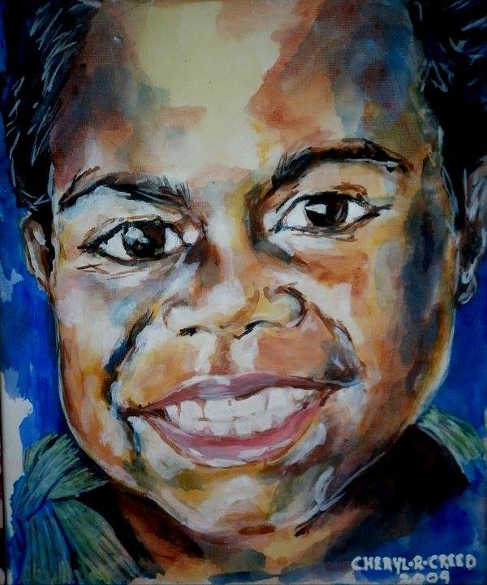
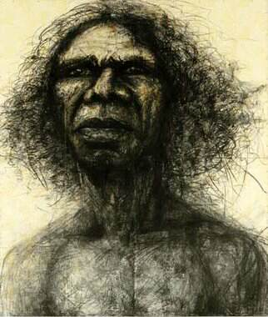
I worked on a series of small portraits of young children and babies; experimenting with colour, applying blues and purples to highlight the dark skin tones of the children. I thought by replacing the natural colour of their skin, using these colours, would highlight the beauty of their dark features. I was very happy with the results, experimenting with colour, as it told its own story. I enjoyed blending these colours together. These children are unidentified, but they are of real people. I did the “Blue series Portraits” in 2004.
Title: Blue Series
Size: 25x15cm
Medium: Acrylic on canvas
(also see pg. 48)
Archibald Prize 2004
David Gulpilil, two worlds
mixed media on wallpaper on board/charcoal and graphite
204 x 240cm
Craig Ruddy

Slide 46
My concern towards non-Indigenous artist portraying Indigenous People/s images, I feel they fail to recognise or connect with our struggle (past & present), our spiritual and physical essence or quantity. We are a vibrant and rich culture, and so are the people, we come with intensity, greatness, integrity, honesty, personality and an intelligence invisible to mainstream folks. We are a people with distinct and diverse cultures, customs and language/s. Like the many colours of the rainbow, we reflect a beauty of physical and biological radiance, this is not seen by the dominate communities, because their take on beauty is only reflective in their own image/s and they see us as the inferior other. They continue to paint us in that unintelligent and primitive imagery portray by early European artist’s It’s upsetting to look at portrait s of my People, painted by many non-Indigenous artists born on Aboriginal Land. Reason being, that I have taken up portraiture, to share the beauty that I so admire about my people

Slide 47
Has Much Changed In The Past 50 Years
Lets just say, Australia still hasn’t learnt enough about their First People/s

