Slide 1
Canadian Indigenous People’s Conceptions of Giftedness:
Perceptions of Elders, Students, Faculty and Staff
Preliminary Findings
Sal Mendaglio, PhD
Jacqueline Ottmann, PhD
University of Calgary

Slide 2
Purpose of the Study
To begin the process of gaining an understanding of the conceptions of giftedness among Canadian indigenous people, which is the first step in our research program aimed at increasing the representation of gifted students who are First Nations, Metis and Inuit (FNMI)

Slide 3
Rationale
Underrepresentation of indigenous students in K-12 gifted education programs.
Primary reason: Use of standardized tests of cognitive ability for selection.
Such tests privilege students of the majority culture;

Slide 4
Method
Participants
Data Collection
Analyses

Slide 5
Participants
Notes: u=student; s=staff; e=elder
Name | Role | Gender | Age | FNM
KVu | Student | Female | 18-25 | FN Cree
CMu | Student | Female | 18-25 | FN Cree & Blackfoot
CCs | Staff | Female | 46-65 | Cree
VBs | Staff | Female | 26-35 | Metis
Yf | Faculty | Female | 46-65 | Metis
LDf | Faculty | Female | 46-65 | FN Cree
RWe | Elder | Male | 46-65 | FN Blackfoot
CEe | Elder | Male | 46-65 | FN Blackfoot
KMe | Elder | Female | 46-65 | FN Cree

Slide 6
Data Collection & Analysis
Questionnaire
Sample questions:
  How is giftedness defined in the FNMI society you belong to? Please include specific FNMI term(s) as well.
  Identify any typical examples of what is considered as giftedness or talent in your culture. Give brief and simple descriptions.
Interview
Thematic Analysis

Slide 7
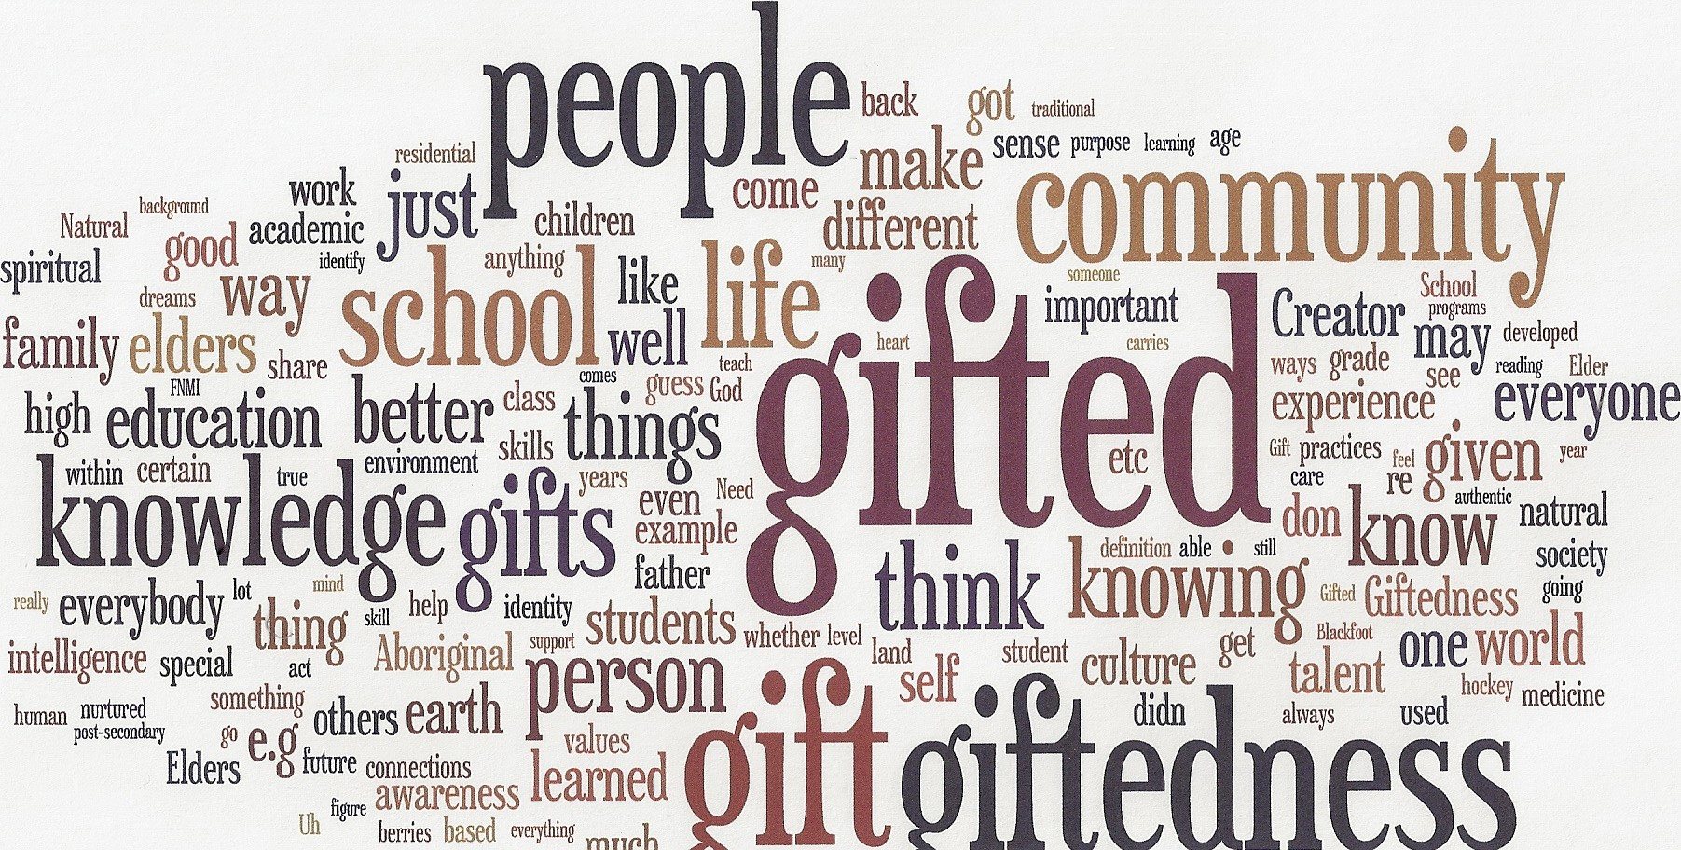

Slide 8
Results: Themes
Theme 1: Everyone has a gift and ‘it’s gifted’ (part of Indigenous language)
  “Everybody has a gift you just have to figure out what it is, and it has to do with their mission here on earth, and I know that”
  “Everybody has a gift, and has own definition of what giftedness is, genetic and the environment contributes, and how you interact with world around you, all develops gift; each person has a life purpose… gifts come from the Creator.”
  “All people are gifted in different ways: spiritual practice, intelligence, medicine, storytelling, hunting…”

Slide 9
Themes
  Theme 2: Gifted by the Creator: innate, spiritual component
  “[A gift is ]God given .., the Creator has blessed you with something. . “
  “gifts are given from the creator so that you may make the world a better place”
  "showing the world what you have been gifted with from the Creator"

Slide 10
Themes
  Theme 3 : It’s an ability or skill, more than intellectual
  “Smart means knowing land, knowing place in world, where you come from, your family and making those connections and acting according with teachings and giftedness – all this gives one strength”
  “. . .what you are exceptional at. So for example being exceptional at knowing the medicinces or knowing the plants that transform into medicine that can cure people or having the gifted of vision in terms of perhaps seeing the past or seeing the future through dreams ‘

Slide 11
Themes
  Theme 4 : Heightened sense of awareness to self, others, environment (interconnectedness between creation, Creator, and cosmos)
  “… a person has knowledge and a greater capacity of what life is all about, and they realize that they don’t have all of [the understanding], but they have a vaster more comprehensive knowledge base of life, so they can share it and teach others…you can’t take gift with you so it’s our responsibility to share it”
  “Our people grew up with the knowledge that our Creator is a kind, loving…”
  “there is a heightened awareness of self, a relationship to the environment, the land, place, for hunting…”
  “I relate to people, can tell things about them without them telling you verbally; I also learn things through dreams”

Slide 12
Themes
Theme 5: Identified by elders and adults in the community
“Elders observe and identify gift, they confirm, affirm”
“people observed children to see what they are able to do, drawn to. Learning about gifts depended on [adults’] knowing children … family dysfunction has challenged this”

Slide 13
Themes
Theme 6: Gift is for the benefit of the community and the individual
“I wouldn’t necessarily think of it from an academic perspective but your ability to assess the needs of your community and act accordingly in the betterment of a collective.”
“[the purpose of a gift is] to help make society a better place. . . .not so that you can make a million dollars . . .there are conditions. . .you have a responsibility”
  “values-oriented, such as humility, respect, compassion, helper, self-starter”

Slide 14
Conclusion
Increasing representation of indigenous students in gifted education programs is challenging, not simply because of the testing issue, but also because of the differences between majority culture’s and indigenous cultures’ conceptions of giftedness: an example of what Leroy Little Bear termed “worldviews colliding”.
Based on the themes, what definition of giftedness would you propose?

