Slide 1
Closing the Gap in mental health outcomes: Do socioeconomic conditions matter?
Carrington Shepherd
March 2014

Slide 2
Overview
Background
Aims
Methods
Ethics
Results
Discussion

Slide 3
Note
In this talk … ‘Aboriginal’ is used to refer to Aboriginal and Torres Strait Islander peoples

Slide 4
Background
Socioeconomic status (SES) a powerful predictor of health inequalities
Population health follows a social gradient … almost always!
Is this pattern found in Indigenous populations? [Anderson (2007); Morrissey (2003); Anderson, Baum & Bentley (2007); Carson et al. (2007)]

Slide 5
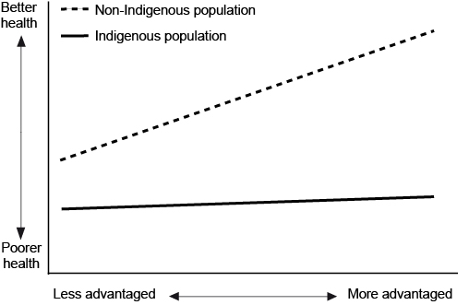
Background Why is this important?

Slide 6
Background Australian and international evidence
Dearth of research on this topic
A less universal and less consistent social patterning of health among Indigenous Australians - Why!?
-----------
Shepherd, C.C.J., J. Li, and S.R. Zubrick, Social gradients in the health of Indigenous Australians.
American Journal of Public Health. 2012, 102(1):107-117.

Slide 7
Background My earlier empirical work
There are significant socioeconomic disparities in the physical health outcomes of Indigenous children in WA
The direction, shape and magnitude of these socioeconomic disparities varies considerably, by both socioeconomic measure and health outcome
Area-level (neighbourhood/community) SES indicators exhibit the strongest and most consistent gradients
-----------
Shepherd, C.C.J., J. Li, and S.R. Zubrick, Socioeconomic disparities in physical health
Among Aboriginal and Torres Strait Islander children in Western Australia. Ethnicity &
Health. 2012:1-23.

Slide 8
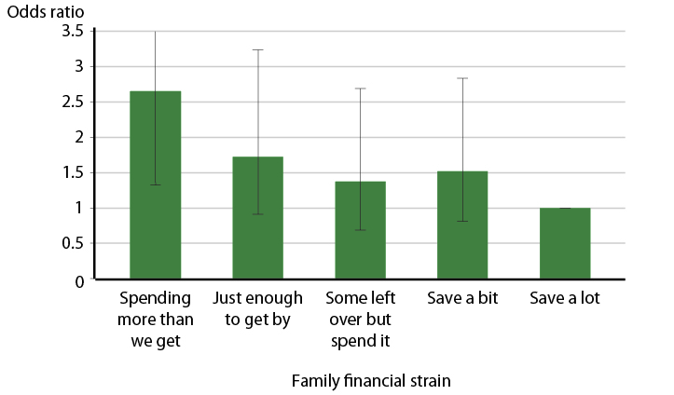
Background My earlier empirical work
Relative odds of recurring chest infections

Slide 9
What are the patterns for mental health?

Slide 10
Aims
Provide insights into the nature of the relationship between SES and health among Australian Aboriginal peoples
Focus on mental health outcomes of Aboriginal children in Western Australia
Western Australian Aboriginal Child Health Survey (2000-2002)
– 5,289 Aboriginal children aged 0-17 years
Outcome – Risk of clinically significant emotional or behavioural difficulties (CSEBD)

Slide 11
Methods
6 SES constructs (7 variables)
educational attainment of primary carer
occupational class – highest among carers
family financial strain
housing tenure
housing quality
neighbourhood/community disadvantage – SEIFA – Biddle’s Index of Relative Indigenous Socioeconomic Outcomes (IRISEO)

Slide 12
Methods
Multivariate logistic regression models, within a multi-level framework – producing odds ratios
Analytic approach: – bivariate, adjusting for confounders (examine “total effect”) – multivariate, adjusting for a range of relevant covariates, iteratively

Slide 13
Ethics
Western Australian Aboriginal Health Information and Ethics Committee (WAAHIEC)
Endorsed by the Aboriginal Collaborative Council Advising Research and Evaluation (ACCARE) at the Telethon Institute for Child Health Research
Curtin University’s Human Research Ethics Committee

Slide 14
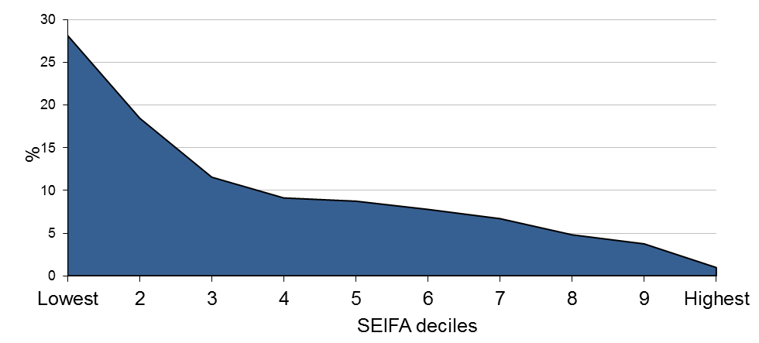
[Context of] Results Broadly speaking…
24% of Aboriginal children was at high risk of CSEBD
Largely distributed in the more disadvantaged categories of most measures of SES

Slide 15
Results Broadly speaking…
There are significant socioeconomic disparities in the mental health of Indigenous children in WA
Higher SES associated with reduced risk of mental health problems
Pattern not always linear

Slide 16
Results Disparities & patterns
Housing quality and tenure and neighbourhood-level disadvantage all have a strong association with child mental health

Slide 17
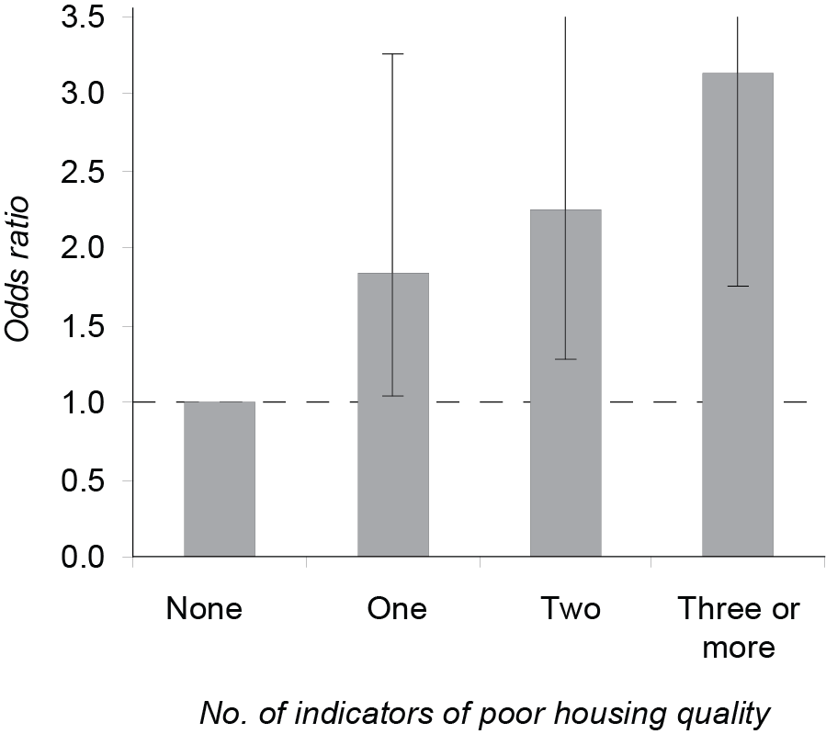
Results Disparities & patterns
Odds of high risk CSEBD by number of indicators of housing quality

Slide 18
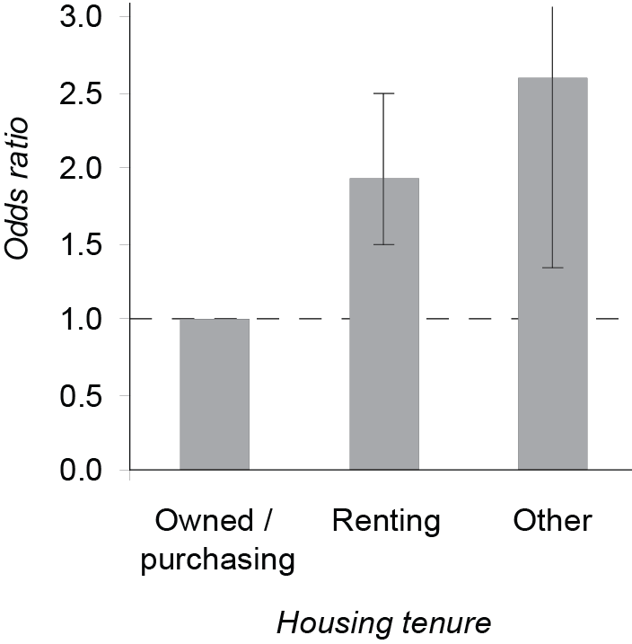
Results Disparities & patterns
Odds of high risk CSEBD by housing tenure

Slide 19
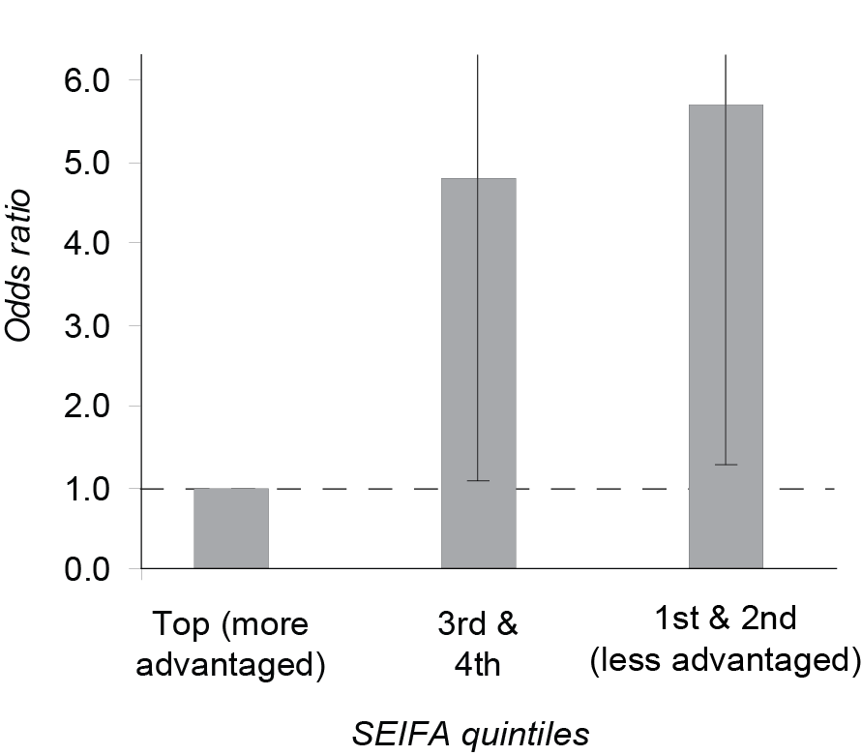
Results Disparities & patterns
Odds of high risk CSEBD by SEIFA

Slide 20
The lifting power of education?
Lack of clear evidence of a relationship between primary carer education and child health

Slide 21
Some explanatory mechanisms?
The circumstances of Aboriginal families (stress, racism, family functioning, etc.) is an important explanatory mechanism underpinning the relationship between child mental health and material wellbeing (carer employment status and family financial circumstances)

Slide 22
Results
Odds of high risk CSEBD by occupation and family financial strain
Socioeconomic measure | Step 1. Adjust for age, sex & location | Step 2. Also adjust for child’s health | Step 3. Also adjust for health of carer | Step 4. Also adjust for family circumstances
Occupation– Managers/professionals Tradespersons, clerical workers and labourers Not employed | 1.10 1.00 ***1.94
Family financial strain Can save a lot Can save a bit Some left over but spend it Just enough to get by Spending more than we get | 1.00 *1.75 1.61 **1.79 ***2.70
*p < 0.1; **p < 0.05; ***p < 0.01; p values are calculated using chi-square tests adjusted
for the complex sample design

Slide 23
Results
Odds of high risk CSEBD by occupation and family financial strain
Socioeconomic measure | Step 1. Adjust for age, sex & location | Step 2. Also adjust for child’s health | Step 3. Also adjust for health of carer | Step 4. Also adjust for family circumstances
Occupation– Managers/professionals Tradespersons, clerical workers and labourers Not employed | 1.10 1.00 ***1.94 | 1.08 1.00 ***1.91
Family financial strain Can save a lot Can save a bit Some left over but spend it Just enough to get by Spending more than we get | 1.00 *1.75 1.61 **1.79 ***2.70 | 1.00 **1.86 *1.72 **1.89 ***2.72
*p < 0.1; **p < 0.05; ***p < 0.01; p values are calculated using chi-square tests adjusted
for the complex sample design

Slide 24
Results
Odds of high risk CSEBD by occupation and family financial strain
Socioeconomic measure | Step 1. Adjust for age, sex & location | Step 2. Also adjust for child’s health | Step 3. Also adjust for health of carer | Step 4. Also adjust for family circumstances
Occupation– Managers/professionals Tradespersons, clerical workers and labourers Not employed | 1.10 1.00 ***1.94 | 1.08 1.00 ***1.91 | 1.07 1.00 **1.64
Family financial strain Can save a lot Can save a bit Some left over but spend it Just enough to get by Spending more than we get | 1.00 *1.75 1.61 **1.79 ***2.70 | 1.00 **1.86 *1.72 **1.89 ***2.72 | 1.00 **1.95 *1.80 **1.90 ***2.54
*p < 0.1; **p < 0.05; ***p < 0.01; p values are calculated using chi-square tests adjusted
for the complex sample design

Slide 25
Results
Odds of high risk CSEBD by occupation and family financial strain
Socioeconomic measure | Step 1. Adjust for age, sex & location | Step 2. Also adjust for child’s health | Step 3. Also adjust for health of carer | Step 4. Also adjust for family circumstances
Occupation– Managers/professionals Tradespersons, clerical workers and labourers Not employed | 1.10 1.00 ***1.94 | 1.08 1.00 ***1.91 | 1.07 1.00 **1.64 | 0.96 1.00 1.17
Family financial strain Can save a lot Can save a bit Some left over but spend it Just enough to get by Spending more than we get | 1.00 *1.75 1.61 **1.79 ***2.70 | 1.00 **1.86 *1.72 **1.89 ***2.72 | 1.00 **1.95 *1.80 **1.90 ***2.54 | 1.00 1.56 1.25 1.23 1.34
*p < 0.1; **p < 0.05; ***p < 0.01; p values are calculated using chi-square tests adjusted
for the complex sample design

Slide 26
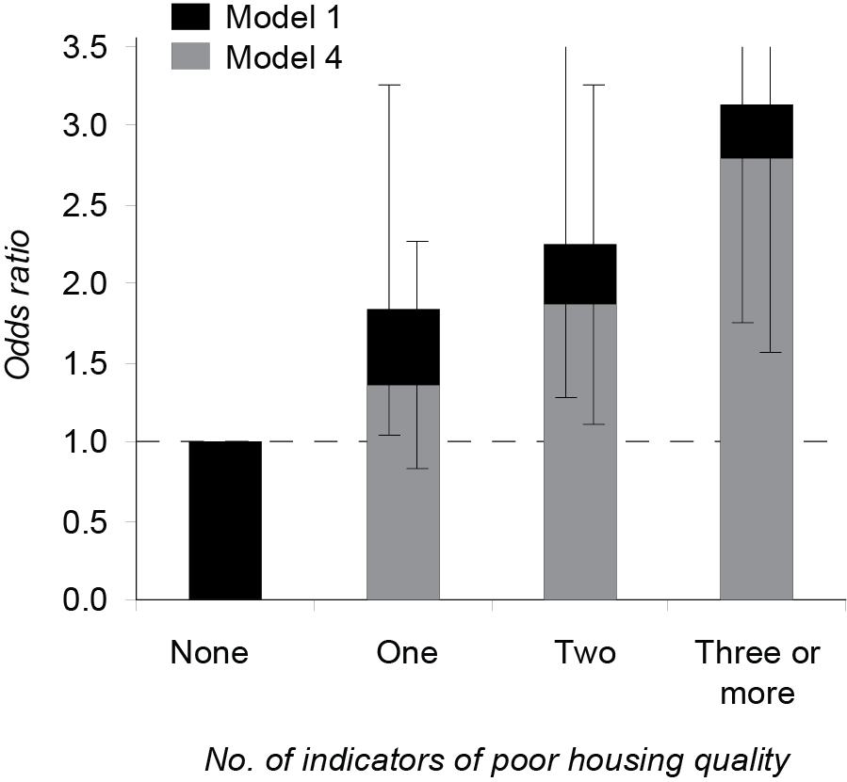
Results
Housing tenure, housing quality and SEIFA
… continue to be strongly associated with Aboriginal child mental health after adjusting for the full range of relevant covariates available from the dataset

Slide 27
Discussion
Incremental evidence of a social gradient in the mental health of Aboriginal children
Improving the social, economic and psychological conditions of Aboriginal families has considerable potential to reduce the mental health inequalities within Aboriginal populations – and, in turn, to close the substantial racial gap in mental health
Interventions that target housing quality, home ownership and neighbourhood-level disadvantage are likely to be particularly beneficial

Slide 28
Do socioeconomic conditions matter to the mental health of Aboriginal children?

Slide 29
Acknowledgements
Jianghong Li
Stephen Zubrick
Francis Mitrou
David Lawrence
CHIRI - Centre for Population Health Research (CPHR)

