Slide 1
Aboriginal Task Force History Project
Australia’s First Program Dedicated to Transitioning Aboriginal and Torres Strait Islander Peoples into University Education

Slide 2
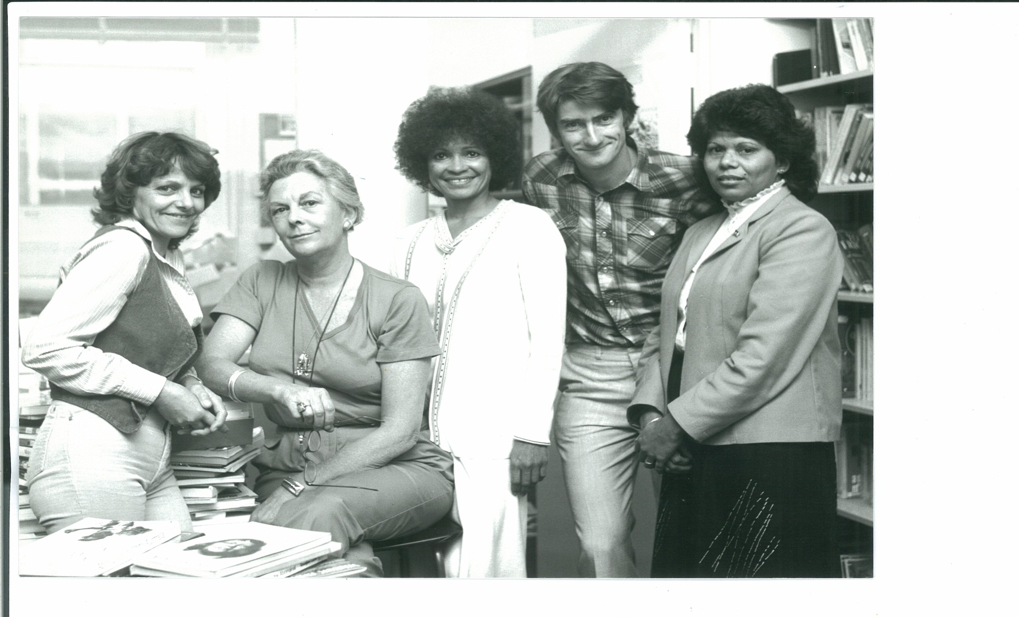
EARLY STAFF L-R: Margaret Wilson, Rosemary Burden, MaryAnn Bin-Sallik, Alan Barnes, Josie Pickett

Slide 3
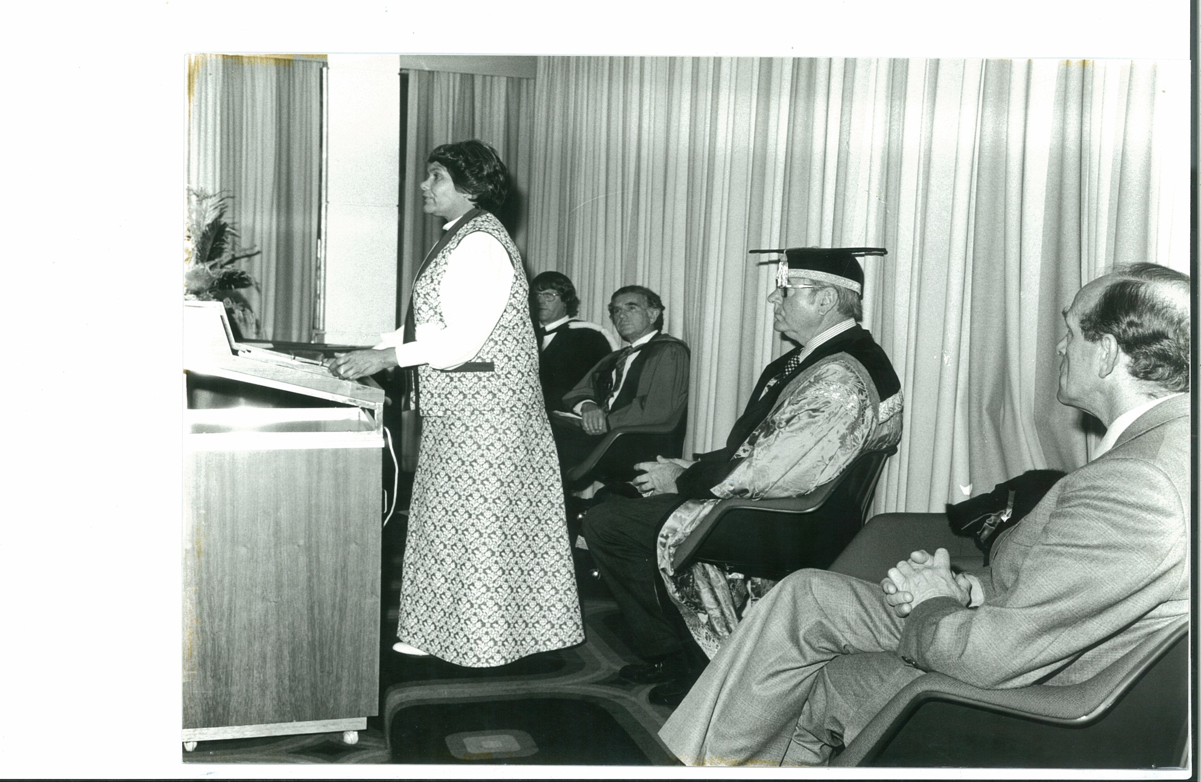
ADVISORY BOARD Professor Paul Hughes (Chair), Dr Mona Ngitji Ngitji Tur, George Tongerie AM, John Moriarty AM, Val Power, Muriel van der Byl and Professor Lowitja O’Donoghue

Slide 4
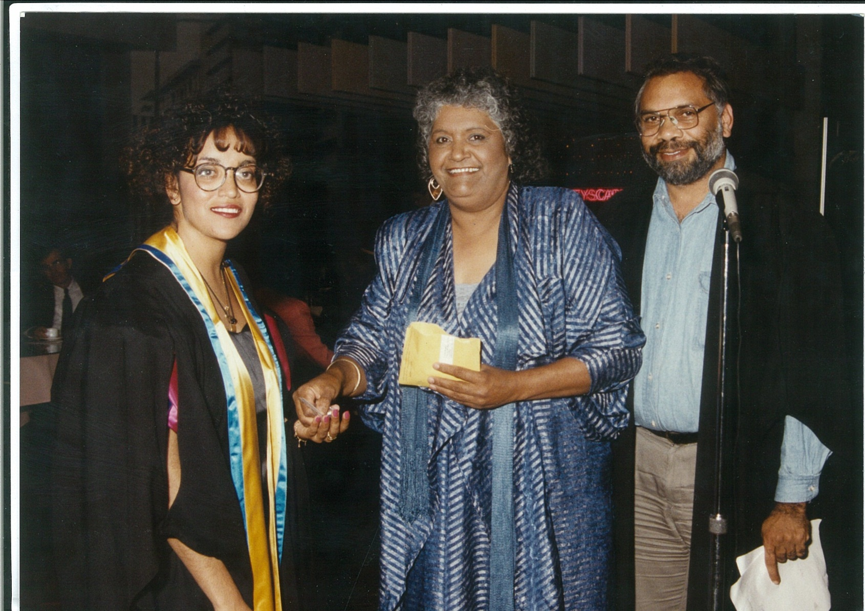
Muriel van der Byl, Ribnga Green

Slide 5
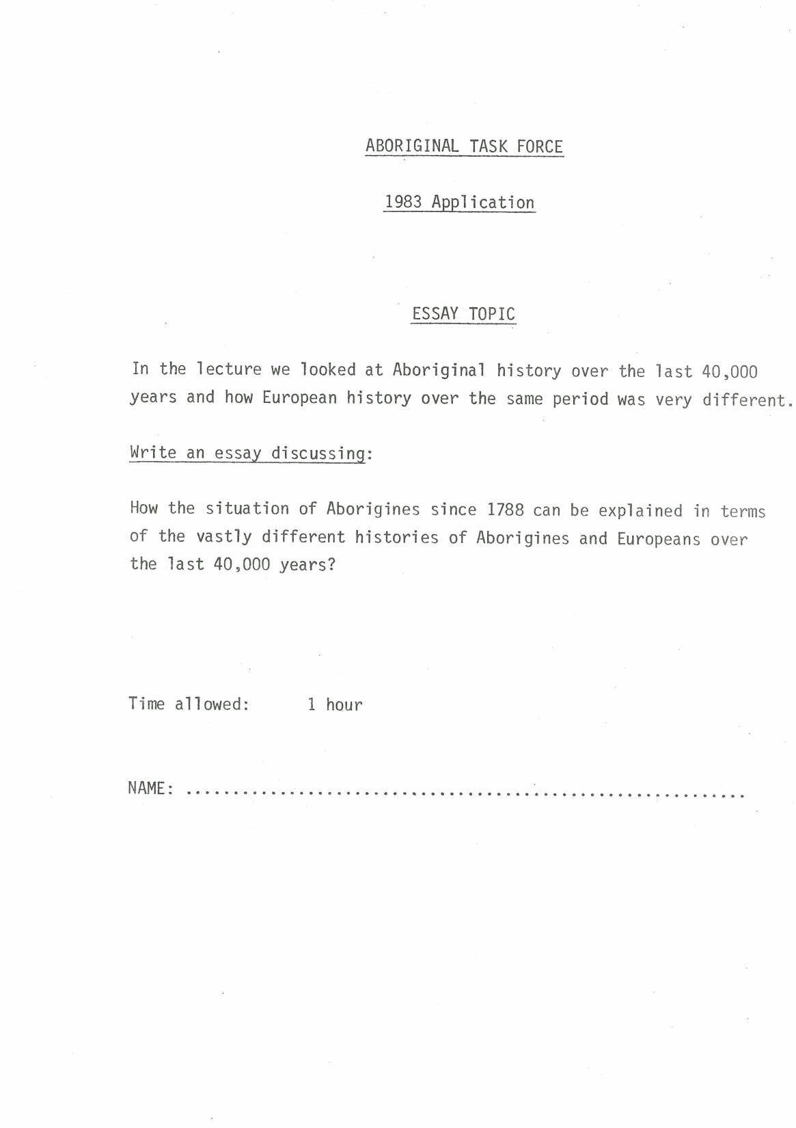

Slide 6
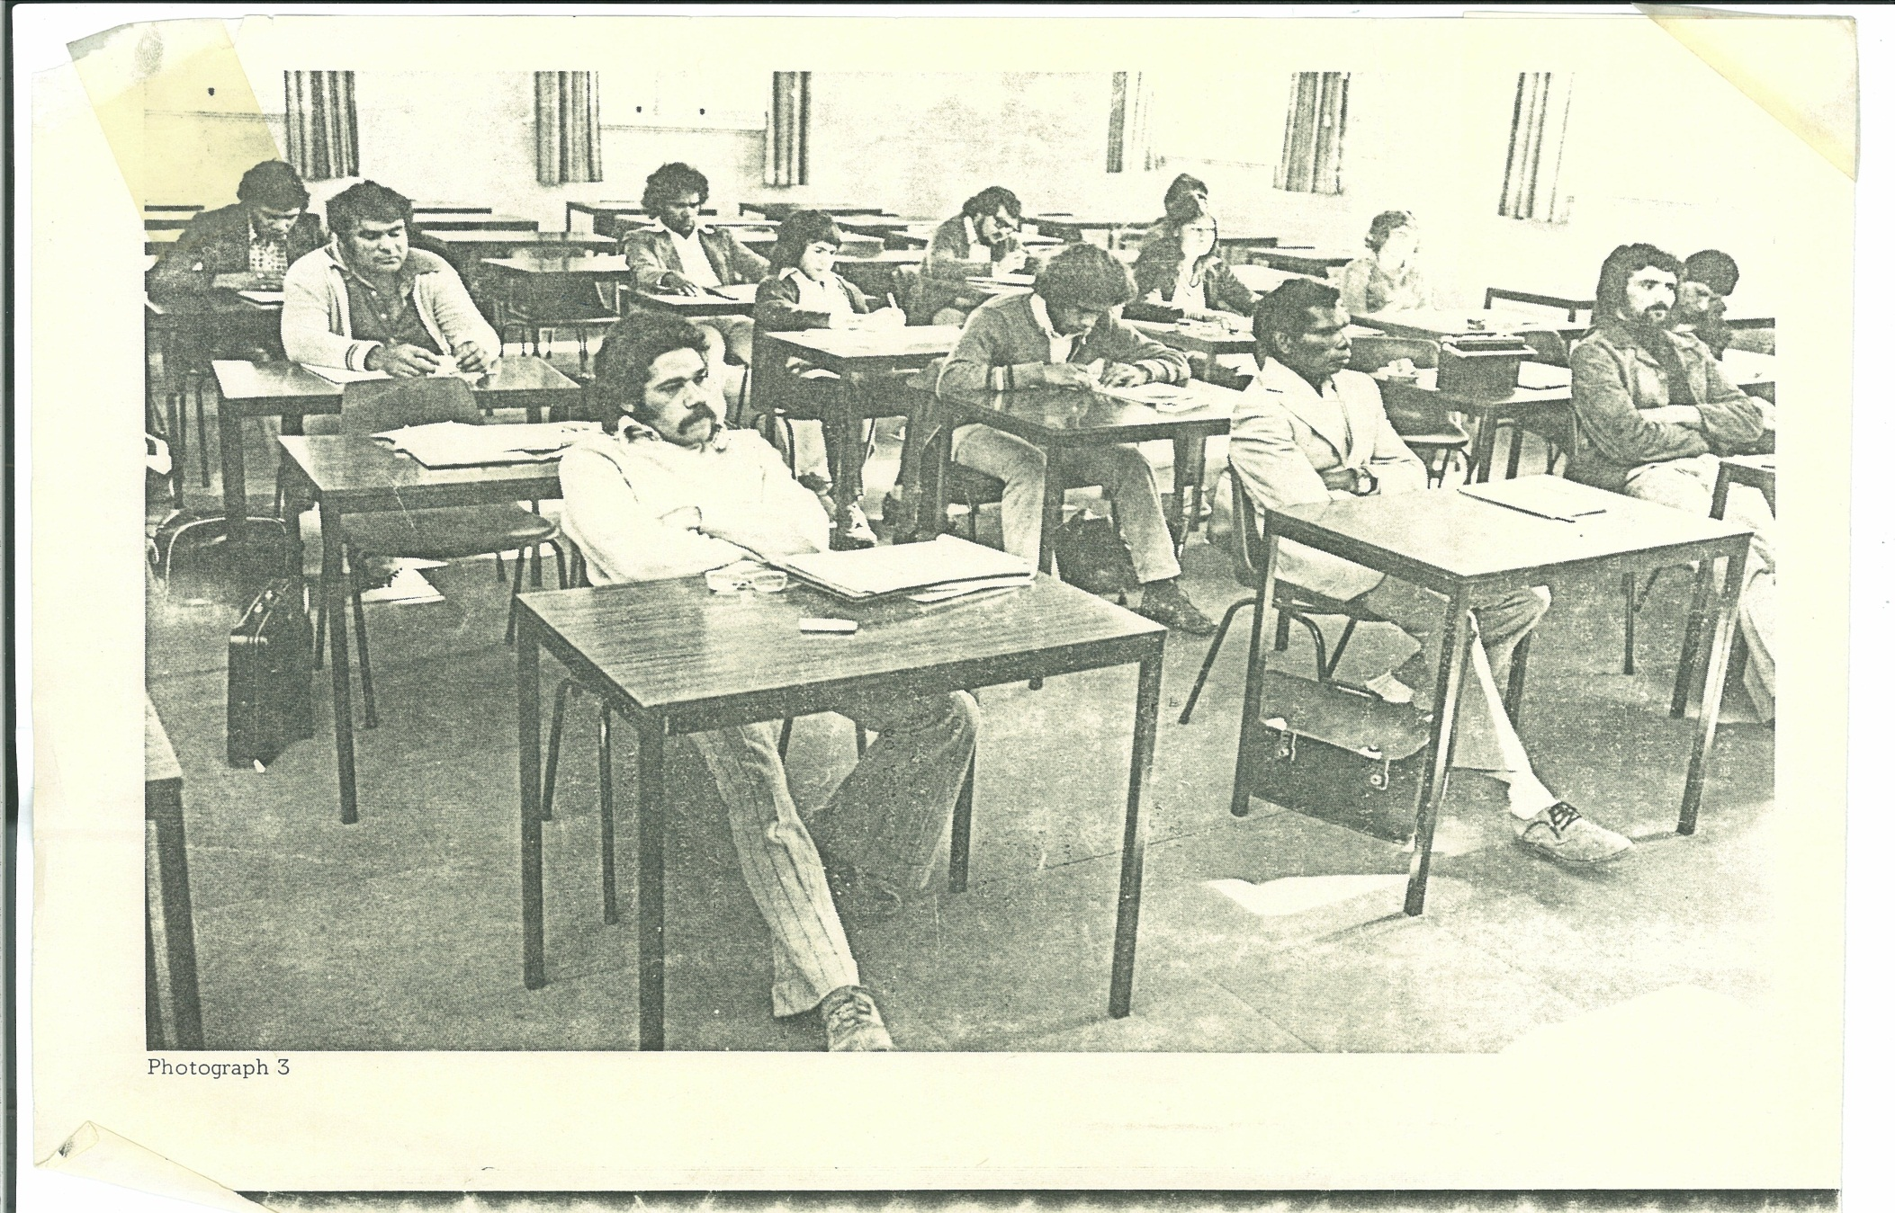
Second intake – 1974/5

Slide 7
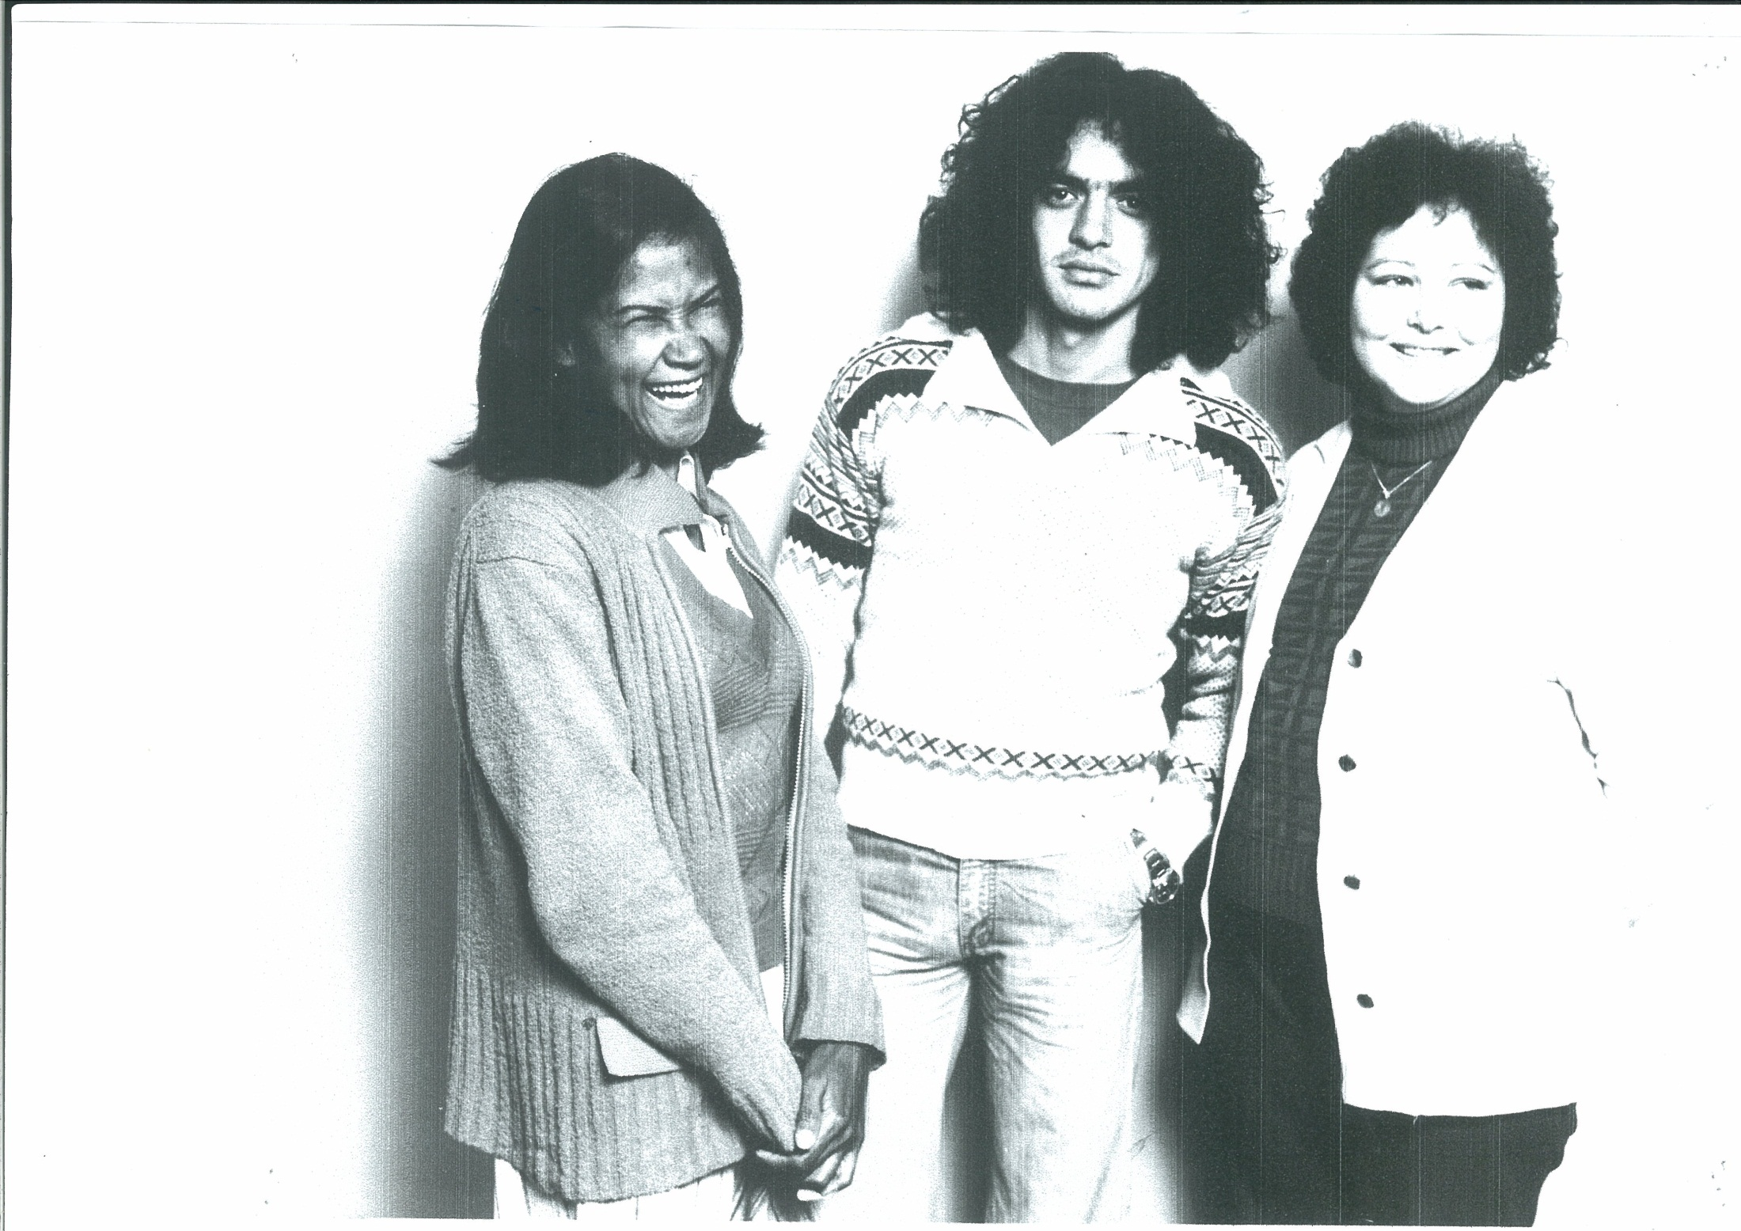

Slide 8
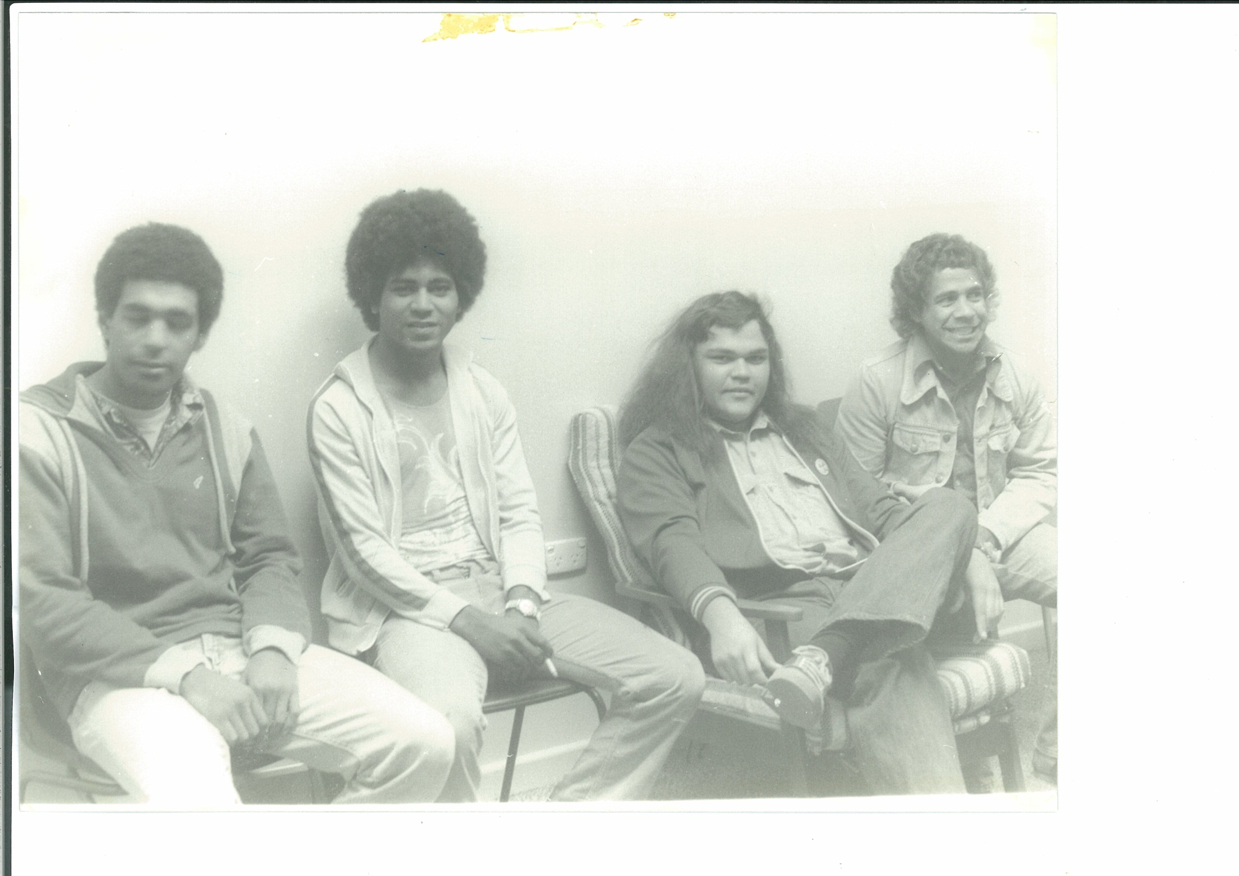

Slide 9
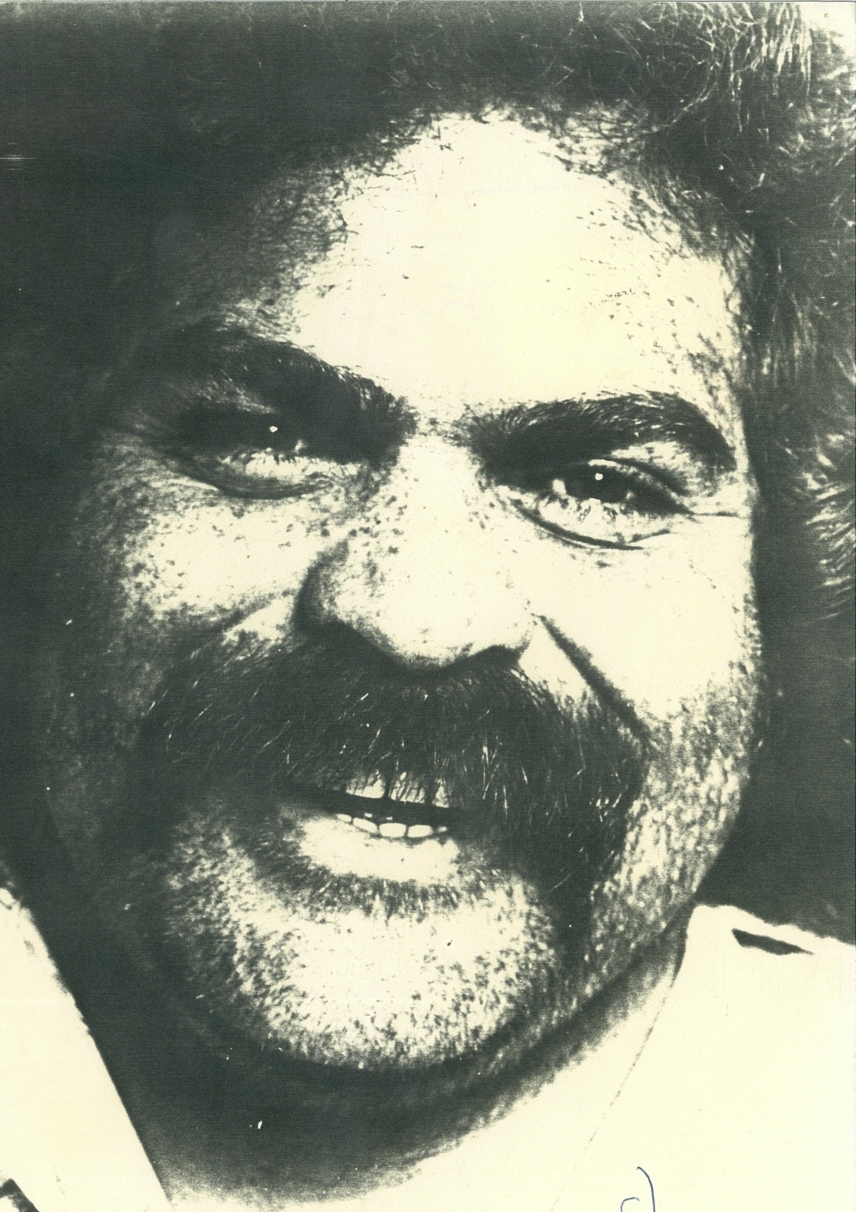

Slide 10
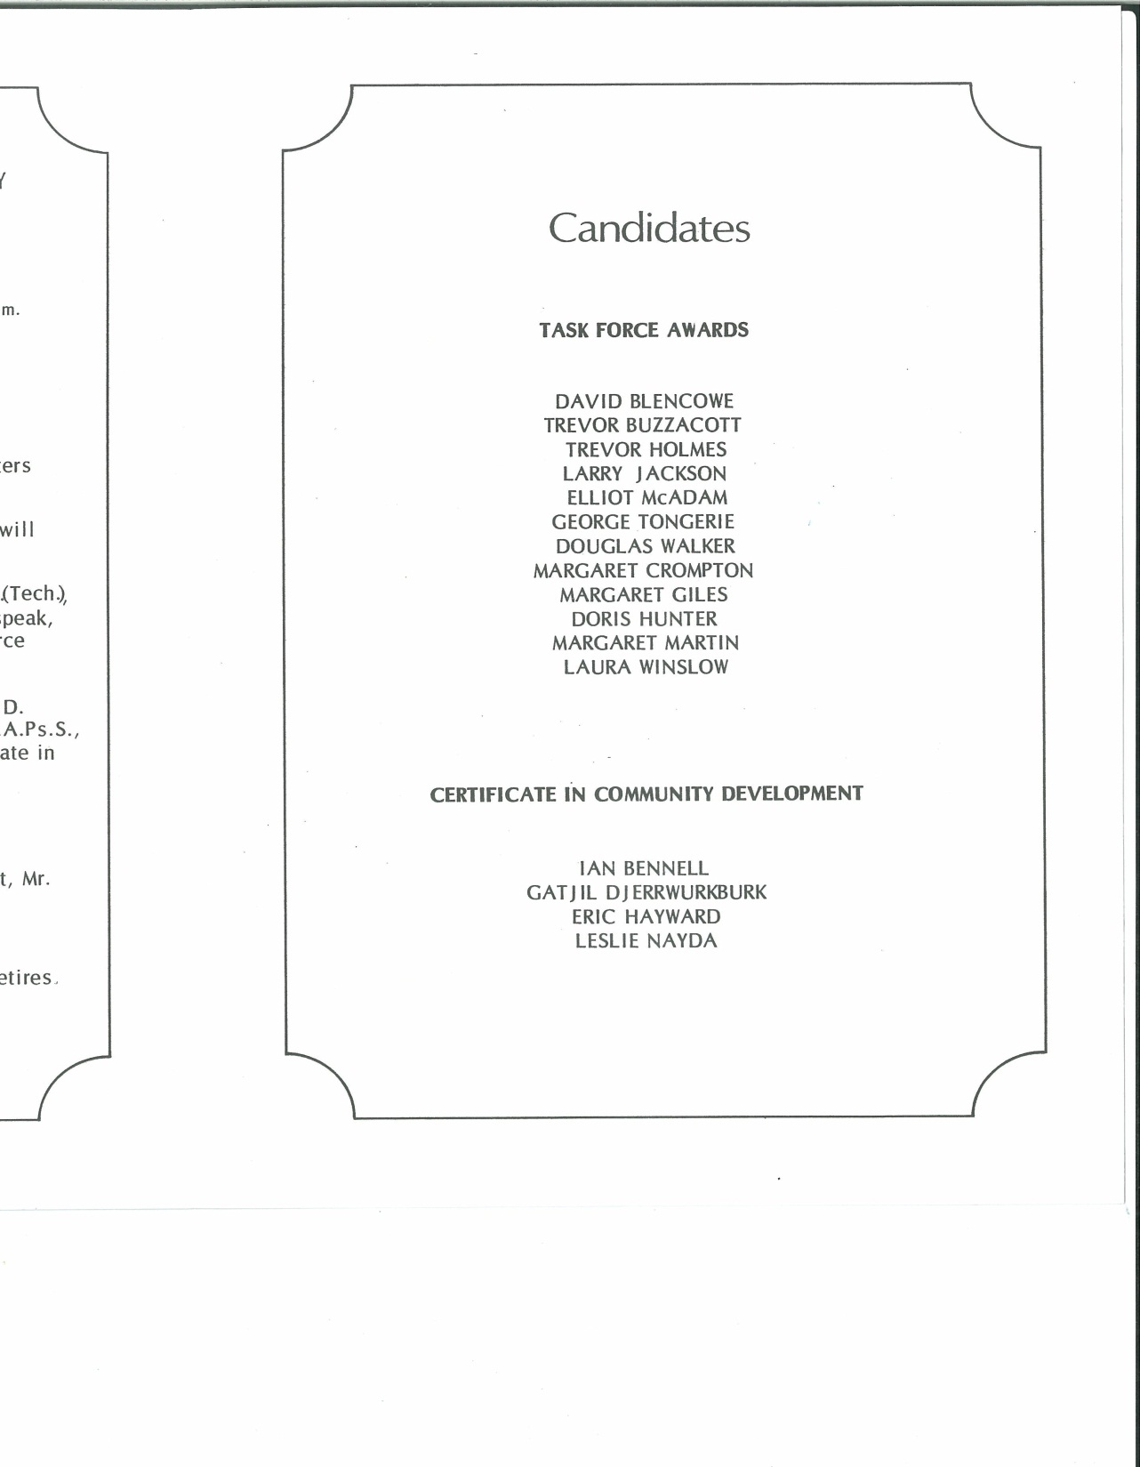
1973/4 Graduates
First Graduation Ceremony

Slide 11
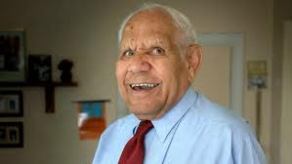
The late George Tongerie
A remarkably happy and positive man

Slide 12
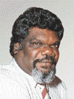
The late Gatjil Djerrkura OAM
ATSIC Chair
1996 - 2000

Slide 13
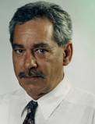
Elliot McAdam

Slide 14
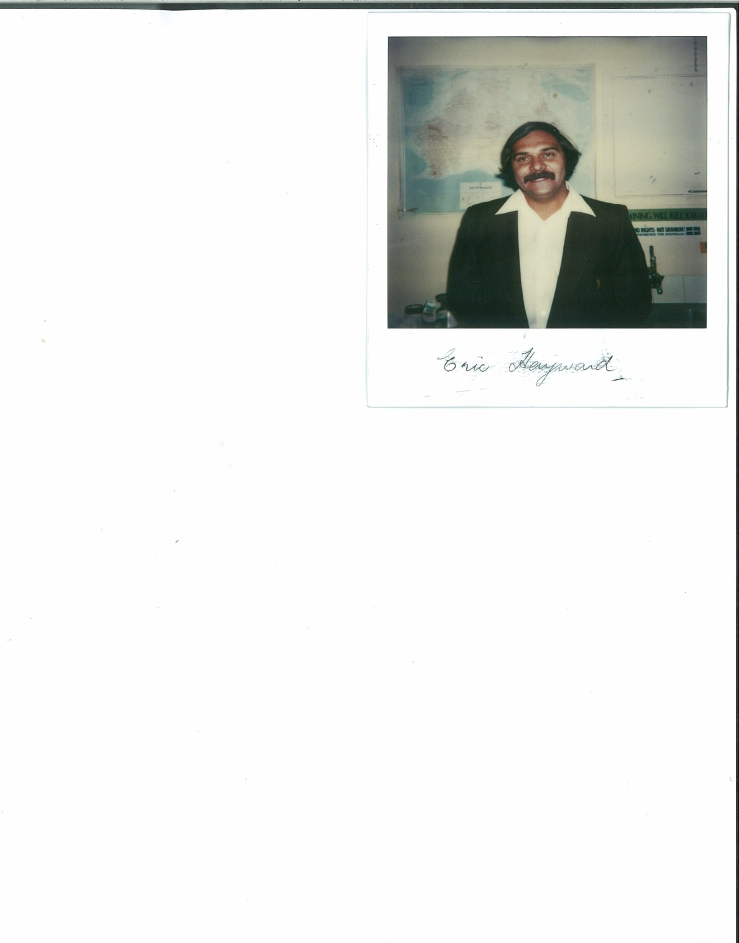
Eric Hayward

Slide 15
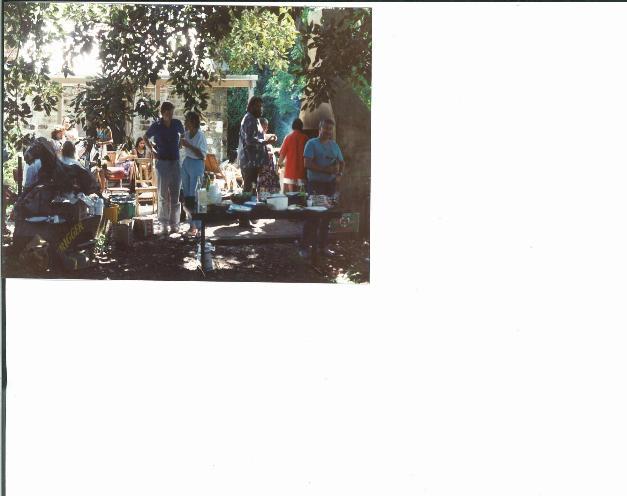
Barbecues

Slide 16
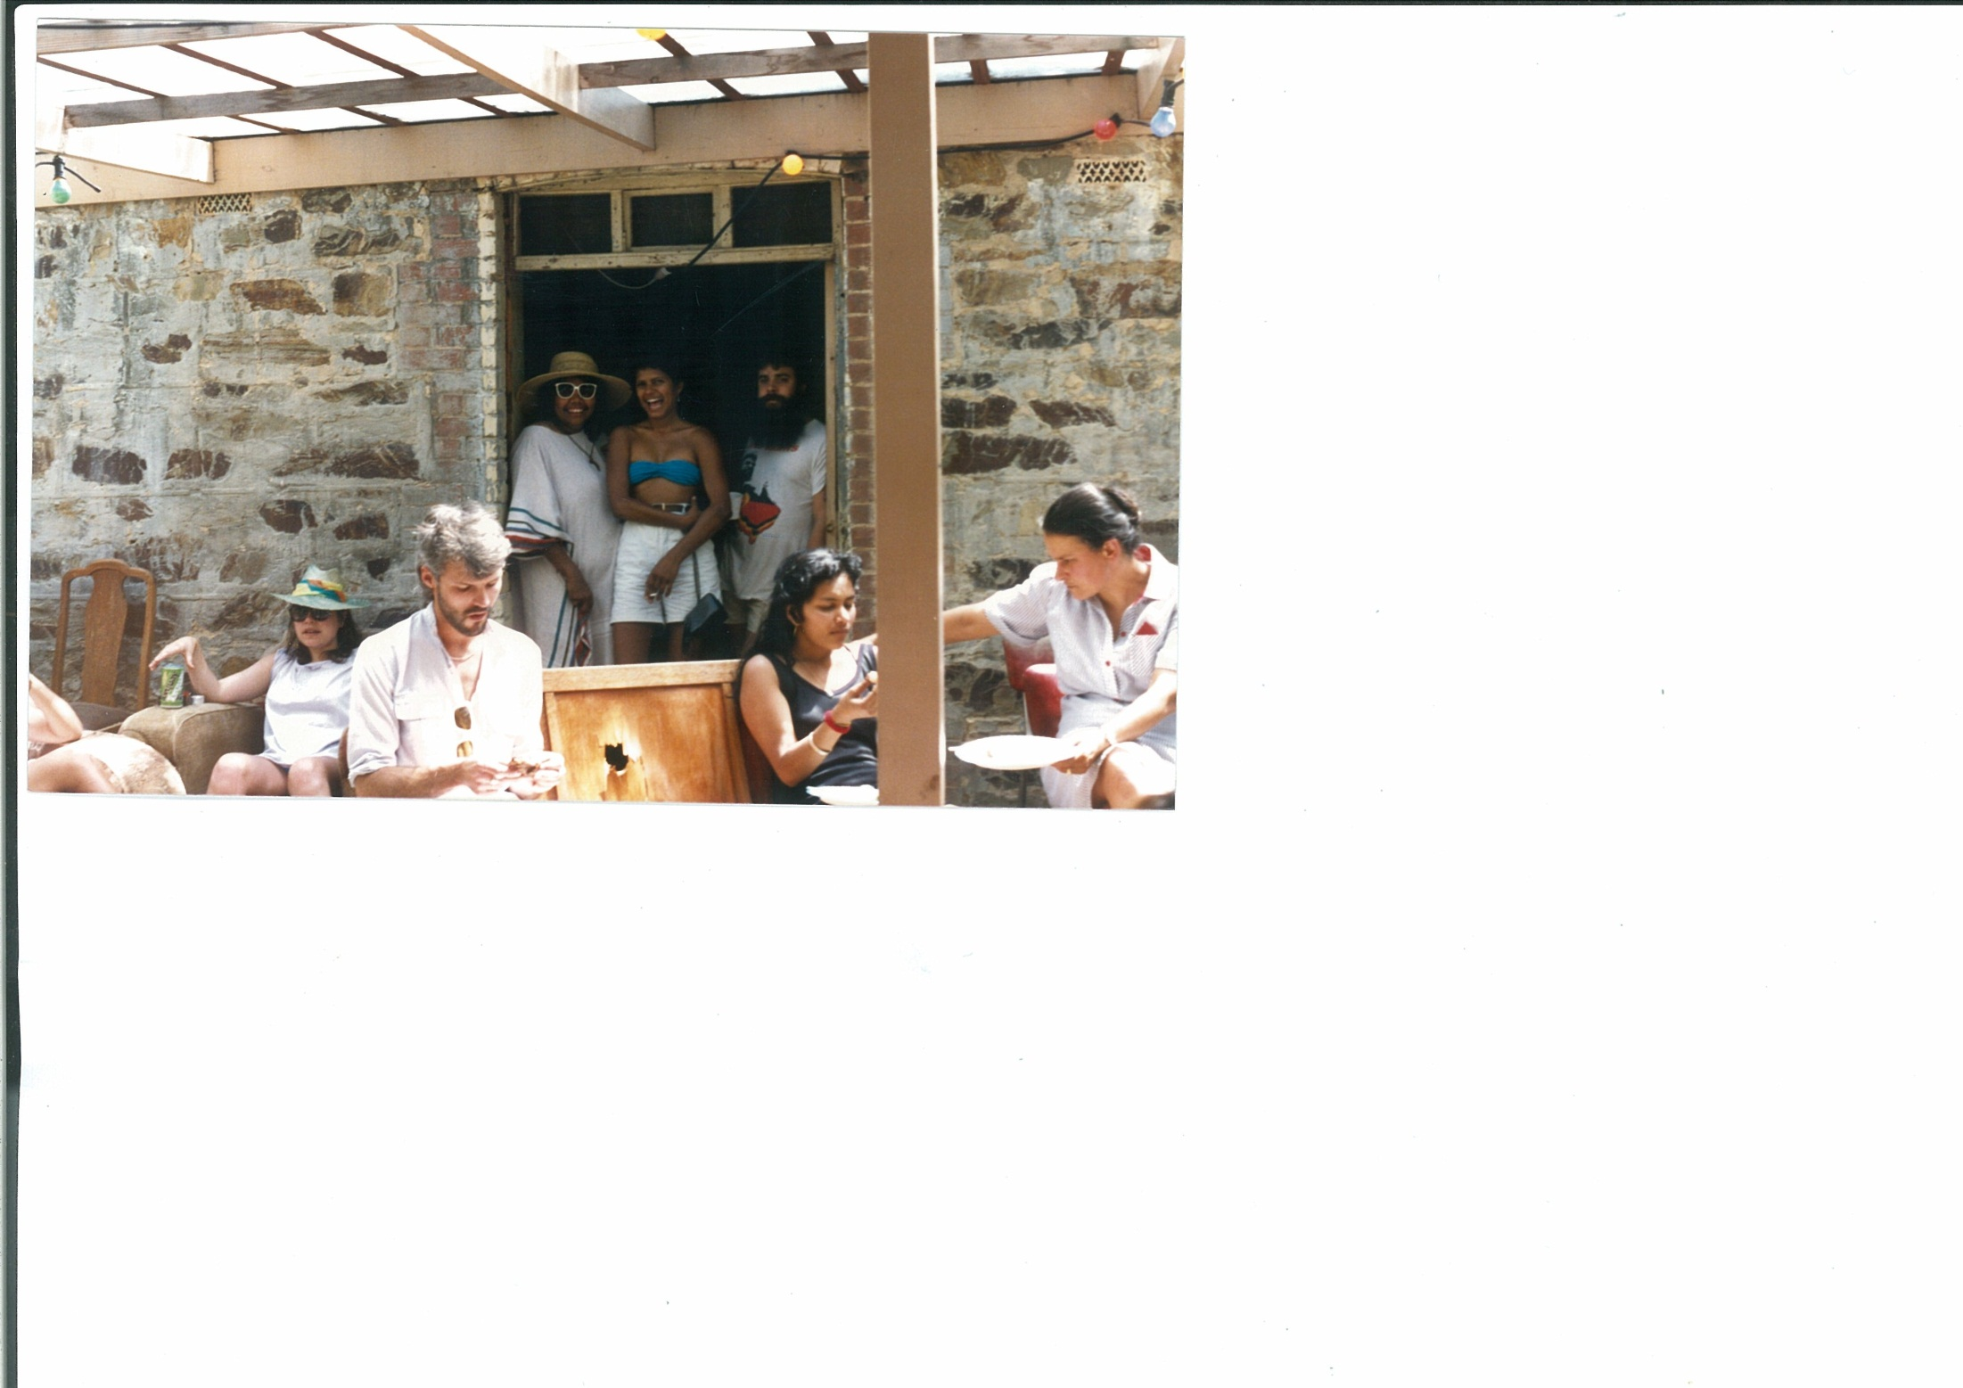

Slide 17
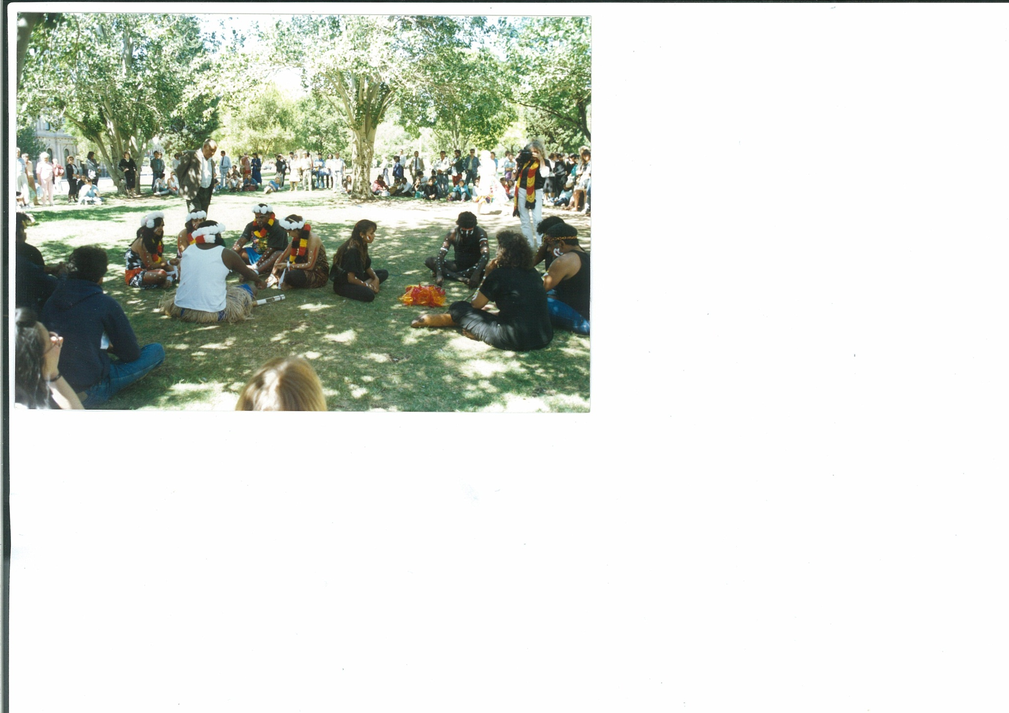
Cultural events

Slide 18
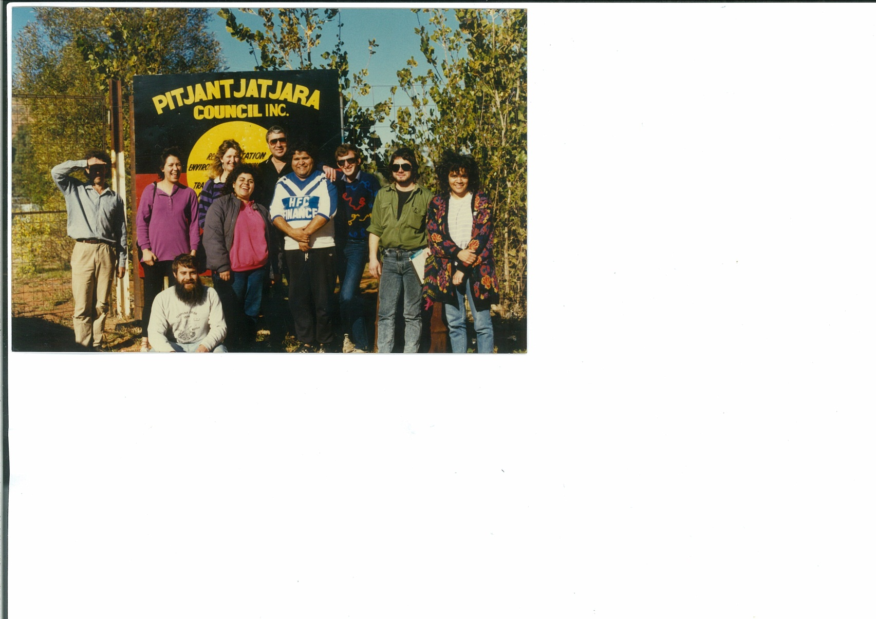
Field trips

Slide 19
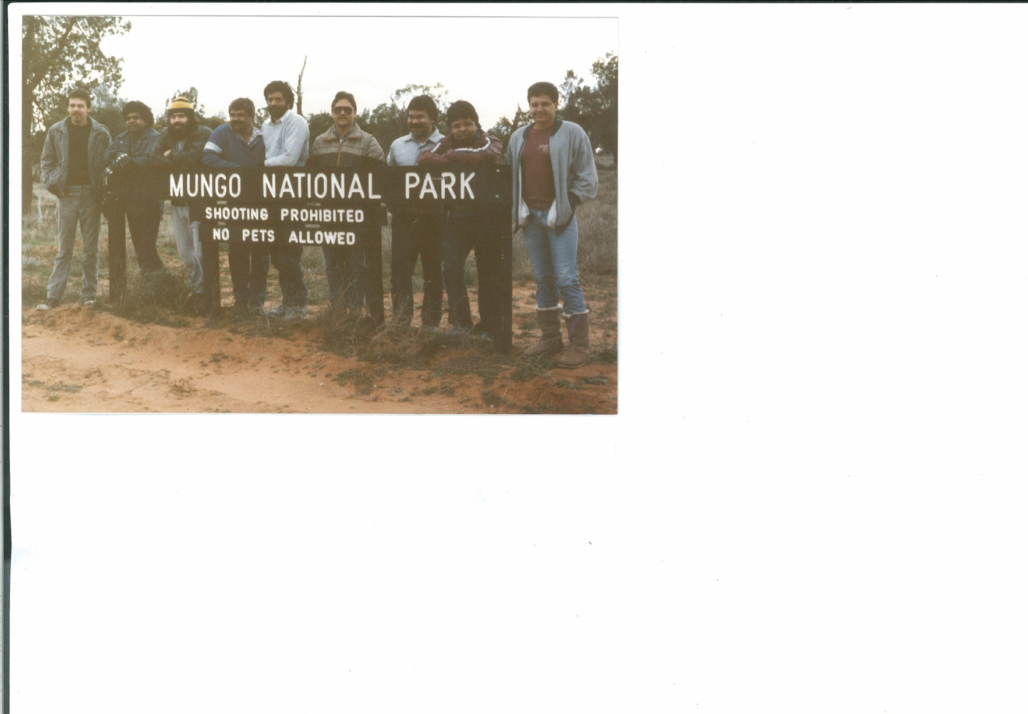

Slide 20
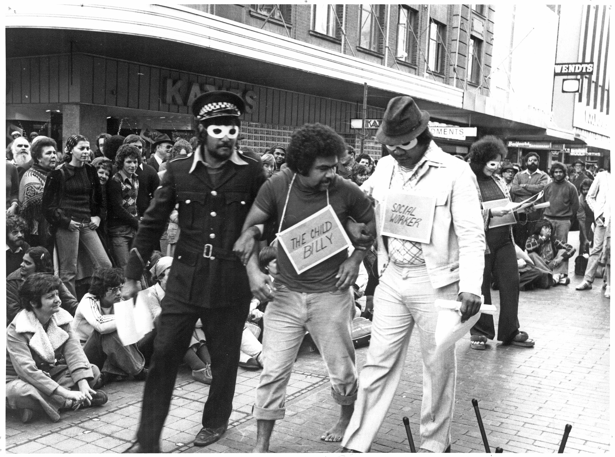

Slide 21
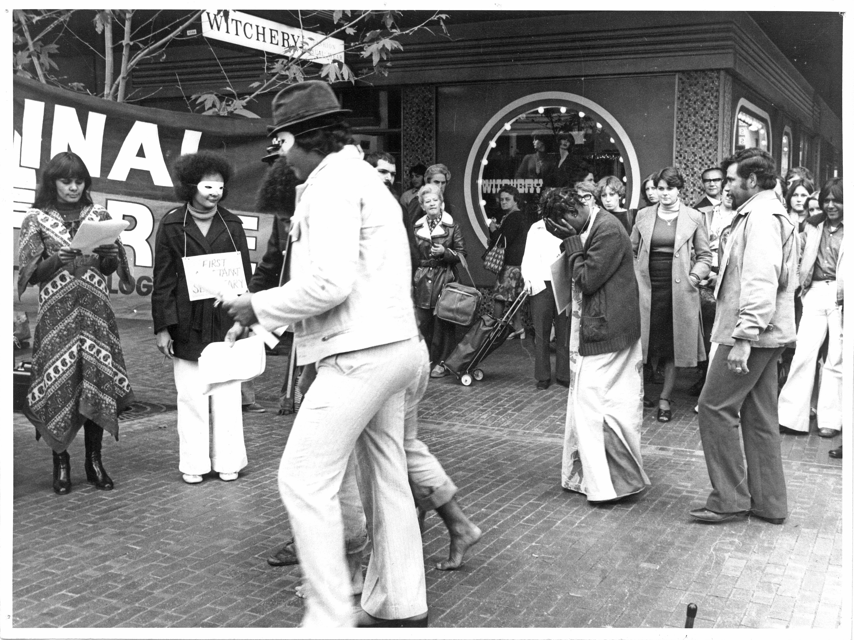

Slide 22
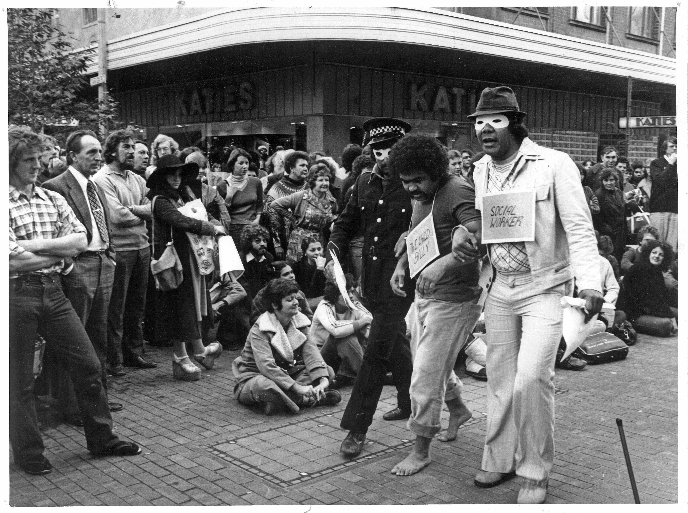

Slide 23
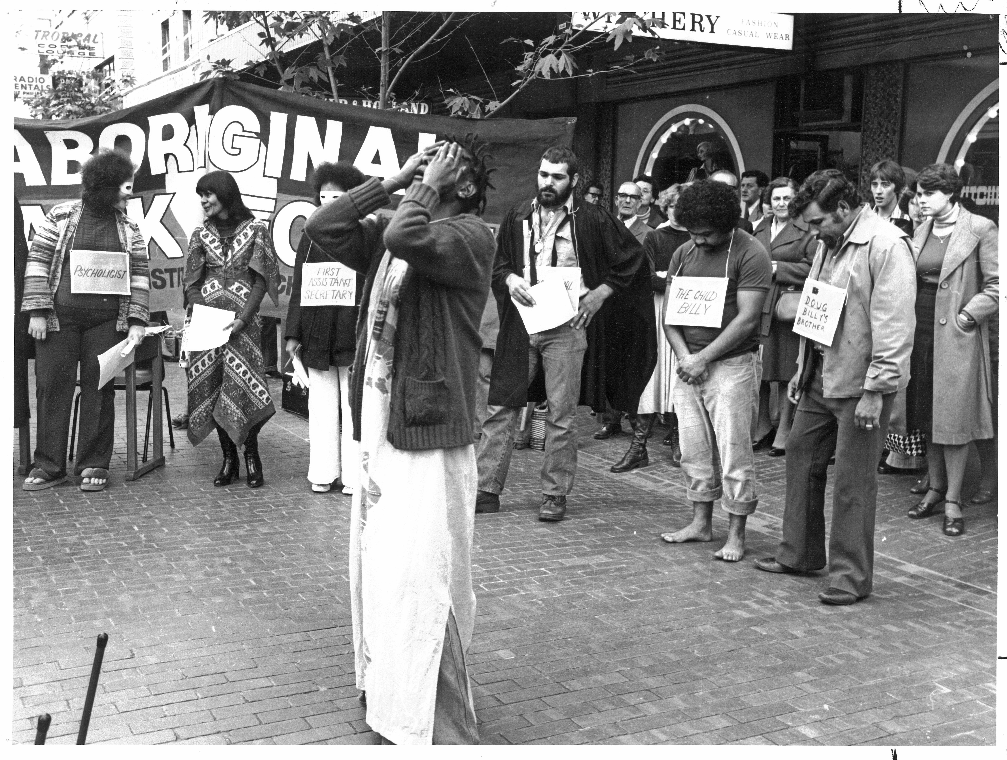

Slide 24
Ivy Trevallyan (nee Aragu)

Slide 25
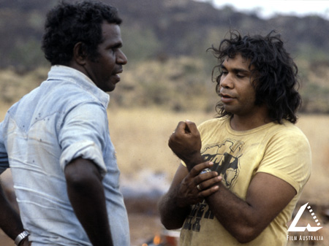
On Sacred Ground 1980

Slide 26
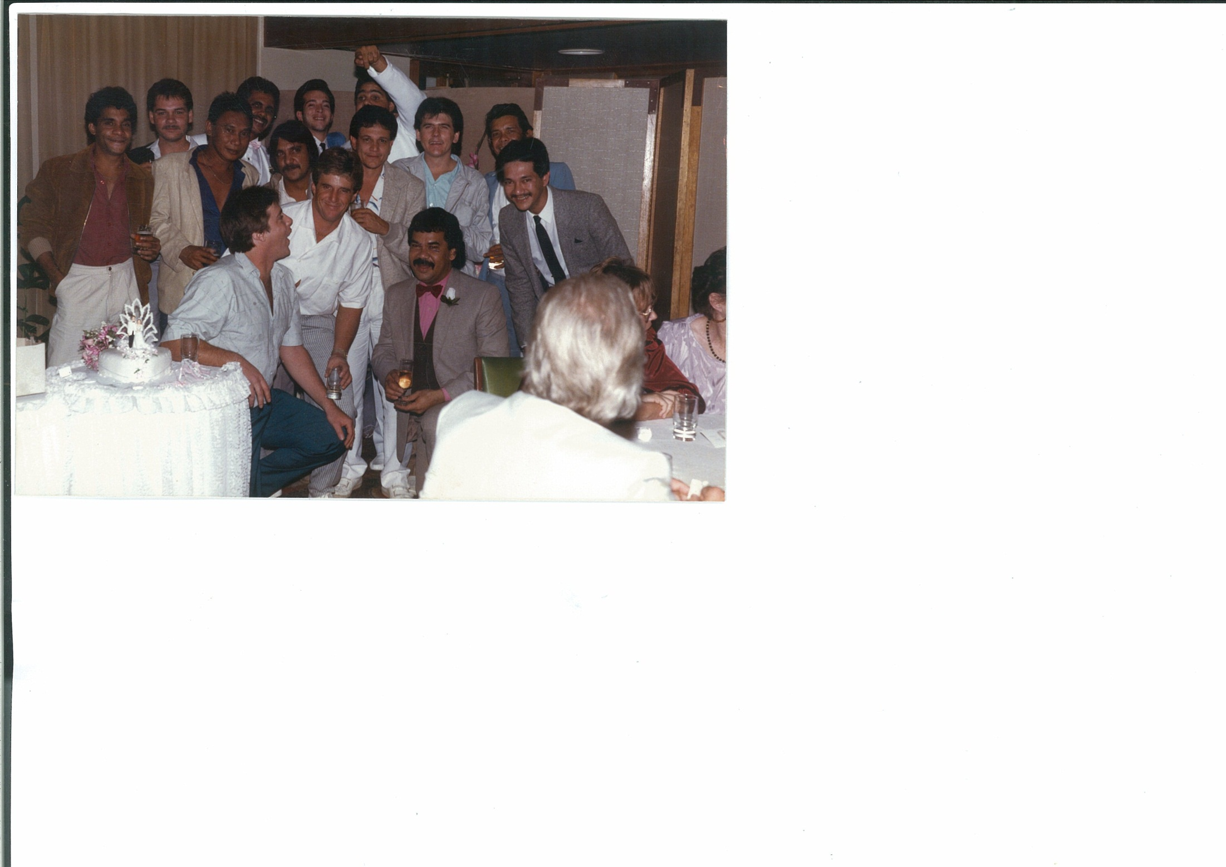

Slide 27
Dr Charles Perkins speaking at the Aboriginal Task Force Tenth Anniversary Conference, Adelaide 1983 (L-R: Daryl Kickett, Dr Wayne Atkinson, Professor MaryAnn Bin-Sallik, Dr Charles Perkins)

Slide 28
The first Aboriginal people to gain an accredited tertiary qualification - 1975 graduates
From left:
Front:
Edmund Wanganeen,
Wayne Atkinson, Joyce Trust, Freda Glynn (Thornton), Cyril Archer,
Andrew Wilson.
Back:
Kevin Dann, Ian Trust, Laurence Poland.

Slide 29
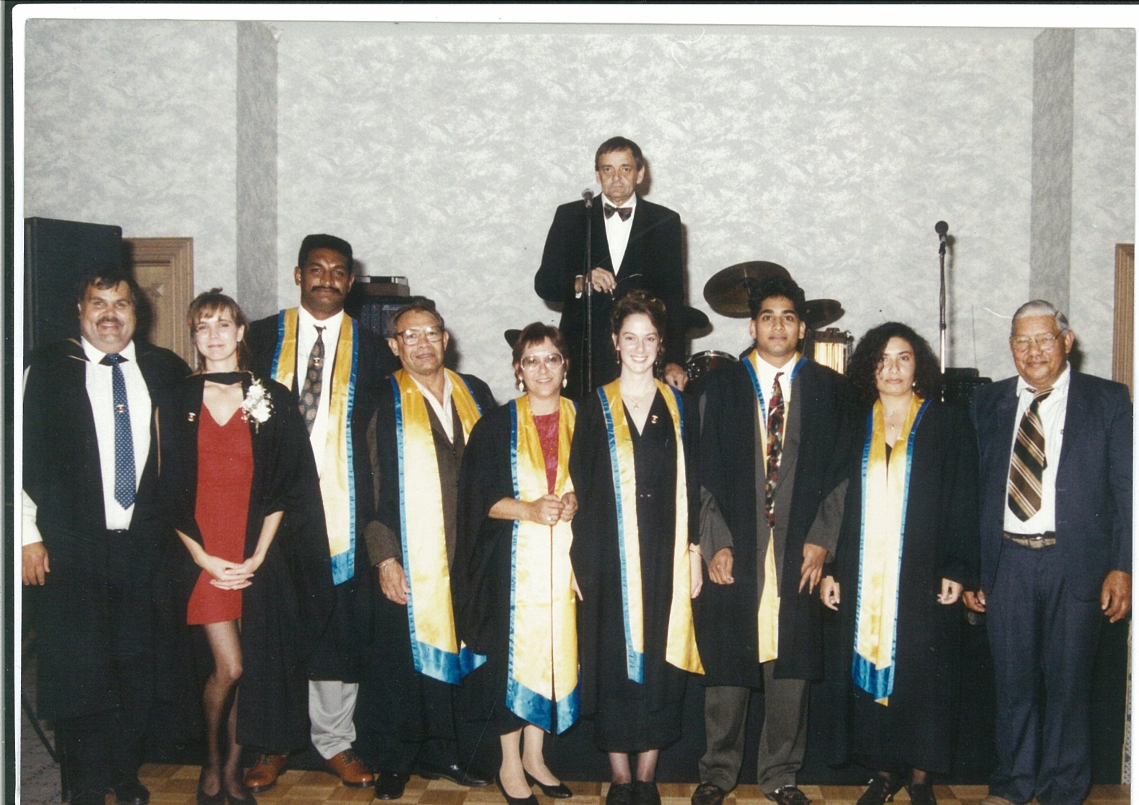

Slide 30
Ivy Trevallyan

Slide 31
TOM CALMA

Slide 32
