Slide 1
Towards information equity for native title groups
Dr Pamela McGrath
Native Title Research Unit
pamela.mcgrath@aiatsis.gov.au

Slide 2
What is information equity?
The fair or reasonable distribution of information among individuals, groups, regions, categories or other social units, such that those people have opportunity to achieve whatever is important or meaningful to them in their lives.
What is information inequity?
To the extent that information is unfairly distributed, people are denied such opportunity and information inequity exists.
Lievrouw et.al (2003), ‘Information and equity’.

Slide 3
Why has native title not delivered information equity?
The size of the information burden of managing native title
The uneven distribution of information assets among interest groups
The digital divide between Indigenous and non-Indigenous Australians.

Slide 4
What is the work of native title corporations?
Distribution of information and benefits
Consultation with members
Cultural heritage surveys for future acts
Meetings (both internal and external)
Environmental management
Agreement making
Monitoring of agreements
Corporate compliance

Slide 5
What documents does this work produce?
Minutes of meetings
Cultural heritage and environmental survey reports
Contracts and agreements
Compliance documents (eg. annual and auditor reports)
Maps and GIS databases
Photographs
Genealogies

Slide 6
What kind of data do these documents contain?
The significance and location of Aboriginal sites
Where sites are not located
Who has made decisions about sites
The location of sites in relation to ore bodies and tenements
The location of sensitive environmental features
The location of exploration and mining tenements
The history of non-Indigenous land tenure

Slide 7
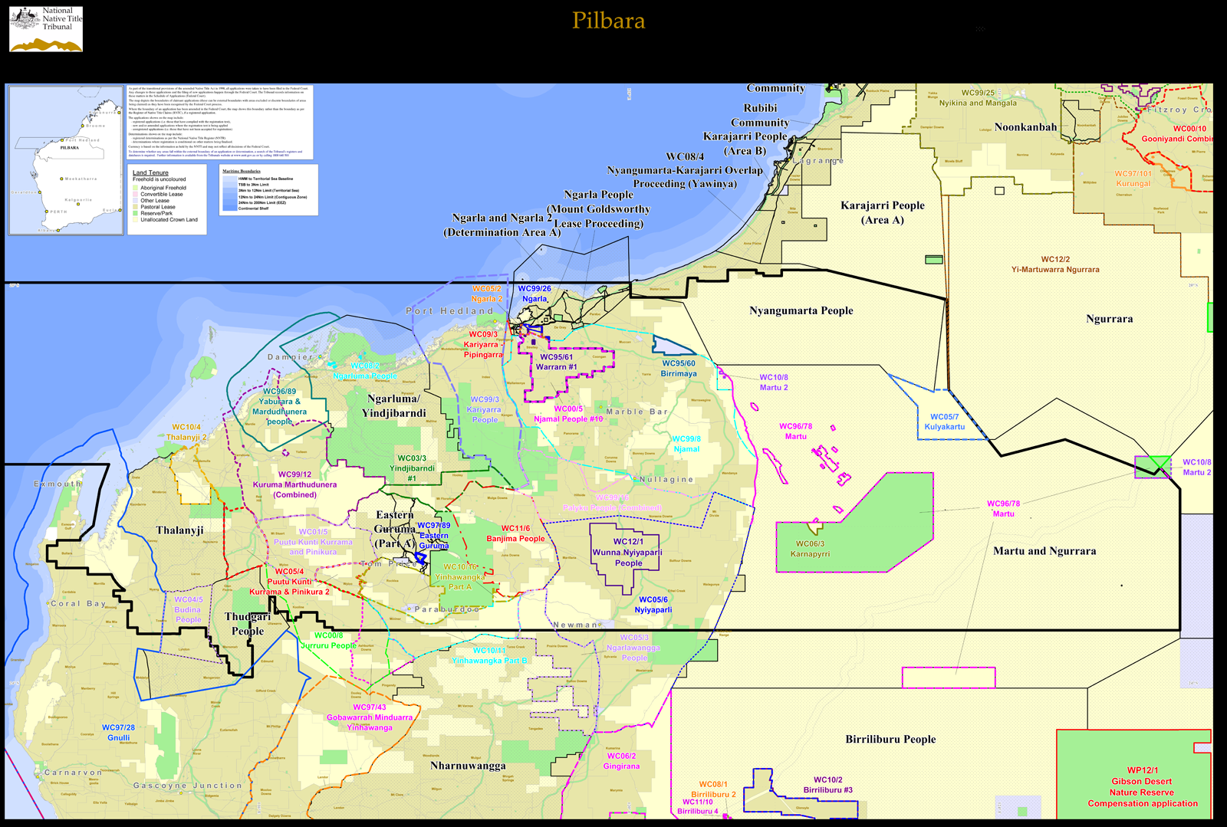

Slide 8
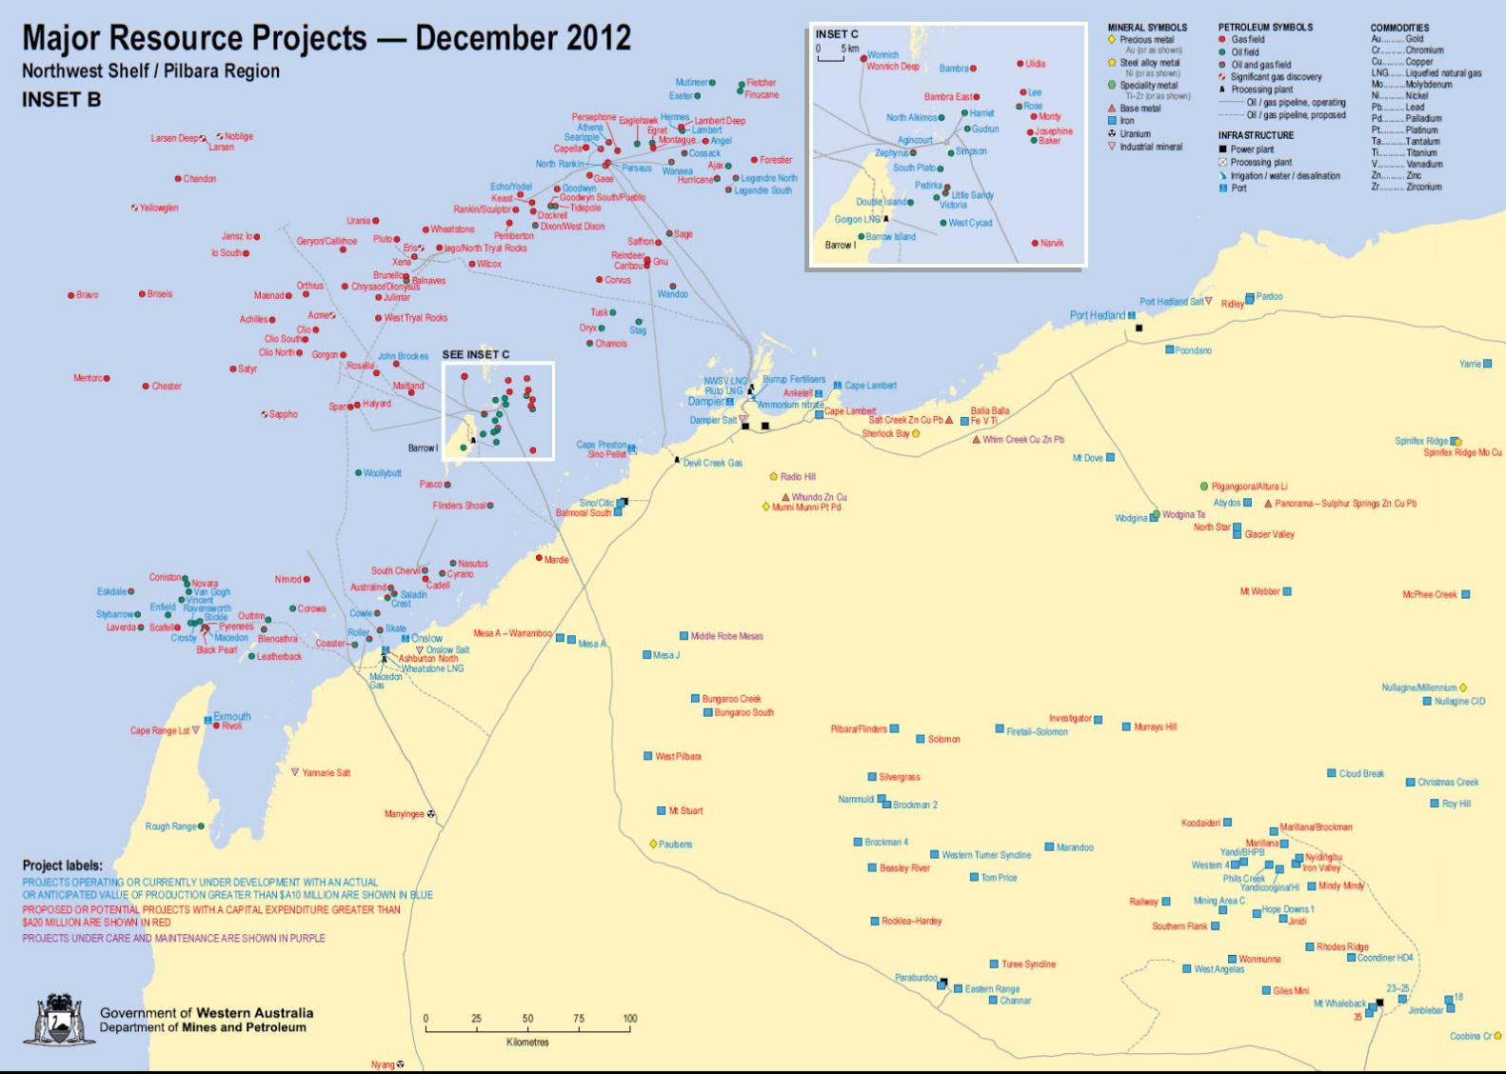

Slide 9
Yamatji Land and Sea Council
2012-13:
443 agreements and 9 ILUAs
247 heritage surveys
191 days of meetings
787 future act notices

Slide 10
Where does this information end up?
State government
Mining companies
Federal Court and National Native Title Tribunal
Native Title Representative Bodies
Registered Native Title Bodies Corporate

Slide 11
Why has native title not delivered information equity?
The size of the information burden of managing native title
The uneven distribution of information assets among parties with competing interests
The ongoing technological marginalisation of many Aboriginal and Torres Strait Islander people.

Slide 12
Information inequity impacts on:
Free prior and informed consent
Bargaining power
Monitoring of agreements
Assessment and management of cumulative impacts
Intergenerational knowledge transfer
‘As along as information resources and technologies are distributed on an ability-to-pay market basis, disparities will persist and grow.’ Liewvrow et.al (2003)

Slide 13
The Mining Knowledge Project
Addressing inequity, building capacity, through:
Technology
Protocols and Agreements
Language Resources
Training and employment
Open Access Research

