Slide 1
Yini: Marmingee
Kinship group: Nyapajarri
Languages: Walmajarri,Juwaliny, Ngarti, Bunuba, Gooniyandi,Kriol. English
Language teacher
Cultural Advisor

Slide 2
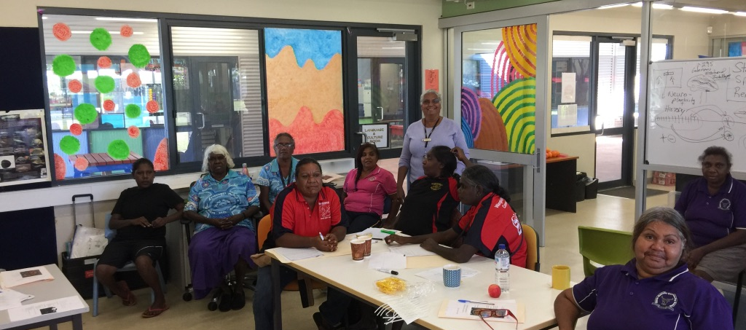
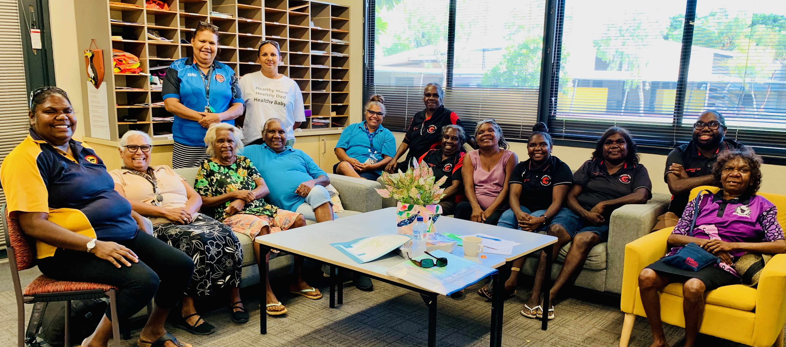
Valley Language Network forum
Looma - Walmajarri,Nyikina and Mangala
Bayulu- Walmajarri and Gooniyandi
Muludja-Gooniyandi
Wangkatjungka-Walmajarri
Djugerari-Walmajarri
Nyalipita-Walmajarri
Independent school
Yakanarra-Walmajarri
Yiyili-Gooniyandi

Slide 3
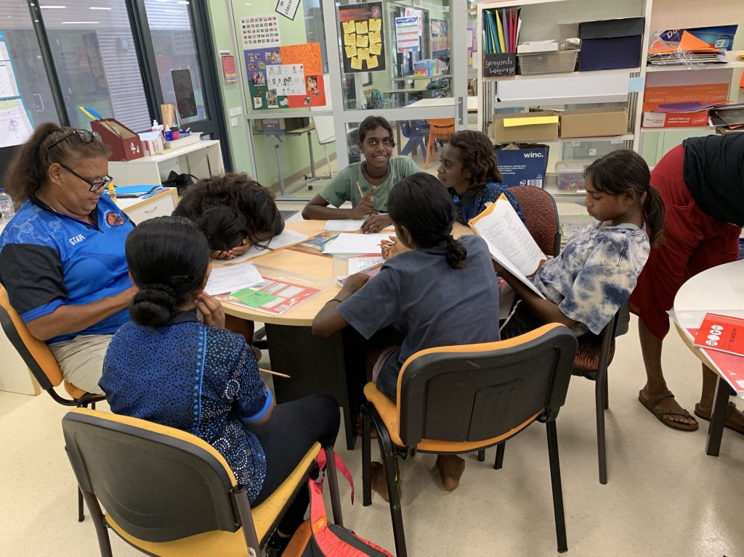
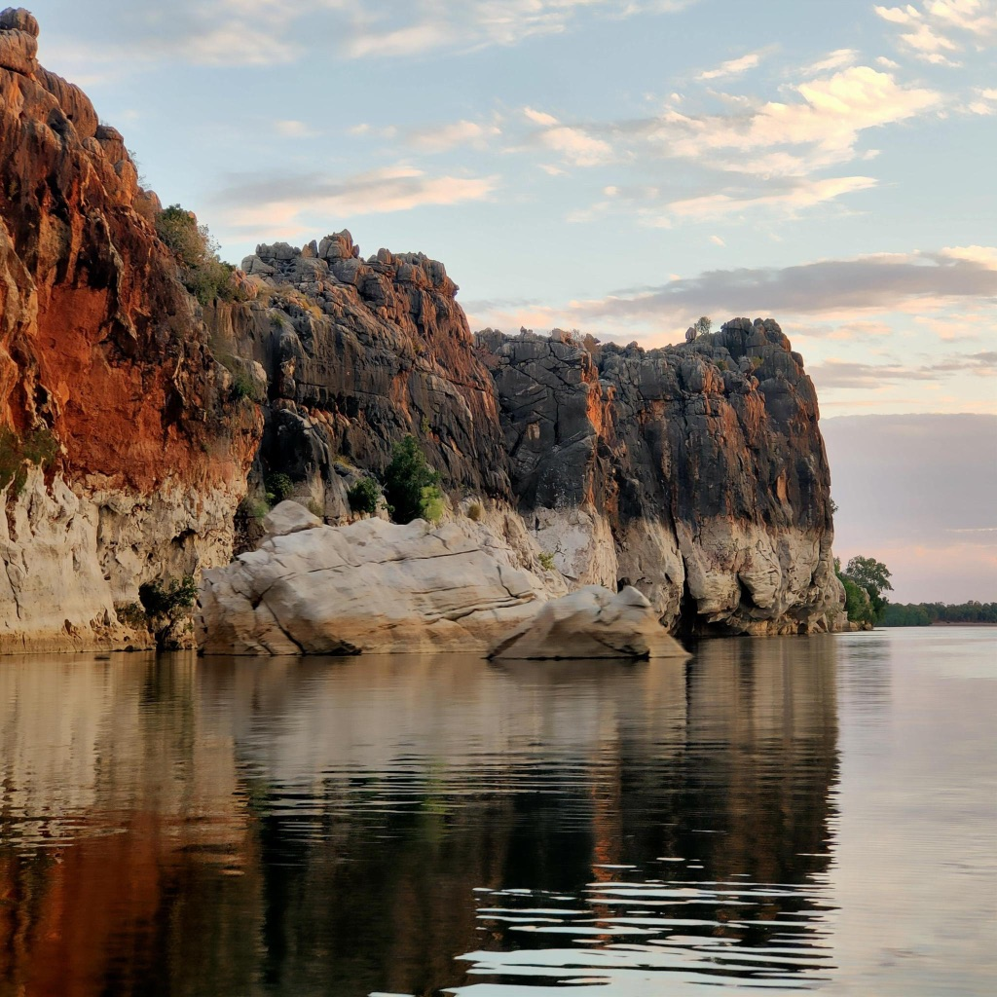
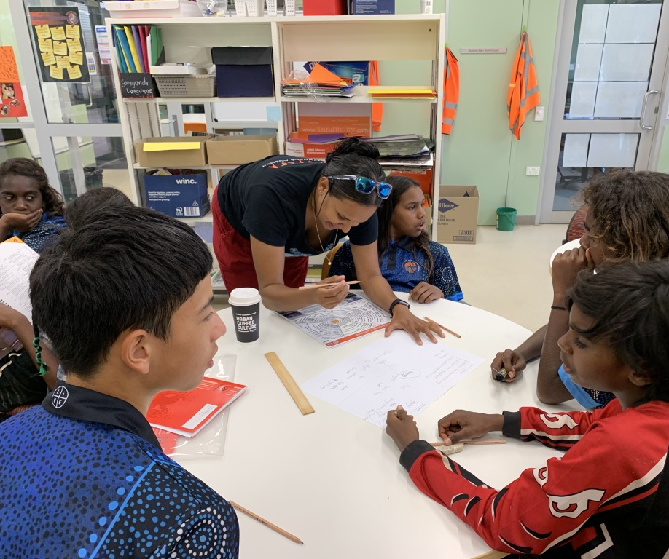
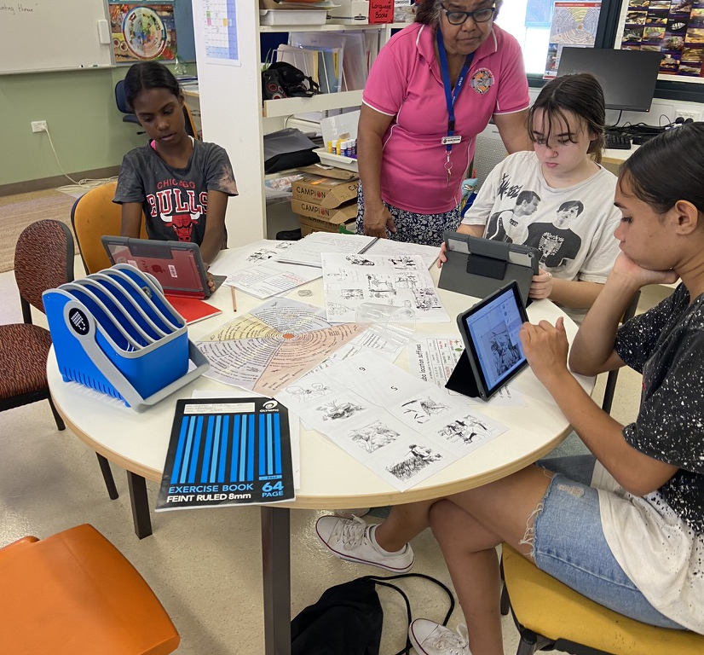
Language teachers in the classroom
Supporting language teachers in the classroom

Slide 4
Dijun storee blungu Jandamarra ee bin Bunuba heeroa longtyeim lunga meebulu for kundree.
Kriol
Kriol is the 1st language of most students at Fitzroy Valley School. Standard Australian English (SAE) is usually the 2nd or 3rd language of most the students.
Literacy in 1st language
Young children learn to read more easily if their early books are in their own language because they can match the written word to the familiar sounds they are hearing. Also the books are about familiar things that they can relate to. When children are older, these bilingual books help them to stop ‘mixing-up’ the two languages. Teachers can use the books to teach children to separate the grammar and vocabulary of Kriol and Standard Australian English.
Artwork by Patrick Green

Slide 5
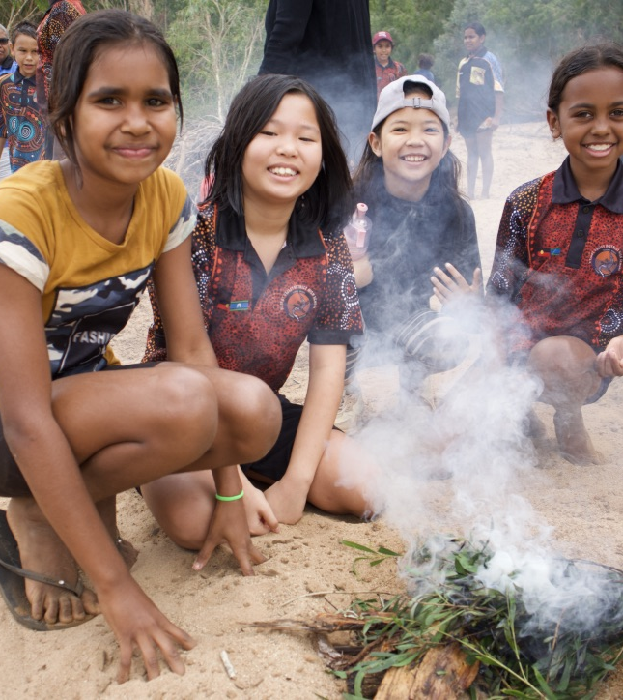
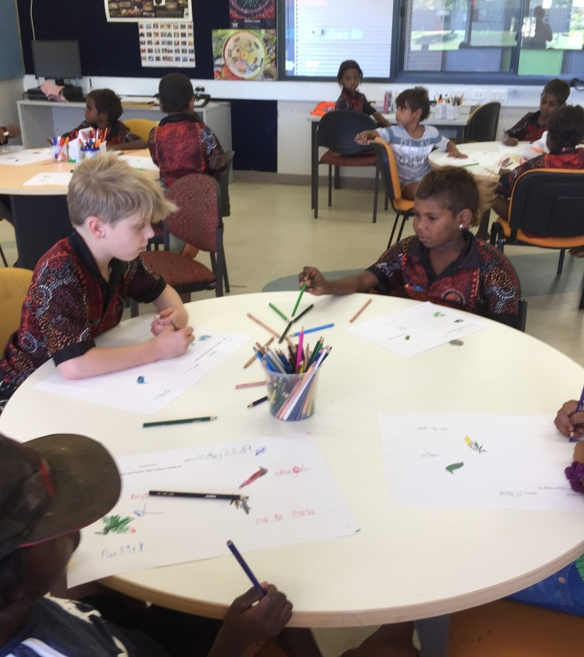
Learning Language In the Classroom and on Country

Slide 6
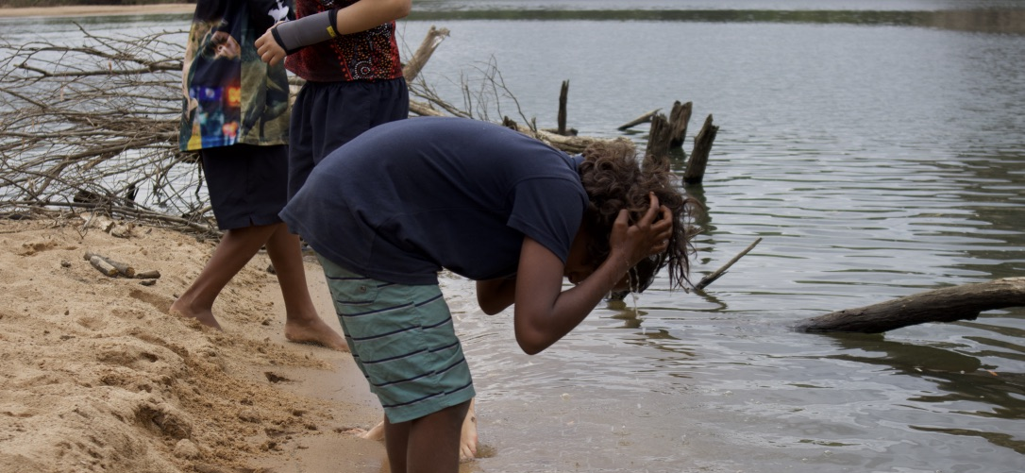
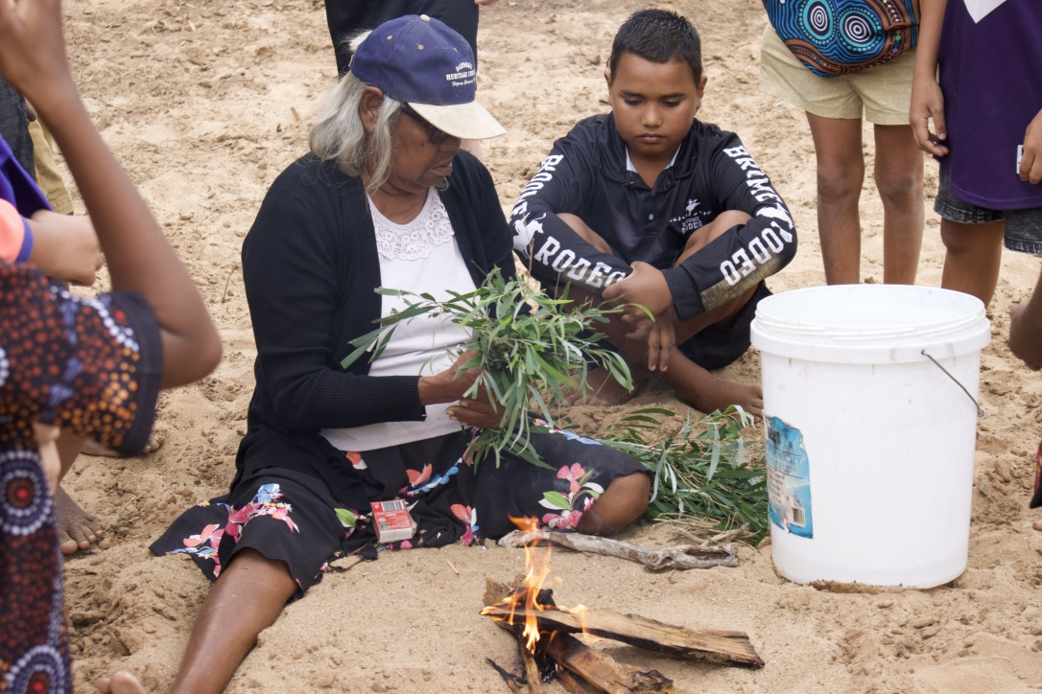
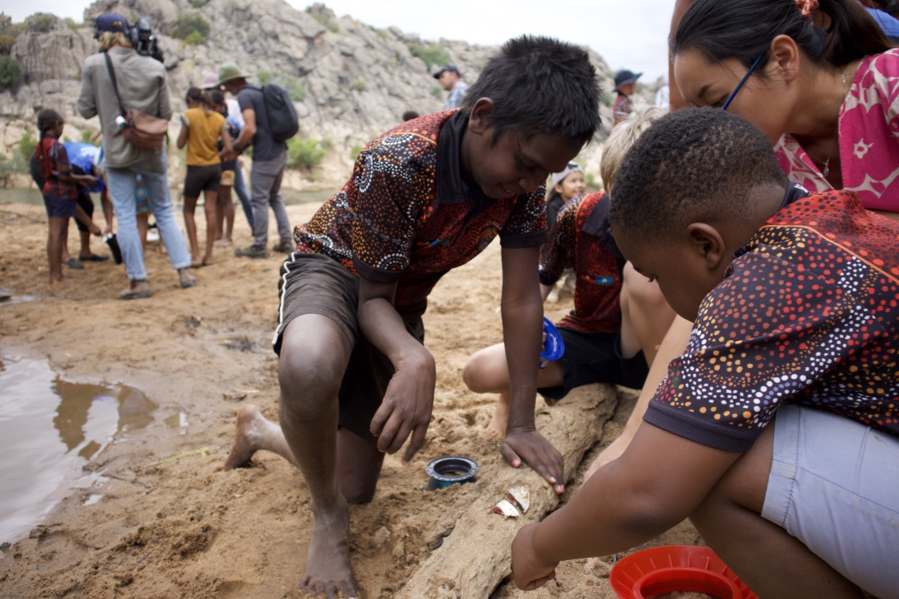
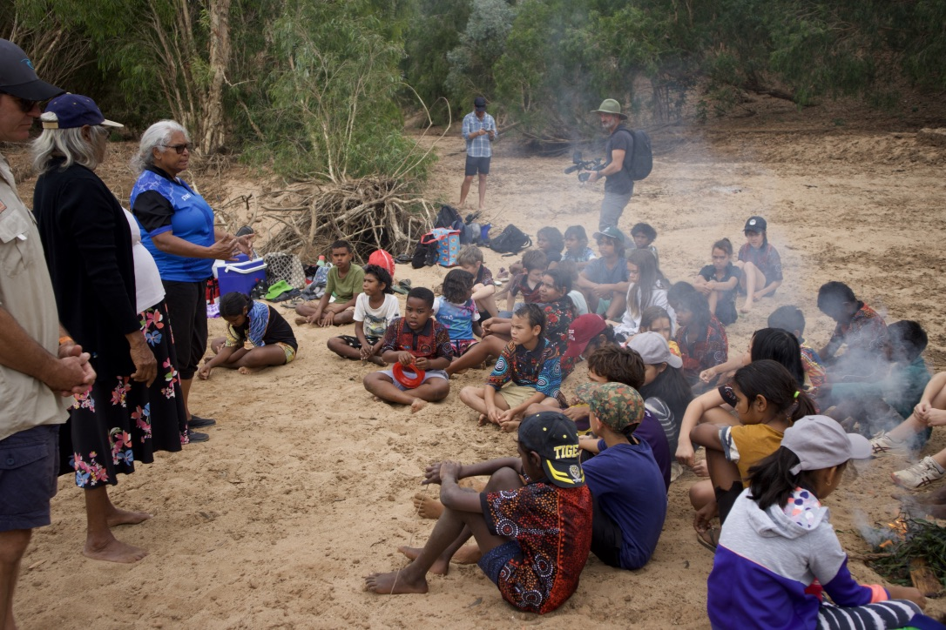
Language Learning On Country

Slide 7
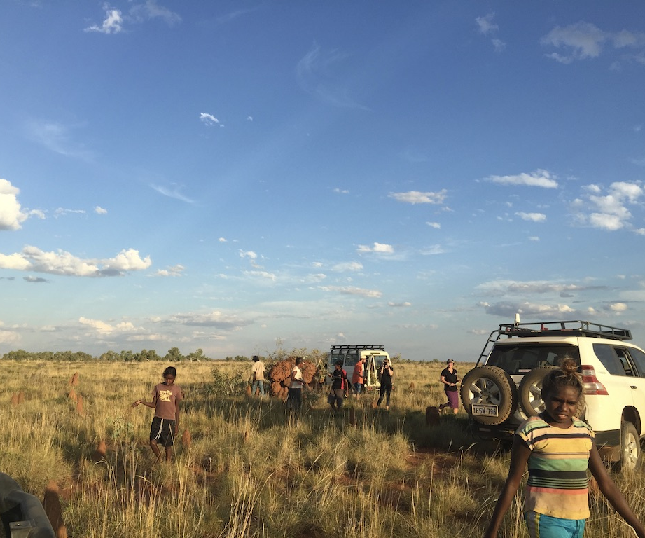
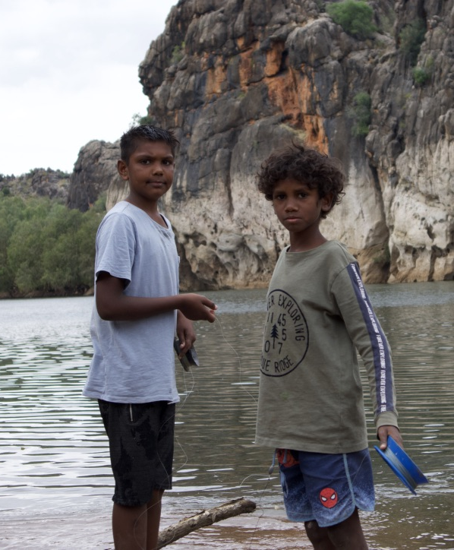
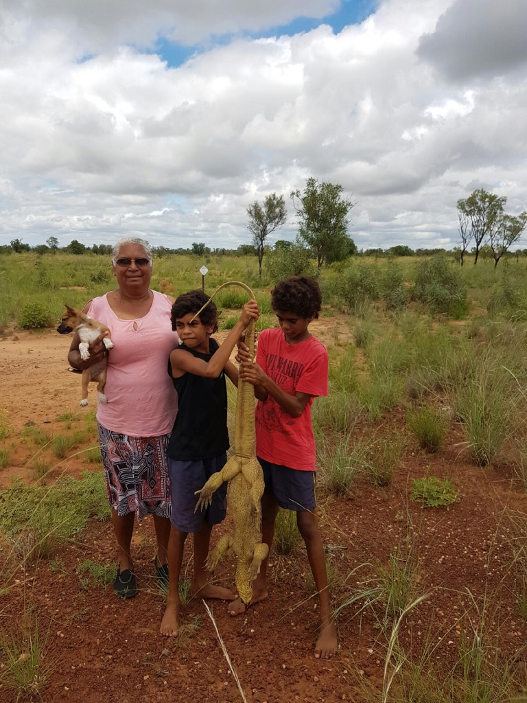
Ruwangal-Going hunting on Country
Children get the opportunity to go out on country to practice speaking the language.
Children connects with country- river country, desert country etc.

Slide 8
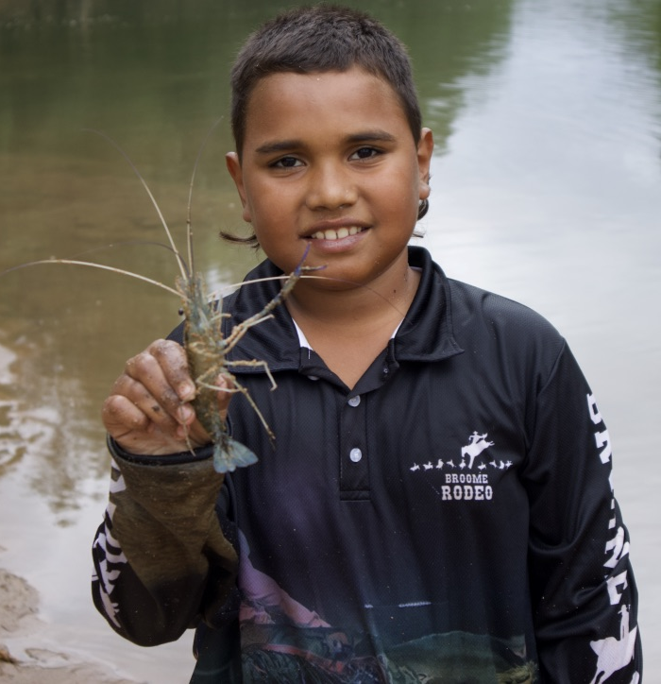
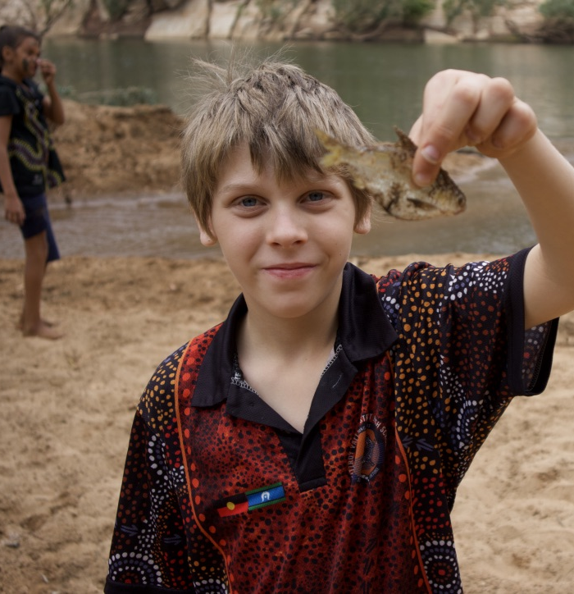
Catching Jarrampa

Slide 9
Two-Way Learning Fitzroy Valley District High School.

Slide 10
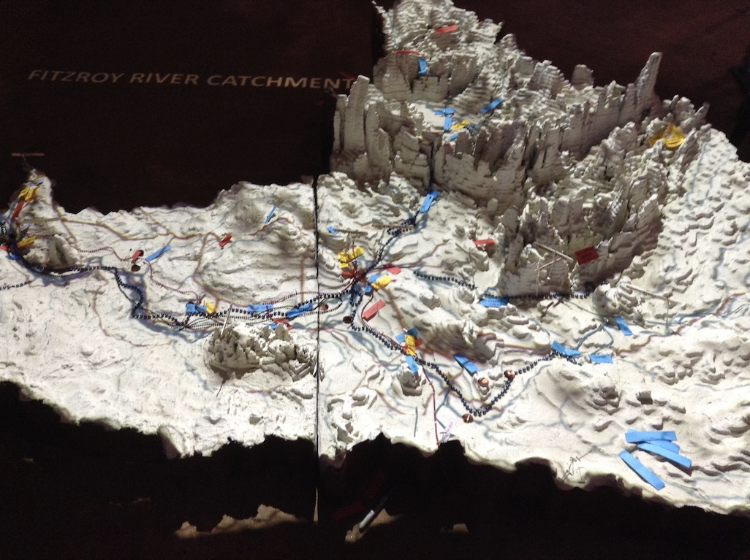
Planning On Country

Slide 11
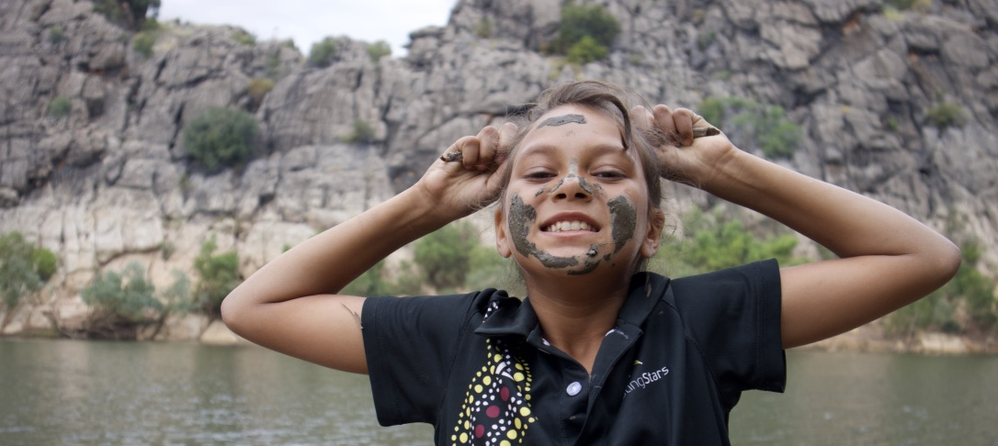
Wali

