Slide 1
50 years on: creating genuine research partnerships to improve Aboriginal Health and Wellbeing
Roz Walker and Clair Scrine
Centre for Research Excellence in Aboriginal Health and Wellbeing
Breaking the Barriers in Indigenous research and thinking 50 years on
2014

Slide 2
Introduction
This paper is based on our experience as researchers who have worked closely in and with many Aboriginal communities, leading Aboriginal academics, researchers and many community workers in Western Australia.
In my case for the last ten years or so and in Roz’s case – 25 years

Slide 3
Introduction
We have both been part of great change:
to the way research is conducted,
how it is seen by Aboriginal people and
in the roles of Aboriginal and non-Aboriginal people in research

Slide 4
Reflecting back over the last 50 years
one of the more interesting changes in Aboriginal research is the way research itself and the subjectivity of the researcher has been challenged and critically assessed.
challenges from Aboriginal scholars of research as merely an extension of colonisation - determining and owning knowledge about Indigenous peoples.

Slide 5
Shifting research paradigms
The growth of critical theory, feminist studies and ‘whiteness studies’ saw a major redirection in which a self-reflexive examination of white privilege
a greater recognition of how research has served the power and knowledge in the scientific disciplines.

Slide 6
Shifting research paradigms
The dominance of western scientific discourses that were promoted as objective and neutral – and ultimately seen as the legitimate, rigorous form of knowledge - not only subjugated Aboriginal people – they perpetuated a denial or lack of recognition of Aboriginal values, worldviews and knowledge and voices.

Slide 7
Reflecting Back
For a long time Aboriginal people have dismissed research as irrelevant, an interference and a one way street – serving only the interests and needs of white researchers.
For a long time there was a feeling of dread when researchers approached communities-
‘we are being researched to death’

Slide 8
Contemporary Research Context
However, things have changed on both sides.
Attitudes about our role, our own knowledge practices, and our subjectivity has changed –
So too have the roles, knowledge of many of the Aboriginal people we work with.
We have learnt to not only respect the call of ‘nothing about us without us’ but to see the value gained from local knowledge, community engagement and participation and a partnership approach.

Slide 9
Adopting a strength-based approach
Another important change that has taken place is the focus on a strengths-based approach.
Researchers have moved away from what one of our Noongar colleagues so eloquently describes as Aboriginal health research being about non-Aboriginal experts trying to fix all the broken and busted Aborigines.

Slide 10
Recognising cultural connections
Much of our research is embedded in Aboriginal peoples’ deeply complex connections to family and kinship networks, culture, land, spirituality and holistic understandings of health.

Slide 11
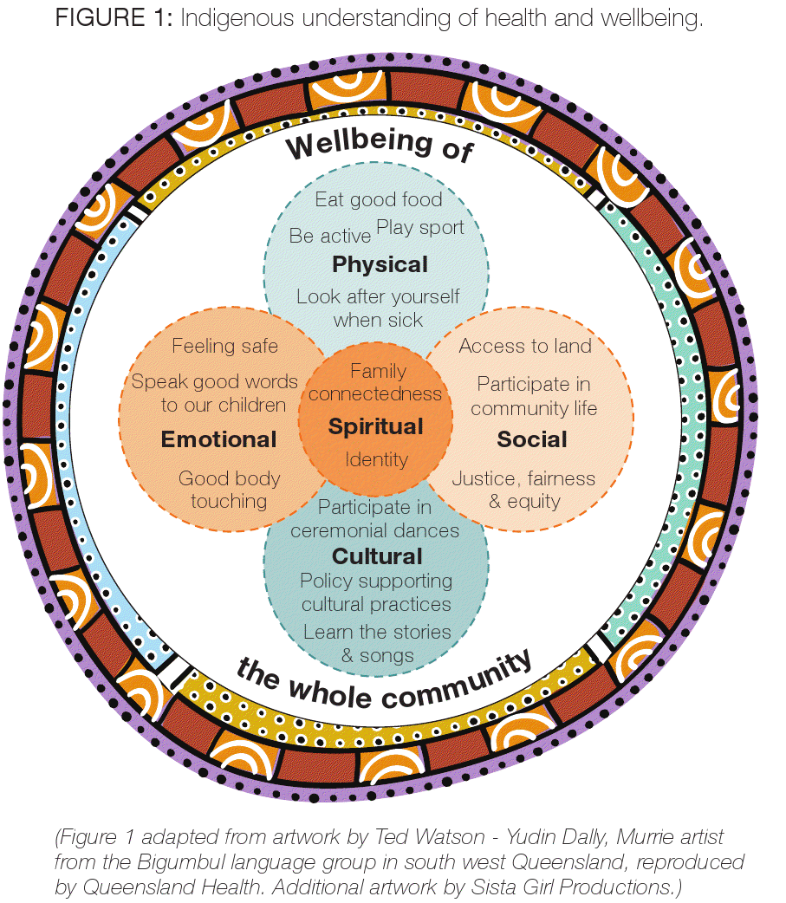
Indigenous understanding of health and well being
Physical
Social
Emotional
Cultural
= SPIRITUAL
Notes:
Present Wellbeing diagram and talk through 5 factors/circles
The Wellbeing of ourselves is central to who we are as individuals and how we develop, support and love our families.
The Wellbeing of ourselves and where we live in our communities – Beagle Bay) is central to present day existence
So how do we define Empowerment, Leadership and Healing?
You’ve just seen the ? Definitions and this diagram?
Is it relevant to you and your family structure? Can you see the similarities?
Is it relevant to your community in which you live in?
Rather we work from the basis that our role is to build the evidence base on the cultural determinants of health and wellbeing - on the ways that strong connectedness to culture and country can strengthen individual and collective identities, self-esteem and resilience, which in turn leads to improved outcomes across the social determinants of health including family functioning, community capacity and children’s capacity to thrive.
11

Slide 12
Developing Relationships
One of the most significant changes that have occurred to the place of non-Aboriginal researchers has come out of the understanding that research involves:
developing working relationships that are characterised by trust and reciprocity and patience with Aboriginal communities; and
that this can be a complex social process that is often messy and influenced or highly dependent on local context and circumstances, interactions, emotions and relationships.

Slide 13
Establishing Partnerships
with communities and with our Aboriginal colleagues who conduct aspects of the qualitative research collection - provide opportunities for developing relationships within which to negotiate the values, conceptual frameworks, methodologies, and control of research, as well as for deciding issues of ownership and dissemination of knowledge.
these partnerships require that Recognition, Relevance, Respect, and Reciprocity are valued by all parties and characteristics of the research practice.

Slide 14
Establishing and maintaining partnerships
The necessity of a partnership approach, and of the research process working to advance the strengths contained within Aboriginal knowledge of health and wellbeing is where the legitimate place of research lies with the non-Aboriginal researcher supporting communities by working alongside them.
This is the future of health research if it is to be relevant, targeted, appropriate, and ultimately make any significant improvements in closing the gap in Aboriginal people’s health and wellbeing.

Slide 15
Moving forward
Research must be supported by a greater understanding and respect for cultural protocols.
universities must ensure strict adherence to Aboriginal research ethics, and that processes are in place so that Aboriginal people can challenge the research process
Grant and research bodies that adequately resource projects to enable Aboriginal communities to develop their own research priorities
Ensuring processes in academic institutions are not designed so that Aboriginal people cannot challenge the research process –by ensuring that community representatives are included on a project throughout all phases of the research from the proposal, planning and the funding and ethics approval have been obtained.
These are just some of the challenges we see for the next 50 years !
Notes:
Id like to hand over to Roz whose going to provide some case studies to outline some of what I have been describing as our approach in and with communities……. Roz

Slide 16
Practical examples
Research using a strength-based approach to support and enhance the protective elements of good family functioning
holistic programs that work to simultaneously to strengthen Aboriginal family functioning and address risk factors
Halls Creek Community Families Initiative is a good example (next section)
Notes:
Risk factors such as financial strain, carer education and employment, lack of access to services) which can impact negatively on family functioning.

Slide 17
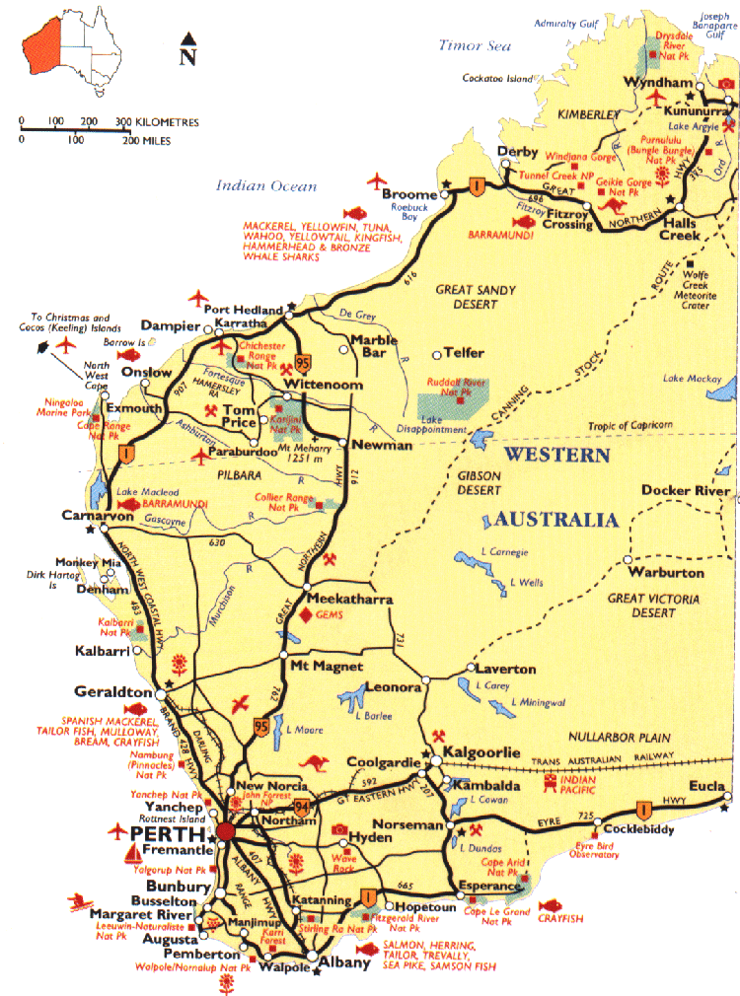
http://www.genepi.org.au/images/misc/map.jpg

Slide 18
Examples of working together
The Yanan Ngurra-ngu Walalja Community Families Program ─ Encouraging Families to Grow Strong Roz Walker 1, Valma Banks 2, Sandra Deegan 2, Alana Stretch 2 James Yaloot 2, Community Care Workers, Yanan Ngurra-ngu Walalja, Halls Creek
The Kimberley Empowerment Program
Hear our voices
Staying on track - Involving young people in research
Starting on track – engaging communities in research

Slide 19
Aboriginal families
are pivotal to the wellbeing of Indigenous communities and their culture and survival.
important in defining identity and a sense of connectedness to kinship and culture.
are influenced family structures and relationships and which in turn influenced by diversity of history, geography and cultural experiences

Slide 20
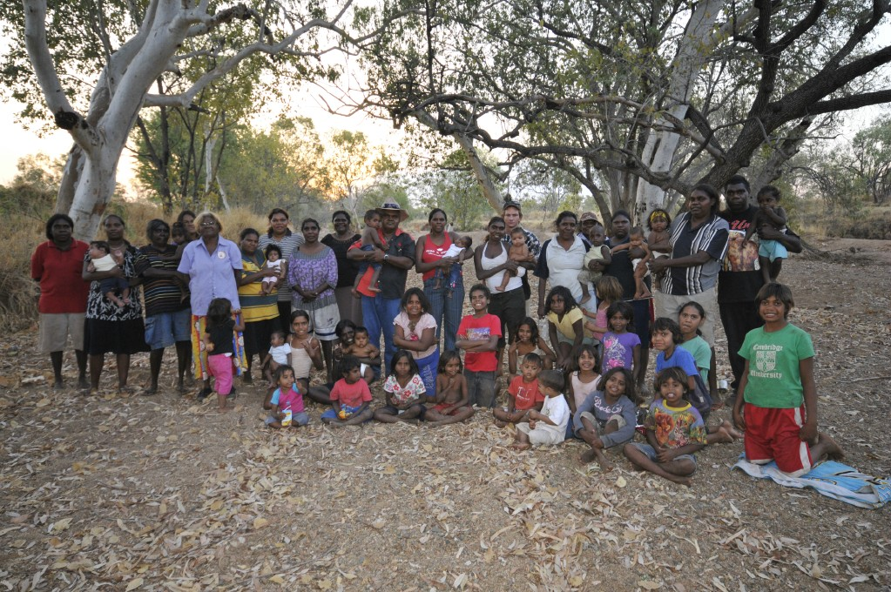
The families

Slide 21
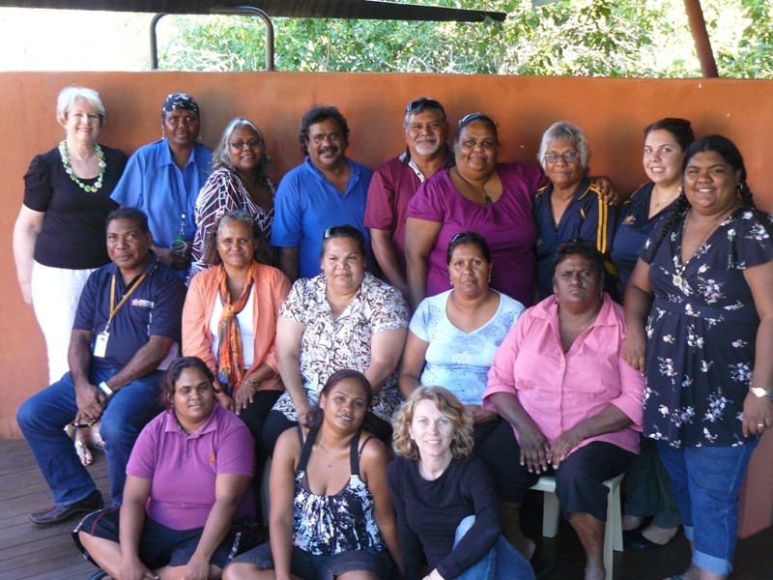
Working with communities

Slide 22
Project Aims
To strengthen the capacity of community members to empower themselves and others to change their lives, their communities and the systems that are barriers to good social and emotional wellbeing.
The key outcome is the development of an accredited innovative program that is culturally appropriate to the empowerment of Aboriginal people in different geographical locations.
Two stages to the project:
- community and stakeholder consultation;
- program development.

Slide 23
Aboriginal Co-Researchers

Slide 24
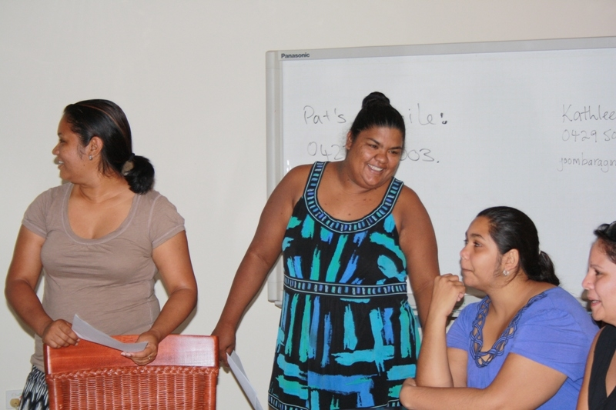
Facilitating Community Workshops

Slide 25
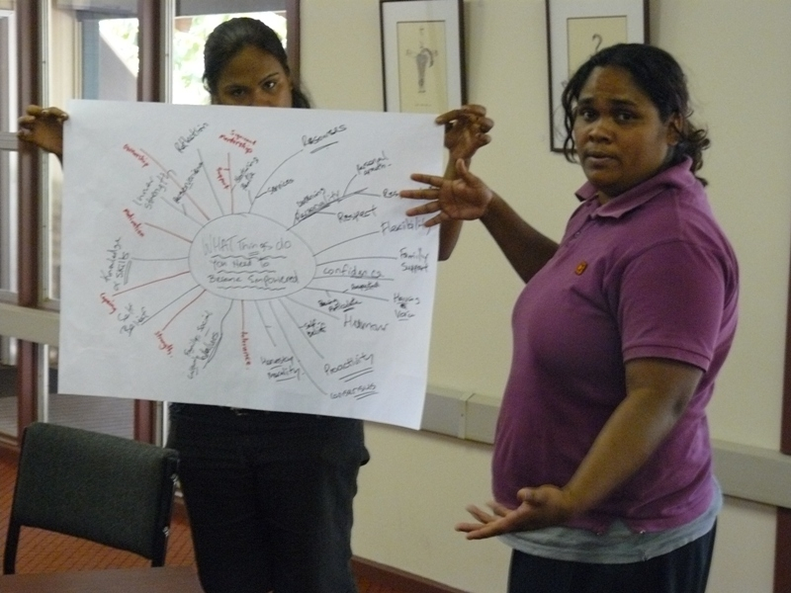
Identifying the issues

Slide 26
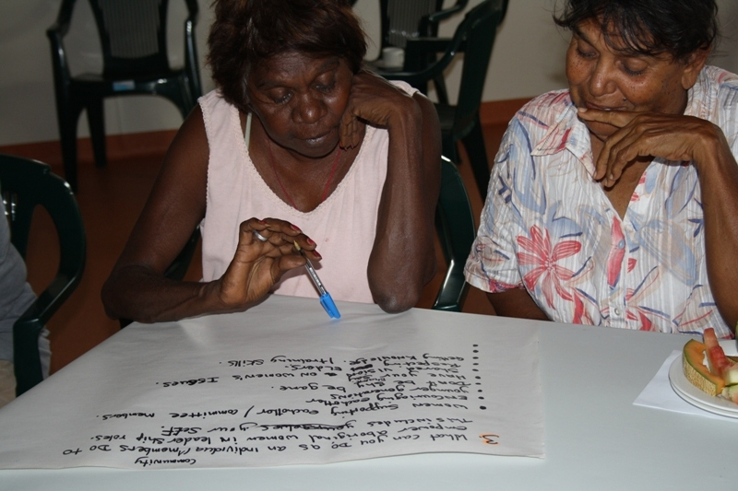
Determining the solutions

Slide 27
Community Feedback
Focus on building self first ‘making ourselves strong’;
Focus on rebuilding family and parenting roles;
Communication - learning how to to share and care for one another;
Ensuring community readiness for change;
Legitimate community support and engagement;
Employing and training local people; and,
Local and culturally based programs.

Slide 28
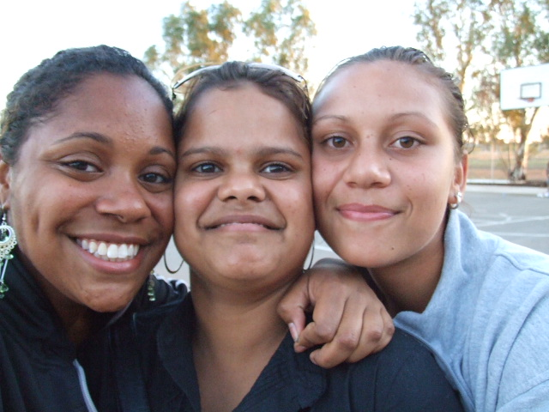
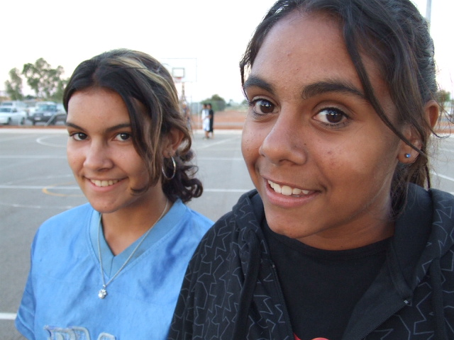
Hedland Youth Stakeholder Workshop Friday 23 November 2007 Gratwick Hall Town of Port Hedland
Shout it Out!

Slide 29
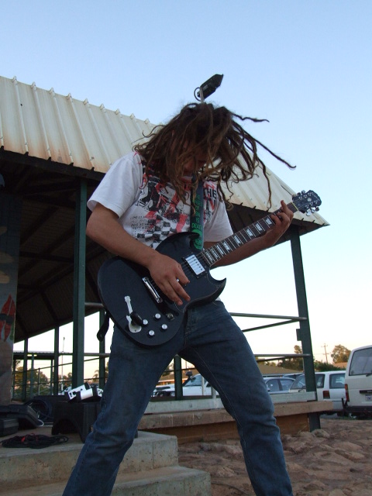
Key Youth Issues
Development of a positive and proactive youth culture
Opportunities for positive youth engagement in the community
Facilities & Amenities
Activities & Events
Programs & Services
Targeted integration of Youth Programs and Services

Slide 30
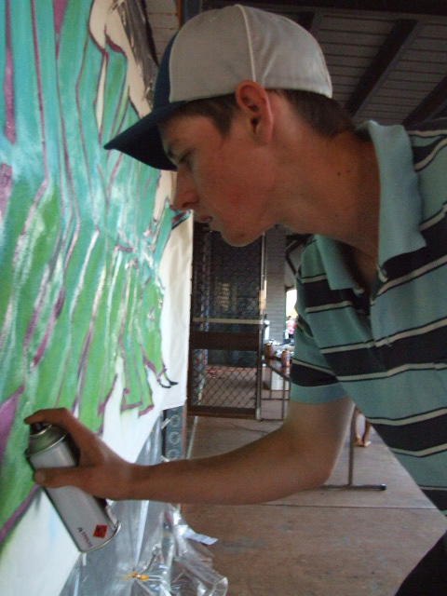
Addressing Youth Needs
Action and follow up from reports and consultation
Harnessing the energy and commitment of stakeholders in a strategic approach to youth development
Services targeted at needs
Identification of stakeholder roles and contributions
Alignment and coordination among service deliverers
Value adding to existing service and program delivery through collaboration

Slide 31
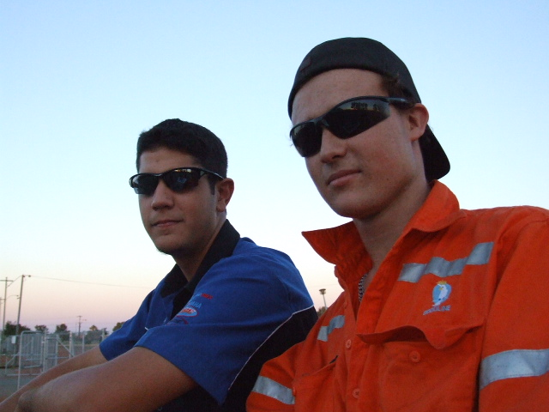
Hedland Youth Leadership Council
Hedland Youth Stakeholder Action Group (HYSAG)
Terms of Reference
Purpose
Hedland Youth Leadership Council (HYLC)
Youth Leadership Programs
Potential Community Facilities
Youth Precinct (JDHC)
Regional Student Hostel
Public Open Space development

Slide 32
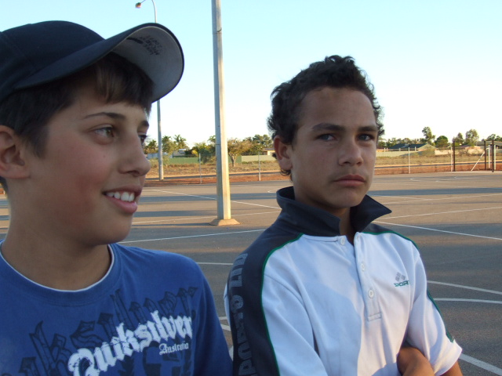
The Challenge of Youth Development Transforming Lives and Growing Community
Key Factors for Success
Enabling Conditions
Engagement
Empowerment
Enthusiasm

Slide 33
Ways of working with the community
helping families, school and health services to work out whether they are doing their best for the future of Martu children.

Slide 34
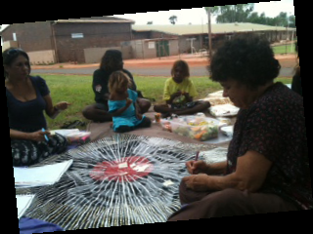
Ways of working with the community
looking at ways to support the communities existing plans and aspirations to help children; and/or
helping groups to identify and come up with new plans which we can help to make those ideas happen

Slide 35
Ways of working with the community
listening to families, teachers, Healthworkers about helping children to do well and be happy at their schools
talking with other people who are working with young people

Slide 36
“Tell the young girls that they have to get the cultural way and learn from the old people and the culture” (Martu elder) (from Jenaya Hart 2009)

Slide 37
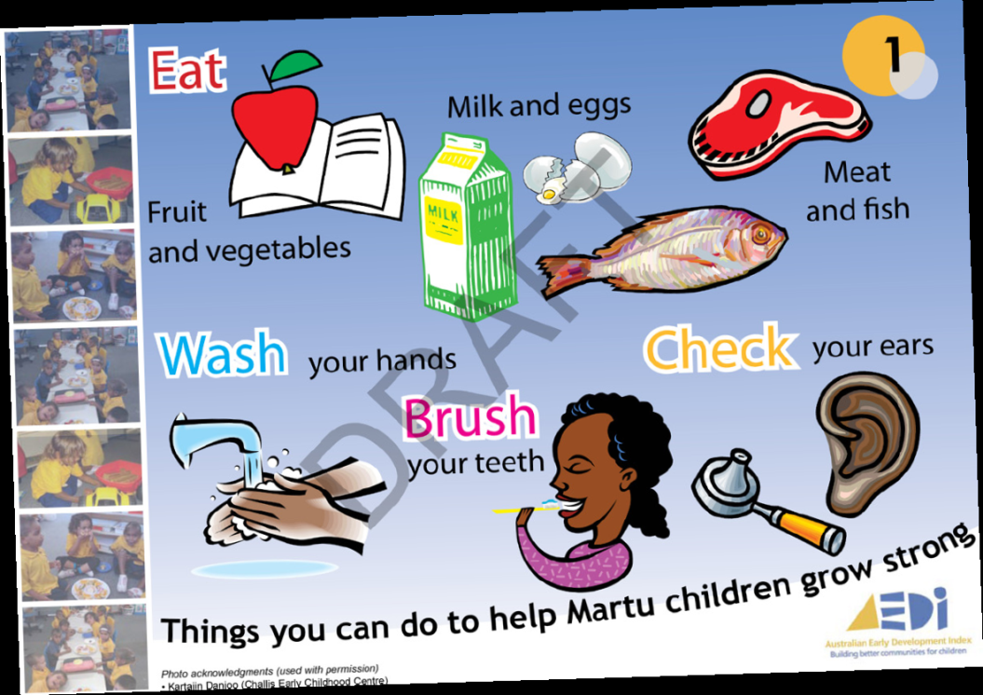
Developing Resources Together

Slide 38
Key Challenges & Opportunities
Indigenous culture, social reality and living circumstances add a layer of complexity when considering the broader influences when doing research in Aboriginal communities
Indigenous people live in very diverse situations and settings – urban, remote and isolated Aboriginal communities of Australia
Strategies need to context-specific and therefore need consideration of the local situation
.

Slide 39
Key challenges/opportunities
Working with various stakeholders and their different agendas (including territory)
Navigating the community politics
Keeping the community involved
Working with funders and other personnel to understand the issues and to agree to context relevant/appropriate measures of success

Slide 40
Opportunities of context
It’s people’s country
Drawing on the strengths of community, their knowledge of country and culture
Working with the context- integrating knowledge of the local community and country into the research

Slide 41
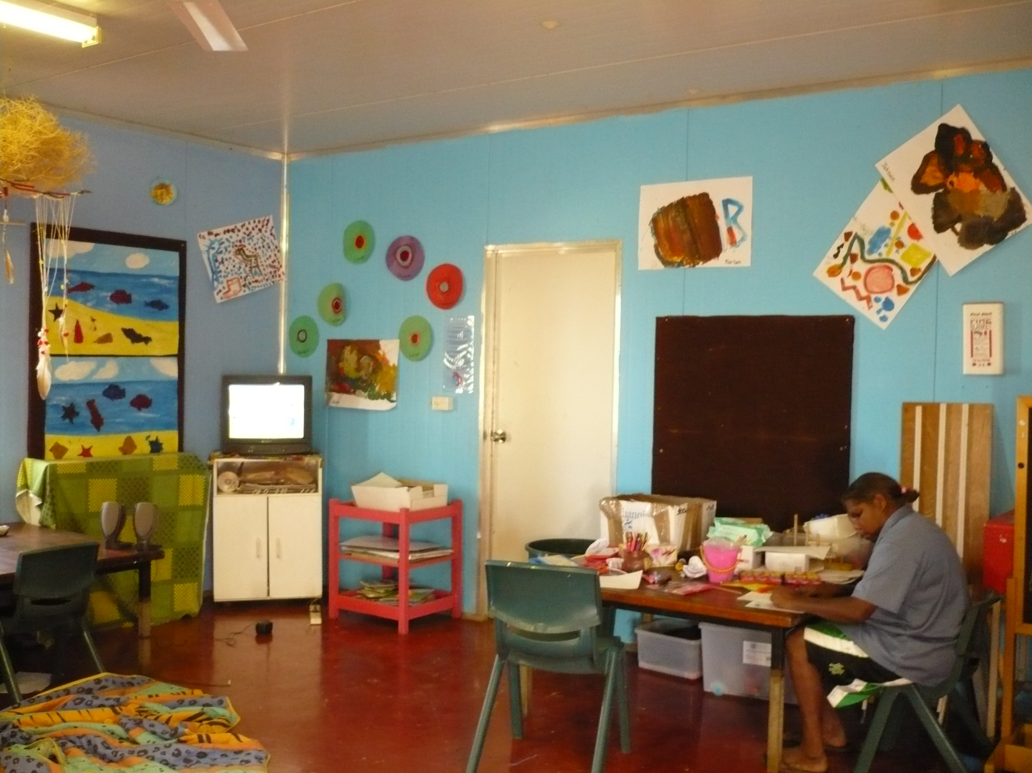
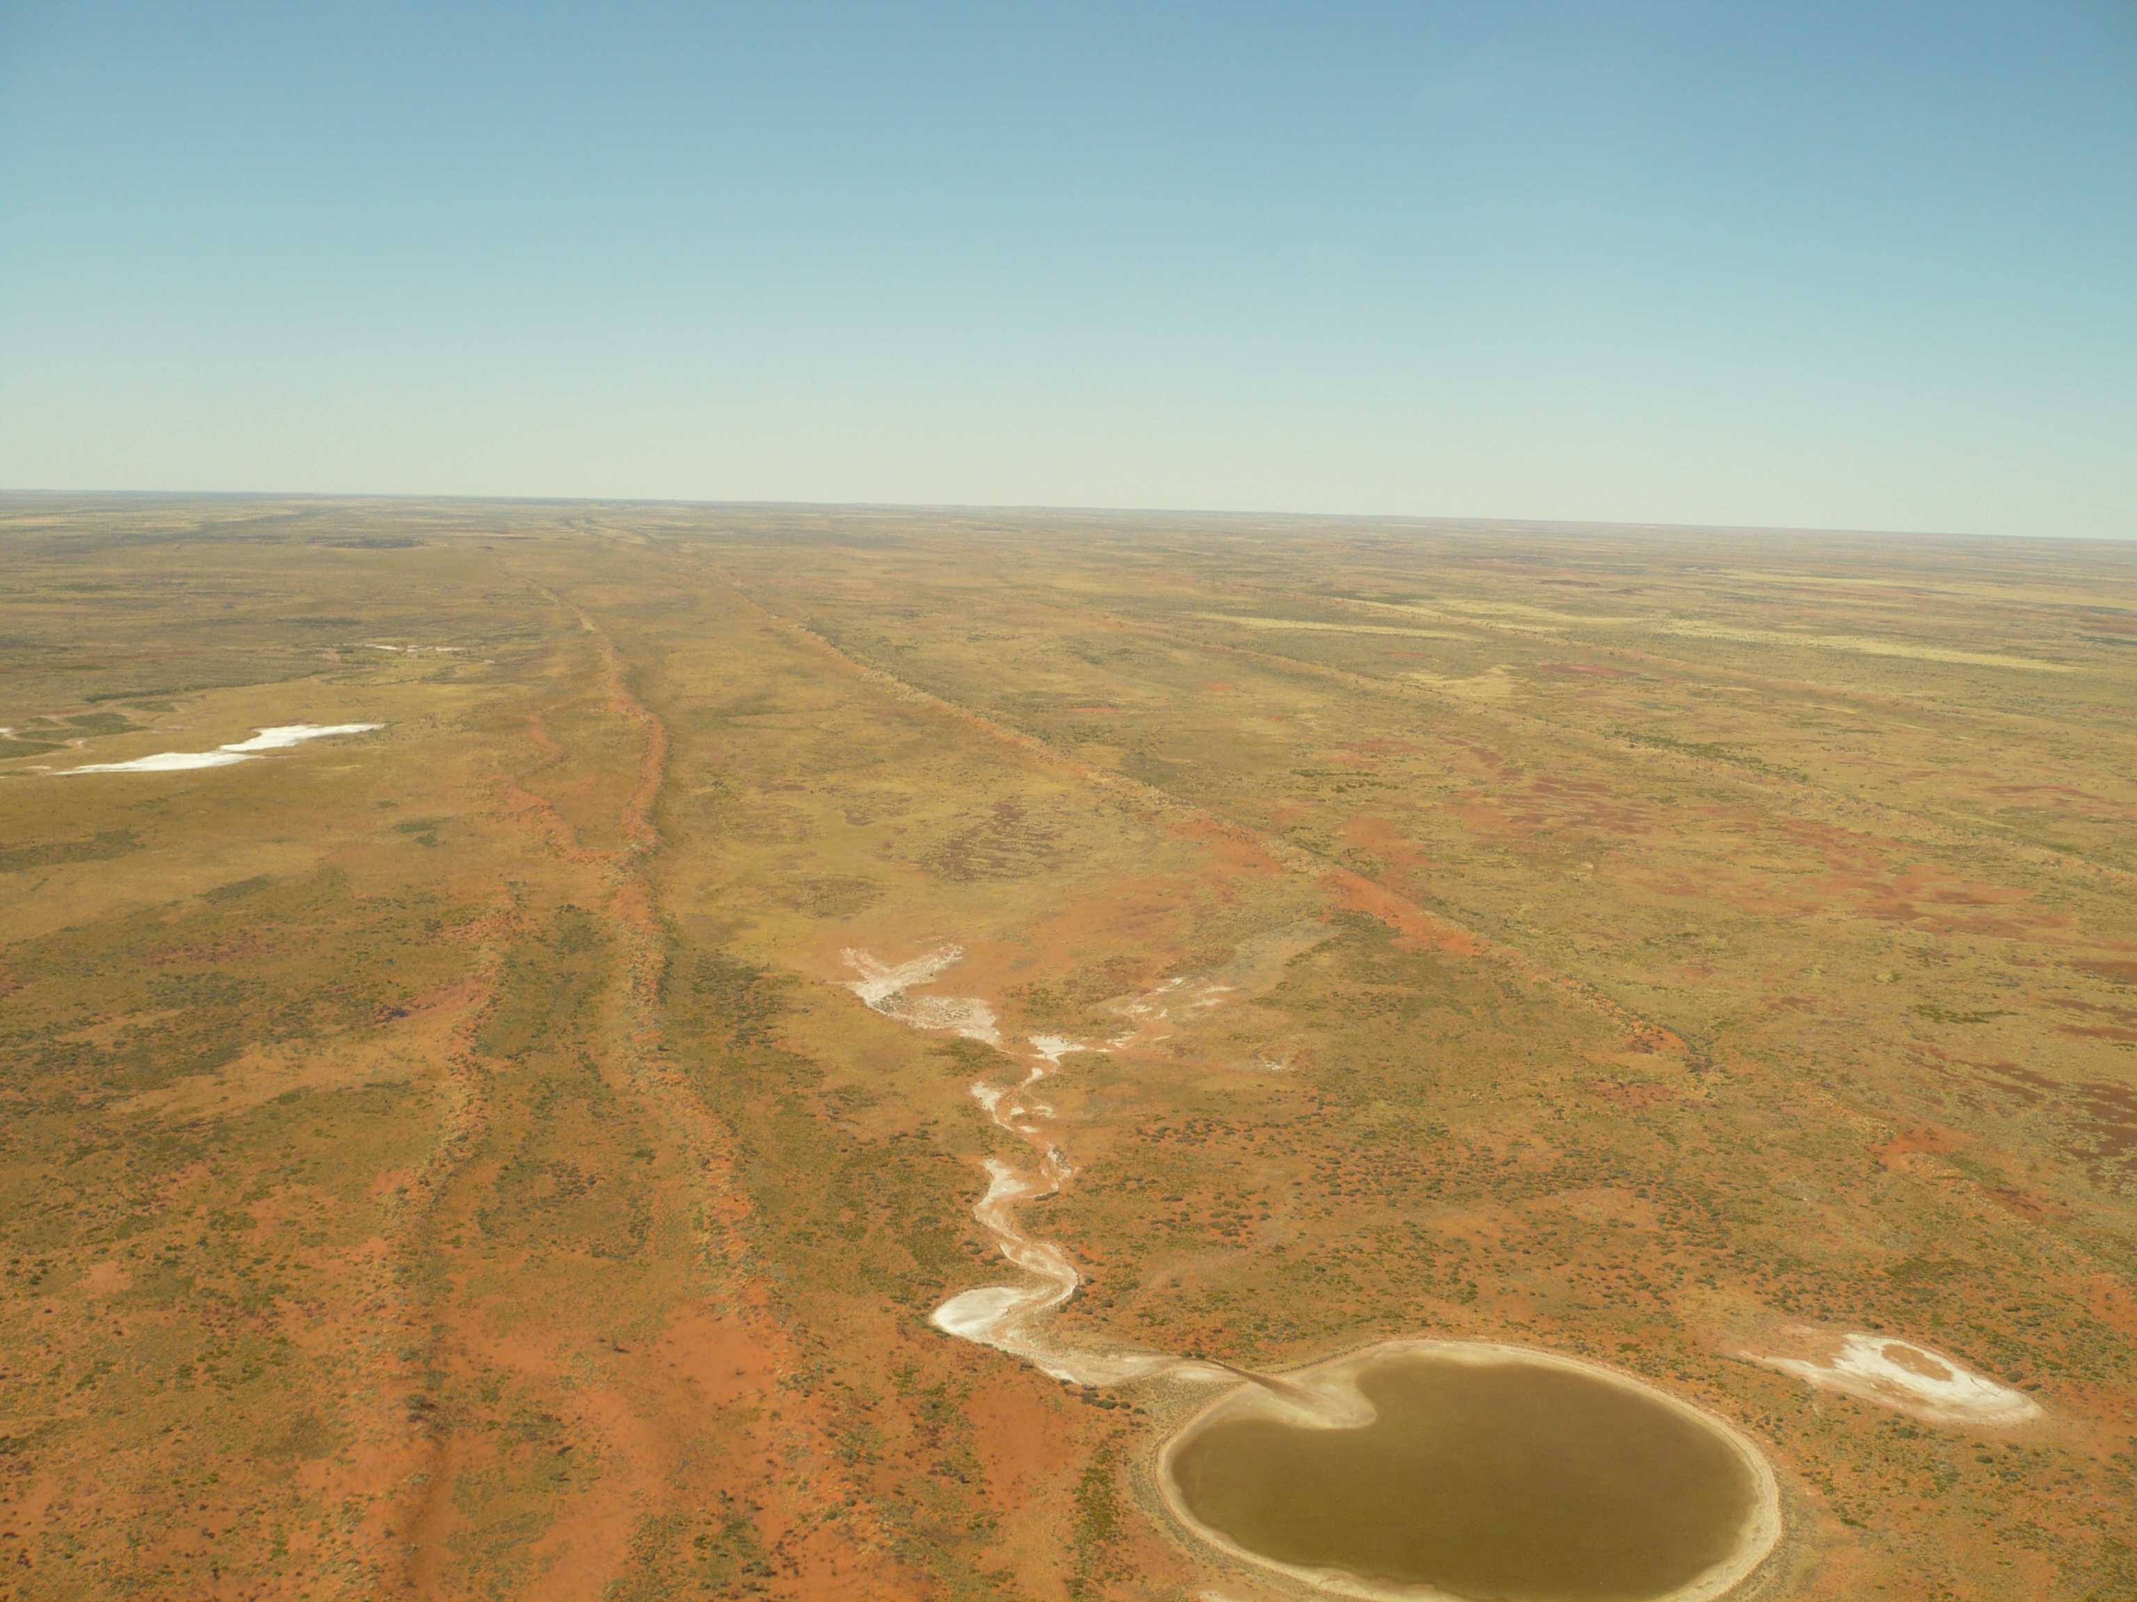

Slide 42
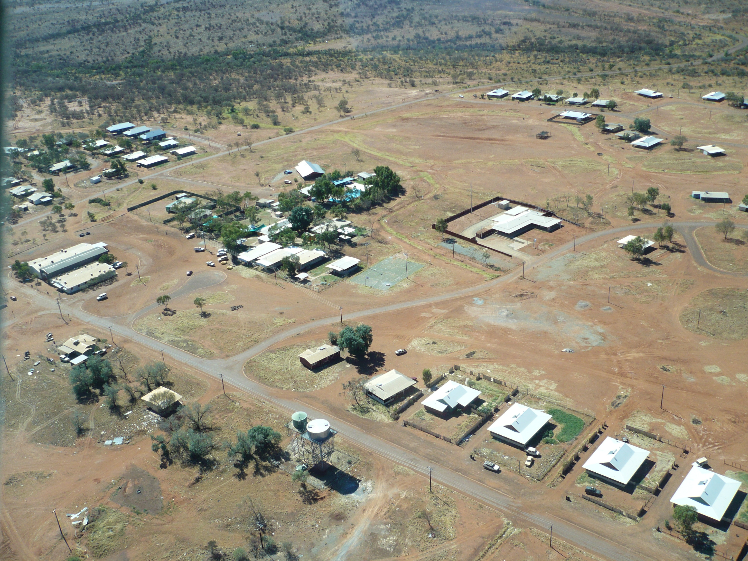

Slide 43
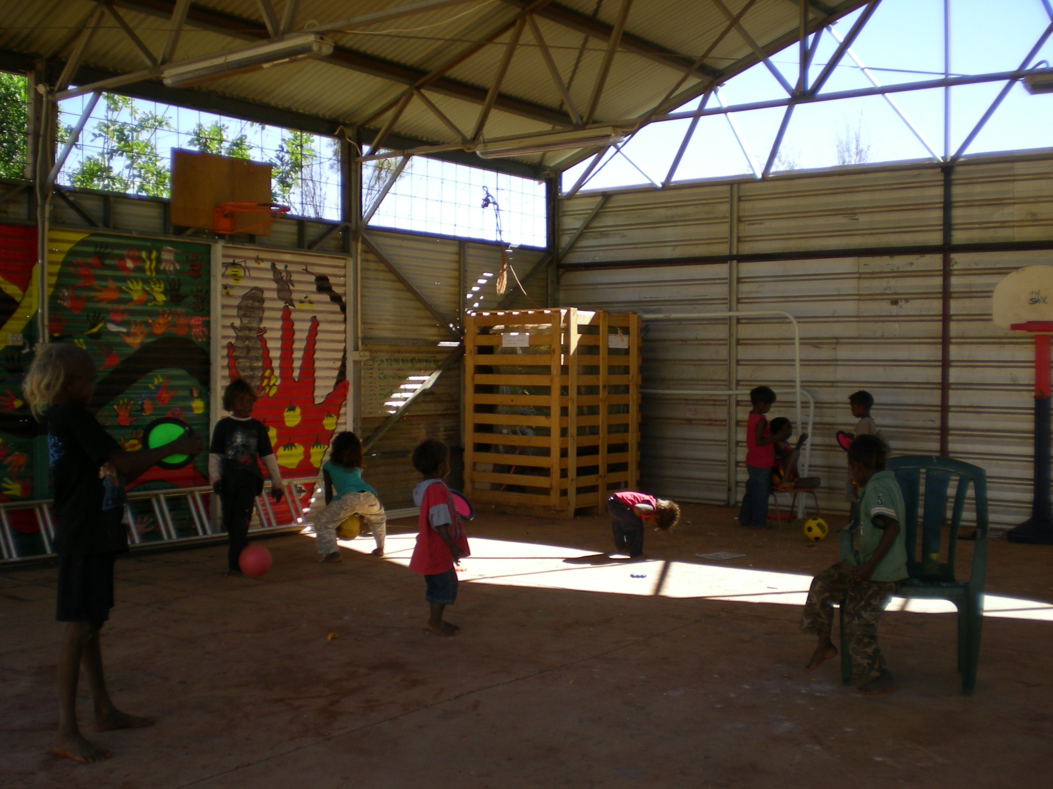

Slide 44
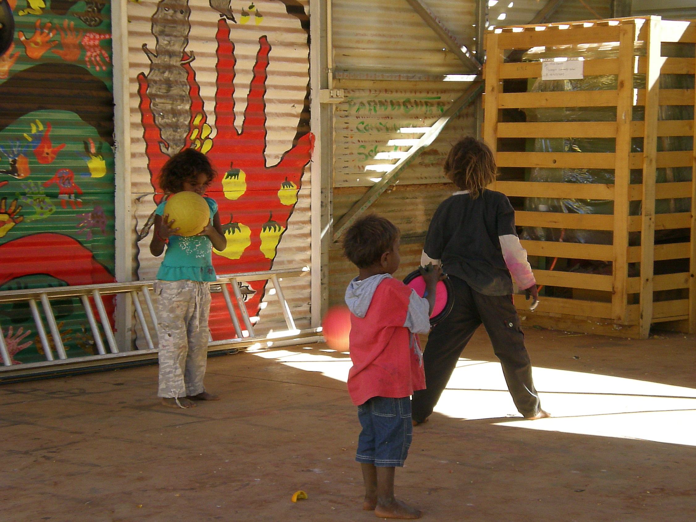

Slide 45
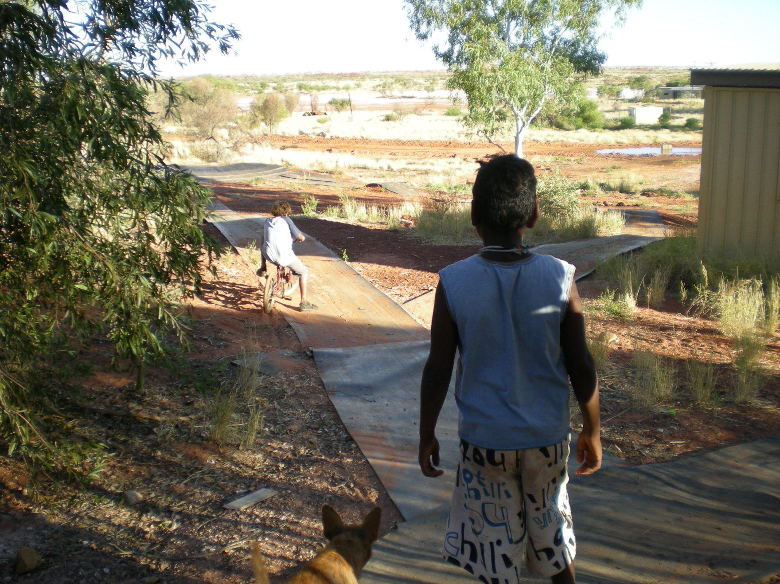

Slide 46
Key research challenges
Keeping the project focused; staying on track;
managing competing expectations;
once people in the community raise issues they want something done;
managing different role/relationship expectations (what do you with some of the stories people share).

Slide 47
Challenges
These partnership processes can also be ambiguous, arduous and time consuming to get it right when working with Aboriginal communities – a fact that many funding bodies, grant institutions and ethic committees often fail to grasp.

Slide 48
Challenges
What do we do with the hard stuff- the moral/ethical dilemmas;
Working out when to take up advocacy work;

Slide 49
Where to from here?
So the challenge and opportunities for all of us is to determine how can we work together in ways that are empowering – that support both cultural continuity, connection and strengthen the capacity and capability of individuals and communities

