Slide 1
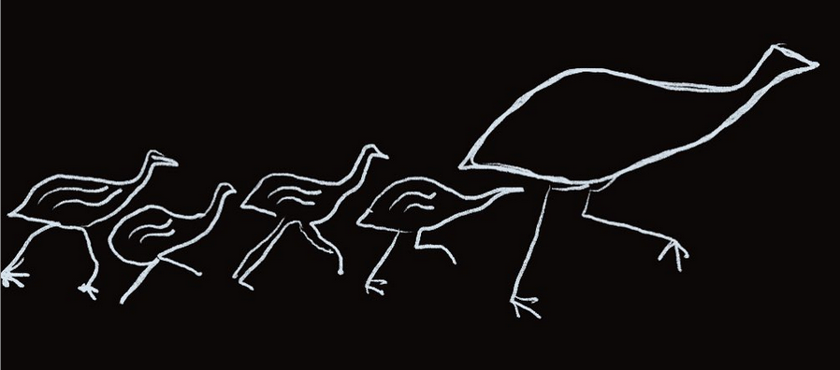
Bayala Dharug Dhalang

Slide 2
Bayady’u budyari Ngunnawal yiyura
Yiyura Ngurragbirang.
Bayady’u budyari warungad baranyiin, yagu, baribugu.
Bayady’u budyari Aboriginal, Torres Strait Islander yiyuragu ngurra bimalgu.
I pay my respects to the Ngunnawal people.
The people who belong to Country.
I pay respect to Ngunnawal elders past, present and emerging.
I pay respect to all Aboriginal and Torres Strait Islander peoples and their homelands.

Slide 3
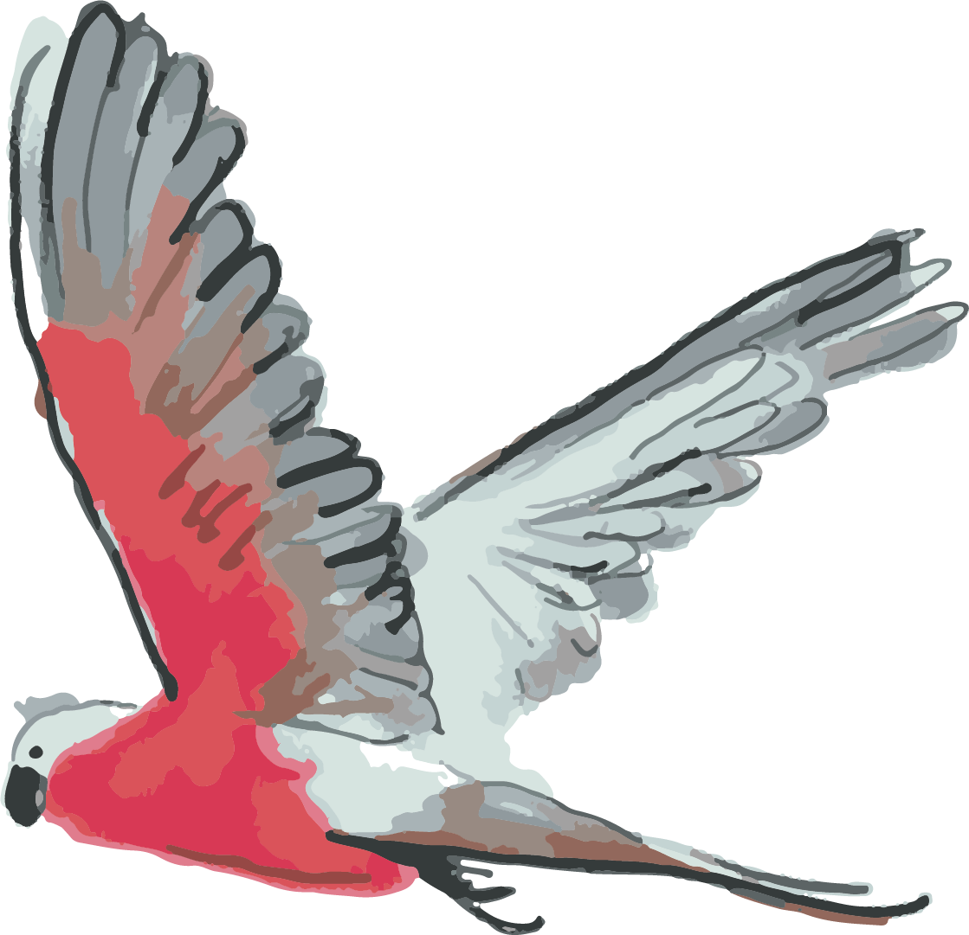
Who we are:
Jasmine Seymour
Corina Norman
Ngilaya Dharug yiyura. We are Dharug people
Ngilaya Dharug Ngurrabirrang. We belong to Dharug Country

Slide 4
Dharug language group belongs to most of the Sydney basin area.

Slide 5
Thank you to AIATSIS for organising this symposium.
This is a wonderful opportunity for us all to really listen and learn about all our different stories for our languages.
There is such a range of language stories here. Our language stories all weave together into the language picture of this continent.
We stand with everybody here and support what is needed for everybody’s languages.

Slide 6
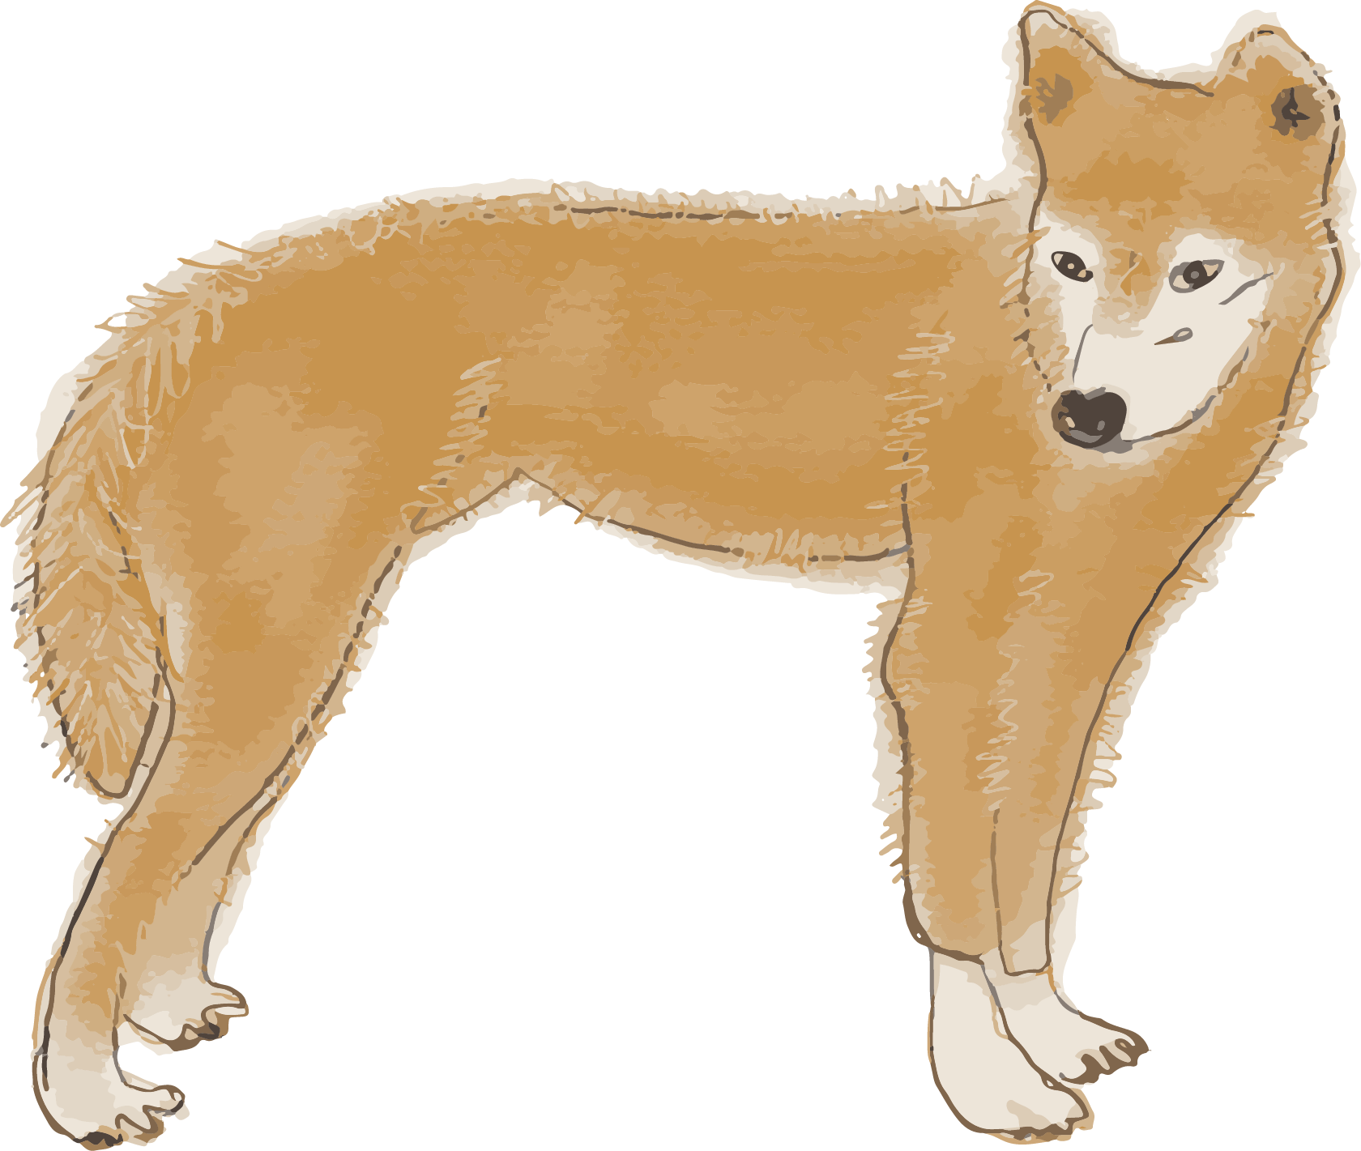
We have just heard from the Top End and the Centre - where some languages are relatively strong.
Our language story is from the other end of the spectrum: But even though we are reviving our language our language is just as important to us.
The Dharug situation has lots in common with Ngunnawal.
Both belong to areas that experienced early Invasion, now capital cities.
Residents –Indigenous and non-Indigenous – come from all over.
Our languages are being reawakened/reignited, so everyone in our language communities are at various stages of learning our language. We are all learners.

Slide 7
Language revival/reawakening/reigniting
The revival context is unfortunately probably the most common language story in Australia.
Dharug language revival work is
without the support of a language centre
not under a NSW Education language nest
at a relatively early stage of the language revival journey
hugely meaningful for our community members’ identity
significantly increasing our recognition by the wider community

Slide 8
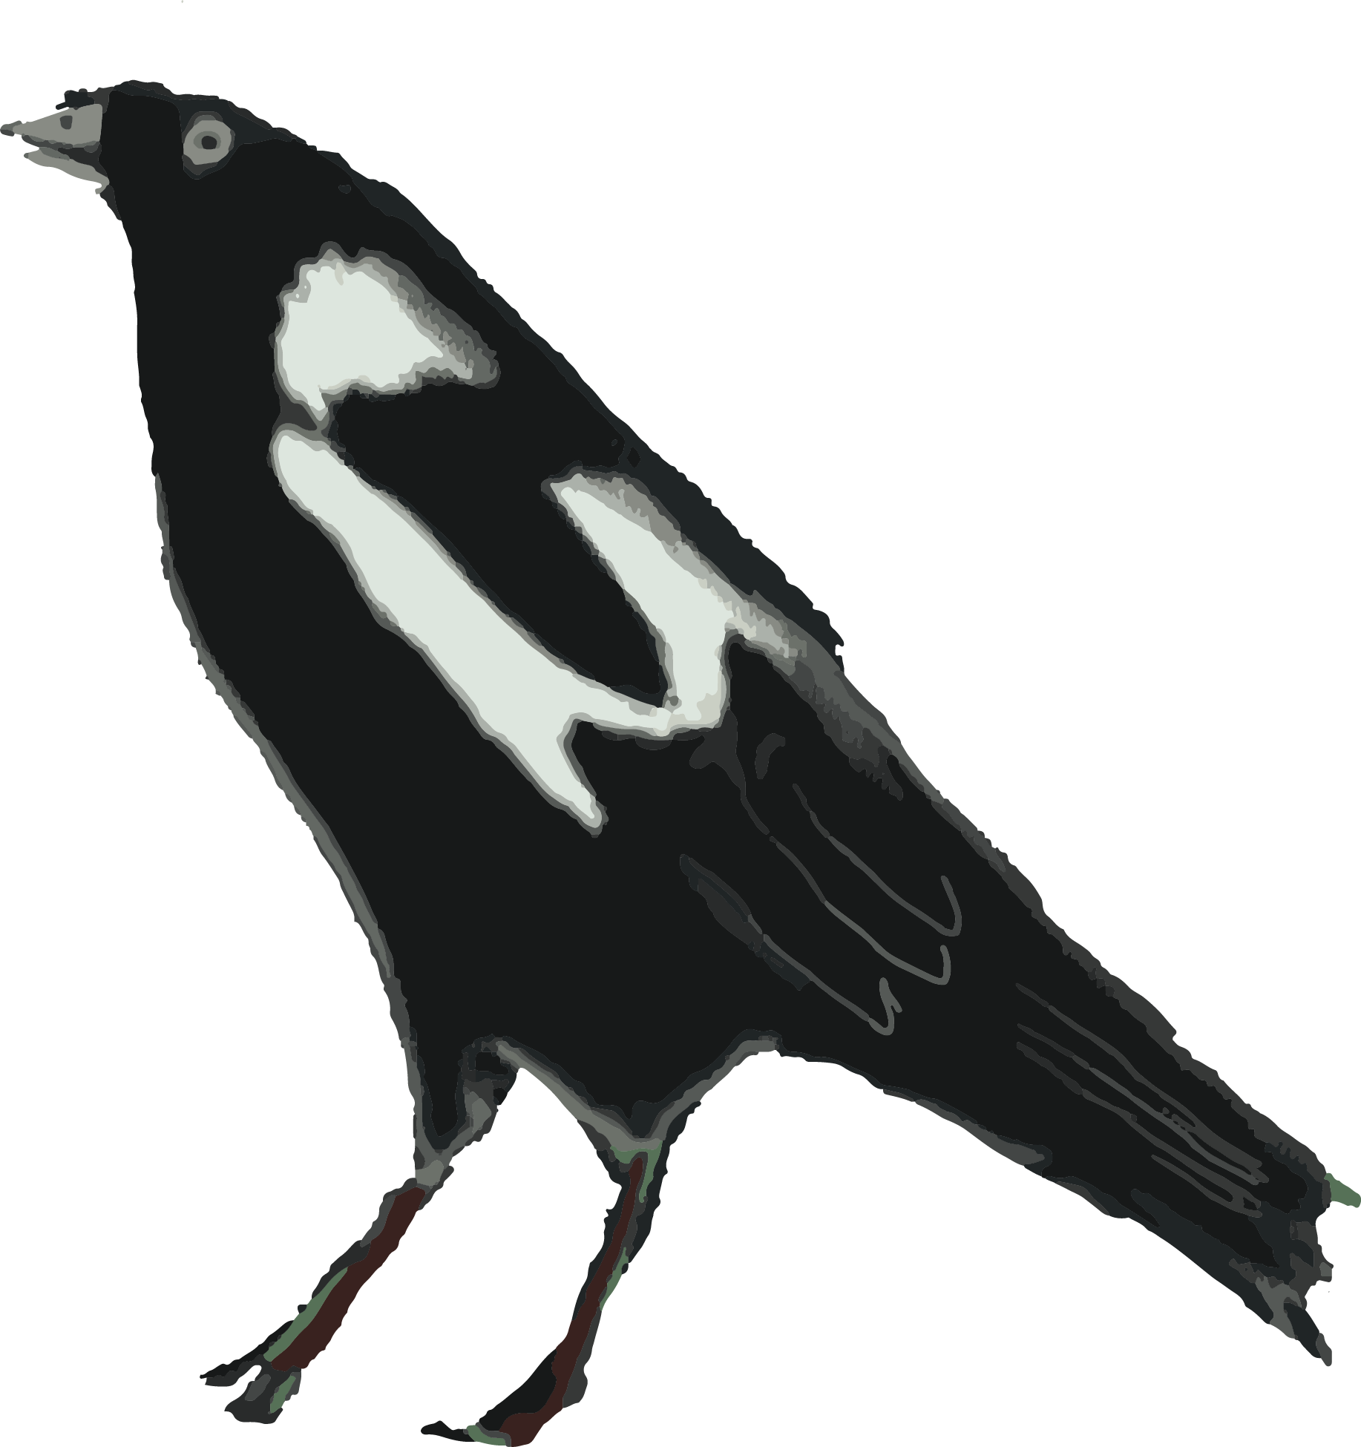
Our languages have the power to create change.
There is a groundswell of demand for Dharug language programs - that we all want it and we can do it – there’s a sense of the benefits for students, Aboriginal community and the wider community too.
Dharug language work opens doorways for Aboriginal people who might not have ever experienced positive educational outcomes.
Community members who are engaging in learning language become visible and “desirable” due to their potential to support language programs.
Notes:
I myself am constantly offered language teaching jobs.
And we are beginning to see people who are engaged in learning Dharug getting employment offers and being headhunted for positions that they might not have been considered for otherwise.
A

Slide 9
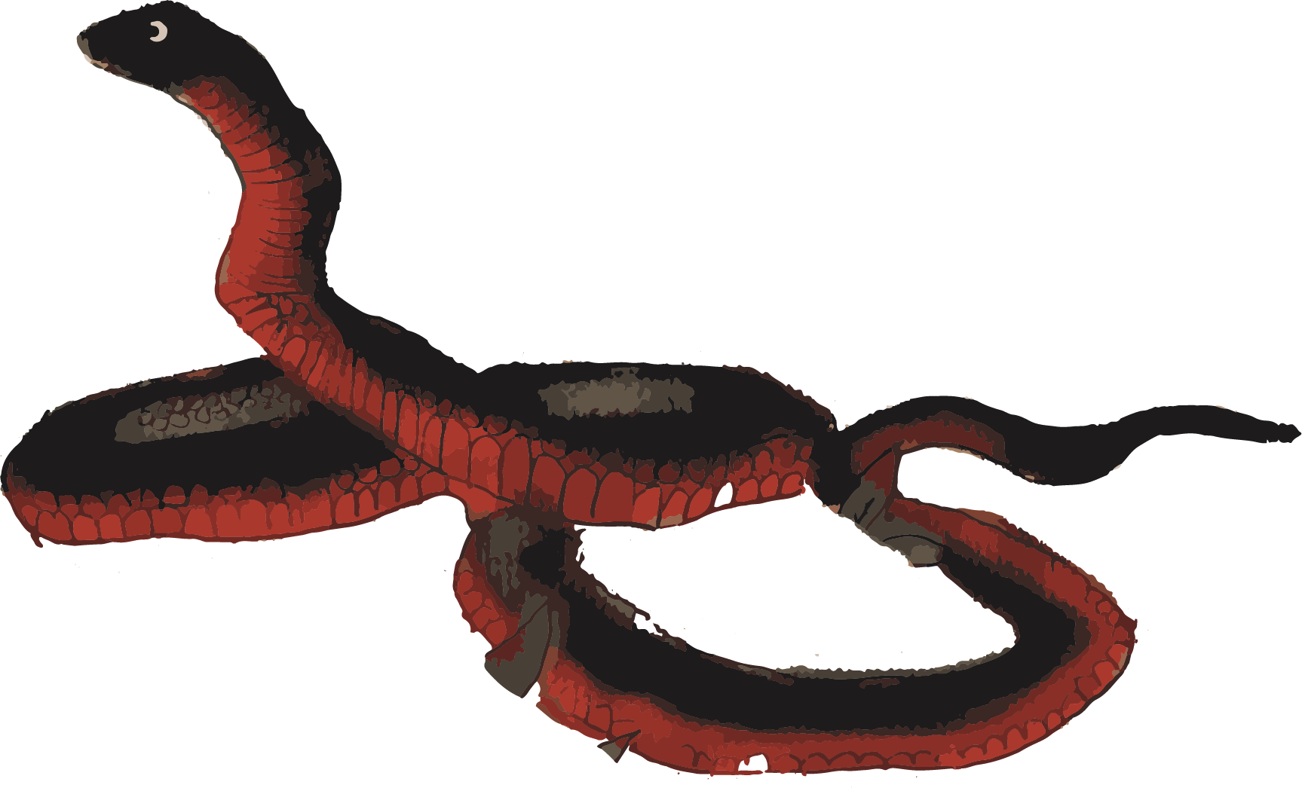
Language builds confidence.
Language gives people agency.

Slide 10
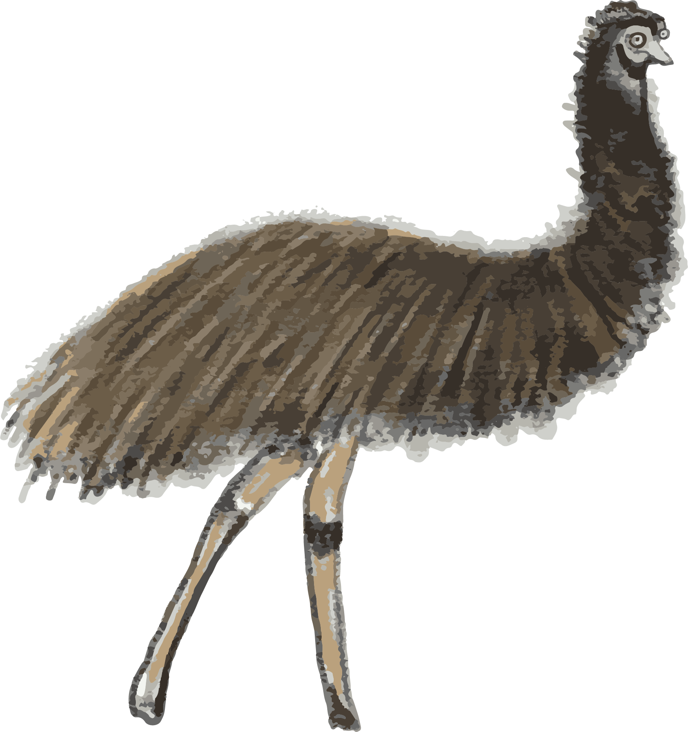
Dharug Dhalang language revival journey
We stand on the shoulders of our many Dharug language heroes and language activists.
In the past Dharug has mainly focused on Vocabulary and formulaic phrases for Welcome to Country ceremonies or other events.
We are building on this, going back to the records of our language and creating communicative language (phrases, sentences, questions) for speaking with each other.
We are sharing everything we do with the Community

Slide 11
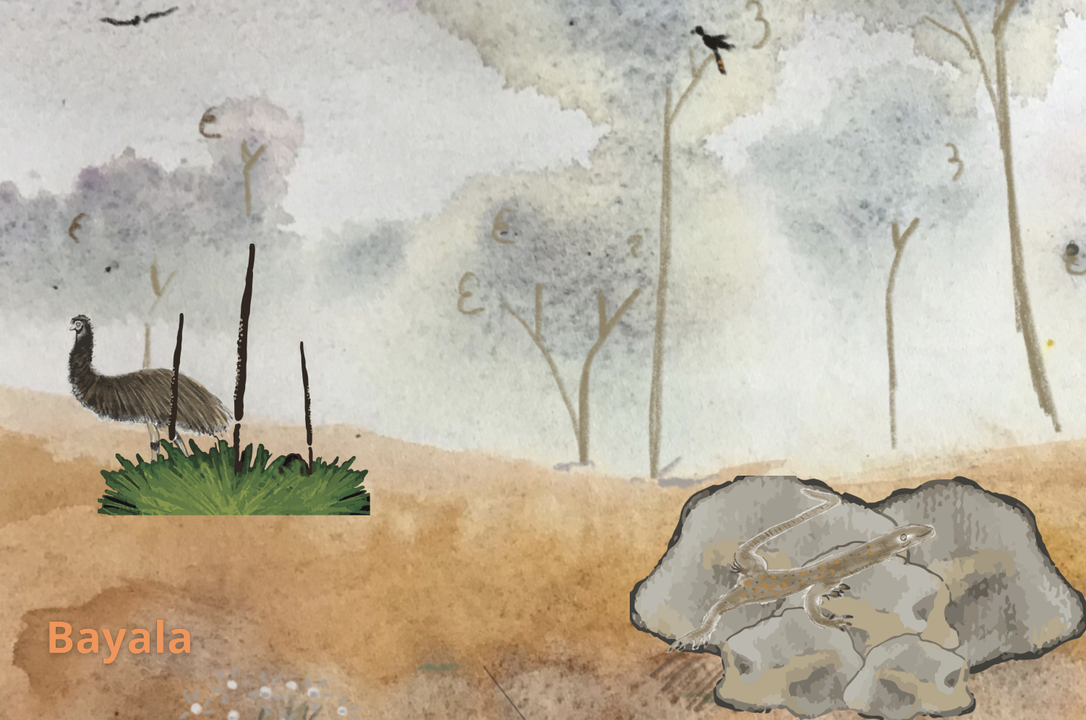
Content words
Yarra - tree
Giba -rock
Guwiyang -fire
Dhurabang - river
Gadi - grass tree
Biyang - dad
Wayang - mum
Biyanga -father
Wayanga - mother
Dyurumin - sister
Babana - brother
Dingu - dingo
Girrawi - cockatoo
Barra - eel
Wirriga - goanna
Dyirrabidy - black snake
Gula - koala
Buru - kangaroo
Waa naadyimi?
What you see?
Naady’u mariyang gadiwa
I see emu behind the grass tree.

Slide 12
How are we doing it?

Slide 13
MILE: Masters of Indigenous Languages Education
(Sydney University)
available to Aboriginal and Torres Strait Islander teachers
us already, 3 more in 2022, more in 2023
toolkit for understanding language description and language teaching
• not part of ”mainstream” educator training
also: engage with broad range of people and languages and their different situations across Australia.
Many groups are in same reawakening phases as Dharug
Hopeful and inspiring
Also shocking….
Shows hows how much work is still needed in revival settings.

Slide 14
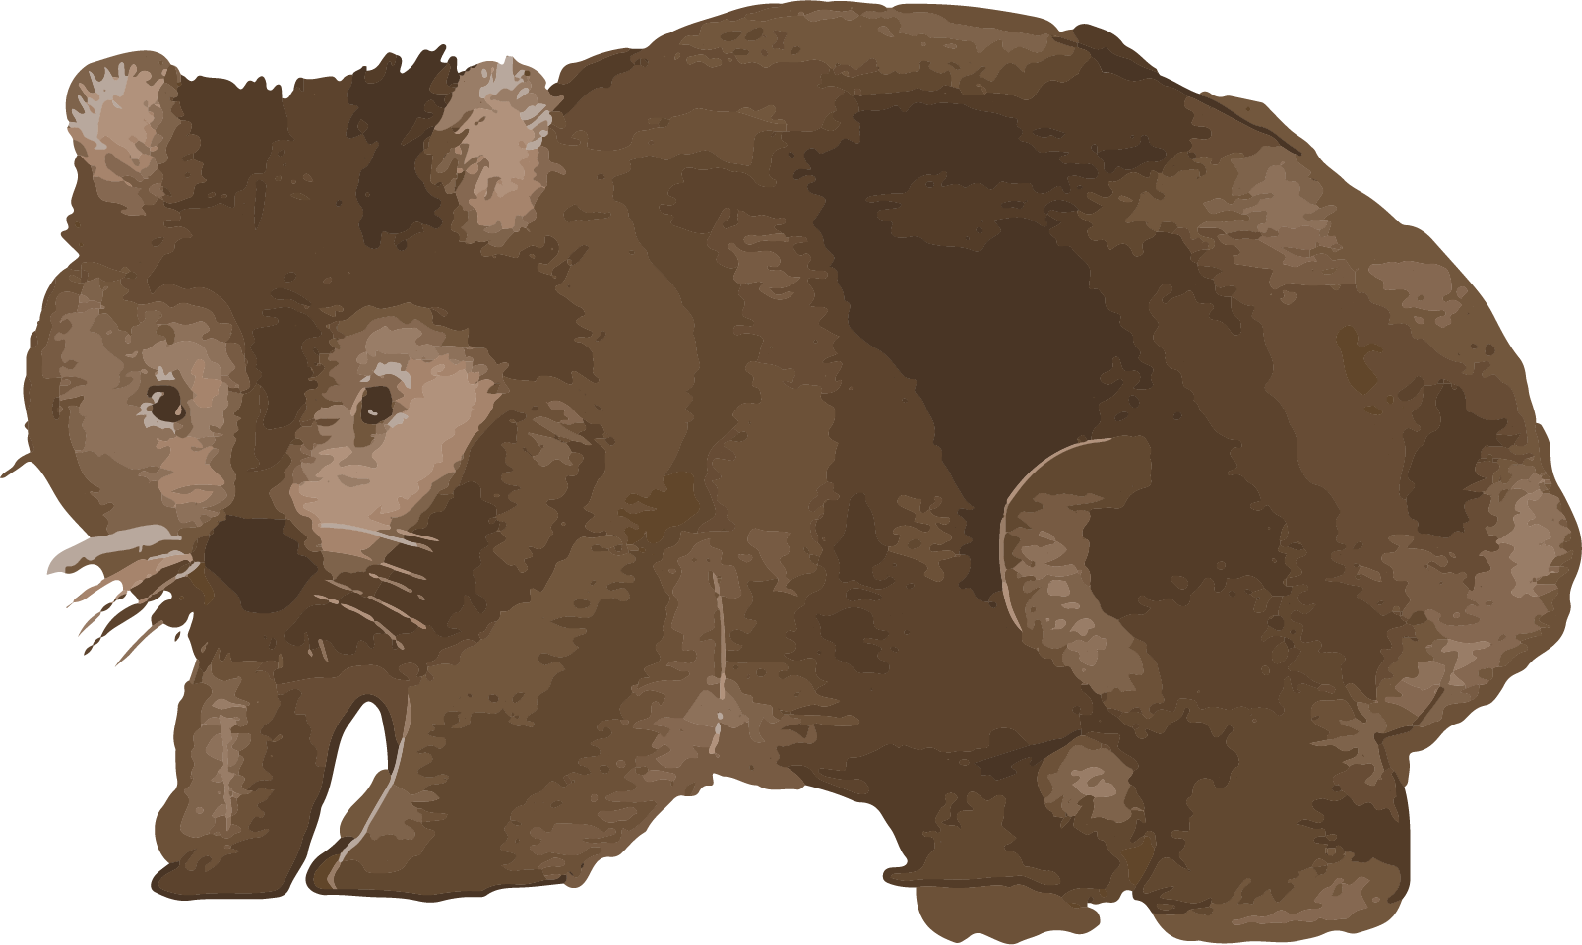
ILA grant: Community language lessons, learning resources
Developed and delivered community language lessons (8 weeks)
500+ people in first year
COVID forced into online delivery now back to face to face
Current large group
LOTS of community enthusiasm
Facebook group, online learner group too
Moving beyond the word list and creating communicative responses.
Developed accessible learning resources
Progressing language description
Increasing language learning resources
Making Strong allies - Aboriginal and non-Aboriginal
We now have lots of language advocates
We have created partnerships

Slide 15
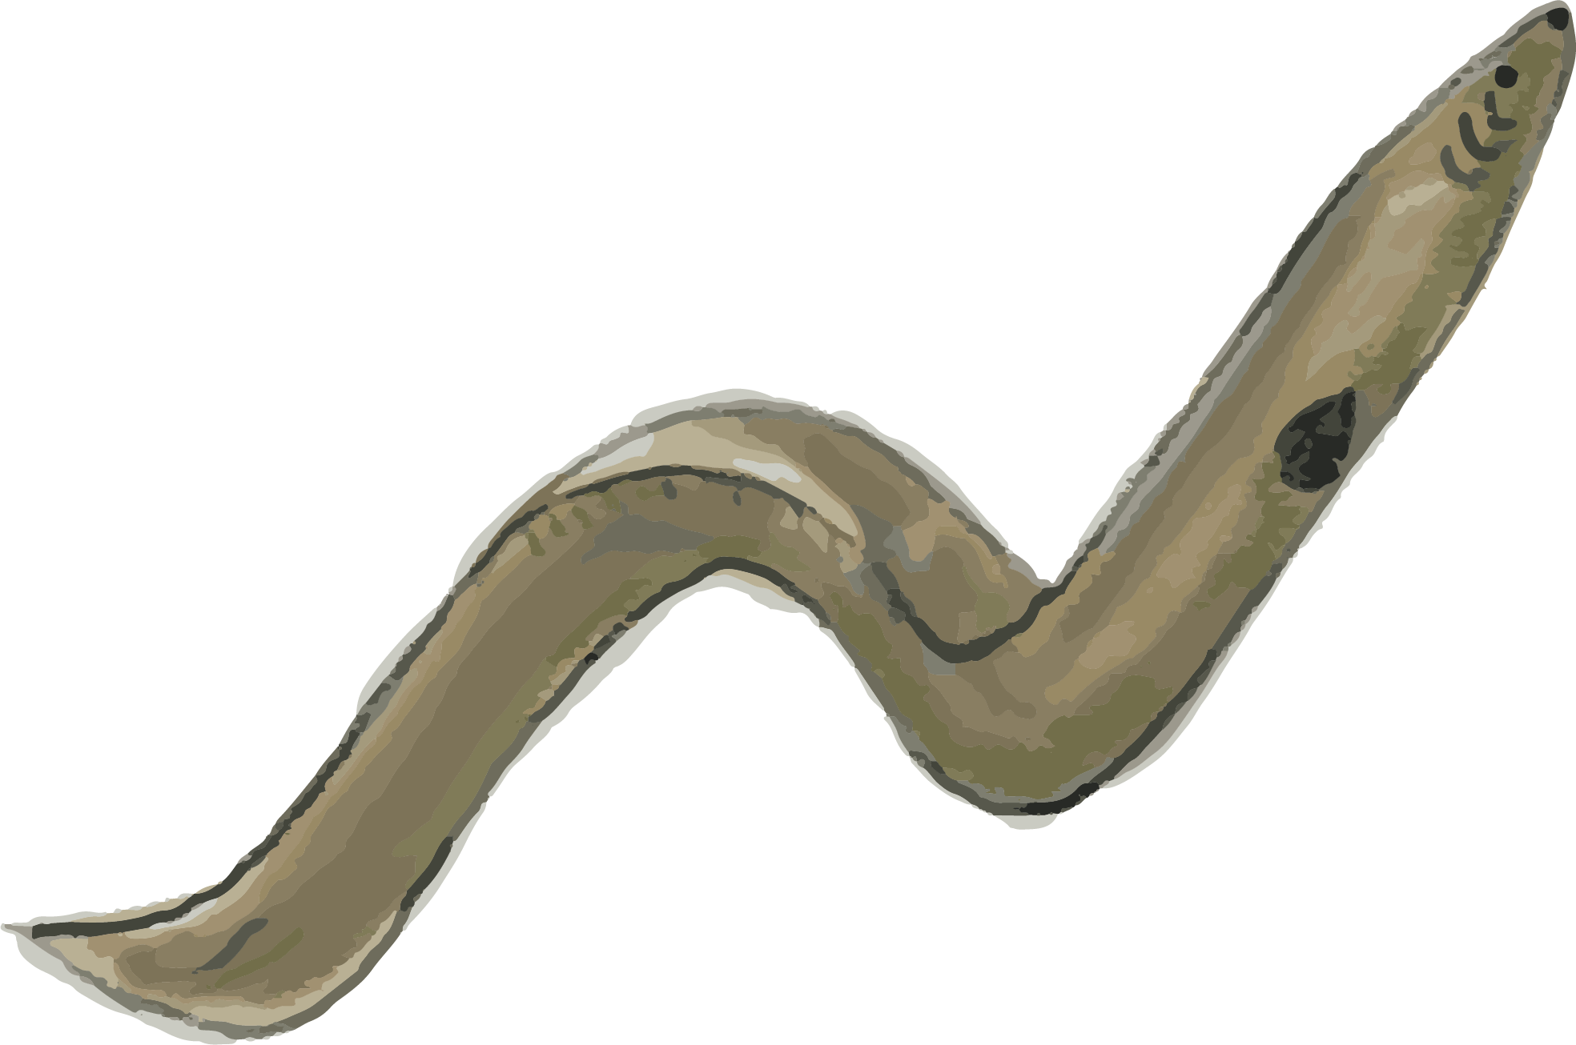
SIGNIFICANT PARTNERSHIPS
Many, but example for ILA…
Two different Dharug organsiations: overwhelming support
core language research partnership: us and extra language researchers (Denise Angelo and David Wilkins)
partnership assists with developing lessons, fuller descriptions of Dharug, more to draw on for community and school language lessons and more accessible language materials.
”Fruits” shared with community members (lessons, facebook group,language materials, current MILE students etc)
Western Sydney University now also assisting – currently with venue for face to face lessons
reate communicative response

Slide 16
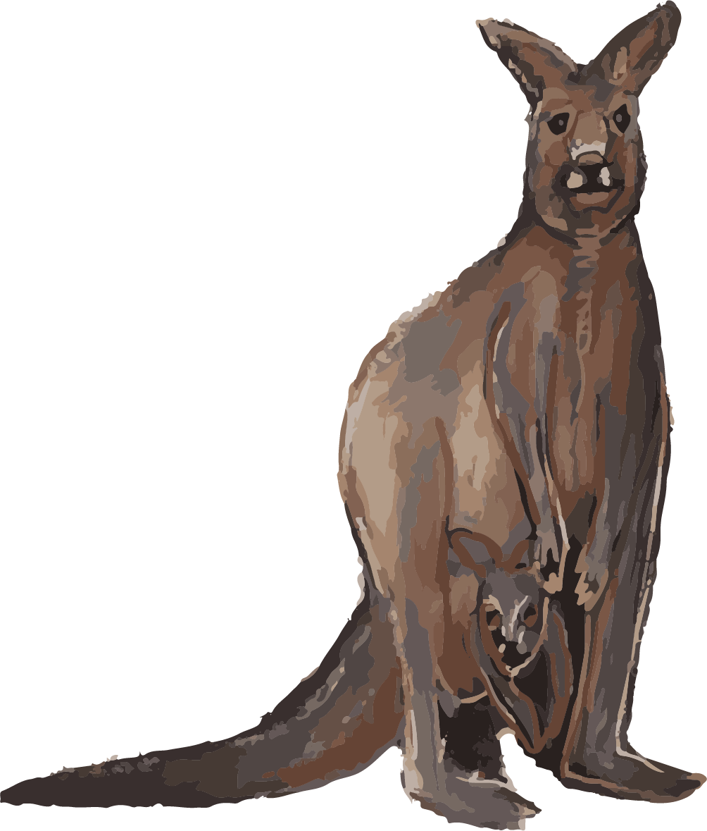
DHARUG SCHOOL PROGRAM
School program (currently very difficult to upscale beyond my single school)
No external support mechanisms: no regional language centre, not part of any NSW language nest etc
Kids get status and recognition from peers and teachers, motivation to be good at it drives their learning.
Some children researching themselves going home using my resources
Children are practising at home, teaching their parents who have not had the same opportunity.

Slide 17
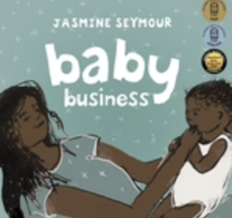
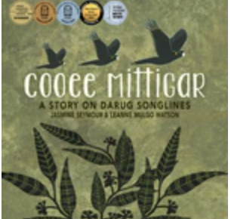
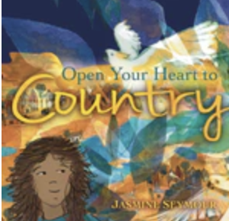
BOOK PUBLISHING
The reason why I initially started on my Dharug language path was as a primary school teacher you quickly realise that there are no resources. So we decided to make some. I can see now that that I was and many others on this journey were at the very beginning of our language learning. A lot has changed since then.

Slide 18
(some of) OUR ISSUES
No consistent funding
$$$$s are hard fought and contested (not fostering cooperation)
Haves and have nots
Makes planning very hard - how to make a living?
one-off/project doesn’t support the continuous language work essential to make more languages strong
closes the door on developing real, ongoing, sustainable language programs
No training pathways or positions
Supporting Dharug, language of place
Despite community interest in learning, it’s difficult to get traction for “Dharug” in Sydney
nowadays more localised words ending in ___-gal, or “Eora Nation” have more visibility
Not our choice: we have right to be heard
Surely people doing the work: study, teaching, sharing, learning, consulting can have a say
Capital cities are complex - people from everywhere, wanting to learn own languages
Dharug people are a small minority - swamped by others and their povs

Slide 19
(some of) OUR ISSUES
Meeting potentially huge demand
Western Sydney has the largest demographic of Aboriginal people.
shameful lack of support for Dharug anguage education here.
no targeted funding despite population (fairness? transparency?)
significant employment opportunities from language programs
resources for language groups who are at the beginning.
Training and professional pathways for the community to become accredited for the purpose of teaching and supporting language.

Slide 20
(some of) OUR WISH LIST
Develop languages policy and quality information & support documents
Develop a broad, inclusive languages policy (currently a policy free zone?)
Recognise the different language contexts for Aboriginal and Torres Strait Islander languages revival - maintenance, starting out - established etc
Be helpful: What might different stages in language work look like: starting off? established? Map it out. Provide community members with useful, practical information
Tailor Aboriginal and Torres Strait Islander language funding for different language situations.
Celebrate and promote Aboriginal and Torres Strait Islander languages
Languages raise profiles of First Nations
Aboriginal people have culture of cultivating multilingualism
Learning languages is good for you - gives you inroads to other languages.

Slide 21
(some of) OUR WISH LIST
Schools, education & training: provide pathways
fair & consistent funding for Aboriginal language programs in schools
funding to support the language pathway for year 11- 12
support key Aboriginal language teachers: work shadowing, modelling, mentoring programs,
assistance with succession planning
training and professional pathways for community members to become accredited for the purpose of teaching and supporting language (pre-school, school, high school, TAFE).
We want a better languages pathway. The system advocates for community members to teach but no NSW pathway for them other than being paid as an Student Support Learning Officer (SLSO) or Aboriginal Education Officer (AEO).
Limited authority to teach (WA model)
Support language resource development
Language programs need teaching and learning resources - literature, songs, graded lesson plans…
Language curriculum development
We have generalised Aboriginal & Torres Strait Islander languages curriculum documents - national, state, TAFE (shells) - everyone has to create their own curriculum for their language, no resources to support this - need knowledgeable assistance

Slide 22
(some of) OUR WISH LIST
We want to be counted
Target 16: Closing the Gap
Cultures and languages are strong, supported
and flourishing
By 2031, there is a sustained increase in the number and strength of Aboriginal and Torres Strait Islander languages being spoken.
Our GROWING number could be counted for target 16 (in a language revival category) but we are not yet visible.
In the recent Census many Dharug people nominated that they were using Dharug in the home.
But Dharug people cannot be counted as Language speakers/users at home because the ASCL (Australian Standard Classification of Languages) doesn't include Dharug.

Slide 23
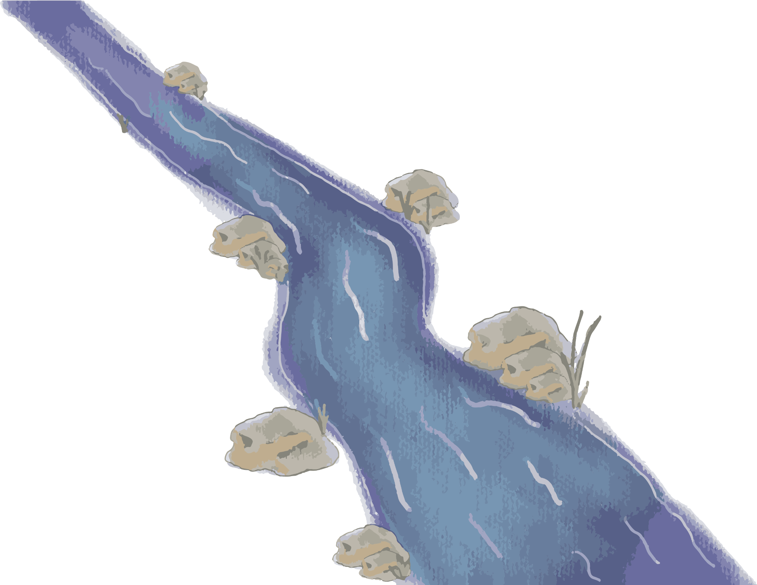
(some of our) FUTURE PLANS
Western Sydney Uni
2 Dharug women doing research degrees
developing a Dharug Course?! and …….!!!
More MILE graduates (our only source of training - for existing teachers)
3 currently doing MILE in 2022
more next year
(all inspired from community language lessons)
Sharing my school language program
Work shadowing at school
More pathways
TAFE certificates?
year 11 and 12 students?
Language resources:
lots of accessible language learning materials
writing up a description of language

Slide 24
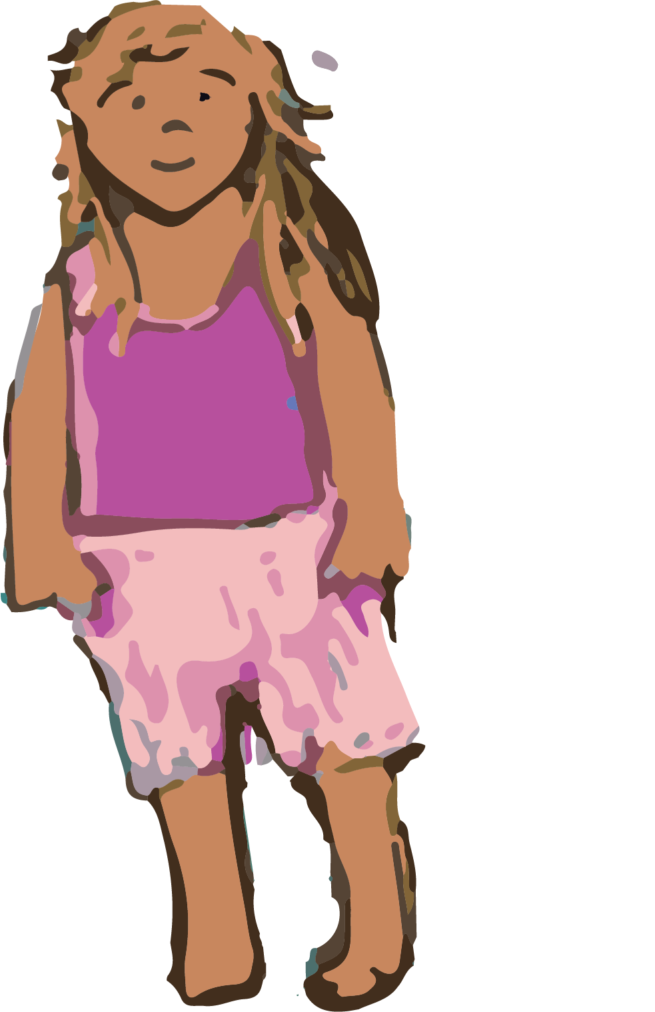
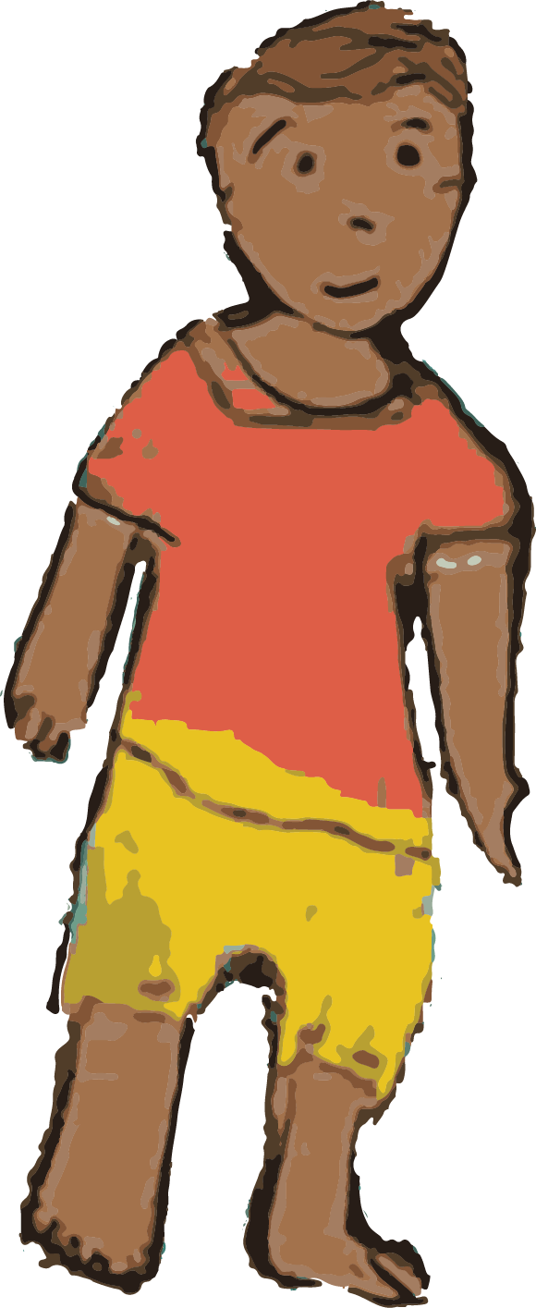
We remain hopeful and inspired by our growing community of learner language speakers!

Slide 25
Yanu

