Slide 1
Top End Language Forum
… and the Strong Languages 2032 statement

Slide 2
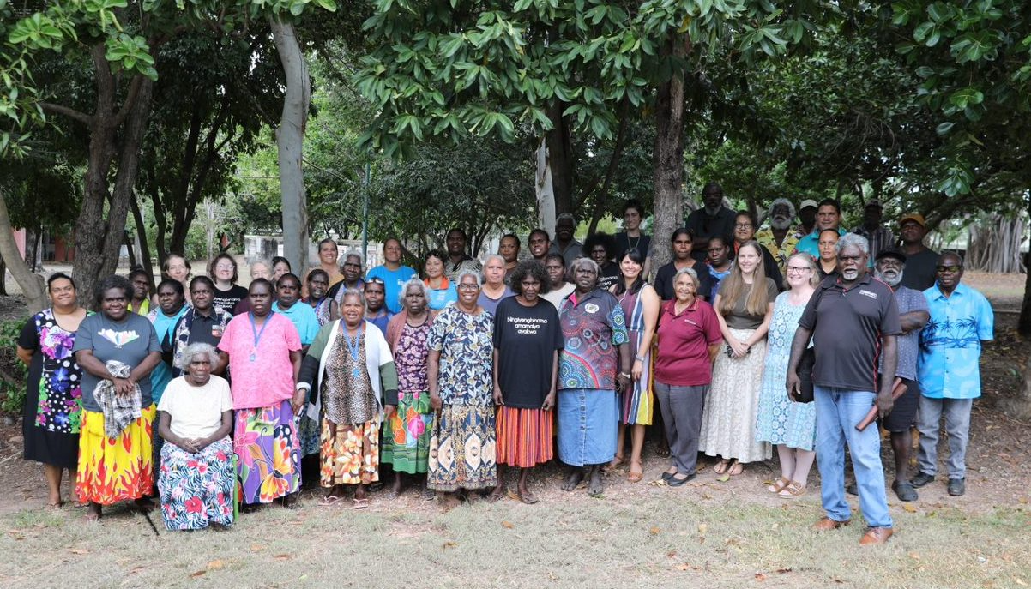
from all across the Top End…

Slide 3
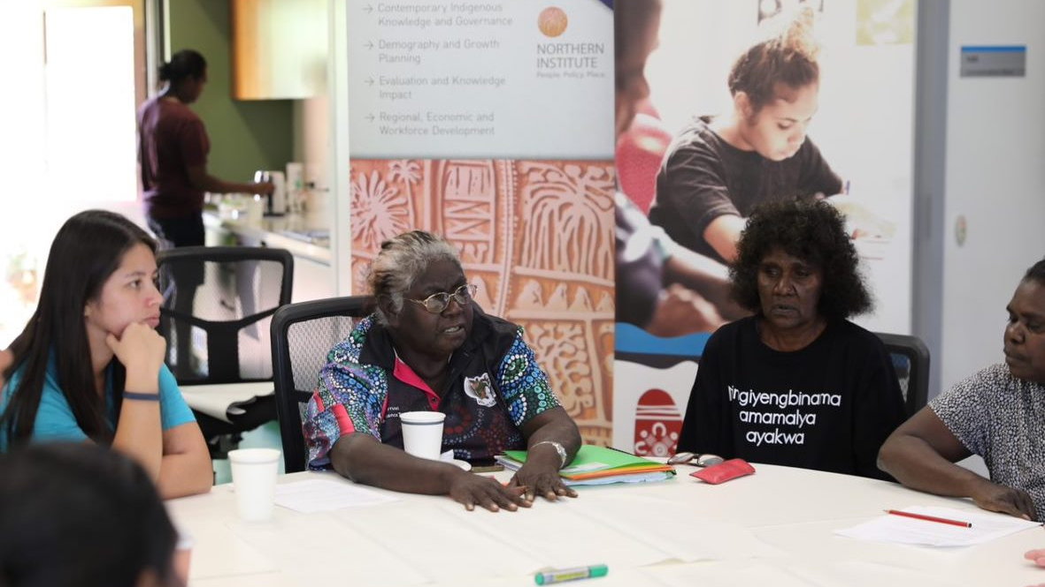
Working together

Slide 4
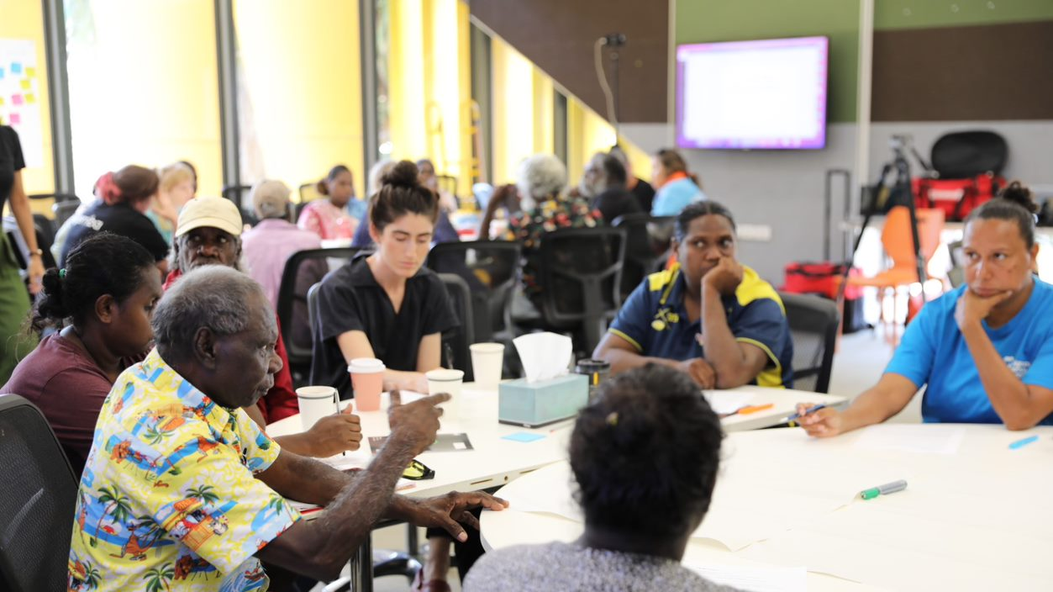
the future of our languages

Slide 6
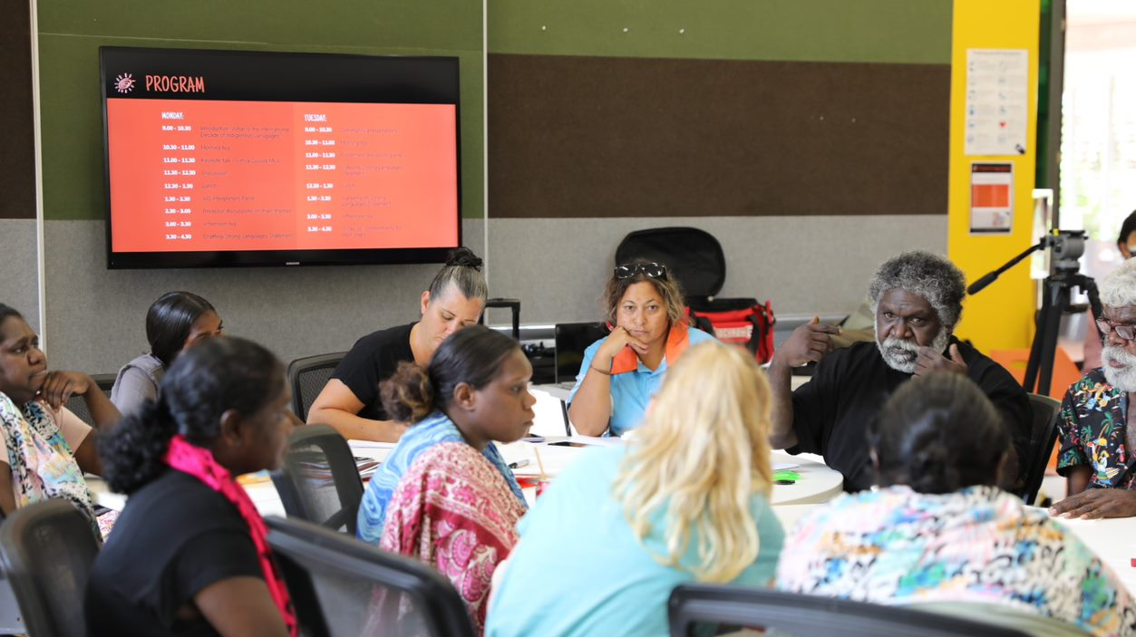
Next steps…

Slide 7
Who was there?
Indigenous discussion space (non-Indig assisting only)
60+ representatives from 10+ communities across the Top End
Many languages used in the meeting, including: Anindilyakwa, Djambarrpuyŋu, English, Kriol, Kungarakany, Mawng, Tiwi, Wagilak, Warlpiri

Slide 8
What did we do?
Meeting at Charles Darwin University, 6-7 June
Discussion, panel, sharing views (not a standard ‘conference’ style with strict schedule)
Drafting of Strong Languages 2032 statement

Slide 9
How did it happen?
Organised over one year by: John Mansfield, † Cathy Bow, James Bednall, Melanie Herdman, Pirrawayingi Puruntatameri, Allyra Murray, Lani Buxton
Small budget funded by: University of Melbourne, Batchelor Institute of Tertiary Education, Charles Darwin University, Centre of Excellence for the Dynamics of Language
Chaired by Rarrtjiwuy Melanie Herdman
Keynote speech by MLA Yiŋiya Mark Guyula

Slide 10
Strong Languages 2032 Statement
Bilingual education
Community-based practices
Connecting communities
Raising the profile of Indigenous languages
(draft document for further consultation)

