Slide 1
YÄKU GA RIRRAKAY
APP

Slide 2
The Team
Yalmay Yunupiŋu, Yirrkala Community School
Melanie Wilkinson, NT Department of Education
Jill Wigglesworth, University of Melbourne & Centre of Excellence for the Dynamics of Language
Jake Stockley, Yirrkala Community School
Robyn Beecham, Yirrkala Community School
App developer: Fardin Elias, Omni Laboratories
With much assistance from:
Bamuruŋu Mununggurr, Natasha Bulmirri Yunupiŋu and Banbapuy Whitehead, as well as Rärriwuy Marika and Ganhdhurrminy Yunupiŋu
We also thank the many children who helped us with testing the app, the teachers who allowed us to take them out of class, and the school leadership whose ensured we had time to work together over many years

Slide 3
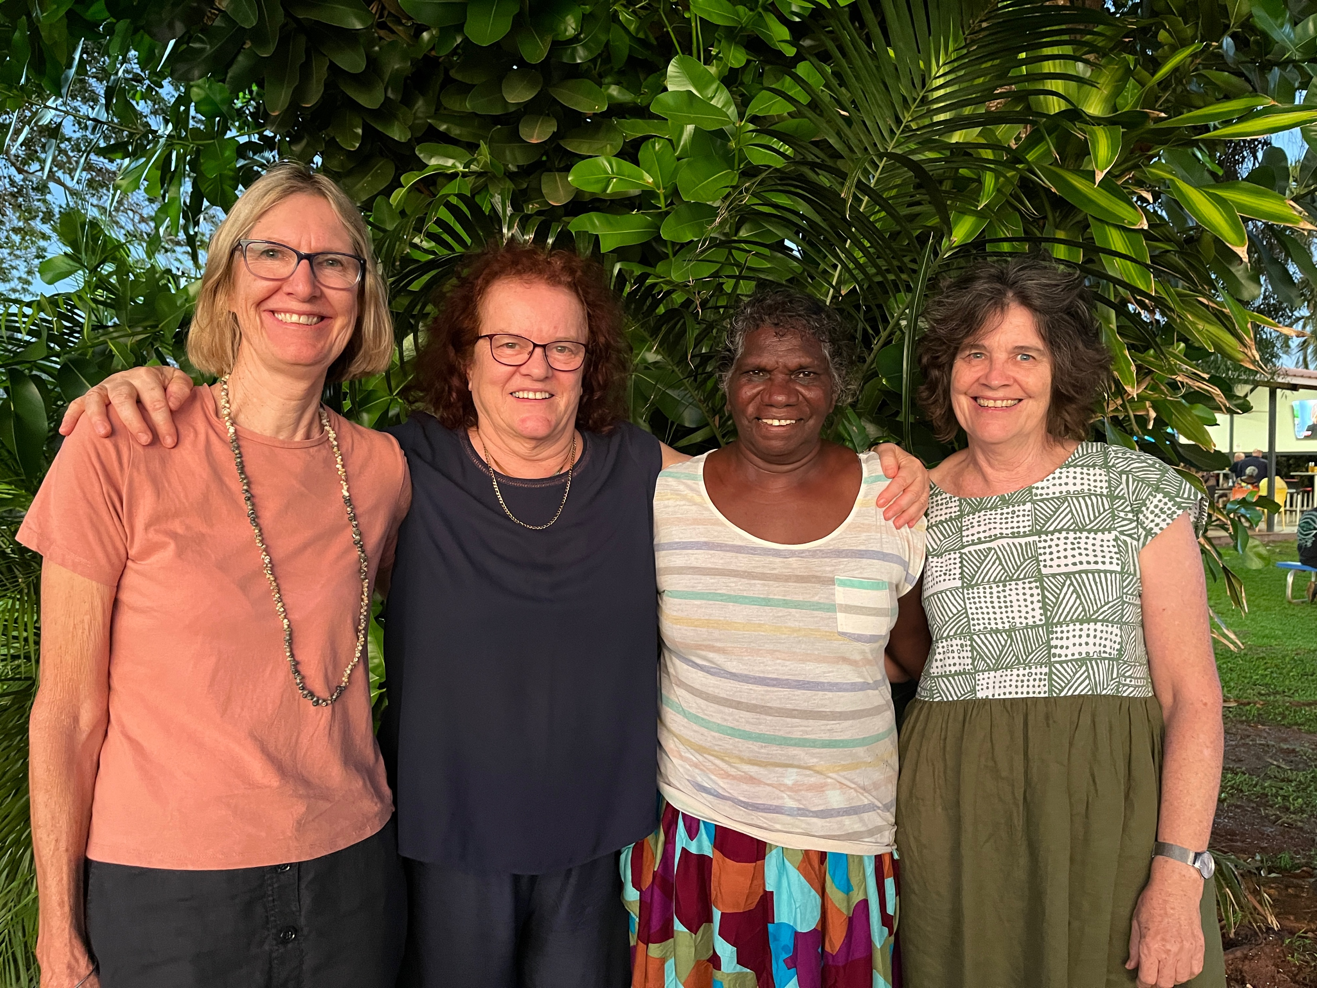
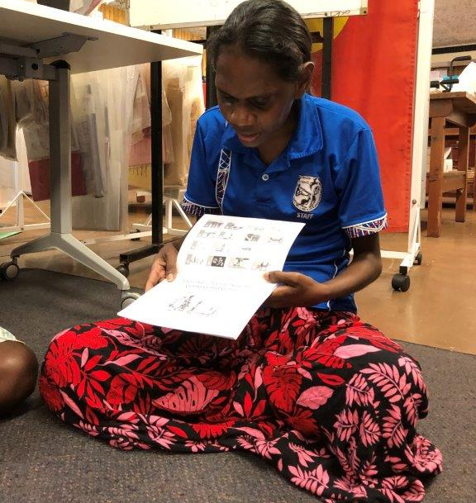
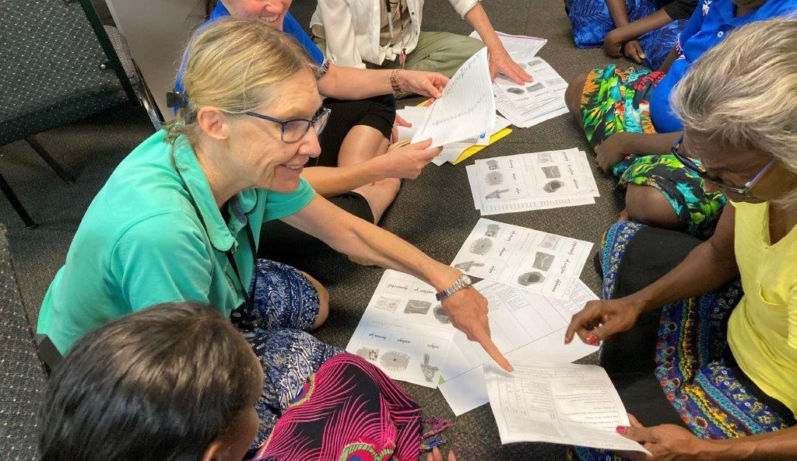
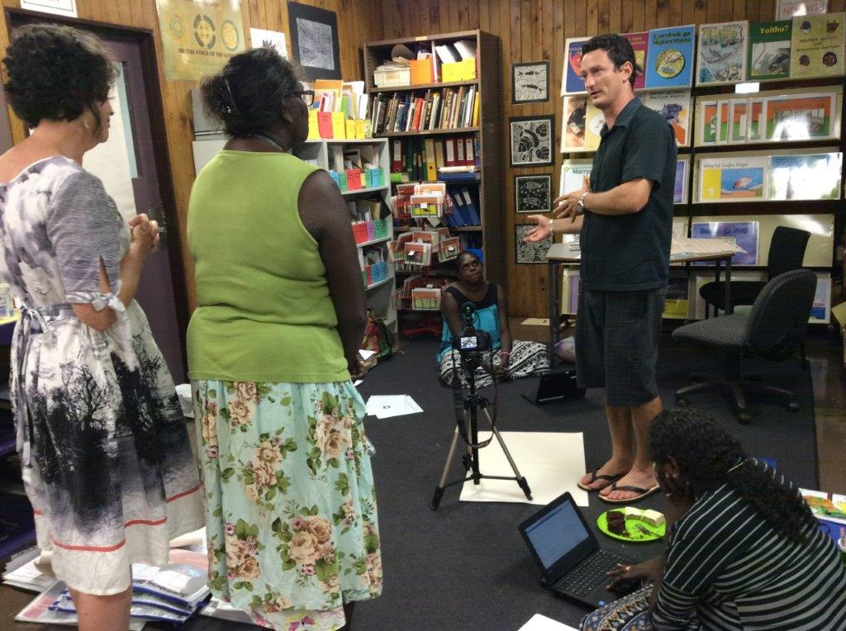

Slide 4
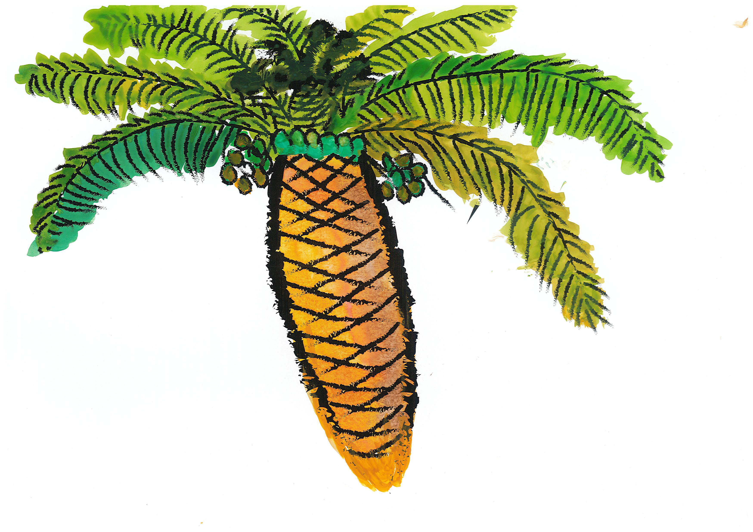
ŊATHU (CYCAD TREE)

Slide 5
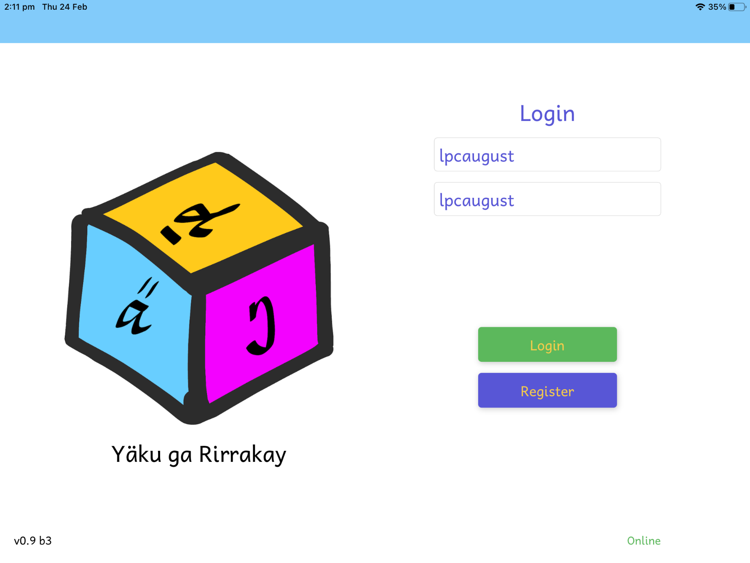
Logging in

Slide 6
Task Levels 1-2

Slide 7
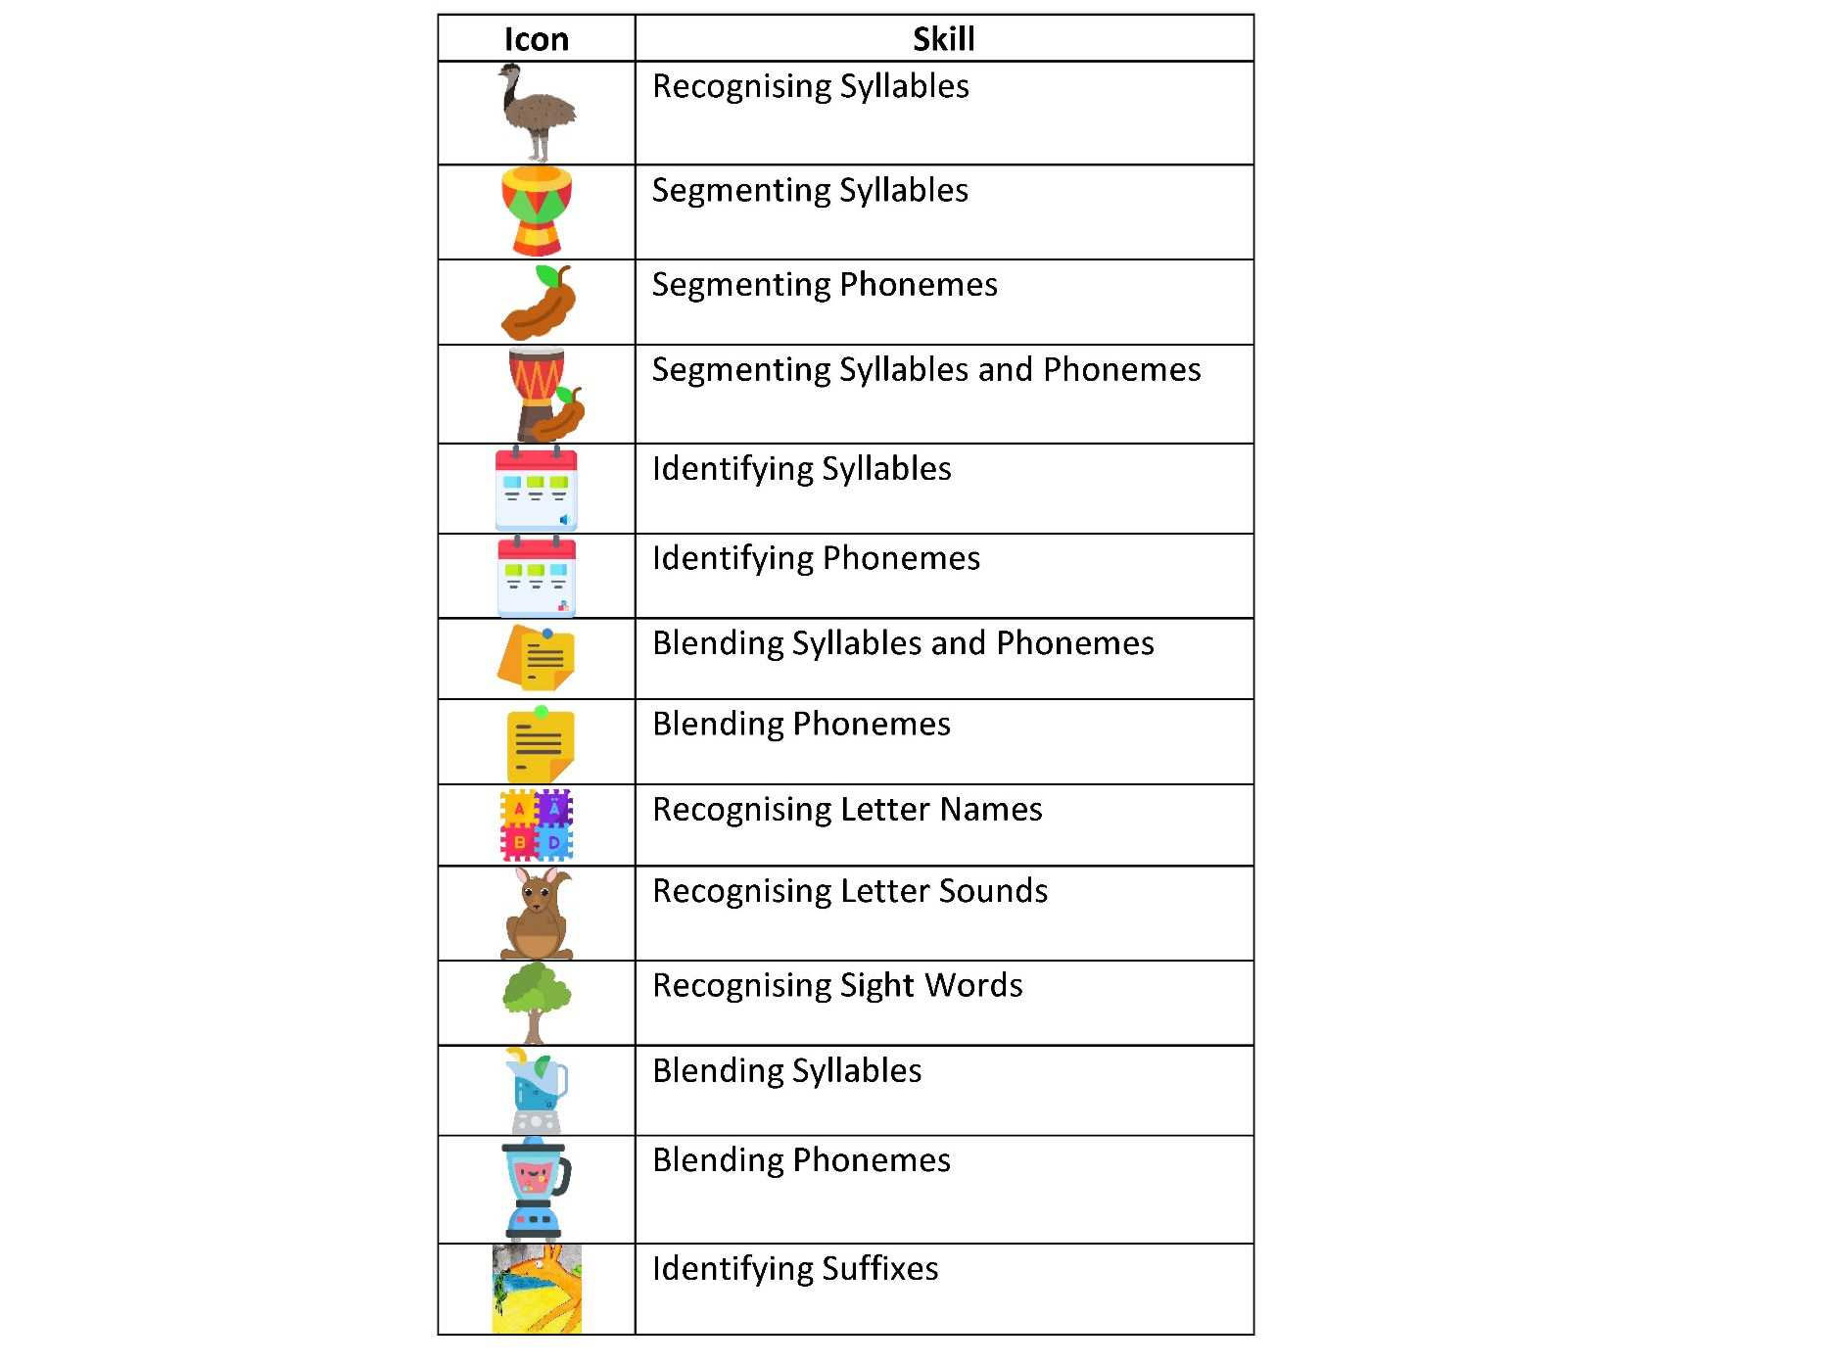
Skills

Slide 8
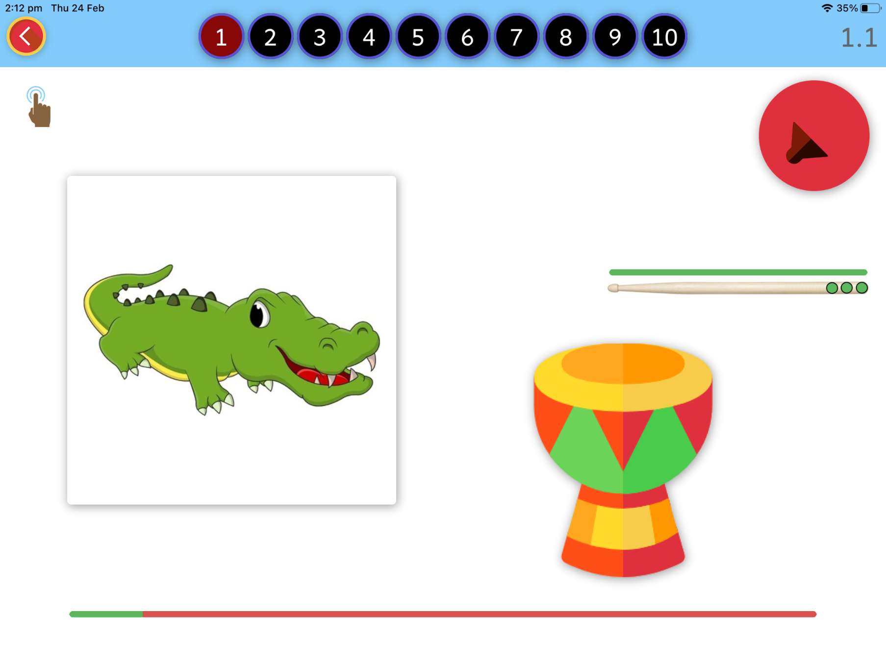
Task – Segmenting Syllables

Slide 9
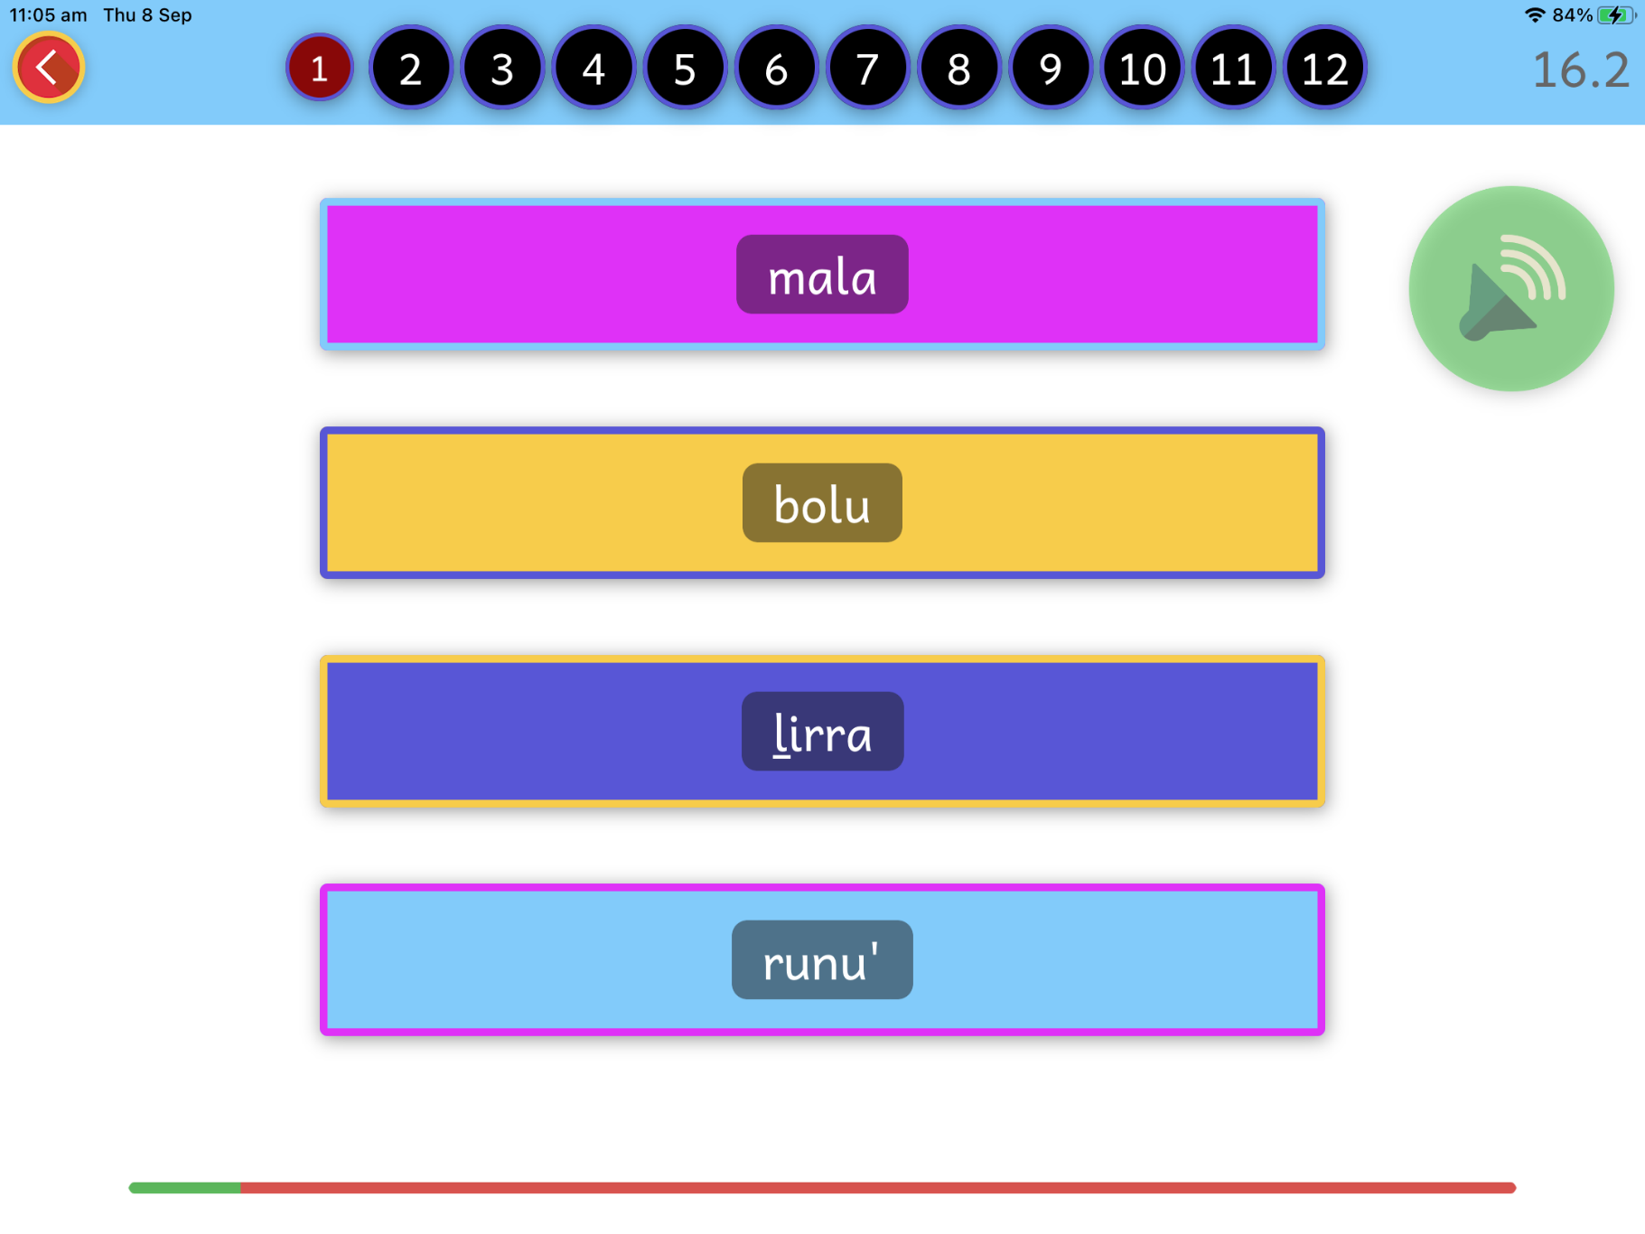
Task – Blending Syllables + Phonemes

Slide 10
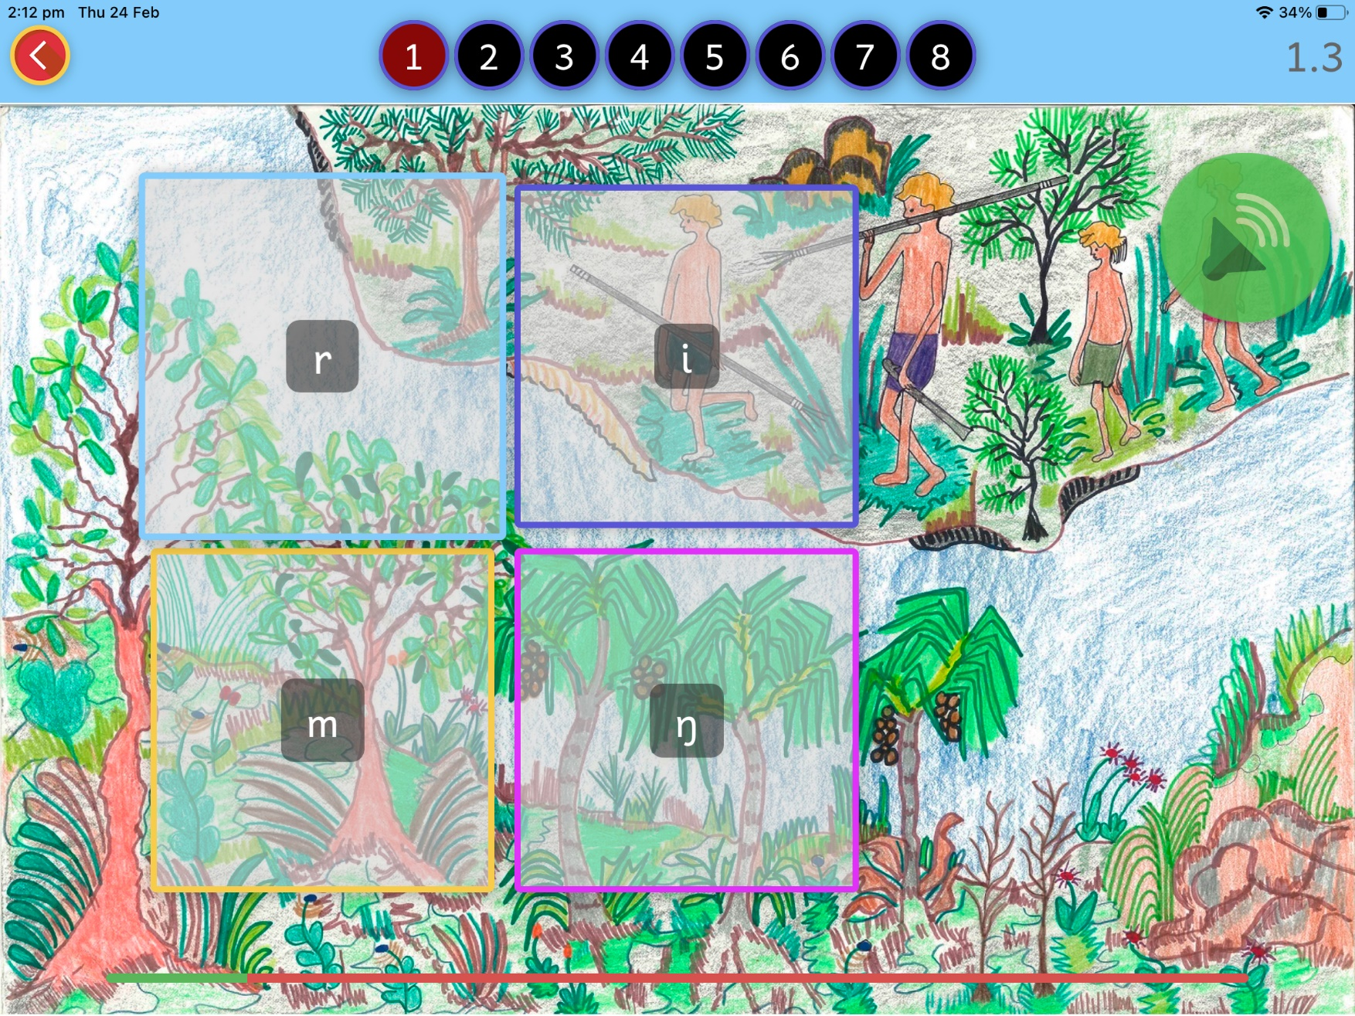
Task – Recognising Letter Names

Slide 11
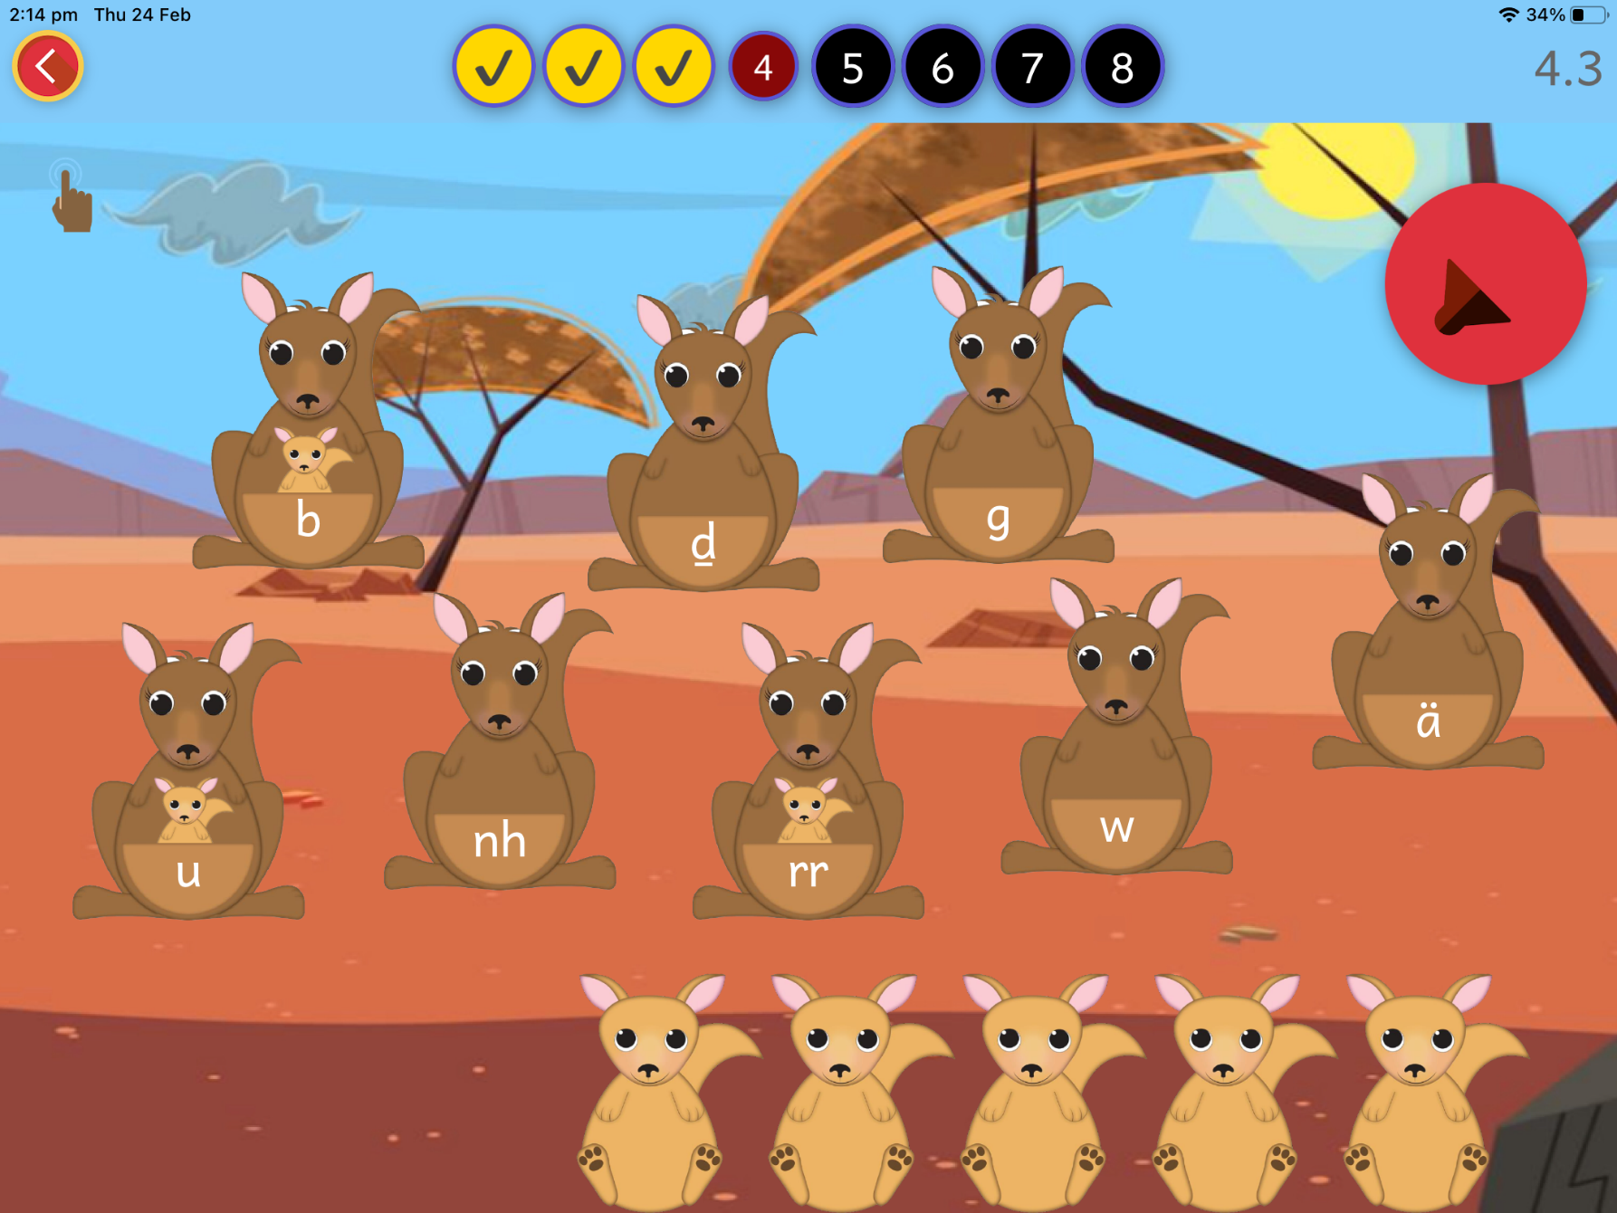
Task – Recognising Letter Sounds

Slide 12
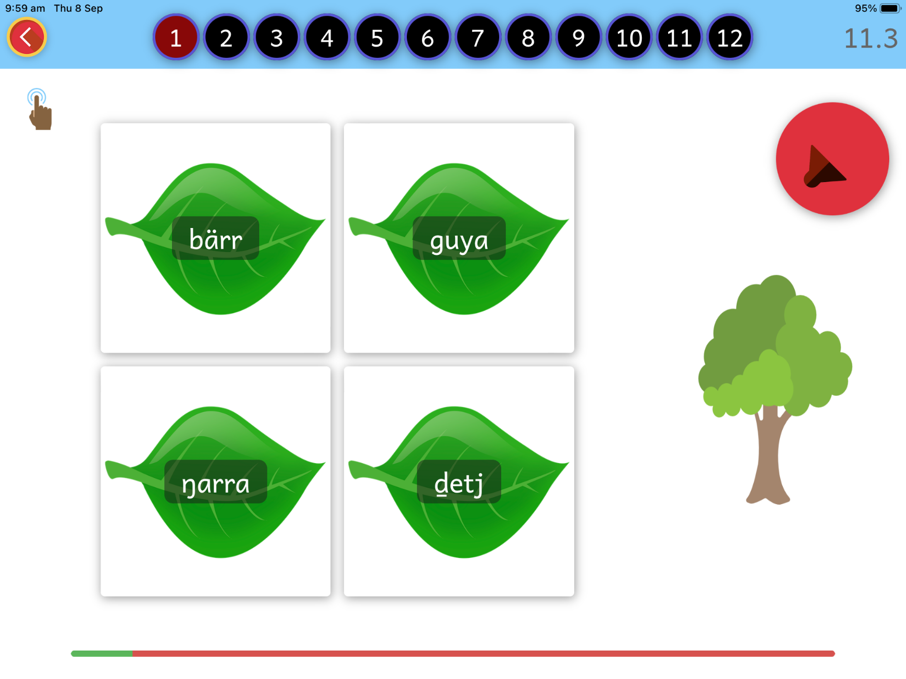
Task – Recognising Sight Words

Slide 13
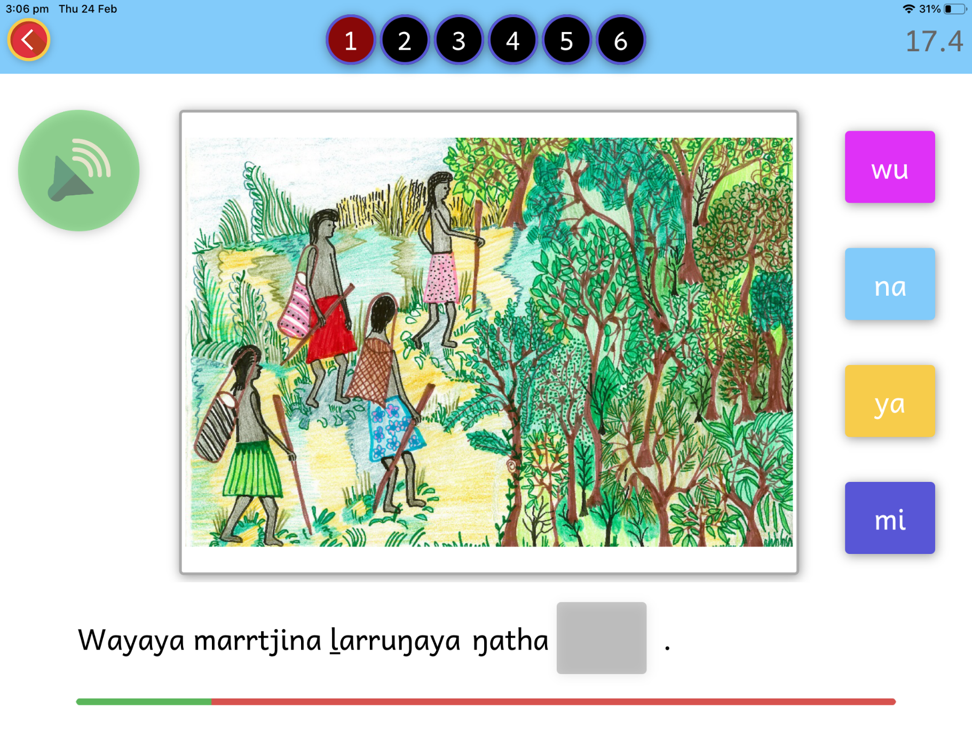
Task – Identifying Suffixes

Slide 14
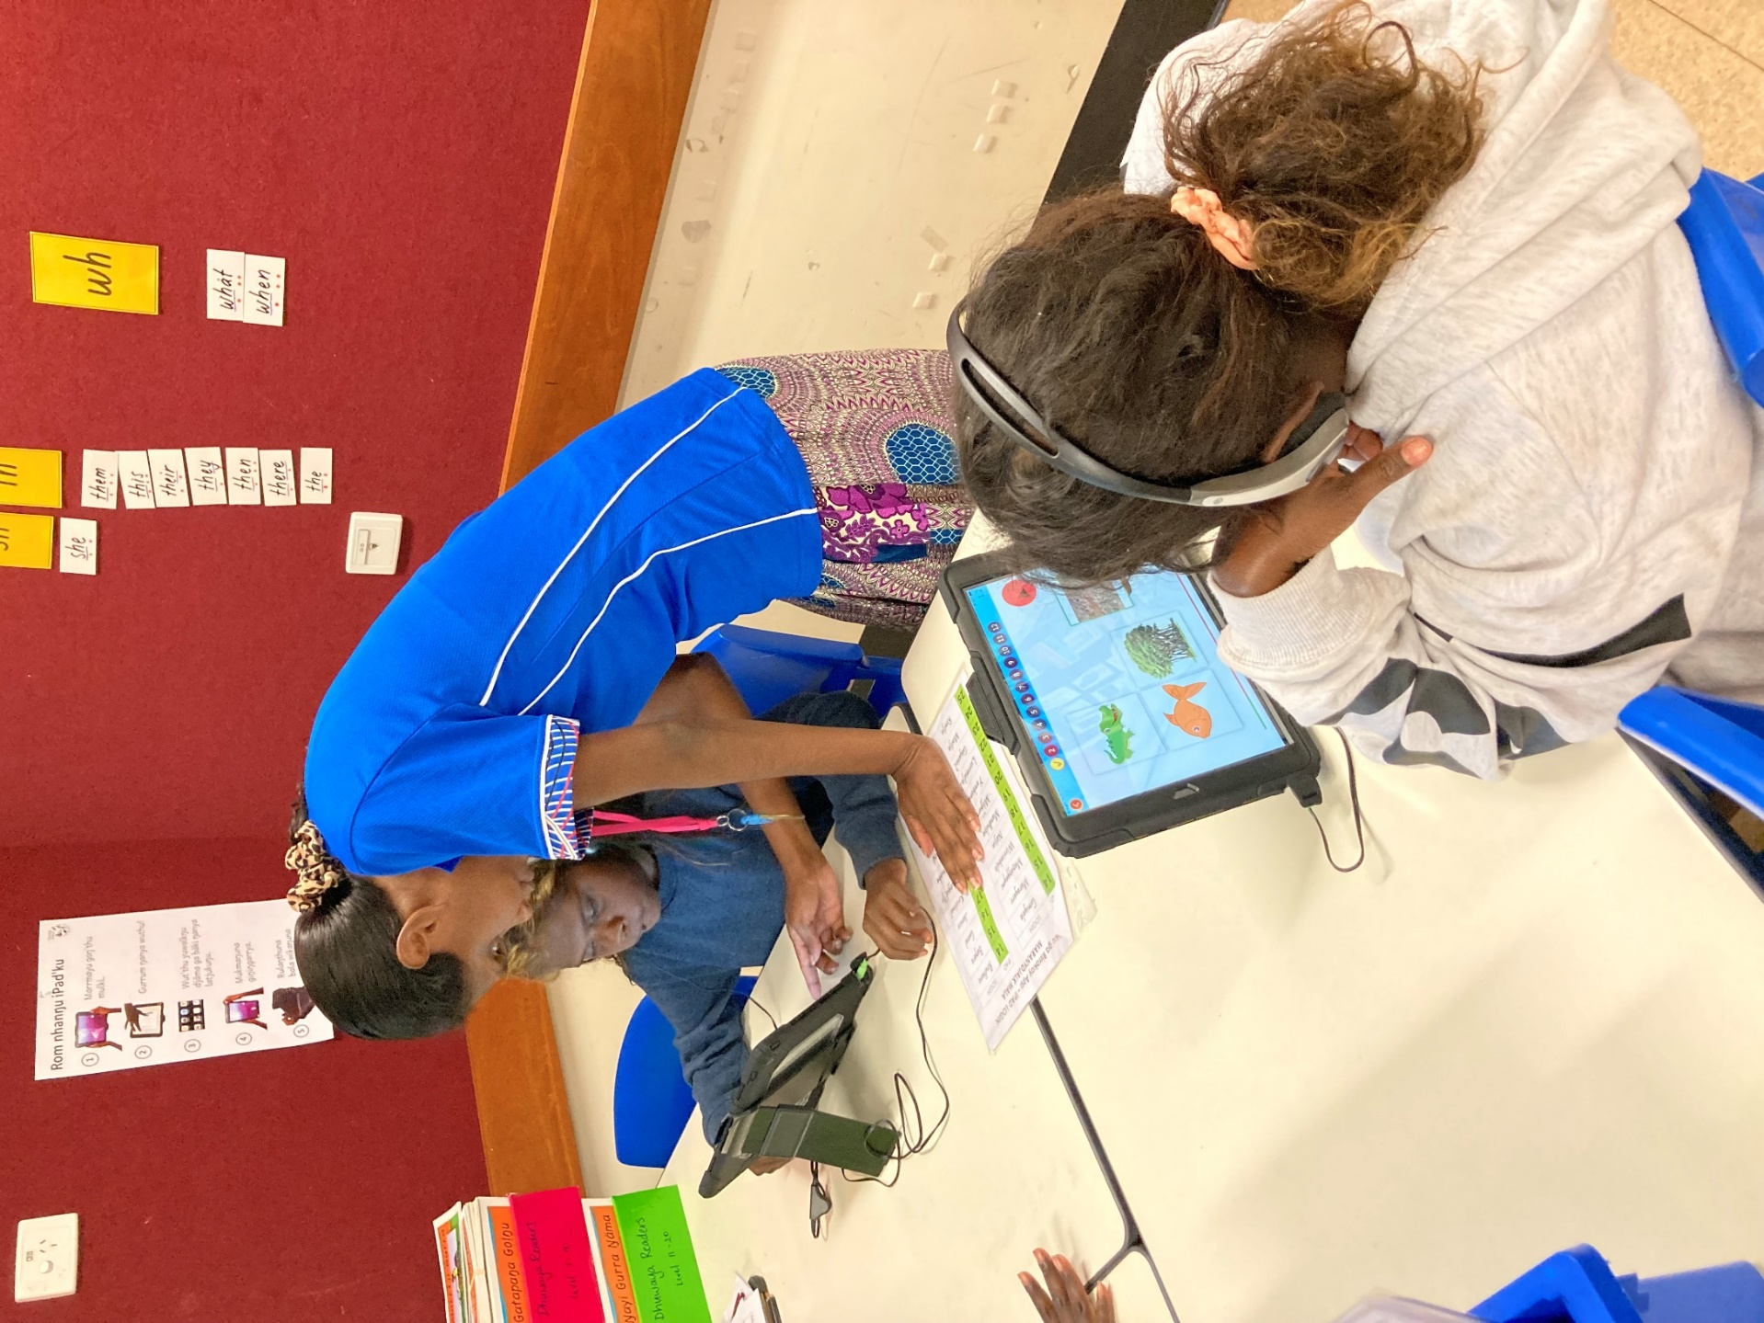
Yäku ga Rirrakay in the classroom

Slide 15
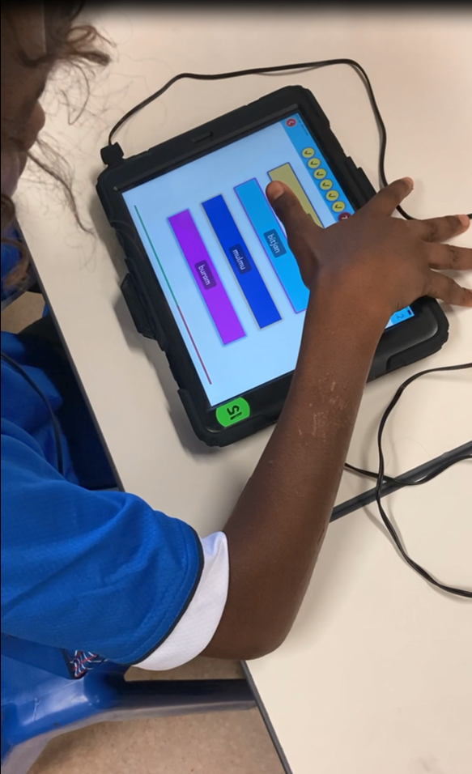

Slide 16
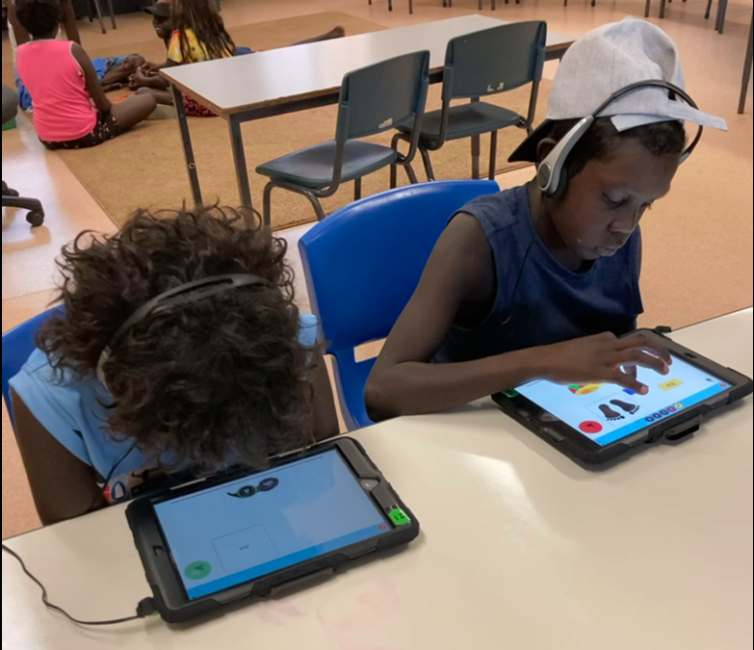

Slide 17
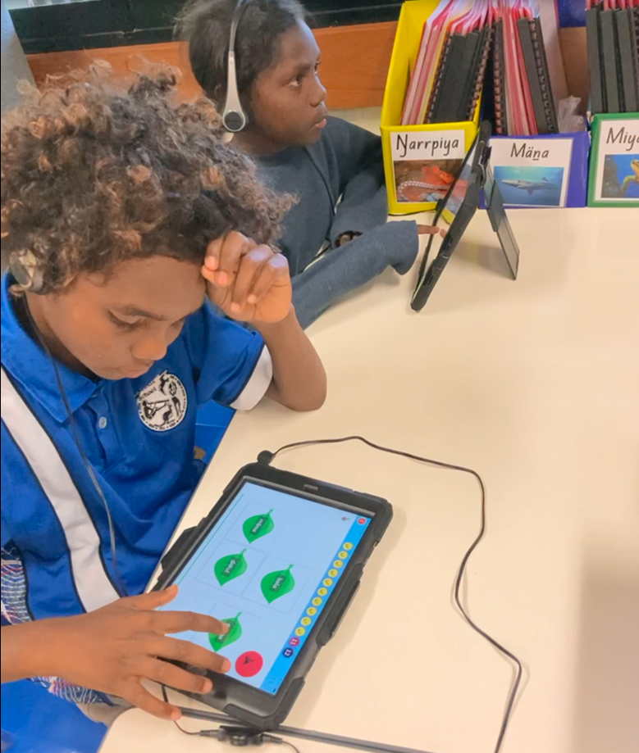

Slide 18
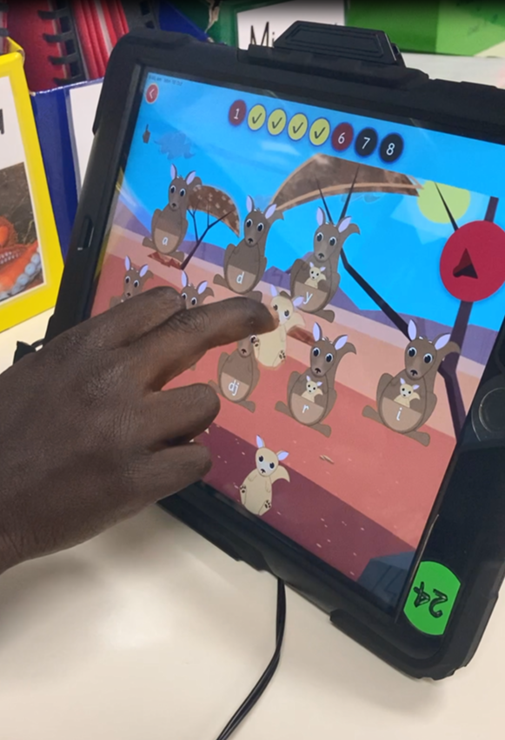

Slide 19
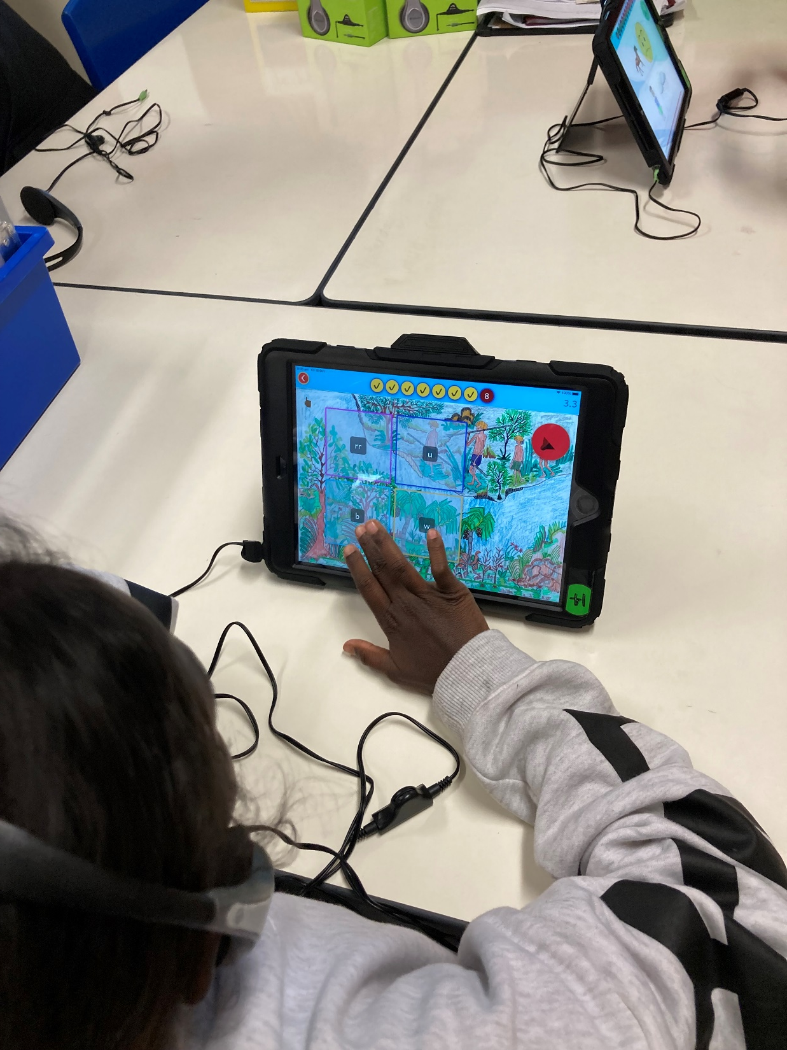

Slide 20
The Journey
After we had the first four levels we tested them on the students and then had to make lots of changes:
the app froze
it had glitches
there were lots of changes
After ten levels we restructured some of the levels and the vocabulary; this involved many re-recordings of sound files
And then we retested and made further changes; Jake liaised with Fardin and the rest of us focused on the content
It was a long journey with lots of laughs and as we were all in different places as progress was slow and we worked on the app when we were all in Yirrkala
we all learnt a great deal and hope the app will be a useful classroom tool to help the students with their reading now and into the future.

Slide 21
The Journey
After we had the first four levels we tested them on the students and then had to make lots of changes:
the app froze
it had glitches
there were lots of changes
After ten levels we restructured some of the levels and the vocabulary; this involved many re-recordings of sound files
And then we retested and made further changes; Jake liaised with Fardin and the rest of us focused on the content
It was a long journey with lots of laughs and as we were all in different places as progress was slow and we worked on the app when we were all in Yirrkala
we all learnt a great deal and hope the app will be a useful classroom tool to help the students with their reading now and into the future.

Slide 22
The Challenges
In Dhuwaya most sound link to one letter but some link to two; these have spelling rules which are a later step in literacy learning
We needed target words, sounds, syllables and suffixes that did not need that knowledge to select the right answer
We needed to include suffixes that change meaning e.g. Yirrkala > Yirrkalayi (to Yirrkala)
We needed to decide the best Dhuwaya words to use to help the children: also an ongoing part of training for Yolŋu educators
Glottal stops were a challenge: Yolŋu often use them in list so when we recorded words in lists they often included glottal stops not used in normal speech
So in the rerecordings it was important not add a glottal stop – lots more recording and uploading to be done
Notes:
but these correspond to sounds much better than English

Slide 23
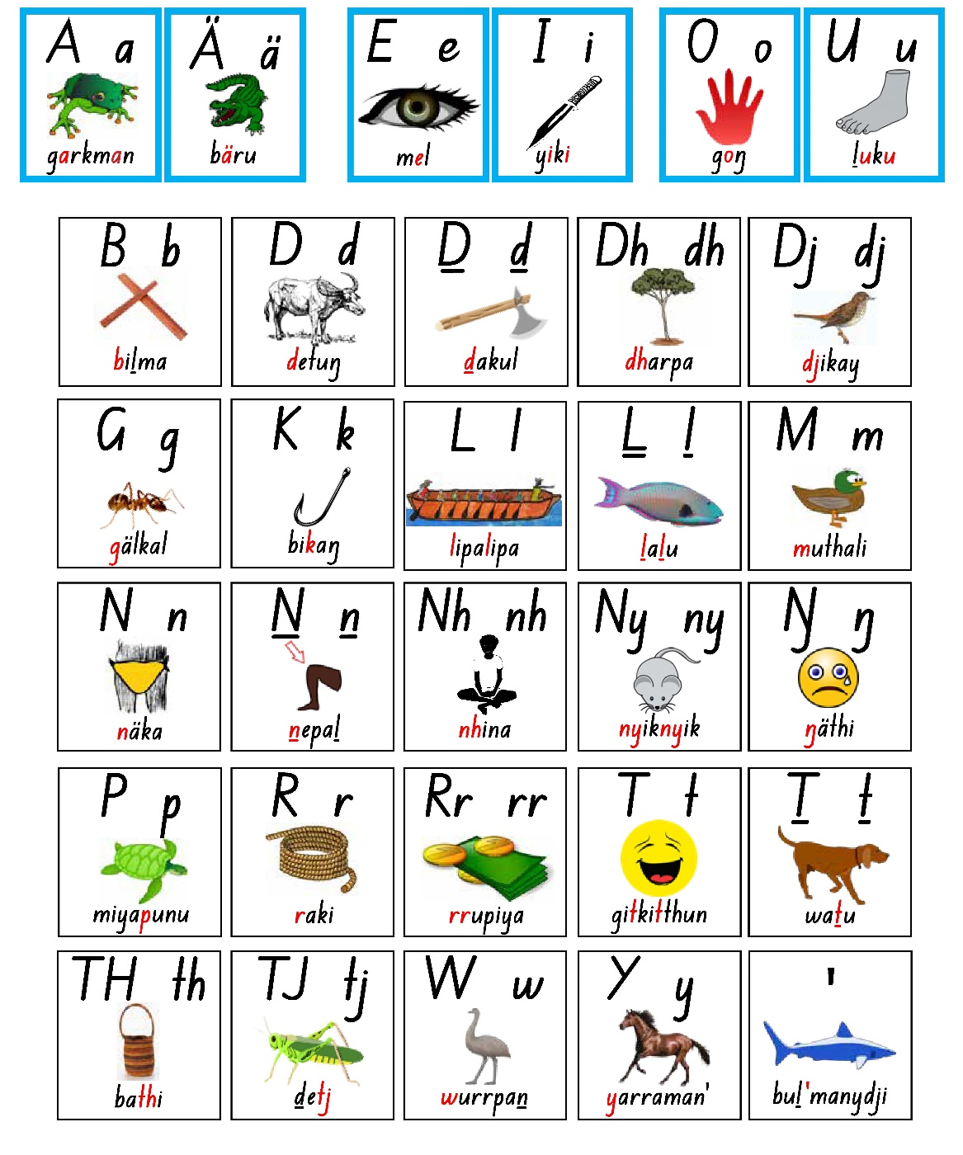
Yolŋu Dhäruk Rirrakay

Slide 24
All instructions are in Dhuwaya

Slide 25
Yolŋu Colours

Slide 26
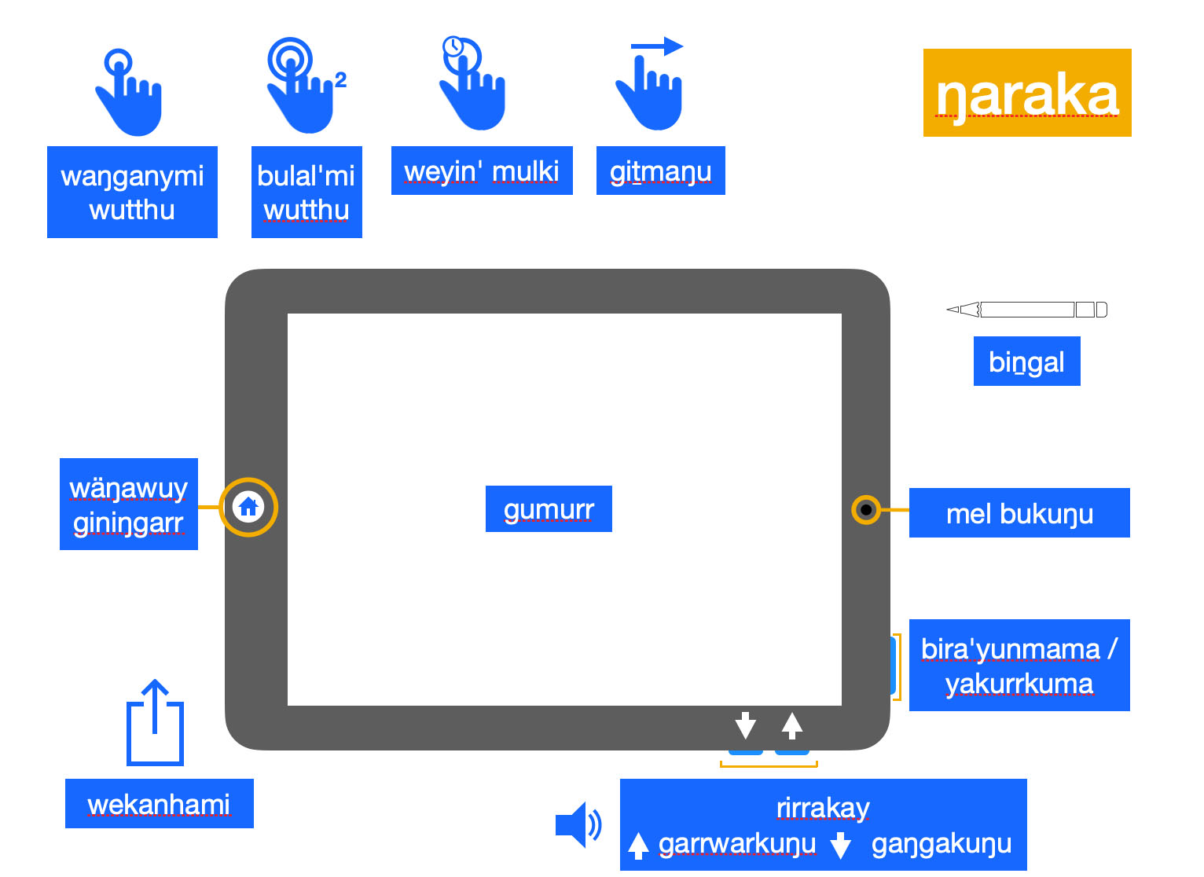
Yolŋu names for the iPad

Slide 27
In the end
We did it!
The kids love it!
We will soon do a validity study to see what difference it makes; we were unable to do this because of COVID
This may involve more changes, but we hope not too many
We hope you enjoy playing with it!
Notes:
but these correspond to sounds much better than English

Slide 28
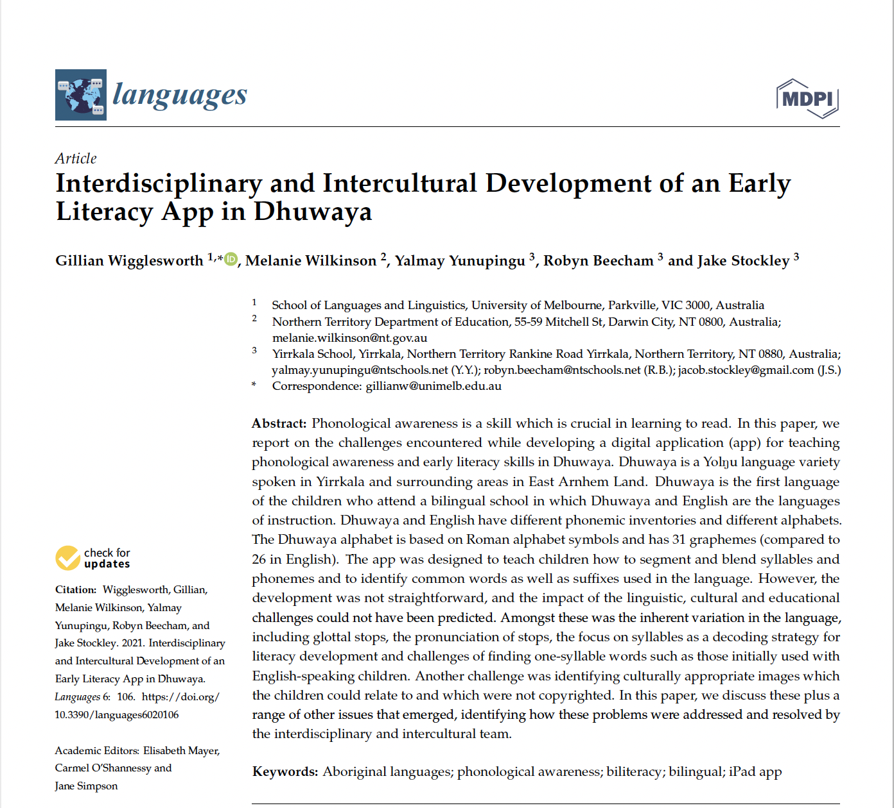
Paper about the App - 2022

