Slide 1
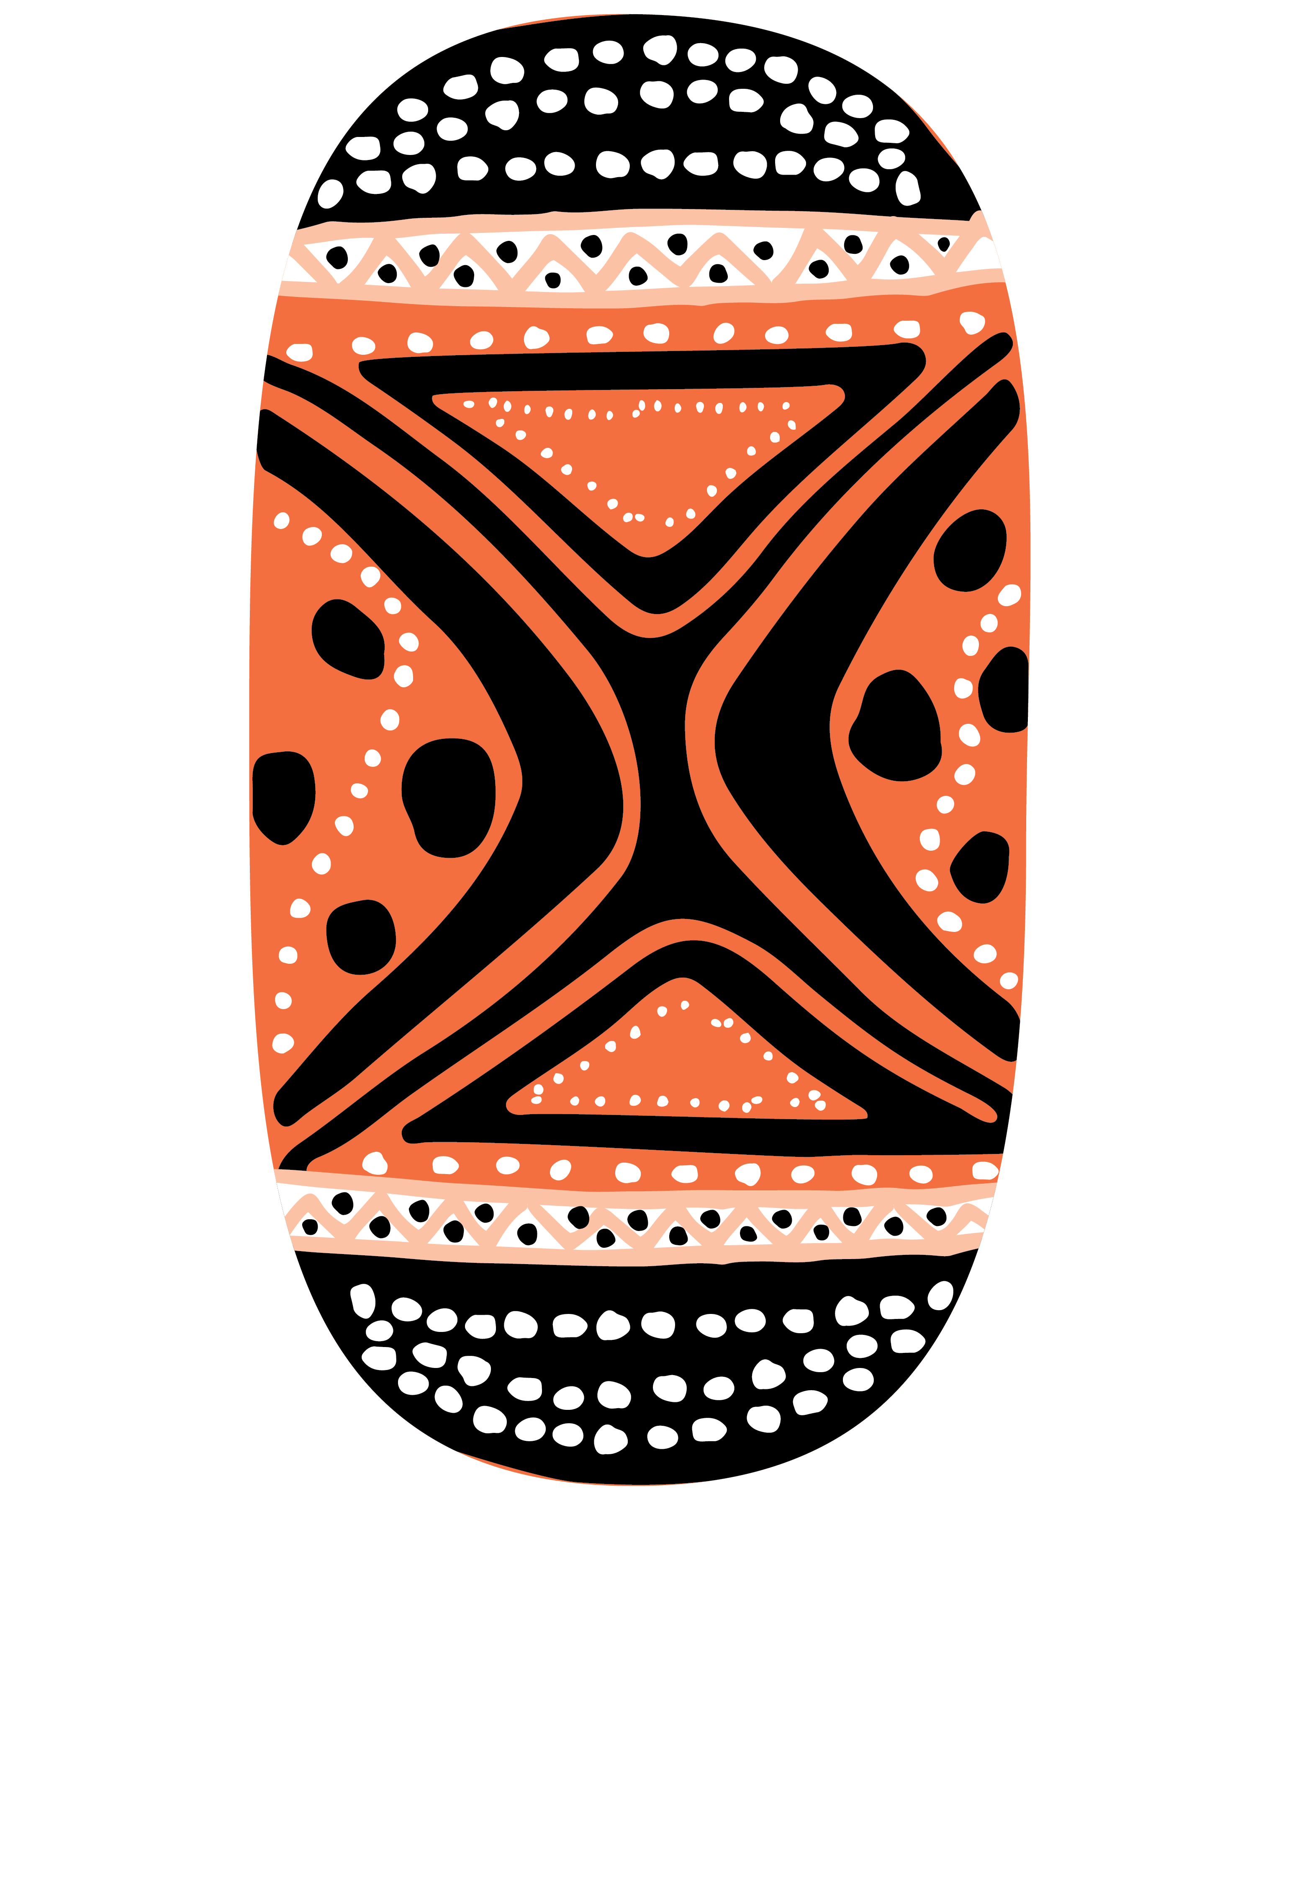
National Indigenous Languages Strategy and Policy
Language Policy Symposium
26 September 2022, Craig Ritchie

Slide 2
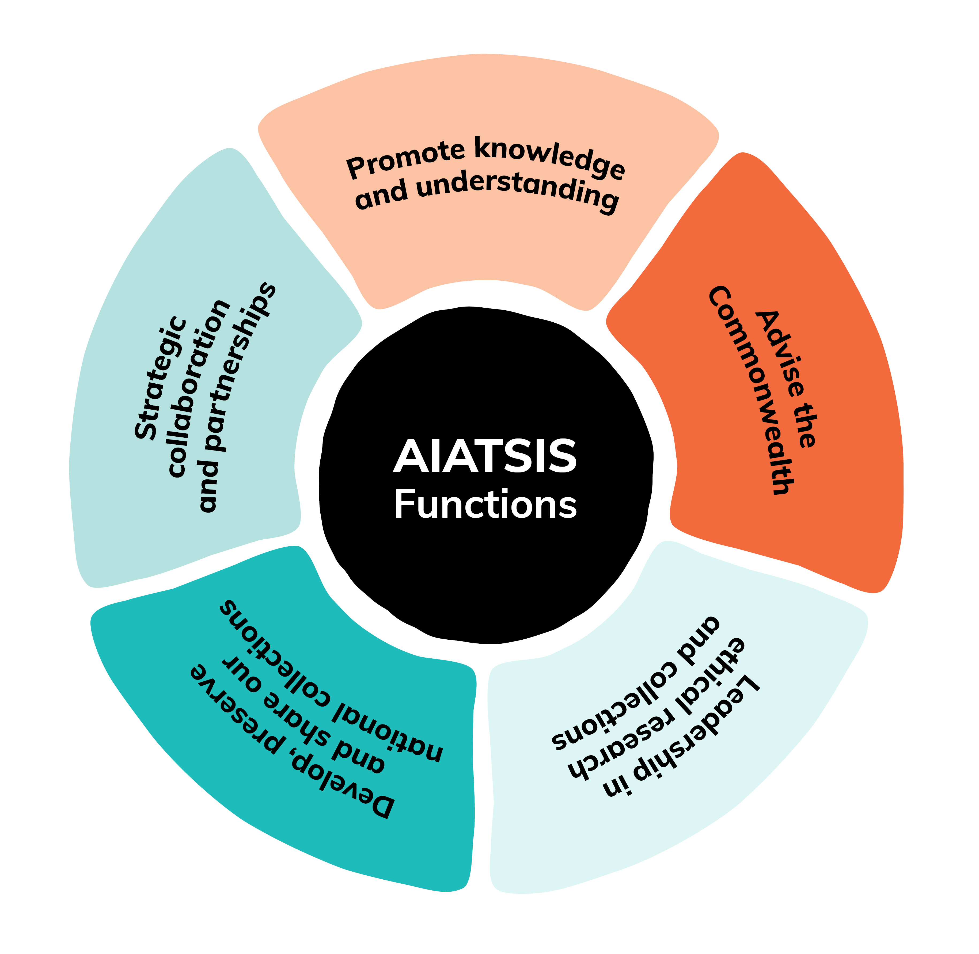
AIATSIS Functions

Slide 3
UN Declaration on the Rights of Indigenous Peoples
Article 13
Indigenous peoples have the right to revitalize, use, develop and transmit to future generations their histories, languages, oral traditions, philosophies, writing systems and literatures, and to designate and retain their own names for communities, places and persons.
States shall take effective measures to ensure that this right is protected and also to ensure that Indigenous peoples can understand and be understood in political, legal and administrative proceedings, where necessary through the provision of interpretation or by other appropriate means.

Slide 4
National Indigenous Languages Policy 2009
National attention: To bring national attention to Indigenous languages – the oldest surviving languages in the world; and the pressures they face.
Critically endangered languages: Reinforce use of critically endangered Indigenous languages that are being only partly spoken to help prevent decline in use and to maintain or extend their common, everyday use as much as possible.
Working with languages to Close the Gap: In areas where Indigenous languages are being spoken fully and passed on, making sure that government recognises and works with these languages in its agenda to Close the Gap
Strengthening pride in identity and culture: To restore the use of rarely spoken or unspoken Indigenous languages to the extent that the current language environment allows.
Supporting Indigenous language programs in schools: To support and maintain the teaching and learning of Indigenous languages in Australian Schools
The importance of Australia’s Indigenous languages

Slide 5
A New Languages Policy and Strategy
The increasing urgency of Indigenous language revitalisation and preservation demands a new National Indigenous Languages Policy and the first ever National Languages Strategy.
The 2009 policy began as and was based on a press release by then Federal Arts Minister Peter Garrett. It remains a relatively short policy without supporting documents in the form of fully rounded green and white papers.
A new national policy and strategy developed iteratively through green and white papers can provide a depth and detail not present in the 2009 policy.

Slide 6
 | NILS 1 (2005) | NILS 2 (2014) | NILS 3 (2018-19)
Total languages spoken (out of 250+) | 145 | 120 | 123
Strong | 18 | 15 13 traditional 2 new | 14 12 traditional 2 new
Endangered | 110 | 100 | 51
Reawakening | Not measured | 30 | 31

Slide 7
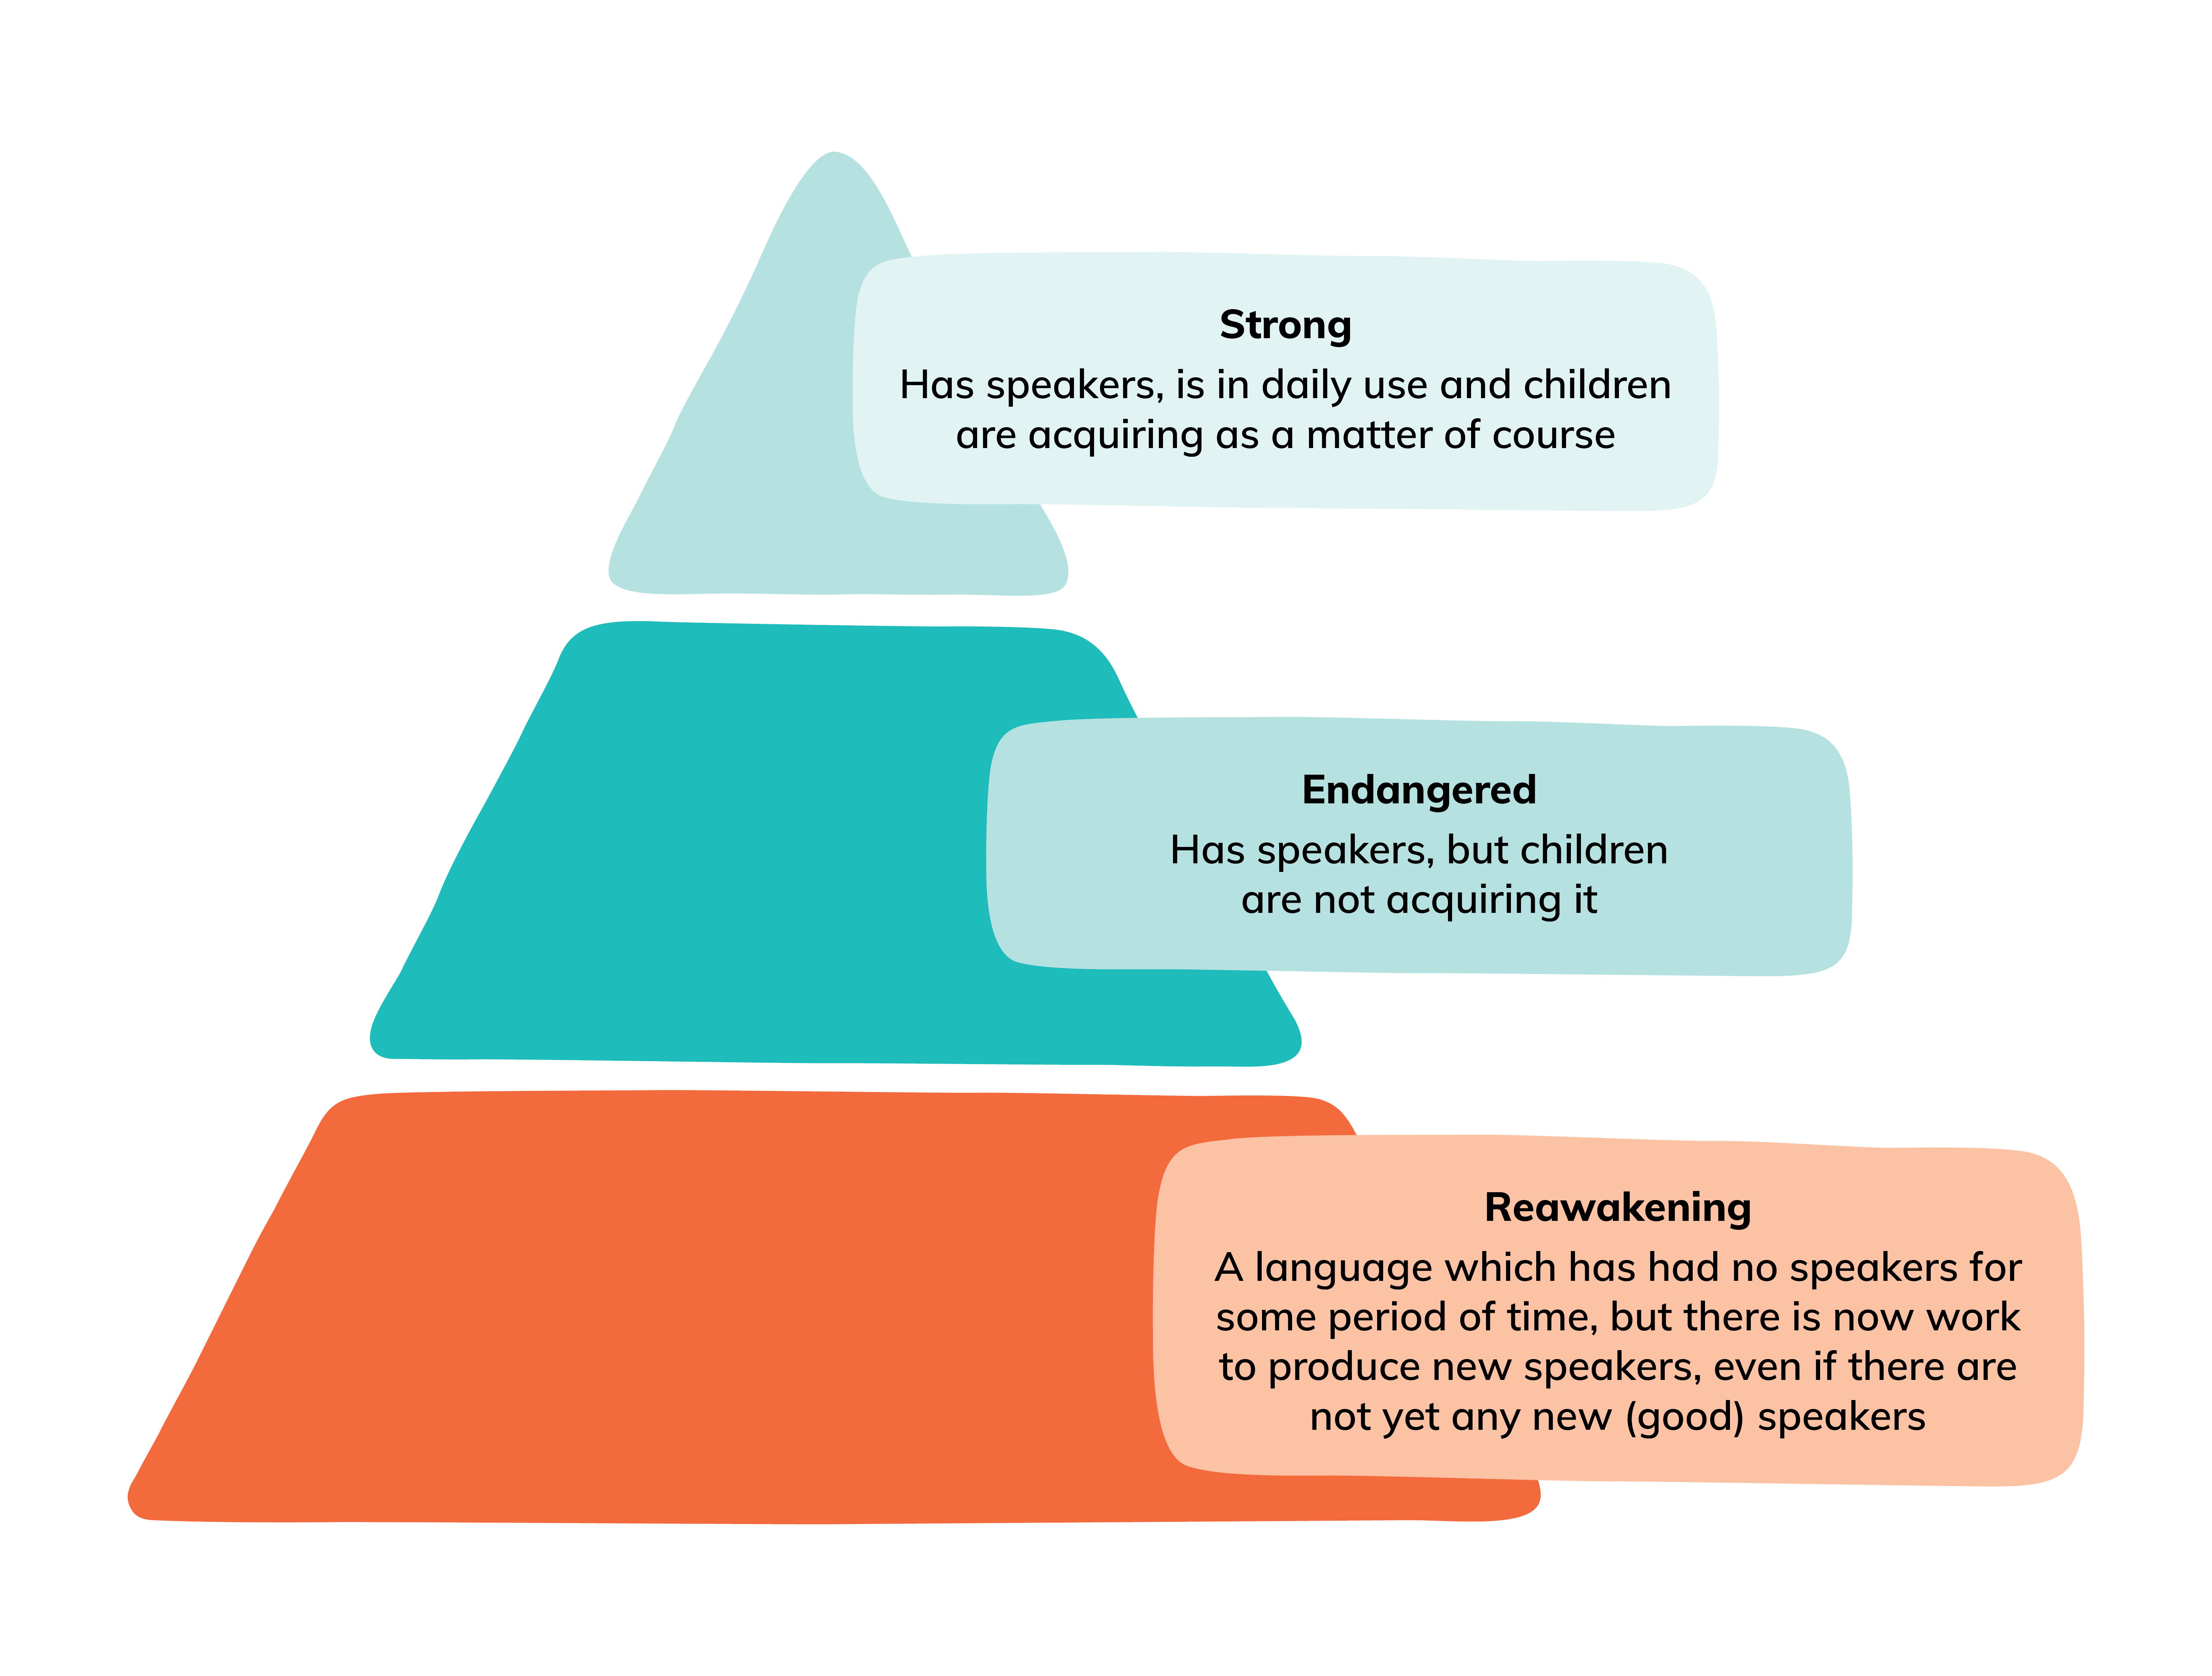
Endangerment contexts

Slide 8
Strong | Endangered | Reawakening
Warlpiri Murrinh-Patha Yolngu Matha | Wajarri Badimaya Wambaya Wirangu | Kaurna Ngunnawal Yiman
Mother-tongue school education (including vernacular literacy—the best way of teaching English literacy) Documentation/analysis Master-Apprentice Translation and interpreting Language nests Family language support Create/extend domains of usage (e.g. news, government services) | Documentation/analysis Master-Apprentice Formal language learning (adult classes, school classes) Create/extend domains of usage (e.g. banking, shopping) | Historical materials analysis Documentation of existing knowledge Formal language learning Emblematic usage (e.g. Welcome to Country, Acknowledgement of Country)

Slide 9
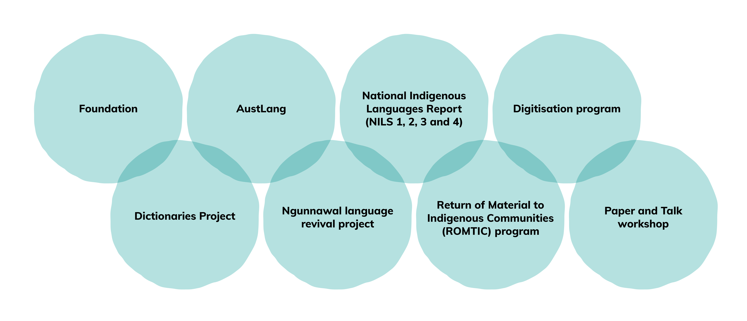
AIATSIS Initiatives

Slide 10
AIATSIS Language Strategies
These are intended as statements of ambition. They may never be all fully achieved, but they provide a guidance as to direction and lead on to developing concrete actions and plans.
Every Indigenous Australian language should be documented for use by current and future generations
Every language community can strengthen their language
Every Australian has the opportunity to learn and take pride in an Australian language

Slide 11
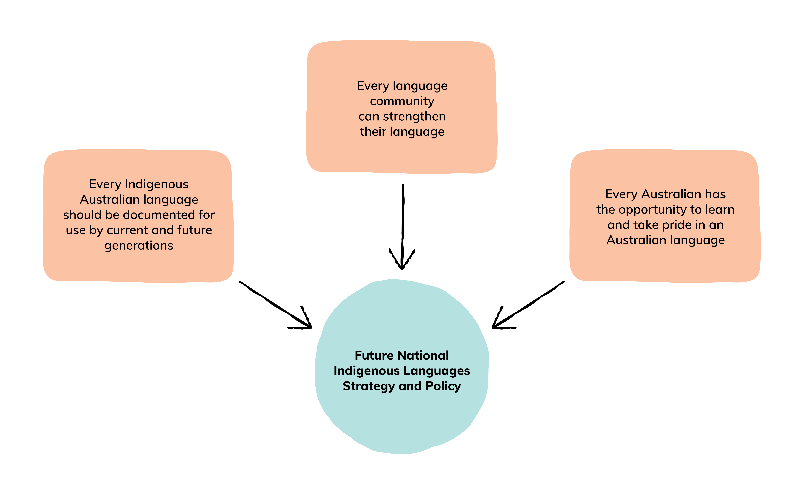
Caption text will go here…

Slide 12
The Future
Structural
National Indigenous Languages Policy and Strategy
Legislation
Coordination
Social
Language in the public space
Recording
Publication - dictionaries

Slide 13
The Australian Institute of Aboriginal and Torres Strait Islander Studies acknowledges the traditional owners of country throughout Australia and their continuing connection to land, culture and community. We pay our respects to elders past and present.
aiatsis.gov.au

